Slide 1
Cataloging in LEAP
An Introduction
Celia Mulder (they/them)
Head of Collection Management & Co-system Administrator
Clinton-Macomb Public Library, Clinton Township, MI

Slide 2
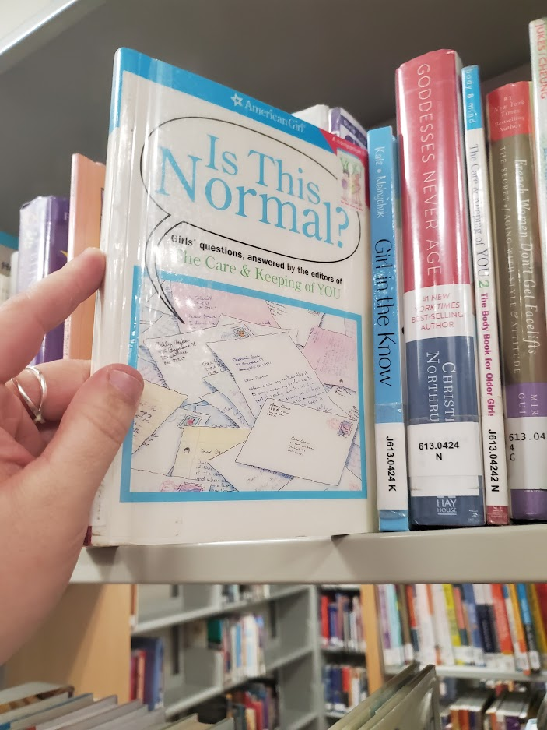
Outline
Moving to LEAP with CMPL
Building buy-in with staff
Discussion & Brainstorm

Slide 3
Me
Former reference librarian
Metadata enthusiast
On the job cataloging training

Slide 4
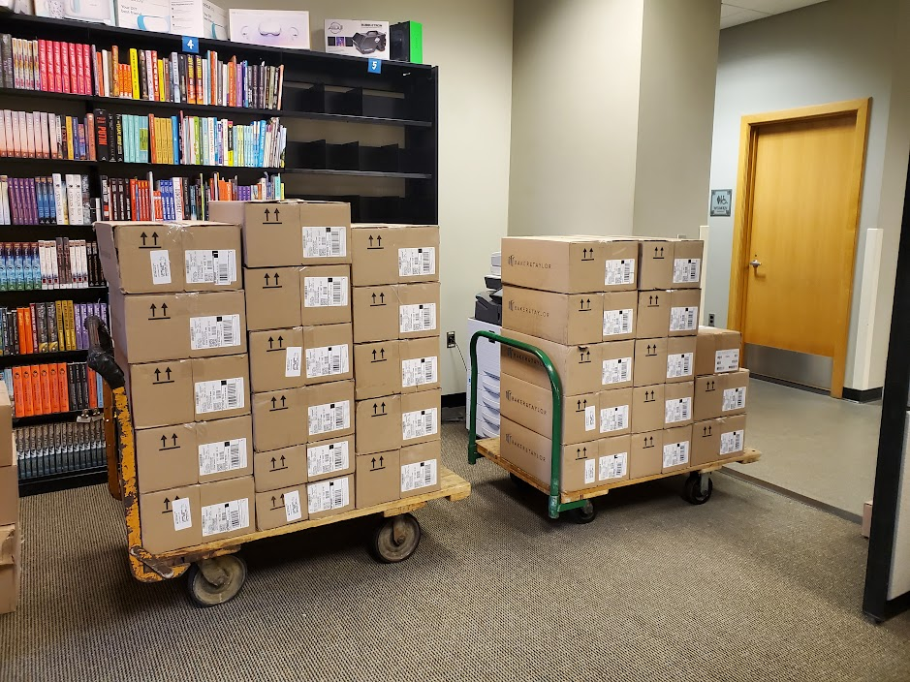
Clinton-Macomb Public Library
Suburban library system north of Detroit, Michigan serving the townships of Clinton and Macomb
Growing population of 190,000
Main library and two branches
Centralized cataloging and semi-centralized collection development

Slide 5
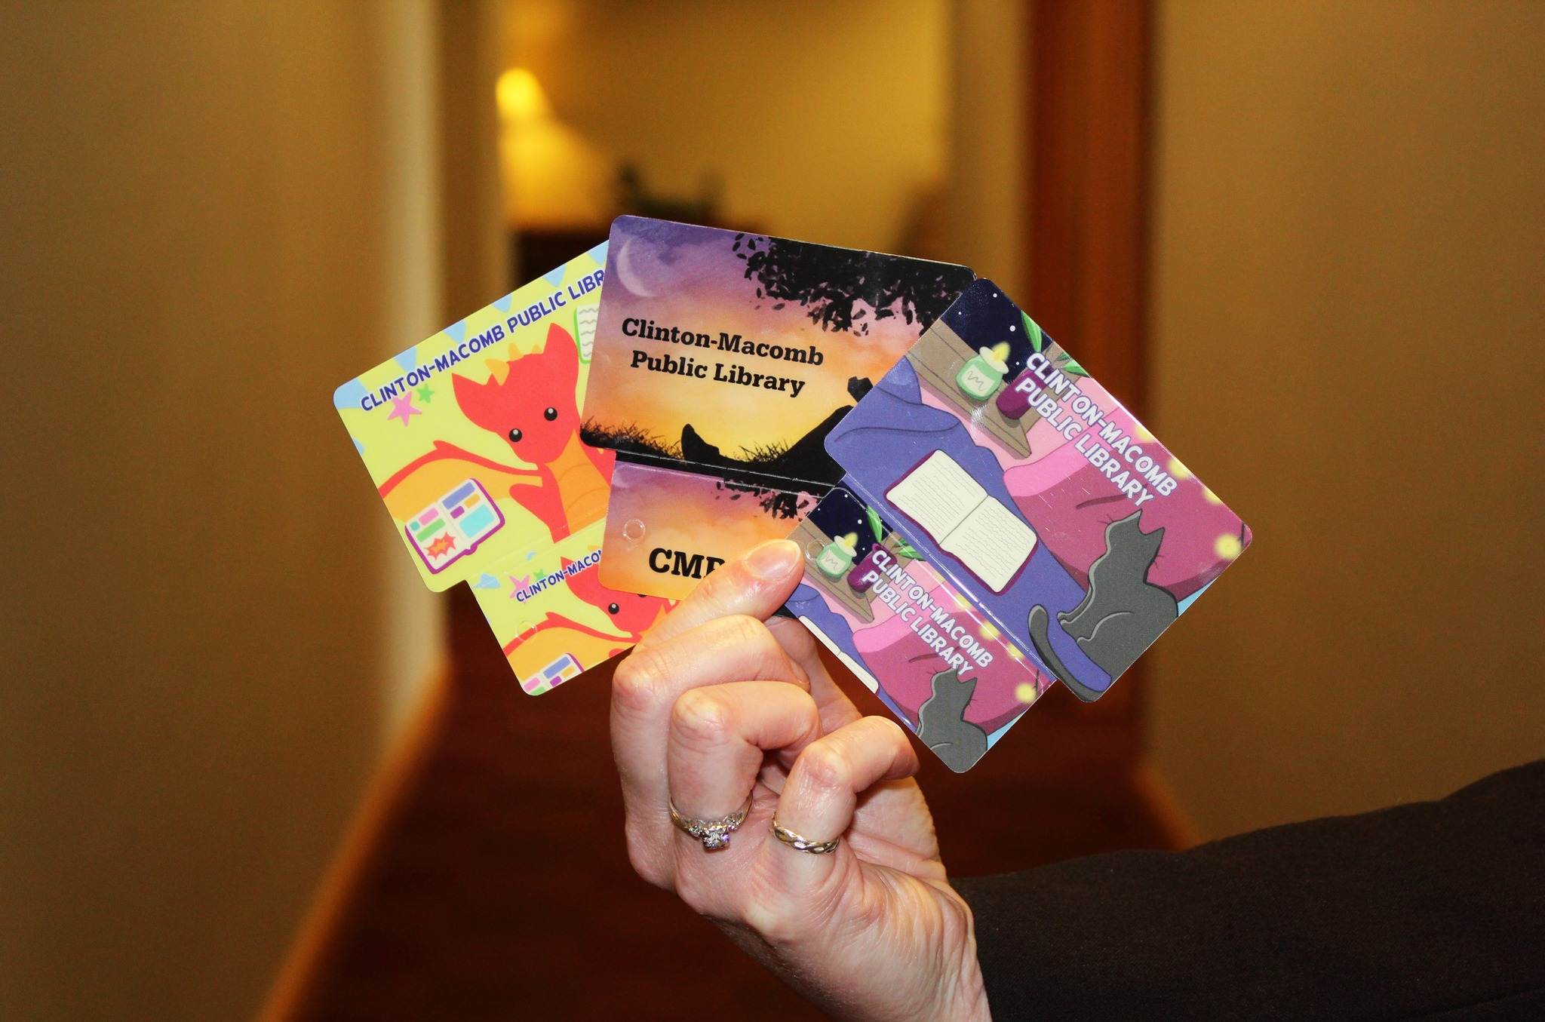
Moving to LEAP
Polaris users since 2003
Began using LEAP right away
In 2017 all circulation staff were moved to LEAP
Incoming substitute librarians are only trained on LEAP
Incoming salaried librarians are trained in LEAP
Only a few tasks still take them to the client.

Slide 6
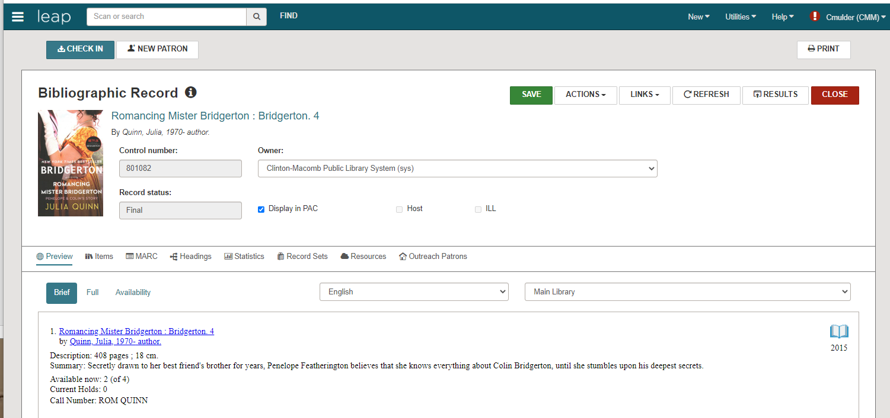
CMPL Starts Cataloging in LEAP
The early adopter vs. the never-in-a-million years staff

Slide 8
Start slow
Have a LEAP window open all the time
Train staff to use LEAP for tasks like searching, circulation tasks, check in, placing holds, patron look up, etc.
Adjust to LEAP before jumping into MARC editing in LEAP
Ongoing LEAP training, especially after upgrades

Slide 9
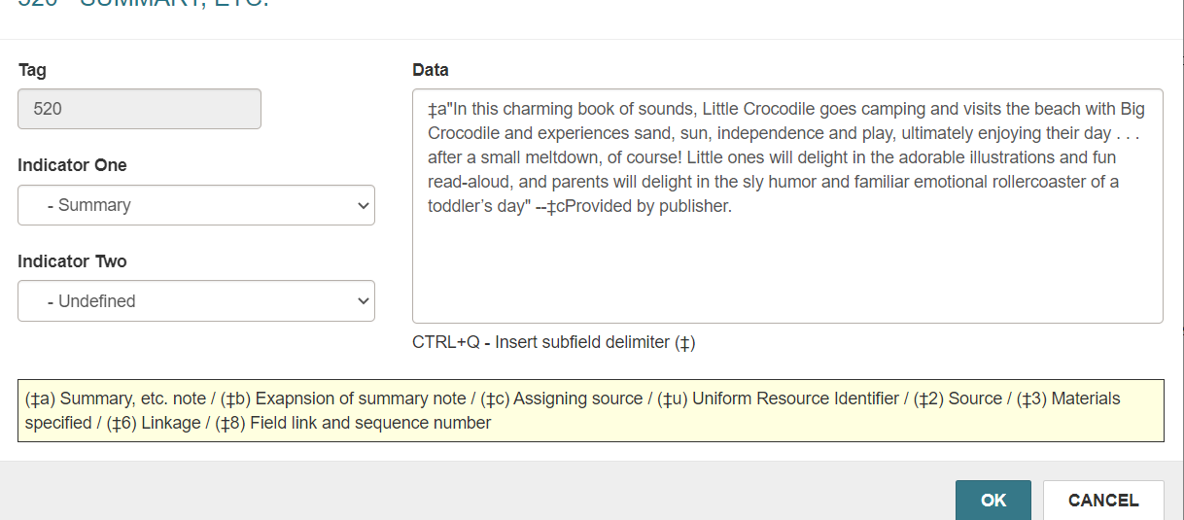
Building Buy-in with Staff
Focus on the pros
Opening the 520 field automatically fixes any rouge characters in the description.

Slide 10
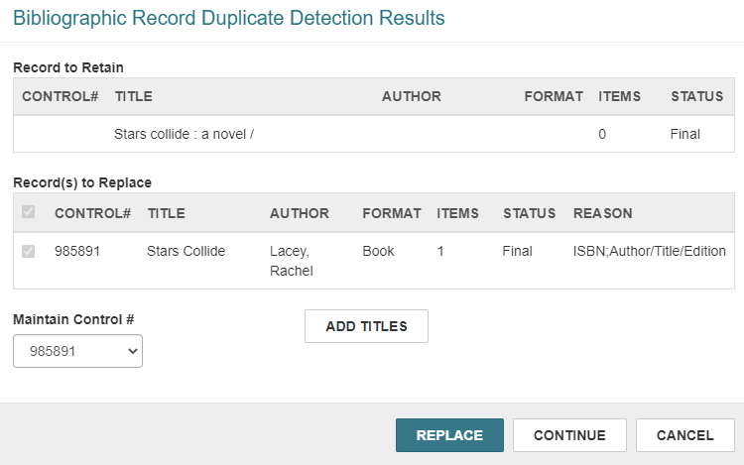
Saving the record: no replace all, easier to find additional titles, don’t get alternate formats popping up as often.
OCLC often freezes when we search and you have to search again. LEAP has the pending results you can pull in without having to stop and search again.

Slide 11
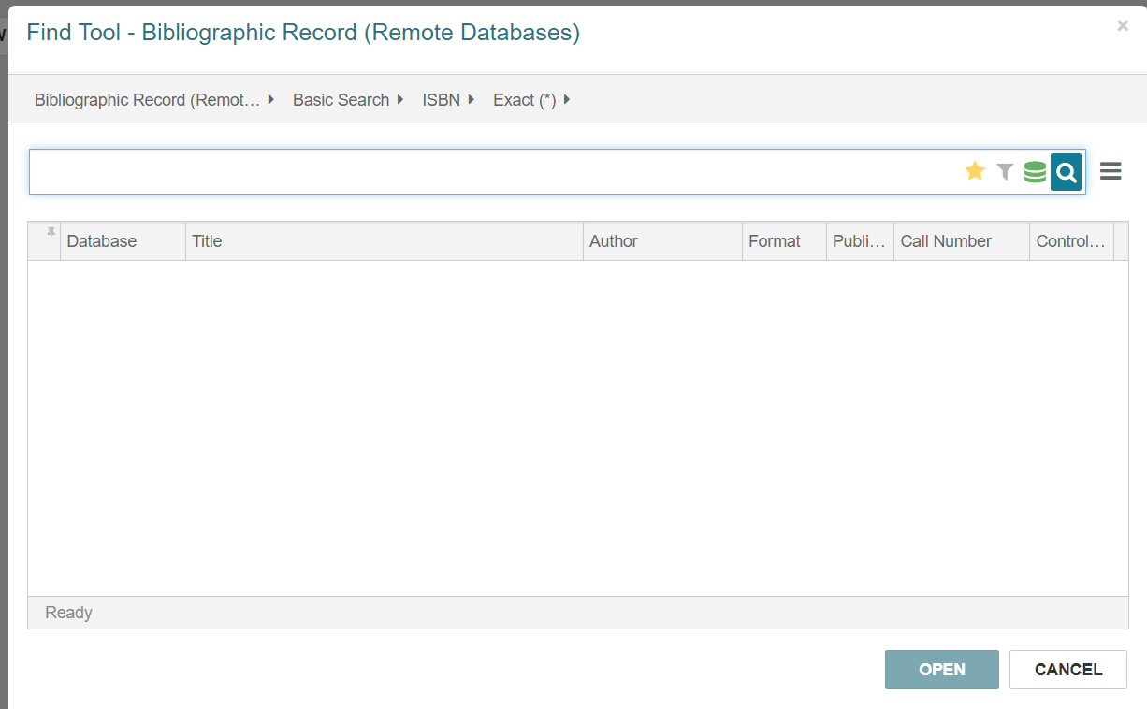
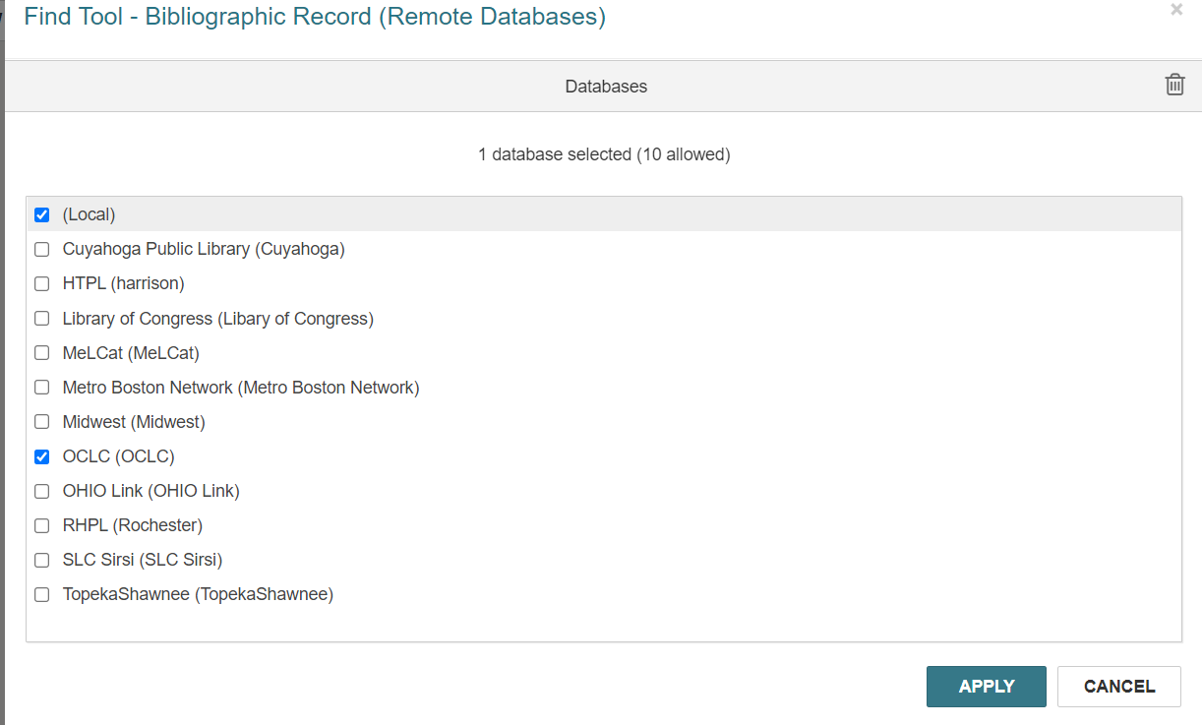
Emphasize new functions in LEAP that weren’t available in the client
Customize user settings right away
Shadow people who started on LEAP

Slide 12
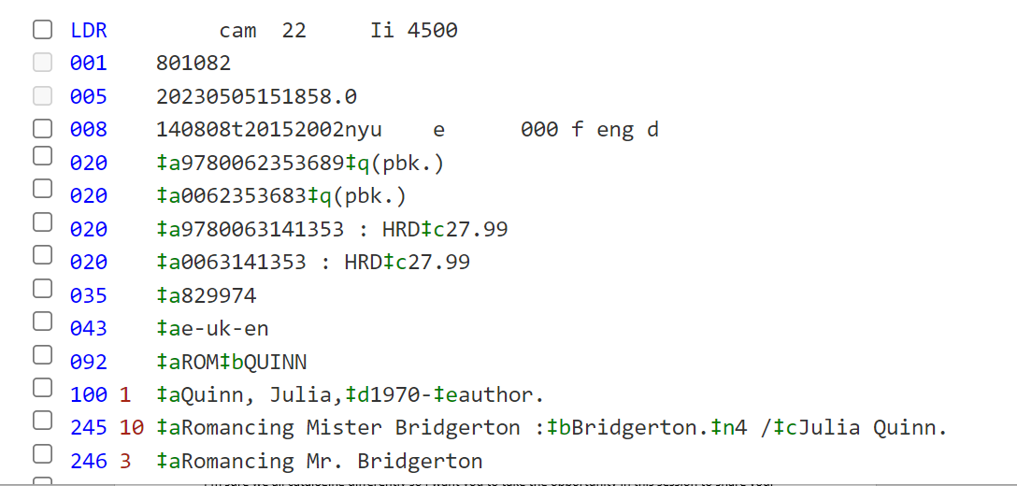
Accessibility in LEAP
Access from any computer, on or off network
Resizing the browser window and the text

Slide 13
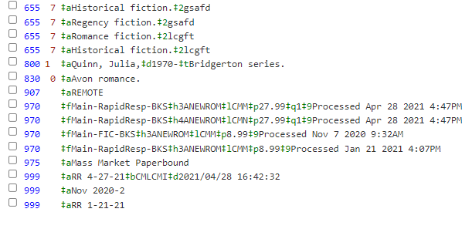
Remote Work in LEAP
Remote work in 2020
Remote work after 2020 - Telework policy
Cataloging from home
Remote report and finishing items
Winter/spring 2023 – value proven

Slide 14
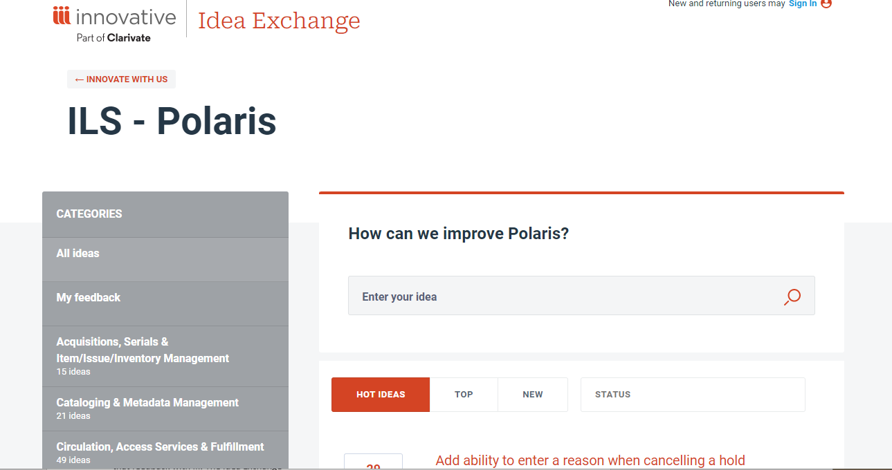
Updates and Requests
All cataloging staff are encouraged to suggest ideas for improvements or functions they use and are missing in LEAP
Idea Exchange
Product board

Slide 15
Discussion & Brainstorm

Slide 16
Discussion Questions
Do you use LEAP to catalog?
What are your LEAP pros and cons?
What improvements do you want to see?
Are there any tips, tricks, or shortcuts you know and would like to share?

Slide 17
https://tinyurl.com/catinLEAP

Slide 18
THANK YOU
Celia Mulder – cmulder@cmpl.org

