Slide 1
4 Perspectives on Using Holds Data with SQL
Victor Zuniga: Poudre Libraries, CO
Bob Gaydos: Stark Library, OH
Rebecca King: Thousand Oaks Library, CA
Jeremy Goldstein: Minuteman Library Network, MA

Slide 2
Holdshelf Time to Pickup
Victor Zuniga
Poudre Libraries, CO

Slide 3
Intro
Are you finding yourself wondering how the current Time to Pick up setting (Holdshelf) value was determined?
Are you curious to find out how much time patrons take to pick up an item on average? Can this be tweaked to improve response time?
Learn practical techniques you can apply to your library based on actual patron behavior (data)

Slide 4
Why are we here?
To challenge the phrase: This is how it's been done in the past….
Nothing which is meaningful exists outside discourse – Michael Foucault
Notes:
Perception vs. Reality
Behavior mirror actions, actions provide patterns.
It is not new; it is just getting the attention it deserves.
Consider adding an image representing behavior (i.e., something along the lines of predicting future actions based on behavior)

Slide 5
Loan Rule Table
Notes:
Add a screenshot of the Time-to-Pick-up field from the Loan Rule table.
Add a screenshot of the Holdshelf activity report from Decision Center. Is there an equivalent for the legacy Web management Report module?
It provides numbers on Placed On Holdshelf, Picked up from Holdshelf, Abandoned from Holdshelf, Abandoned Percentage
What additional information could we add to this so it's more useful for staff?
Add a screenshot of Holdshelf SQL data showing a sample of data along with the average time patrons typically pick up their holds.

Slide 6
Time to Pickup (a.k.a Holdshelf)

Slide 7
Hold-to-item Ratio Buying Report

Slide 8
Holdshelf Activity Report
Notes:
It provides numbers on Placed On Holdshelf, Picked up from Holdshelf, Abandoned from Holdshelf , and Abandoned Percentage
What additional information could we add to this so it's more useful for staff?

Slide 9
SQL

Slide 10
SQL

Slide 11
SQL

Slide 12
SQL

Slide 13
SQL

Slide 14
SQL

Slide 15
CONSIDER THIS:
A similar approach can be applied to the analysis of Loan Rules and the duration for each one of them based on actual data.
Notes:
Having two ears should allow us to listen twice before we speak… - Tommy Reeves

Slide 16
Learn More Hold data
Holdshelf activity report via Decision Center
Evaluation> Holdshelf Activity
Development > Hold-to-Item Ratio Buying
Sierra DNA
hold
hold_removed *
Notes:
This view is available in Sierra 5.5 and later.
URL
https://techdocs.iii.com/sierradna/Content/Transactions/Circulation.htm

Slide 17
The Collection Health Holds Report
Bob Gaydos
Stark County District Library
Canton, OH

Slide 18
The Collection Health Holds Report
This monthly report displays on a per-branch basis:
Number of holds checked out
Number and percentage of those filled from the local collection
Number and percentage of those filled via transit from other Stark Library branches
Number and percentage of outbound INN-Reach holds
Number and percentage of inbound INN-Reach holds
Source: circ_trans
Notes:
This view is available in Sierra 5.5 and later.
URL
https://techdocs.iii.com/sierradna/Content/Transactions/Circulation.htm

Slide 19
The Collection Health Holds Report
Notes:
This view is available in Sierra 5.5 and later.
URL
https://techdocs.iii.com/sierradna/Content/Transactions/Circulation.htm

Slide 20
The Challenge in Querying circ_trans
Checkouts which fill holds are paired with a Filled Hold transaction in circ_trans:
Transaction Type | op_code
Filled Hold | f | Paired, but not necessarily
Checkout | o | adjacent rows
The query identifies these pairs in circ_trans and records the pairs in a temporary table.
Notes:
This view is available in Sierra 5.5 and later.
URL
https://techdocs.iii.com/sierradna/Content/Transactions/Circulation.htm

Slide 21
Bonus: New SQL Tricks!
generate_series() function
– a "table-valued" or "set returning" function
LATERAL keyword – like a foreach loop
–
PostgreSQL will iterate over each row in a result set and evaluate a subquery using that row as a parameter.
Notes:
This view is available in Sierra 5.5 and later.
URL
https://techdocs.iii.com/sierradna/Content/Transactions/Circulation.htm

Slide 22
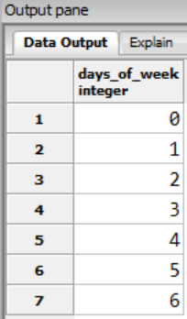
generate_series(start, stop [, step])
SELECT generate_series(0, 6) AS days_of_week
Notes:
This view is available in Sierra 5.5 and later.
URL
https://techdocs.iii.com/sierradna/Content/Transactions/Circulation.htm

Slide 23
The LATERAL keyword in context
Notes:
This view is available in Sierra 5.5 and later.
URL
https://techdocs.iii.com/sierradna/Content/Transactions/Circulation.htm

Slide 24
The LATERAL keyword, zoomed in
Notes:
This view is available in Sierra 5.5 and later.
URL
https://techdocs.iii.com/sierradna/Content/Transactions/Circulation.htm

Slide 25
Improved High Demand Holds
Rebecca King
Thousand Oaks Library, CA

Slide 26
Current High-Demand Holds in Sierra
Data not Showing in High-Demand Holds
Frozen holds
Copies on order
Holds to copies ratio

Slide 27
Export Output File and Open in Excel

Slide 28
How to get holds data with SQL?
Staff requested that the following data be included in the report:
Exclude frozen holds
Include copies on order
Check if holds-to-copies ratio over 5:1
Additional information, such as
Published year
Link to the library catalog

Slide 29
Building a Query
We'd like to resolve each hold to a 'bib_record_id' so we can get a sense of the number of holds on each title. A hold in the hold table is on a 'record_id', which could be for bib ('b'), item ('i'), or volume ('j') level.
Let's create a TEMPORARY TABLE (or TEMP TABLE) to find bib holds that are not frozen.
The TEMP TABLE will be removed after a session is ended.

Slide 30
Building a query (cont.)
The DROP TABLE clause helps if I modify the query and re-run it (to avoid an error on multiple runs.)
We bring in data about the record type ('r.record_type_code') and all the rest of the data concerning the hold (h.*)
We can work with the TEMP TABLE in subsequent statements as long as it's the same session.

Slide 31
Building a TEMP TABLE
DROP TABLE IF EXISTS temp_tol_holds;
CREATE TEMP TABLE temp_tol_holds AS
SELECT
h.*,
r.record_type_code,
CASE
WHEN r.record_type_code = 'b' THEN (h.record_id)
ELSE NULL
END AS bib_record_id

Slide 32
Building a TEMP TABLE (cont.)
FROM
sierra_view.hold as h
LEFT OUTER JOIN
sierra_view.record_metadata as r ON r.id = h.record_id
WHERE
r.record_type_code = 'b'
AND h.is_frozen is false; -- not frozen hold

Slide 33
Count Active Holds (not including the frozen holds)
SELECT
id2reckey(t.bib_record_id) ||'a' as "Bib Record #",
b.best_title as "Title",
b.best_author as "Author",
CASE
WHEN b.material_code = '7' THEN 'WIFI HOTSPOT'
WHEN b.material_code = '8' THEN 'LAPTOP KIT'
WHEN b.material_code = 'a' THEN 'BOOK'
WHEN b.material_code = 'g' THEN 'DVD'
WHEN b.material_code = 'n' THEN 'BLU-RAY'

Slide 34
Count Active Holds (cont.)
WHEN b.material_code = 'i' THEN 'SPOKEN WORD'
WHEN b.material_code = 'z' THEN 'LARGE PRINT'
WHEN b.material_code = '12' THEN 'VIDEO GAME'
ELSE 'unexpected code '||b.material_code
END AS "Material Type",
( SELECT
COUNT(*)
FROM temp_tol_holds as t1
WHERE t1.record_id = t.record_id
) AS "Active Holds",

Slide 35
Count Active Copies (circulating items)
COALESCE((
SELECT
COUNT(*)
FROM sierra_view.bib_record_item_record_link as l
JOIN sierra_view.item_record as i ON i.record_id = l.item_record_id
LEFT OUTER JOIN sierra_view.checkout as c ON c.item_record_id = l.item_record_id
WHERE l.bib_record_id = t.record_id
),0) AS "Active Copies",

Slide 36
Count Copies On Order (item not yet received)
COALESCE((
SELECT
SUM(c.copies)
FROM sierra_view.bib_record_order_record_link as l
LEFT OUTER JOIN sierra_view.order_record as o ON o.record_id = l.order_record_id
JOIN sierra_view.order_record_cmf as c ON c.order_record_id = l.order_record_id
LEFT OUTER JOIN sierra_view.order_record_received as r ON r.order_record_id = l.order_record_id
WHERE l.bib_record_id = t.bib_record_id
AND o.order_status_code = 'o'
AND r.id IS NULL
GROUP BY l.bib_record_id
), 0) AS "Copies On Order",

Slide 37
Get Published Year
CASE
WHEN b.publish_year > '2024'
THEN ('20'||SUBSTRING(b.publish_year::VARCHAR,1,6))::INTEGER
ELSE b.publish_year
END
as "Pub Year",

Slide 38
Get the Total Number of Active Holds
CASE WHEN
(Total number of active copies + Total number of copies on order) = 0
THEN 0
ELSE
ROUND(CAST((
SELECT
COUNT(*)
FROM temp_tol_holds as t1
WHERE t1.record_id = t.record_id
) AS decimal(8,2)) /

Slide 39
Get the Total Number of Active Copies
CAST((
((COALESCE((
SELECT
COUNT(*)
FROM sierra_view.bib_record_item_record_link as l
JOIN sierra_view.item_record as i
ON i.record_id = l.item_record_id
LEFT OUTER JOIN sierra_view.checkout as c
ON c.item_record_id = l.item_record_id
WHERE l.bib_record_id = t.record_id
),0)) +

Slide 40
Get the Total Number of Copies On Order
(COALESCE((
SELECT SUM(c.copies)
FROM sierra_view.bib_record_order_record_link as l
LEFT OUTER JOIN sierra_view.order_record as o ON o.record_id = l.order_record_id
JOIN sierra_view.order_record_cmf as c ON c.order_record_id = l.order_record_id
LEFT OUTER JOIN sierra_view.order_record_received as r ON r.order_record_id = l.order_record_id
WHERE l.bib_record_id = t.bib_record_id
AND o.order_status_code = 'o' AND r.id IS NULL
GROUP BY l.bib_record_id), 0)))
) AS decimal(8,2)),2) END as "ratio",
'https://thols.na2.iiivega.com/search/card?recordId='|| REPLACE((id2reckey(t.bib_record_id)), 'b','') as "Vega Link"

Slide 41
End of the Query
FROM temp_tol_holds as t
JOIN sierra_view.bib_record as br ON br.record_id = t.bib_record_id
JOIN sierra_view.bib_record_property as b ON b.bib_record_id = t.bib_record_id
WHERE -- records are bib type and not suppressed
t.record_type_code = 'b' and br.bcode3 ='-' -- Bib records include vendor cancellation, missing copies, etc.
GROUP BY t.bib_record_id,2,3,4,5,6,7,8,9
HAVING COUNT(t.record_id) >= 3 -- hold is equal or larger than 3
ORDER BY 8 desc; --sort by ratio

Slide 42
Full SQL Query and Python Script
Full SQL Script
https://www.tolibrary.org/Custom/Library/HighDemandHoldsReportdemo.txt
Full Python Script:
https://www.tolibrary.org/Custom/Library/HighDemandHoldsReportdemoPY.txt
Scan the QR code on your mobile device.

Slide 43
Use pgAdmin 4 to test the Query

Slide 44
Export Data to Excel

Slide 45
High-Demand Holds Report Workflow
Use Python to run the SQL and create an Excel file on local drive.
Use a batch file to move the Excel file from the local drive to the OneDrive High-Demand Holds folder.
Share the OneDrive folder with selectors.
Use the Windows Task Scheduler to run the Python script and the batch file every Monday morning.
The selectors add comments in the report on whether they will order additional copies.

Slide 46
Purchase Alert Revisited
Jeremy Goldstein
Minuteman Library Network, MA

Slide 47
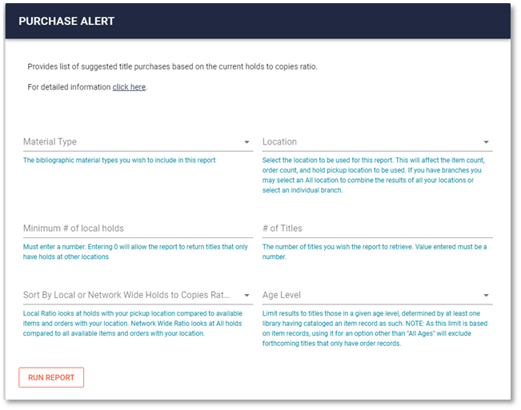
Background
Saw Gem Stone Logan's automating reports presentation at IUG April 2017
V1 Launched in May 2017
First of many automated reports to come
Uploaded to staff FTP site for distribution
On Demand version live June 2020
Notes:
Going into IUG 2017 I had never worked with Python and was still very much a SQL novice. I attended this presentation Gem gave showing how to write a script that would run a query, throw the results into an Excel file, and email that off and immediately thought it was something I could actually do. A month later we had our first version of this report, essentially using Gem's script but uploading the file to an FTP server instead of emailing it.
3 years later we launched our new staff Intranet site that included a mechanism for staff to run canned SQL reports, and crafting an on demand version of this tool, with a few extra filtering options was one of the very first reports we included.

Slide 48
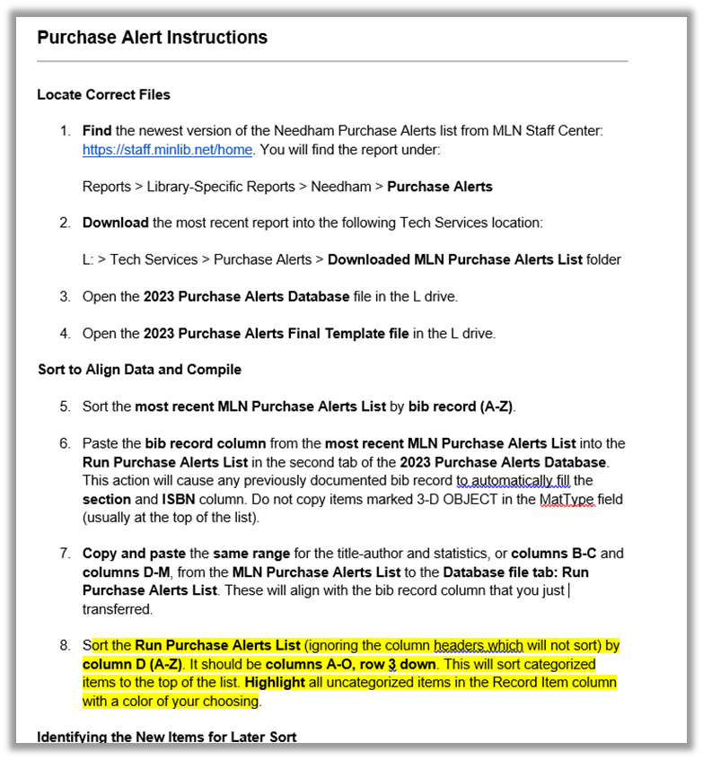
Nov 2023
Meet with new dept head at a member library
Learn this exists
It goes on for a few more pages
This library wasn't alone
Notes:
And that's how things were until the end of '23 when I met with a new department head at one of our libraries and she shared the instructions her predecessor had left her on the additional processing their staff would do with the report EVERY week. It goes on like this for another 2 dozen steps.
Mostly they wanted to take the massive list we produced each week and portion it out to different selectors at their library according to each's subject area. We put out some feelers to other libraries in the network to get a sense of how they used this report and quickly learned that while the instructions here were a bit of an extreme example, they were hardly unique.

Slide 49
Purchase Alert V.2
New Features
ISBN/UPC
Streamline Filters
Local Copies In Process
Divide list into sub collections
Adult Fic & Nonfic, AV, Large Print, Juv, YA, Adult Unknown, Other
Suggested Purchase Quantity
Notes:
So we took that feedback and came up with a list of improvements to make to the report to at least mitigate that extra effort everyone was doing. From a practical perspective we still need this to be a bit of a one size fits all tool so we couldn't customize it to the collection areas for every staff member throughout the network, but wanted to reduce that extra processing everyone was doing as much as possible, and while we were at it add in a few extra data columns that staff said they'd like to see.

Slide 50
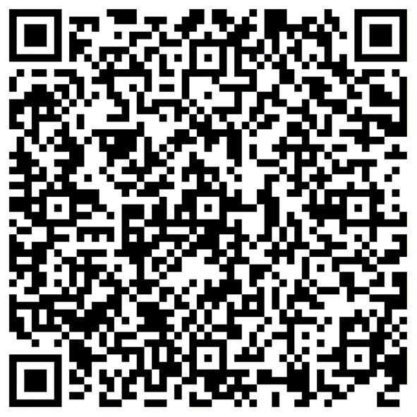
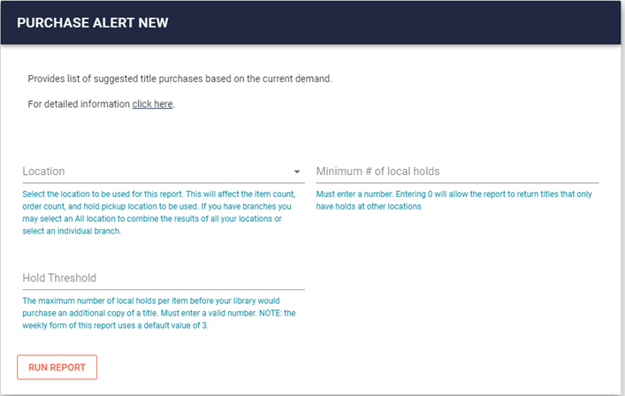
The On Demand Query
https://github.com/Minuteman-Library-Network/SQL-Queries/blob/master/Custom%20reports%20site/purchase%20alert%20v2.sql
Notes:
We made updates to both versions of our purchase alert which you can access on the two following slides. This will take you to the on demand query accessed via the user interface you see here, and which could be fairly easily adopted by others, just replace the variables this fills in with your own parameters.

Slide 51
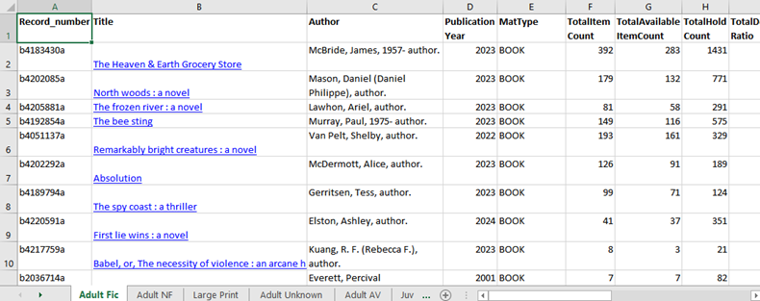
The Automated Script
https://github.com/Minuteman-Library-Network/Purchase-Alert
Notes:
And here you can find the Python script and related SQl queries for the automated version that produces the spreadsheets we place on our FTP server each week.

Slide 52
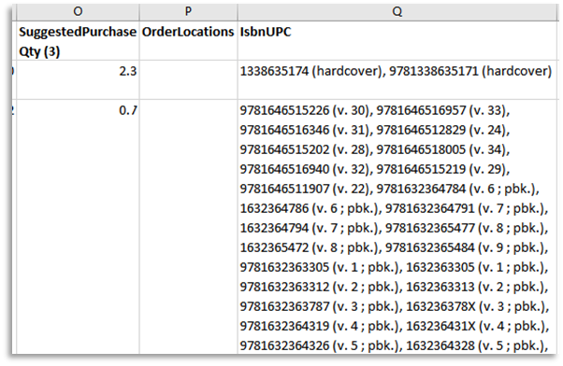
ISBN/UPC
(
SELECT
COALESCE(STRING_AGG(REPLACE(REGEXP_REPLACE(v.field_content,'(\|a|:)','','g'), '|q','
'),'(\|c|\|2|\|d).*?(\||$)',''),', '),'') AS isbns
FROM sierra_view.varfield v
WHERE
brp.bib_record_id = v.record_id AND v.marc_tag IN ('020','024')
) AS isbns
Notes:
To quickly go through the additions we made to our original report, which was quite similar in nature to what Rebecca just presented. Staff wanted the inclusion of ISBN and UPC codes to help make the report a bit more actionable. This way when the report alerts them to a title they should consider purchasing they can just copy and past the number directly into the vendor's site to place the order. What you see here aggregates all such numbers on a bib record into a single comma delimited field, using the string_agg() function, and performs some regular expression based cleanup to remove unwanted text from those fields, resulting in the sort of display seen here.

Slide 53
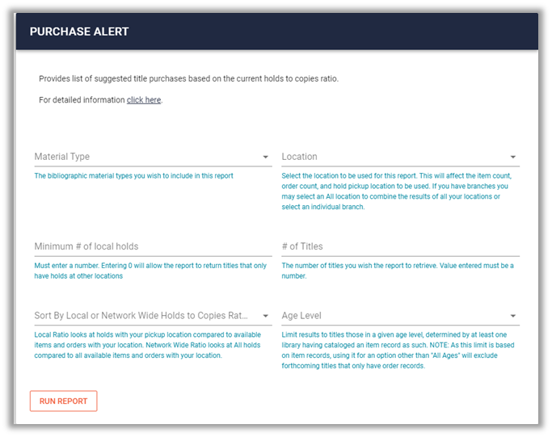
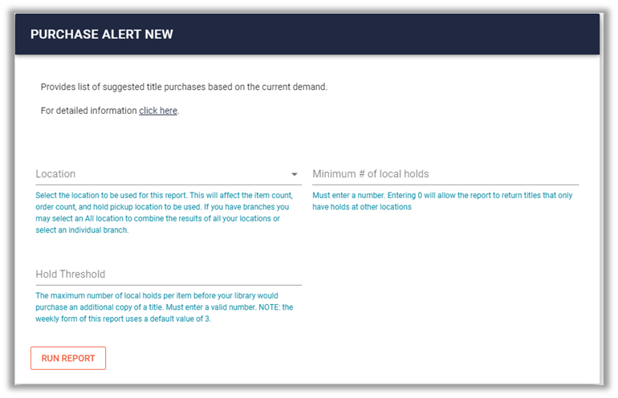
Streamline Filters
Before
After
https://github.com/Minuteman-Library-Network/SQL-Queries/blob/master/Custom%20reports%20site/purchase%20alert.sql
Notes:
With the on demand version of the report, I overthought the filtering options a bit in the prior version which just confused people. That and the addition of age level and mat types getting worked into the collection category logic meant those were no longer useful as filters. The # of titles was more important when we were generated one huge list, but once it's subdivided it's more manageable so that can go. Controlling the sort order was just needless complexity and as you can tell by the filter label I was already struggling to explain it so we're just going with a default and if someone wants to resort that's easy enough to do in Excel.
But then we have to add in the new Hold threshold, more on that in a moment

Slide 54
Local Copies In Process
# added to inner query
SUM(oc.copies) FILTER(WHERE o.order_status_code = 'a' AND o.received_date_gmt::DATE >= CURRENT_DATE - INTERVAL '14 days') AS processing_copies,
COUNT(DISTINCT ia.id) FILTER(WHERE rmia.creation_date_gmt::DATE >= CURRENT_DATE - INTERVAL '14 days') AS in_process_item_count
#added to main query
CASE
WHEN MAX(mv.processing_copies) > 0 AND MAX(mv.in_process_item_count) <
MAX(mv.processing_copies) THEN MAX(mv.processing_copies) –
MAX(mv.in_process_item_count)
ELSE 0
END AS LocalCopiesInProcess
Notes:
He we had a request to reproduce the logic we've used in Encore try to capture materials that have been recently received but may still be waiting in tech services to be added to the collection. Our setting for that in process message was 14 days so we're reproducing that here.
In the inner query created counts of orders that were received in the past 14 days and items on the same bib records that were created in the past 14 days.
Then in the main query we can do the math for instances where there are more in process orders than there are items. Note we've used the MAX() function when calling all of those, which was a lazy method of reconciling possible one-to-many join errors that might sneak in there due to the number of LEFT JOINS and subqueries we have in play.

Slide 55
Collections (Age Level)
# added to inner query
MODE() WITHIN GROUP (ORDER BY SUBSTRING(i.location_code,4,1)) AS age_level
#added to main query
CASE
WHEN mv.age_level = 'j' THEN 'JUV'
WHEN mv.age_level = 'y' THEN 'YA'
WHEN mv.age_level IS NULL THEN 'UNKNOWN'
ELSE 'ADULT'
END AS age_level
Notes:
Our item locations are structured so the 4th character identifies juv and YA collections. So we're pulling those and then looking for the most frequently assigned location among all items on a bib using the MODE() function. It is however the case that due to pre publication titles in the list that some titles will have zero items, hence the Unknown option in the case statement

Slide 56
Collections (is_fiction)
# added to main query
MODE() WITHIN GROUP (ORDER BY
CASE
WHEN phrase_entry.index_entry ~ '((\yfiction)|(pictorial works)|(tales)|
(^\y(?!\w*biography)\w*(comic books strips etc))|(^\y(?!\w*biography)\w*(graphic
novels))|(\ydrama)|((?<!hi)stories))(( [a- z]+)?)(( translations into [a-z]+)?)$'
AND brp.material_code NOT IN ('7','8','b','e','j','k','m','n')
AND NOT (leader_field.bib_level_code = 'm' AND leader_field.record_type_code = 'a'
AND control_field.p33 IN ('0','e','i','p','s','','c')) THEN 'TRUE'
WHEN d.index_entry IS NULL THEN 'UNKNOWN'
ELSE 'FALSE'
END
) AS is_fiction
Notes:
The other data point we need to create is a marker of if a title is fiction or non-fiction. The approach we've taken is one that was pulled out of a prior report we had created and involves looking at subject headings (with a lot of regex), the material types and the MARC leader values. This is a little imperfect but has proven to be decently reliable just with a slight excess of records resolves to unknown due to pre-pub vendor records that haven't received full cataloging as of yet.

Slide 57
Collections (Python)
workbook = xlsxwriter.Workbook(excelfile,{'remove_timezone': True})
worksheet_adf = workbook.add_worksheet('Adult Fic')
worksheet_adnf = workbook.add_worksheet('Adult NF')
worksheet_adlp = workbook.add_worksheet('Large Print')
worksheet_adunknown = workbook.add_worksheet('Adult Unknown')
worksheet_adav = workbook.add_worksheet('Adult AV')
worksheet_j = workbook.add_worksheet('Juv')
worksheet_ya = workbook.add_worksheet('YA')
worksheet_other = workbook.add_worksheet('Other')
for rownum, row in enumerate(query_results):
if row[4] == 'LARGE PRINT':
worksheet_adlp.write(row_adlp,0,row[0],eformat)
elif row[16] == 'ADULT' and row[17] == 'TRUE' and row[4] == 'BOOK':
worksheet_adf.write(row_adf,0,row[0],eformat)
elif row[16] == 'ADULT' and row[17] == 'FALSE' and
row[4] in ['BOOK','MUSIC SCORE']:
worksheet_adnf.write(row_adnf,0,row[0],eformat)
Notes:
Using xlsxwriter we can now create separate worksheets within the spreadsheet we're creating and as the script loops through the SQL results we can use some conditional logic to determine sheet to write each row to. We can't do this with the on demand version of the report since that can only produce .csv files but by exposing these fields staff can easily sort the resulting report and do the final cleanup without too much additional effort.

Slide 58
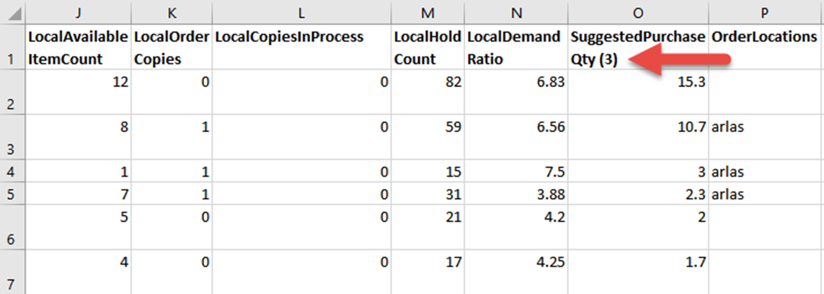
Suggested Purchase Qty
SuggestedPurchaseQty = (LocalHoldCount / [entered hold threshold]) - LocalAvailableItemCount - LocalOrderCopies - LocalCopiesInProcess
Notes:
Finally for some fancy Excel formula work we wanted to make the report more actionable by providing a reasonable suggested purchase amount. The problem being that those needs could differ greatly from library to library in our network where we have urban multi-branch libraries and much smaller suburban communities. So we came up with a method where the formula used to calculate this value would work off of variable within the column header that users could change on the fly. By default it's set to 1 copy for every three local holds then subtracting any copies that are already available, on order or that are in process.

Slide 59
Suggested Purchase Qty
=IF(M2/(VALUE(MID($O$1,SEARCH("(",$O$1)+1,SEARCH(")",$O$1)-SEARCH("(",$O$1)-1)+0))-J2-K2-L2<0,0,ROUND(M2/(VALUE(MID($O$1,SEARCH("(",$O$1)+1,SEARCH(")",$O$1)-SEARCH("(",$O$1)-1)+0))-J2-K2-L2,1))
Notes:
So here you can see the Excel formula necessary for that to actually work, which searches for whatever appears between the parenthesis in cell O1

Slide 60
Suggested Purchase Qty
suggested_purchase_formula = '=if(M{}/(VALUE(MID($O$1,SEARCH("(",$O$1)+1,SEARCH(")",$O$1)-SEARCH("(",$O$1)-1)+0))-J{}-K{}-L{}<0,0,round(M{}/(VALUE(MID($O$1,SEARCH("(",$O$1)+1,SEARCH(")",$O$1)-SEARCH("(",$O$1)-1)+0))-J{}-K{}-L{},1))'
worksheet_adlp.write(row_adlp,14,suggested_purchase_formula.format(row_adlp+1,row_adlp+1,row_adlp+1,row_adlp+1,row_adlp+1,row_adlp+1,row_adlp+1,row_adlp+1), eformat)
row_adlp += 1
=IF(M2/(VALUE(MID($O$1,SEARCH("(",$O$1)+1,SEARCH(")",$O$1)-SEARCH("(",$O$1)-1)+0))-J2-K2-L2<0,0,ROUND(M2/(VALUE(MID($O$1,SEARCH("(",$O$1)+1,SEARCH(")",$O$1)-SEARCH("(",$O$1)-1)+0))-J2-K2-L2,1))
Notes:
And then here's what we had to come up with on the Python end to build that into our sheet. For this to work we had to keep track of the row currently being written to by xlsxwriter, plug that into the blanks in the formula each time its written using string formatting, and then increment the variable used to track that by one each time it goes through the writing loop.

Slide 61
End Result
Notes:
And here's the final result of all these additions.

Slide 62
THANK YOU
Questions?
Rebecca King rking@tolibrary.org
Jeremy Goldstein jgoldstein@minlib.net
Bob Gaydos bgaydos@starklibrary.org
Victor Zuniga vzuniga@poudrelibraries.org

