Slide 1
Spring Cleaning

Slide 2
Spring Cleaning
Using Create Lists to Find (and fix) DATA ENTRY Errors

Slide 3
Spring Cleaning
Thomas O’Connell, Mid-Hudson Library System
toconnell@midhudson.org
Innovative Users Group
2016

Slide 4
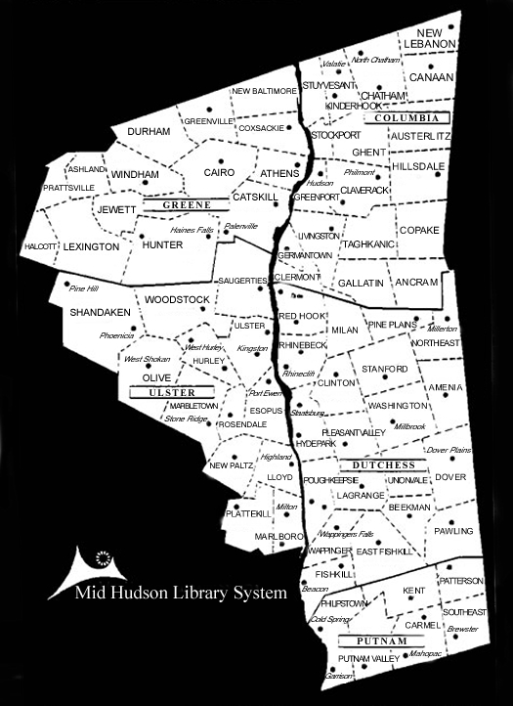
Spring Cleaning
Mid-Hudson Library System

Slide 5
Spring Cleaning
Mid-Hudson Library System
66 member libraries

Slide 6
Spring Cleaning
Mid-Hudson Library System
66 member libraries
5 counties

Slide 7
Spring Cleaning
Mid-Hudson Library System
66 member libraries
5 counties
3.1 million items

Slide 8
Spring Cleaning
Mid-Hudson Library System
66 member libraries
5 counties
3.1 million items
300,000 patrons

Slide 9
Spring Cleaning
Shhhh…

Slide 10
Spring Cleaning
Shhhh… circulation is a little down

Slide 11
Spring Cleaning
Shhhh… circulation is a little down
“we are all in sales”

Slide 12
Spring Cleaning
Shhhh… circulation is a little down
“we are all in circulation”

Slide 13
Spring Cleaning
* To clean up our shared database

Slide 14
Spring Cleaning
* To clean up our shared database
* Not about embarrassing any library

Slide 15
Spring Cleaning
* To clean up our shared database
* Not about embarrassing any library
* How to find these errors..?

Slide 16
Spring Cleaning- Barcodes
What are we looking for?

Slide 17
Spring Cleaning- Barcodes
What are we looking for?
- inconsistencies
- wrong data in data fields

Slide 18
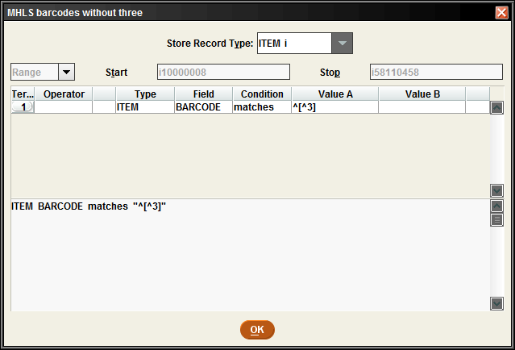
Spring Cleaning- Barcodes
What are we looking for?
- inconsistencies

Slide 19
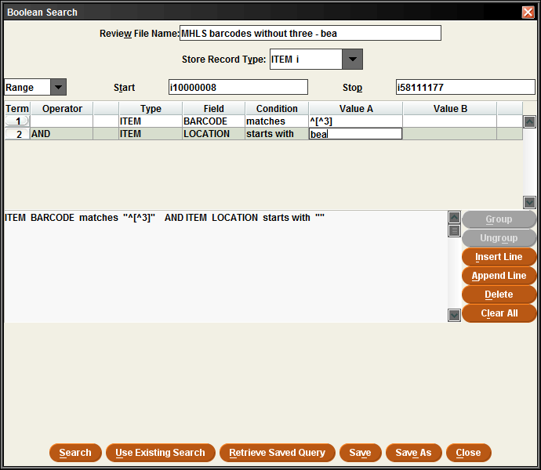
Spring Cleaning- Barcodes
What are we looking for?
- inconsistencies
Item Barcode matches ^[^3]

Slide 20
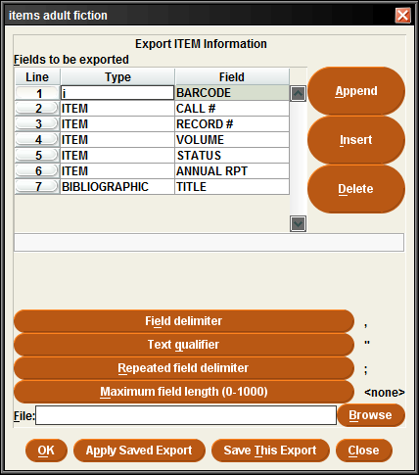
Spring Cleaning- Barcodes
What are we looking for?
- inconsistencies
Export the data…

Slide 21
Spring Cleaning - Barcodes

Slide 22
Spring Cleaning - Barcodes
What are we looking for?
Sort smallest to largest
BARCODE | RECORD #(ITEM) | CALL #
-32916002373990 | i43124082 | FIC MAI
12345 | i34910839 | test preferred search
1234321 | i57806834 | test
792844807 | i3901549x | DVD/Bre
3802900009 | i3203278x | J 551.578 Bra
12345678910 | i32902335 | test
2383000812638 | i58085166 | GN DOCTOR
28047000021237 | i40786997 | FIVC EVA
28058000039681 | i43333370 | YA Pec
28058000039806 | i4336620x | YA Kel

Slide 23
Spring Cleaning - Barcodes
What are we looking for?
Sort smallest to largest
(most mistakes will be at beginning or end)
BARCODE | RECORD #(ITEM) | CALL #
-32916002373990 | i43124082 | FIC MAI
12345 | i34910839 | test preferred search
1234321 | i57806834 | test
792844807 | i3901549x | DVD/Bre
3802900009 | i3203278x | J 551.578 Bra
12345678910 | i32902335 | test
2383000812638 | i58085166 | GN DOCTOR
28047000021237 | i40786997 | FIVC EVA
28058000039681 | i43333370 | YA Pec
28058000039806 | i4336620x | YA Kel

Slide 24
Spring Cleaning - Barcodes
What are we looking for?
Some are test records
BARCODE | RECORD #(ITEM) | CALL #
-32916002373990 | i43124082 | FIC MAI
12345 | i34910839 | test preferred search
1234321 | i57806834 | test
792844807 | i3901549x | DVD/Bre
3802900009 | i3203278x | J 551.578 Bra
12345678910 | i32902335 | test
2383000812638 | i58085166 | GN DOCTOR
28047000021237 | i40786997 | FIVC EVA
28058000039681 | i43333370 | YA Pec
28058000039806 | i4336620x | YA Kel

Slide 25
Spring Cleaning - Barcodes
What are we looking for?
Some are test records
(we can ignore those)
BARCODE | RECORD #(ITEM) | CALL #
-32916002373990 | i43124082 | FIC MAI
12345 | i34910839 | test preferred search
1234321 | i57806834 | test
792844807 | i3901549x | DVD/Bre
3802900009 | i3203278x | J 551.578 Bra
12345678910 | i32902335 | test
2383000812638 | i58085166 | GN DOCTOR
28047000021237 | i40786997 | FIVC EVA
28058000039681 | i43333370 | YA Pec
28058000039806 | i4336620x | YA Kel

Slide 26
Spring Cleaning - Barcodes
What are we looking for?
Barcode is too short
BARCODE | RECORD #(ITEM) | CALL #
-32916002373990 | i43124082 | FIC MAI
12345 | i34910839 | test preferred search
1234321 | i57806834 | test
792844807 | i3901549x | DVD/Bre
3802900009 | i3203278x | J 551.578 Bra
12345678910 | i32902335 | test
2383000812638 | i58085166 | GN DOCTOR
28047000021237 | i40786997 | FIVC EVA
28058000039681 | i43333370 | YA Pec
28058000039806 | i4336620x | YA Kel

Slide 27
Spring Cleaning - Barcodes
What are we looking for?
Some patron barcodes
BARCODE | RECORD #(ITEM) | CALL #
-32916002373990 | i43124082 | FIC MAI
12345 | i34910839 | test preferred search
1234321 | i57806834 | test
792844807 | i3901549x | DVD/Bre
3802900009 | i3203278x | J 551.578 Bra
12345678910 | i32902335 | test
2383000812638 | i58085166 | GN DOCTOR
28047000021237 | i40786997 | FIVC EVA
28058000039681 | i43333370 | YA Pec
28058000039806 | i4336620x | YA Kel

Slide 28
Spring Cleaning - Barcodes
What are we looking for?
Patron barcodes
& too short
BARCODE | RECORD #(ITEM) | CALL #
-32916002373990 | i43124082 | FIC MAI
12345 | i34910839 | test preferred search
1234321 | i57806834 | test
792844807 | i3901549x | DVD/Bre
3802900009 | i3203278x | J 551.578 Bra
12345678910 | i32902335 | test
2383000812638 | i58085166 | GN DOCTOR
28047000021237 | i40786997 | FIVC EVA
28058000039681 | i43333370 | YA Pec
28058000039806 | i4336620x | YA Kel

Slide 29
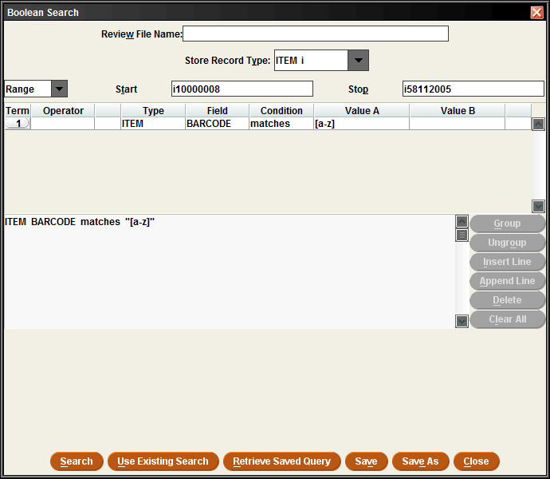
Spring Cleaning - Barcodes
What are we looking for?
- wrong data in barcode field

Slide 30
Spring Cleaning - Barcodes
What are we looking for?
- wrong data in barcode field
ITEM BARCODE matches “[a-z]”

Slide 31
Spring Cleaning - Barcodes
What are we looking for?
- wrong data in barcode field
BARCODE | RECORD # (ITEM) | CALL #
343.73 J.K.;"32383000769085" | i52050920
32912001177755;"bt 10/05 | i5370678x | E Falconer
32914000979579;"32914001006299 Lost copy" | i5720326x | AF ROB
A\38047000389285 | i57681466 | JF BED

Slide 32
Spring Cleaning - Barcodes
What are we looking for?
- wrong data in barcode field
BARCODE | RECORD # (ITEM) | CALL #
38034000165378, gift 12/02 | i29296316 | FIC SMI (pb)
37535000618258LOST;"37535001019571" | i29879425 | 423.1 BRY
36014000372895 basement | i30629597 | YA MYE
32393xxxxxxxxx | i30638392 | FERRIS COLLECTION 973.7 C

Slide 33
Spring Cleaning - Barcodes
What are we looking for?
- wrong data in barcode field
Call numbers as barcodes
BARCODE | RECORD # | CALL # | TITLE
291.4 Zuk;"38029000148820" | i37638506 |  | Soul stories : practical guides to the soul
343.73 J.K.;"32383000769085" | i52050920 |  | J.K. Lasser's your income tax

Slide 34
Spring Cleaning - Barcodes
What are we looking for?
- wrong data in barcode field
Call numbers as barcodes
& so there is no call number
BARCODE | RECORD # | CALL # | TITLE
291.4 Zuk;"38029000148820" | i37638506 |  | Soul stories : practical guides to the soul
343.73 J.K.;"32383000769085" | i52050920 |  | J.K. Lasser's your income tax

Slide 35
Spring Cleaning - Barcodes
What are we looking for?
- wrong data in barcode field
Call numbers as barcodes
& so there is no call number
Speaking of call numbers…
BARCODE | RECORD # | CALL # | TITLE
291.4 Zuk;"38029000148820" | i37638506 |  | Soul stories : practical guides to the soul
343.73 J.K.;"32383000769085" | i52050920 |  | J.K. Lasser's your income tax

Slide 36
Spring Cleaning – Call Numbers
Try to think of things that might be ‘wrong’ with the call number-
Just get a list of records

Slide 37
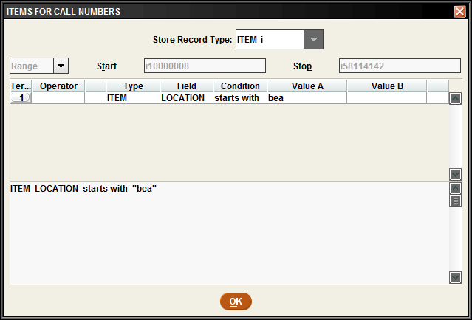
Spring Cleaning – Call Numbers
Try to think of things that might be ‘wrong’ with the call number-
Just get a list of records
Perhaps for a section you know to need some care…

Slide 38
Spring Cleaning – Call Numbers
Try to think of things that might be ‘wrong’ with the call number-
Sort by call number-
Again, the ‘mistakes’ will be at the top or the bottom of the list
CALL #
25.04
808.042
- Child
(new)
353.003 Levy

Slide 39
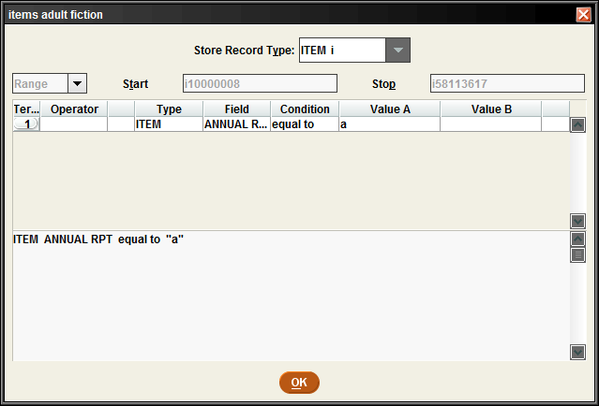
Spring Cleaning – Call Numbers
Try to think of things that might be ‘wrong’ with the call number-

Slide 40
Spring Cleaning – Call Numbers
Try to think of things that might be ‘wrong’ with the call number-
Search for Annual Report Code
Such as Adult Fiction

Slide 41
Spring Cleaning – Call Numbers
Try to think of things that might be ‘wrong’ with the call number-
Inconsistencies…
Inconsistent FIC Call Numbers
CALL # | RECORD # | TITLE
FIC ALG | i12202009 | The man with the golden arm : a novel
FIC ABE | i12046577 | The box man Kobo Abe
F BEA | i12900837 | Rebecca's tale
F NAT | i11357162 | Natural suspect : a collaborative novel
ACH | i12056960 | Girls at war, and other stories.
ADA | i12069553 | Canal town : a novel

Slide 42
Spring Cleaning – Call Numbers
Try to think of things that might be ‘wrong’ with the call number-
Inconsistencies…
Inconsistent FIC Call Numbers
CALL # | RECORE # | TITLE
BEA | i12887006 | Death of a nag / M. C. Beaton.
BEA | i12887237 | Death of a prankster / M.C. Beaton.
BEA | i12887432 | Death of a scriptwriter / M.C. Beaton.
F | i12089060 | Shardik / Richard Adams.
F | i1211036x | Legacy of secrets / Elizabeth Adler.
F | i12148684 | Last respects / Catherine Aird.

Slide 43
Spring Cleaning – Call Numbers
Try to think of things that might be ‘wrong’ with the call number-
Inconsistencies…
Inconsistent FIC Call Numbers
(or none at all)
CALL # | RECORD # | TITLE
 | i12816851 | The Tidewater tales : a novel / John Barth.
 | i1282723x | The emerald illusion / Ronald Bass.
 | i12830768 | Platte river / Rick Bass.
 | i12832984 | The view from Pompey's Head Hamilton Basso.
 | i12835171 | Bed and breakfast Lois Battle.

Slide 44
Spring Cleaning – Call Numbers
Try to think of things that might be ‘wrong’ with the call number-
Or inconsistencies…
Like Volume information where the call number should be.
CALL # | RECORD # | TITLE
1968 | i10248456 | The Best American short stories ... and the yearbook of the American short story.
1974 | i10248444 | The Best American short stories ... and the yearbook of the American short story.
2000 | i10250293 | Best American short stories (Boston, Mass. : 1978);"The best American short stories."

Slide 45
Spring Cleaning – Call Numbers
Try to think of things that might be ‘wrong’ with the call number-
Perhaps, message information stored in the call number field.

Slide 46
Spring Cleaning – Call Numbers
Try to think of things that might be ‘wrong’ with the call number-
For instance, messages in the call number field
CALL NUMBER
Checker Set #3
Checks for 2 Discs & 1 booklet
Daily Freeman - In-library use checkout
DVD 1481;"CHECK FOR SLIPCASE AND FOUR DISCS"
DVD 792 CHECKMATE
DVD O.C. 1- check for 7 discs
DVD W check for sleeve and scene guide

Slide 47
Spring Cleaning – Call Numbers
Try to think of things that might be ‘wrong’ with the call number-
Information in the call number may be correct -

Slide 48
Spring Cleaning – Call Numbers
Try to think of things that might be ‘wrong’ with the call number-
Information in the call number may be correct –
Make sure it is up to date
CALL # | UPDATED | RECORD #
294.3 NEW | 2/14/2015 | i46578870
294.344 NHA (New Shelf) | 1/1/2013 | i45993890
294.3444 Y (NEW SHELF) | 1/1/2013 | i44911397
296.36 K (New) | 1/1/2013 | i19675641
296.493 PAR (New Shelf) | 1/1/2013 | i41282073
296.7 AAR (New Shelf) | 9/2/2014 | i44958018

Slide 49
Spring Cleaning – Status
Try to think of where else we could find inconsistencies…
Status = in transit

Slide 50
Spring Cleaning – Status
Try to think of where else we could find inconsistencies…
Status = in transit
(or display or repair or …)

Slide 51
Spring Cleaning – Status
Try to think of where else we could find inconsistencies…
Status = in transit
How long is a reasonable amount of time

Slide 52
Spring Cleaning – Status
Try to think of where else we could find inconsistencies…
Status = in transit
How long is a reasonable amount of time
(hint, export the message)

Slide 53
Spring Cleaning – What else..?
What else could possible be ‘wrong’ in the database?

Slide 54
Spring Cleaning – What else..?
What else could possible be ‘wrong’ in the database?
Price -

Slide 55
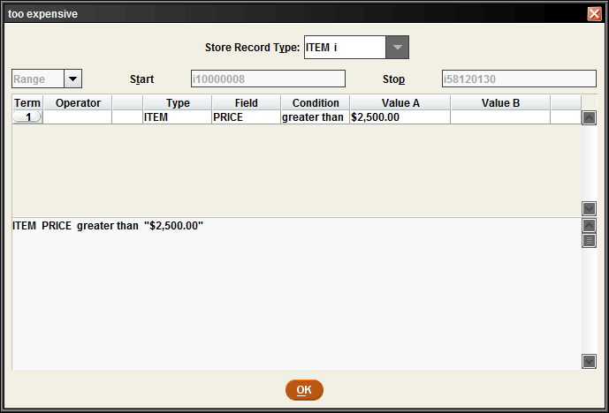
Spring Cleaning – What else..?
What else could possible be ‘wrong’ in the database?
Price -
How about items with incorrect prices?

Slide 56
Spring Cleaning – Price
What else could possible be ‘wrong’ in the database?
Price -
How about items with incorrect prices?
Well, some books are expensive
PRICE | CALL # | TITLE | RECORD #
$2,696.00 | REF 503 McGr | McGraw-Hill encyclopedia of science & technology. | i40632477
$2,696.00 | REF 503 McGr | McGraw-Hill encyclopedia of science & technology. | i40632532
$2,696.00 | REF 503 McGr | McGraw-Hill encyclopedia of science & technology. | i40632581
$2,696.00 | REF 503 McGr | McGraw-Hill encyclopedia of science & technology. | i4063260x

Slide 57
Spring Cleaning – Price
What else could possible be ‘wrong’ in the database?
Price -
How about items with incorrect prices?
But not these…
PRICE | CALL # | TITLE | RECORD #
$2,800.00 | F | Leaving time : a novel / Jodi Picoult. | i57144576
$2,898.00 | 327.73056 Nasr | The dispensable nation | i5112595x
$2,995.00 | DVD 3325 Hay | Haywire [videorecording] | i49151629
$2,995.00 | New FIC GRE | Saving Grace / Jane Green. | i57406492
$3,000.00 |  | Computer use. | i30176773
$3,095.00 | ICR KIP | Jungle book. #3, Mowgli's big birthday | i41298019
$3,230.00 | 636.088 WHI | Betty and friends : my life at the zoo / Betty White. | i48232579

Slide 58
Spring Cleaning – Price
What else could possible be ‘wrong’ in the database?
Price -
How about items with incorrect prices?
But not these…
& not this expensive!
PRICE | CALL # | TITLE | RECORD #
$9,780,300.00 | 363.738 Nor | The climate casino | i52470507
$9,780,500.00 | 917.47 La | On the high line | i57360716
$9,781,619.00 | BK/CD SPA | The longest ride [sound recording] / Nicholas Sparks | i51899619
$10,380,580.00 | JF Coo | The magic pot / Patricia Coombs. | i30137299
$18,000,000.00 | E 571.31 JEN | Creature features | i57138692

Slide 59
Spring Cleaning
Is it really that bad?

Slide 60
Spring Cleaning
Is it really that bad?
Well, yes & no

Slide 61
Spring Cleaning
Is it really that bad?
Well, yes & no
And Does it matter?

Slide 62
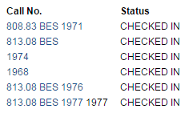
Spring Cleaning
Is it really that bad?
Well, yes & no
And Does it matter?
Yes, it does actually…

Slide 63
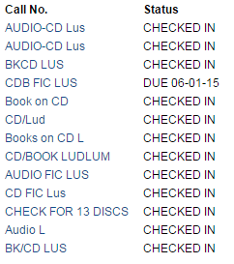
Spring Cleaning
Is it really that bad?
Well, yes & no
And Does it matter?
Yes, it does actually…

Slide 64
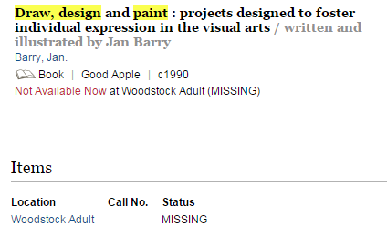
Spring Cleaning
Is it really that bad?
Well, yes & no
And Does it matter?
Yes, it does actually…

Slide 65
Spring Cleaning
Is it really that bad?
Well, yes & no
The problem data is in there, but it is not as bad as it seems.

Slide 66
Spring Cleaning
Is it really that bad?
Well, yes & no
The problem data is in there, but it is not as bad as it seems.
Don’t let yourself become mired in all this negativity -

Slide 67
Spring Cleaning
Is it really that bad?
Well, yes & no
The problem data is in there, but it is not as bad as it seems.
Don’t let yourself become mired in all this negativity –
Pause…

Slide 68
Spring Cleaning – Patron Records
We have looked at Item records, how about the patron records?

Slide 69
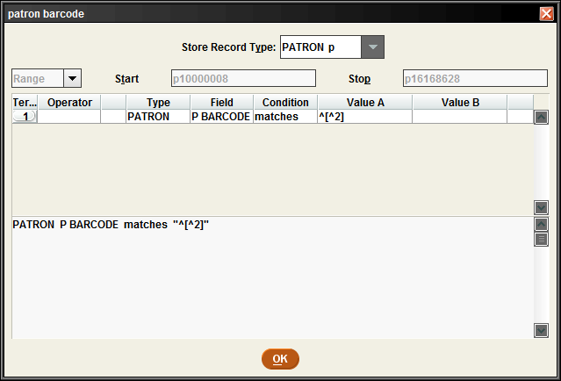
Spring Cleaning – Patron Records
We have looked at Item records, how about the patron records?
Patron barcodes?

Slide 70
Spring Cleaning – Patron Records
We have looked at Item records, how about the patron records?
Patron barcodes?
This was not bad, actually

Slide 71
Spring Cleaning – Patron Records
We have looked at Item records, how about the patron records?
Patron barcodes?
This was not bad, actually – But a few issues
P BARCODE lost2 6022 00011 2817

Slide 72
Spring Cleaning – Patron Records
We have looked at Item records, how about the patron records?
Patron barcodes?
This was not bad, actually – But a few issues
P BARCODE lost2 6022 00011 2817
P BARCODE nogood28024000065332

Slide 73
Spring Cleaning – Patron Records
We have looked at Item records, how about the patron records?
Patron barcodes?
This was not bad, actually – But a few issues
P BARCODE lost2 6022 00011 2817
P BARCODE nogood28024000065332
stolen2 2390 00038 2910do not honor

Slide 74
Spring Cleaning – Patron Records
We have looked at Item records, how about the patron records?
Patron barcodes?
Now, this one is not necessarily a bad idea – to indicate it stolen so it cannot be used by someone else
stolen2 2390 00038 2910do not honor

Slide 75
Spring Cleaning – Patron Records
We have looked at Item records, how about the patron records?
Patron barcodes?
Now, this one is not necessarily a bad idea – to indicate it stolen so it cannot be used by someone else
But it wont match any barcode in the database -
stolen2 2390 00038 2910do not honor

Slide 76
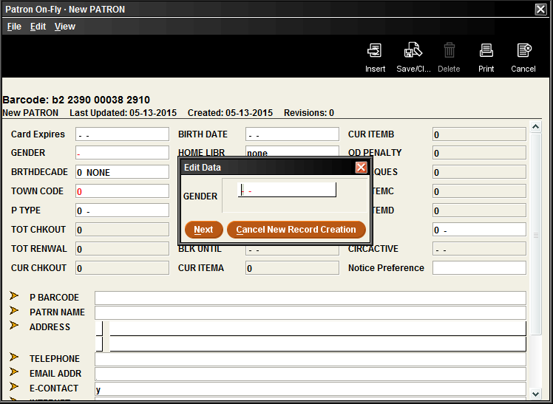
Spring Cleaning – Patron Records
We have looked at Item records, how about the patron records?
Patron barcodes?
And if scanned, will only bring up this

Slide 77
Spring Cleaning – Patron Records
We have looked at Item records, how about the patron records?
Patron barcodes?
Put STOLEN in the message field,

Slide 78
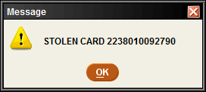
Spring Cleaning – Patron Records
We have looked at Item records, how about the patron records?
Patron barcodes?
Put STOLEN in the message field, that way it will ‘pop-up’ if someone tries to use the stolen card

Slide 79
Spring Cleaning – Patron Records
We have looked at Item records, how about the patron records?
Patron barcodes?
Lost Cards -

Slide 80
Spring Cleaning – Patron Records
We have looked at Item records, how about the patron records?
Patron barcodes?
Lost Cards –
“Click on the old barcode and move the cursor to the beginning of the field and type LOST CARD”
LOST CARD 2 2380 00019 2351

Slide 81
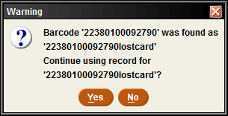
Spring Cleaning – Patron Records
We have looked at Item records, how about the patron records?
Patron barcodes?
Lost Cards –
“Click on the old barcode and move the cursor to the beginning of the field and type LOST CARD”

Slide 82
Spring Cleaning – Patron Records
We have looked at Item records, how about the patron records?
Patron barcodes?
Lost Cards –
If you put the LOST CARD indication at the end of the barcode instead…

Slide 83
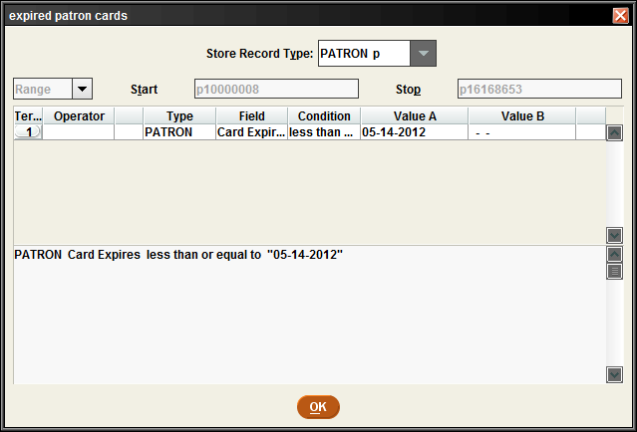
Spring Cleaning – Patron Records
We have looked at Item records, how about the patron records?
Expired cards?

Slide 84
Spring Cleaning – Patron Records
We have looked at Item records, how about the patron records?
Expired cards?
Currently 39,253 in the database

Slide 85
Spring Cleaning – Patron Records
We have looked at Item records, how about the patron records?
Expired cards?
Currently 39,253 in the database
In certain ways, these records are costing you money…

Slide 86
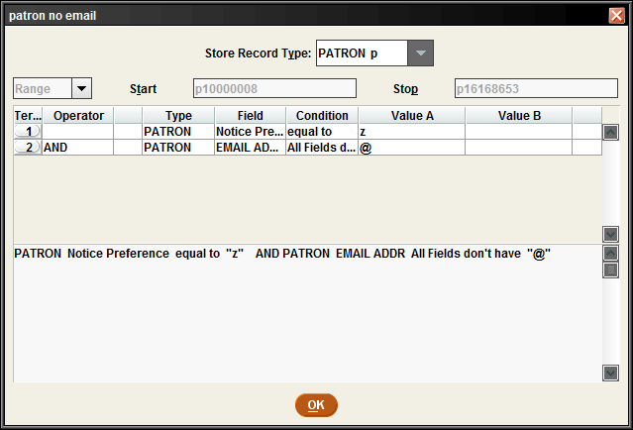
Spring Cleaning – Patron Records
We have looked at Item records, how about the patron records?
Contact preference?

Slide 87
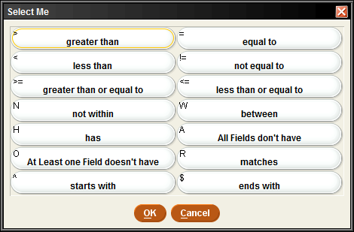
Spring Cleaning – Patron Records
We have looked at Item records, how about the patron records?
Contact preference?

Slide 88
Spring Cleaning – Patron Records
We have looked at Item records, how about the patron records?
Contact preference?
500+ in the database

Slide 89
Spring Cleaning – Patron Records
We have looked at Item records, how about the patron records?
Contact preference?
Most are missing email address
EMAIL ADDRESS | RECORD #
 | p10021656
 | p10101809
 | p10103387
 | p10118548
 | p10123337

Slide 90
Spring Cleaning – Patron Records
We have looked at Item records, how about the patron records?
Contact preference?
Some barcodes in email field
EMAIL ADDRESS | RECORD #
22913000071686 | p10708443
28032000052242 | p14667356

Slide 91
Spring Cleaning – Patron Records
We have looked at Item records, how about the patron records?
Contact preference?
Some not formatted correctly
EMAIL ADDRESS | RECORD #
DASCHREIBYAHOO.COM | p10582538
jhall17.hvc.rr.com | p14896837
jlr1086Ahotmail.com | p10955963
kbgriswo5yr.edu | p14885220
kingueriaol.com | p10270565

Slide 92
Spring Cleaning – Patron Records
We have looked at Item records, how about the patron records?
Contact preference?
And then this…
EMAIL ADDRESS | RECORD #
nancy12589excite.com | p13310094
nmballouyahoo.com | p14643431
y | p14967108

Slide 93
Spring Cleaning – Patron Records
We have looked at Item records, how about the patron records?
Contact preference?
And then this…
EMAIL ADDRESS | RECORD #
nancy12589excite.com | p13310094
nmballouyahoo.com | p14643431
y | p14967108

Slide 94
Spring Cleaning – where to go from here?
Now what?

Slide 95
Spring Cleaning – where to go from here?
Now what?
I would love this presentation to be obsolete

Slide 96
Spring Cleaning – where to go from here?
Now what?
I would love this presentation to be obsolete
Most important is to know your collection

Slide 97
Spring Cleaning – where to go from here?
Now what?
I would love this presentation to be obsolete
Most important is to know your collection
And start searching…

Slide 98
Spring Cleaning
Questions ?

Slide 99
Spring Cleaning
Thank you…

