Slide 1
DIY DEI Analysis
Jeremy Goldstein
Data Curation Librarian
jgoldstein@minlib.net

Slide 2
About Jeremy
Librarian for 15 years
With MLN since 2017
All but a year of that time has been on Millennium/Sierra
Originally a cataloging/acquisitions person now handle misc. database projects

Slide 3
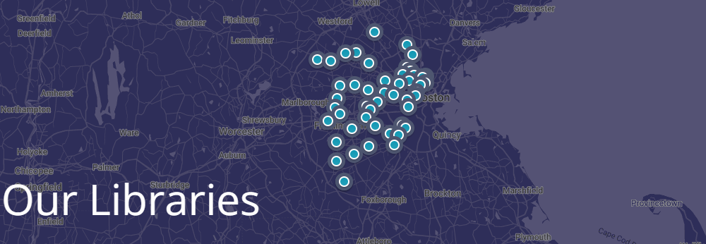
About Minuteman
Minuteman Library Network
41 Member consortia
MetroWest area outside Boston
Both Public and Academic members

Slide 4
Background
Aug 2021 Members became interested in CollectionHQ DEI audit report
Sep 2021 Received Overdrive DEI Audit
Increasing number of webinars on the subject and generally growing demand among members
Opted to build our own tools

Slide 5
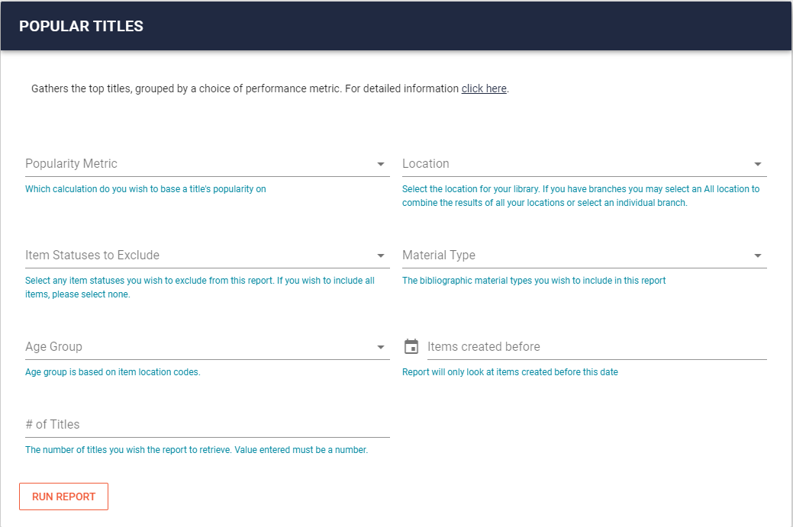
Report Builder
Notes:
We already have a site for providing staff access to canned SQL queries. Would use this as the primary means of making reports available

Slide 6
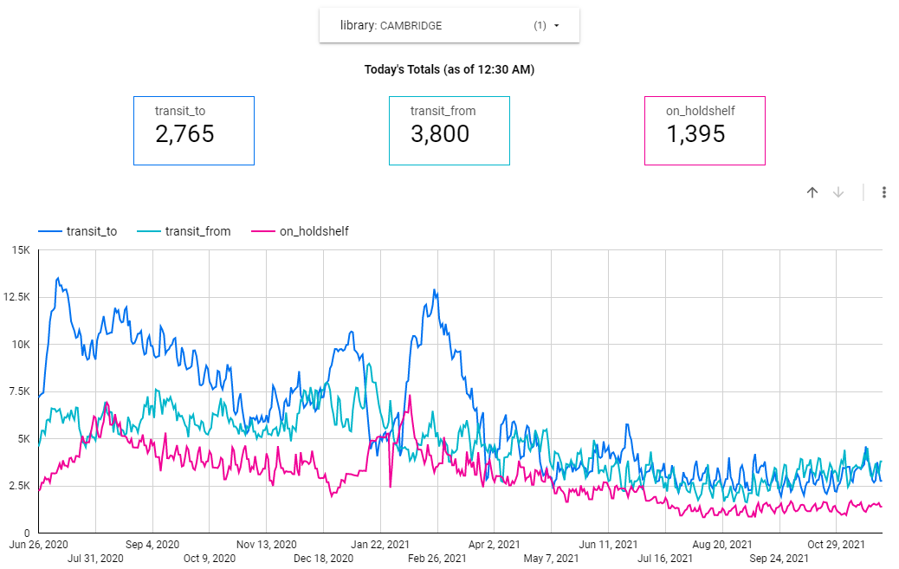
Google Data Studio
Notes:
Over the course of the pandemic had become heavily reliant on Data Studio for providing libraries stats and planned to build a DEI dashboard to supplement

Slide 7
Approach
Phase 1: Report Builder DEI Analysis
Phase 2: Collection Development tools
Phase 3: Data Studio Dashboard
Phase 4: Curated collection tool
Phase 5: Refinement
All queries and scripts are available on Github
https://github.com/jmgold/DEI-Collections

Slide 8
Phase 1: Diversity Analysis
Notes:
Aspiration goal was to build something like this, similar to reports advertised by various vendors and what fulfilled the immediate demand of our libraries. We’ll see more on this particular display in a bit, but that’s getting ahead of things.

Slide 9
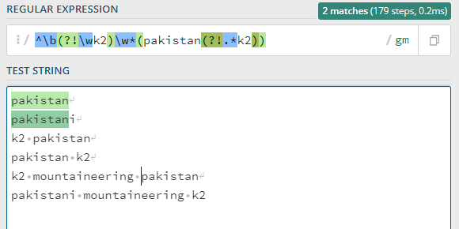
Phase 1: Diversity Analysis
Defining Topics
Used topics from vendor tools as starting point
Search LC subjects via a lot of RegEx matching
https://regex101.com seen here
Notes:
CollectionHQ/Overdrive reports use BISAC, which we lack.

Slide 10
Parsing Subjects
https://regex101.com seen here
Notes:
Phrase_entry table contains normalized text of fields used for Sierra indexes
Search against the subject portion of that, it’s indexed so it’s fast, and the normalized text removes issues of handling special characters and capitalization. You do however lose MARC tags
Besides using this sort of logic to exclude obviously unwanted topics like mountaineering, also striped out things like Islamic Fundamentalism or the wars in Afghanistan, Iraq, Vietnam and Korea where such titles were technically but more often than not about American perspectives
Then it’s a lot of regex

Slide 11
A LOT of RegEx

Slide 12
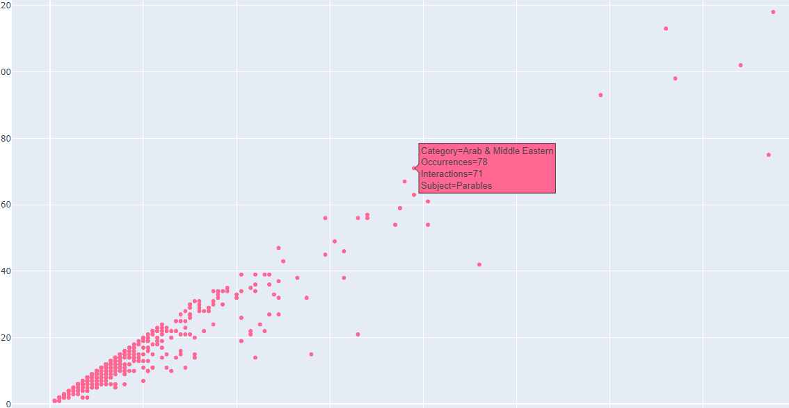
Topic testing
Kate Wolfe of the Cambridge Public Library built subject interaction charts to help
Notes:
Spot overlapping subjects to add to topic and outliers/errors to exclude
Here Parables was accidentally being pick up by the Arab & Middle Eastern topic
Make corrections, pull new data, repeat until happy

Slide 13
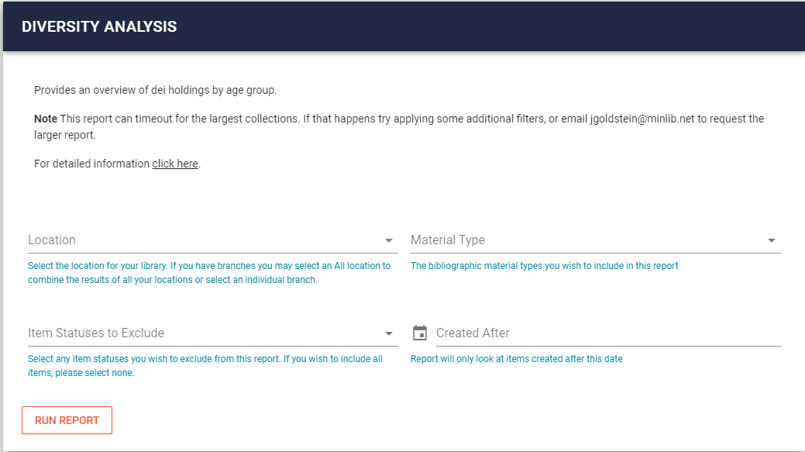
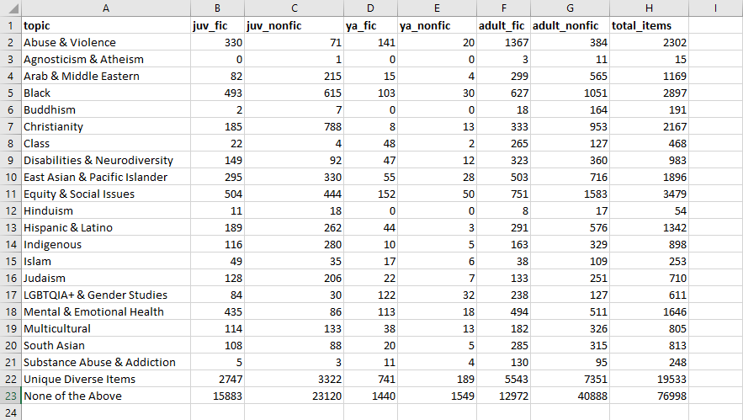
Full query available
Replace variables in {} with your selections
J/YA/adult columns based on our location code structure
Notes:
Items can exist in multiple categories, case statement in query is roughly in ascending order of subject frequency so lesser used topics are given preference, which Christianity last as the not necessarily diverse topic in the list
Within the report builder query needs to run in under 5 minutes, which it mostly does (exception being if our largest library chooses to run this against their entire collection, that runs about 30 seconds over).
Issues: Abuse and Violence includes nearly all mystery/crime/horror titles. East Asian includes most Manga

Slide 14
Phase 2: Collection Dev Tools
Notes:
Now that we have a way to assign records to these topical categories we can reuse that portion of our query for other reports.
Collection Dev, Popular Titles and Unowned were all reports we already had within our report builder and we just had to adapt them to use this data.

Slide 15
Collection Development Report
Query available here
Notes:
We’ve run this report monthly for our libraries by scat code to provide a high level overview of collection performance, contains every metric we could think of that could be calculated purely using item record data. Due to the lack of circ_transaction data we have all the middle columns that break out circ by last checkout date.
Relative totals columns at the end are the truly helpful ones.

Slide 16
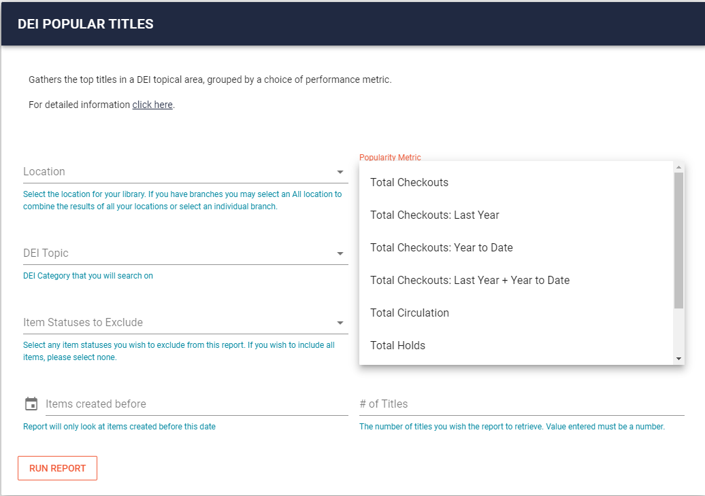
Popular Titles
Query available here
Notes:
Simply lists out the x titles with the highest popularity (defined by choice of metric as seen here). Now the DEI topics are one of the possible filters instead of being a part of the output.

Slide 17
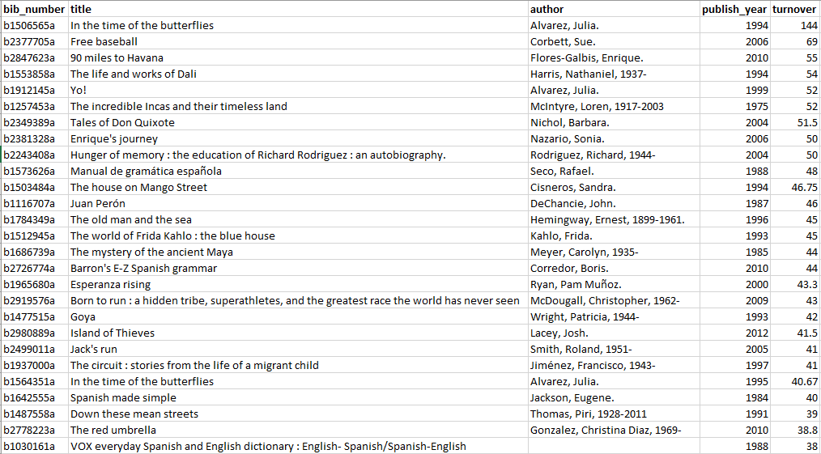
Unowned Report
Query available here
Notes:
Top Hispanic/latino titles by turnover not owned by Arlington

Slide 18
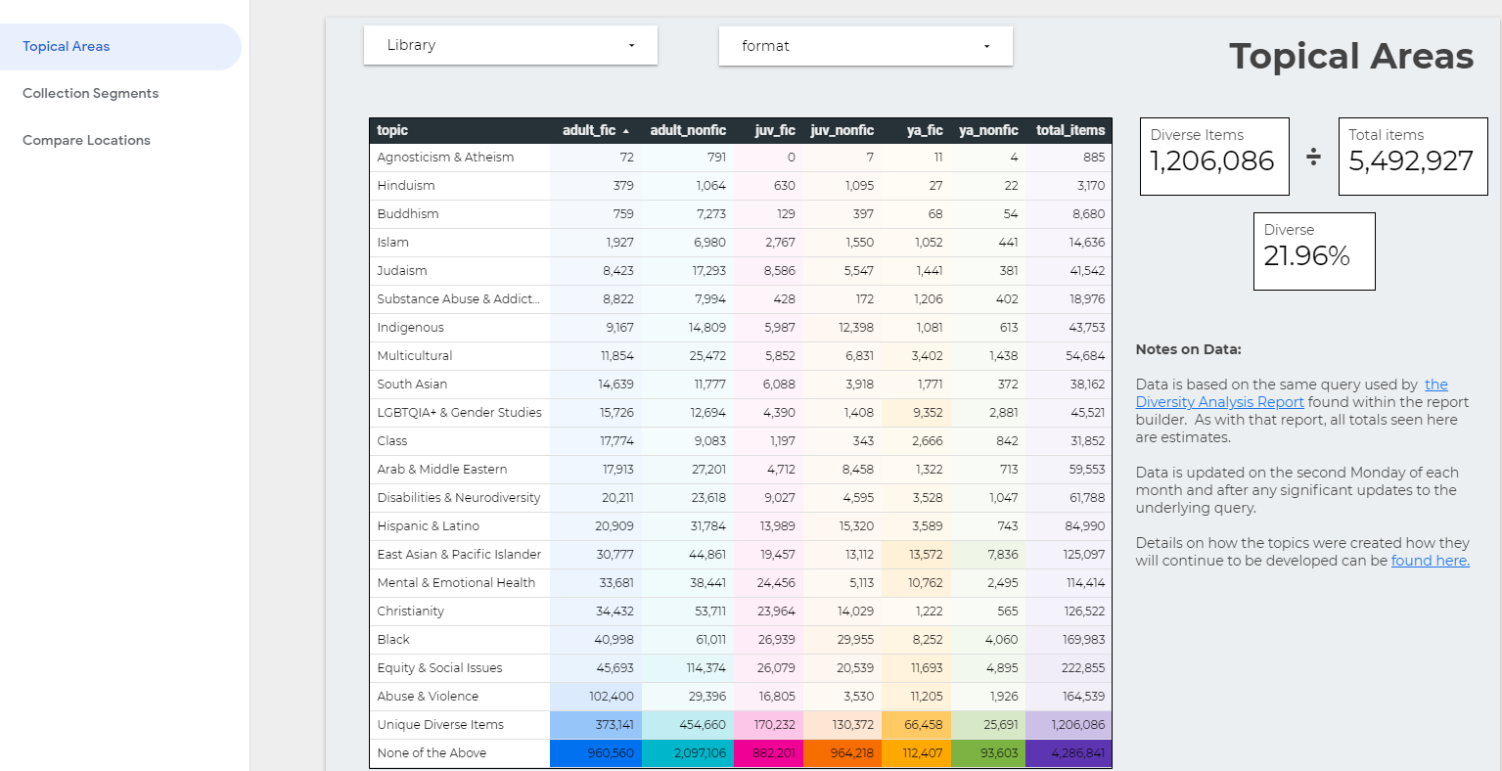
Phase 3: Data Studio

Slide 19
Crafting Charts
Notes:
Settings for the fiction pie chart

Slide 20
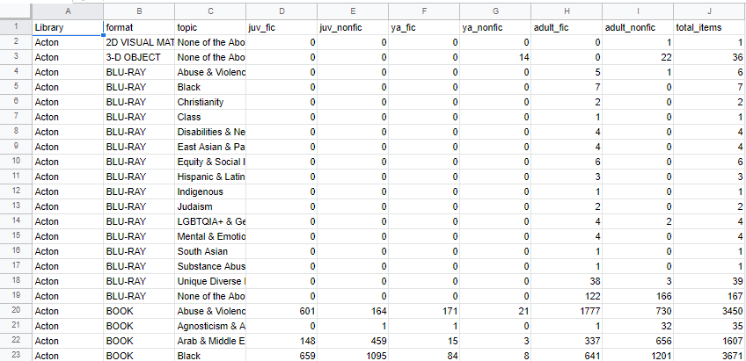
Data Source
Notes:
Single Google sheet behind the dashboard. Essentially the Diversity analysis query seen before, just with columns added for library and format in order to provide filtering options

Slide 21
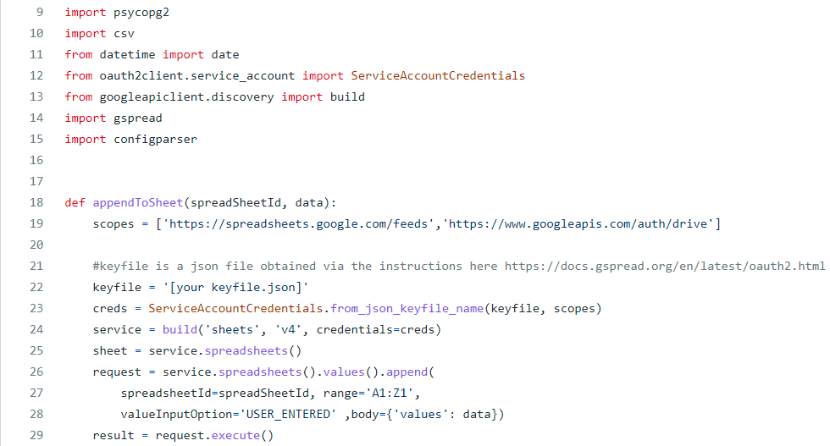
Automating Dashboard
Script available here
Notes:
Script takes about 2 hours to run for all of our libraries, so we have it currently set to update once a month
Uses gspread library working with the Google Sheets API to append new data to our desired spreadsheet

Slide 22
Automating Cont
See Gem Stone-Logan’s 2018 Presentation Automating Reports with Python for more
Notes:
Script really starts at line 265, the existing spreadsheet is opened and all rows minus the headers are cleared, then the main function is called once for each location
In the main function our a function called runquery is called to run or DEI analysis query for the specified library, and then the results of that are sent to the appendToSpreadSheet function from the prior slide
The whole script is then called by a .bat file and that in turn is triggered to run monthly by Windows Task Scheduler

Slide 23
Phase 4: Curation Based
Problems with existing tools
No data for what our database lacks
Catalog records are a poor source for some DEI information
Anything pertaining to the authorship of a work
Problem to address
How to match data from non-library sources

Slide 24
Data
List of holdings
csv or Excel File containing titles, authors and a unique identifier such as record number
Title list
csv or Excel file of titles and authors from external source
Notes:
Lists could be in other formats so long as you can wrangle them into a Pandas Dataframe in Python. These are simply the easiest options for most end users.

Slide 25
Fuzzy Matching Strings
Fuzzy Matching at Scale by Josh Taylor
Based on Term Frequency, Inverse Document Frequency (tf-idf) commonly used with natural language processing
Breaks words into 3 character trigrams, counts occurrences of each one and inverse weights them by frequency (‘the’ scores low so it’s not significant for matching)
Can then compare those trigrams across records
Notes:
No I don’t actually follow how quite how all that works either, but I don’t have to as Josh happily shared his code.

Slide 26
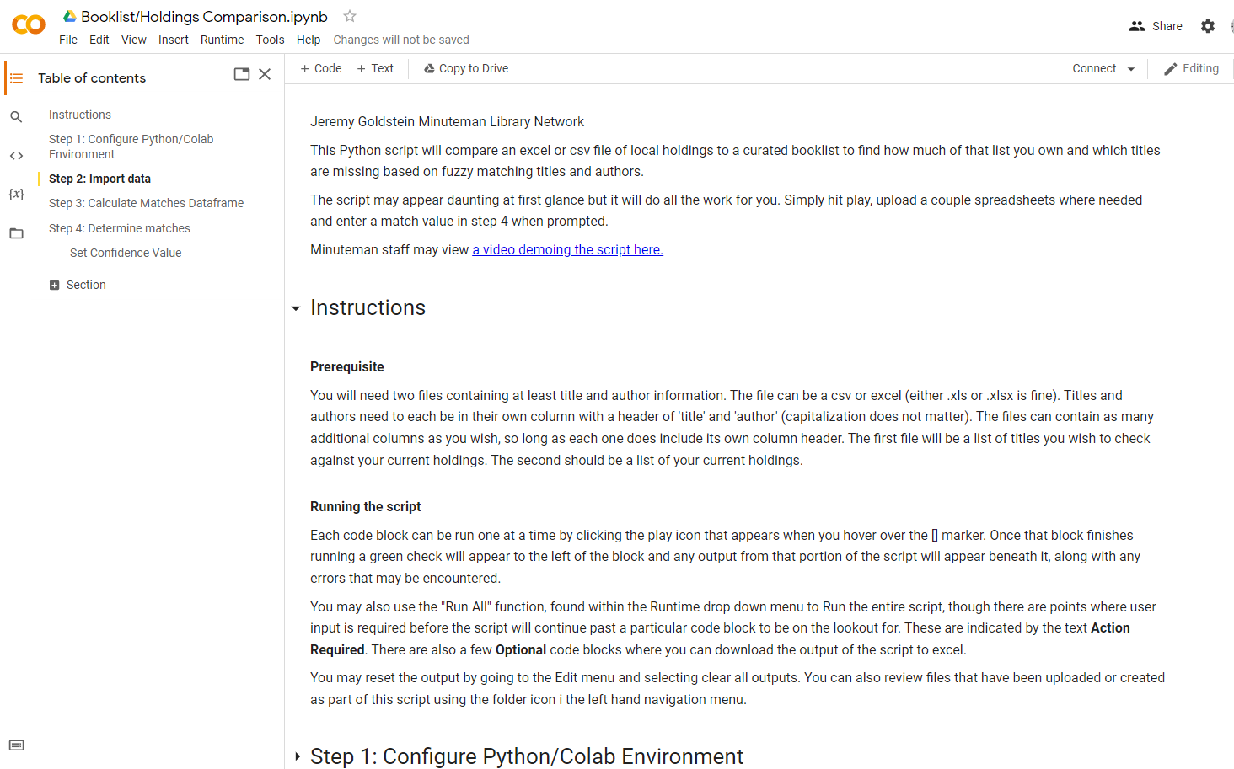
Google Colab
Try the script here
Notes:
Script will open in view mode so you may safely run it without impacting the experience for other users. You may expand any section to view the underlying code if you wish. You may also make a copy of the script if you wish to experiment with the code and make and modifications.

Slide 27
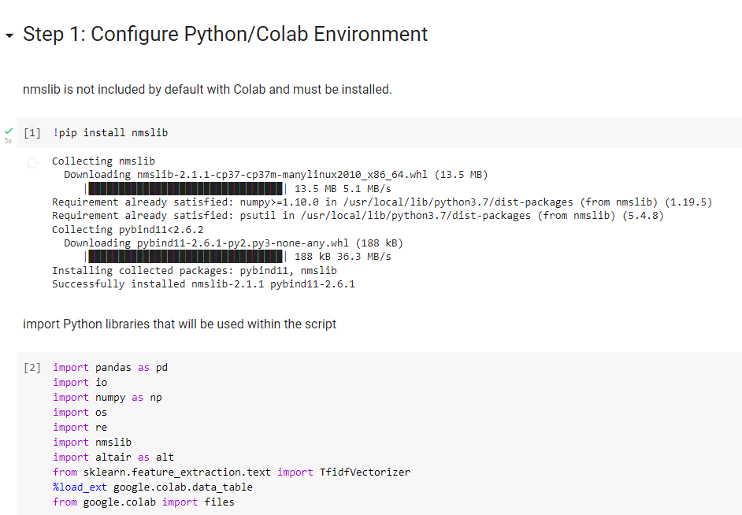
Notes:
Upon running the first code block you will see a pop-up message warning you about running a script from an unknown source (me) and asking for approval to run it anyway.

Slide 28
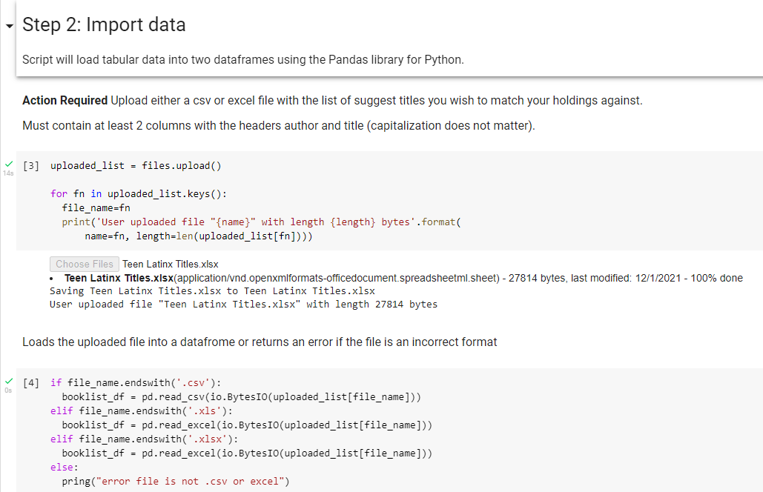
Notes:
Up

Slide 29
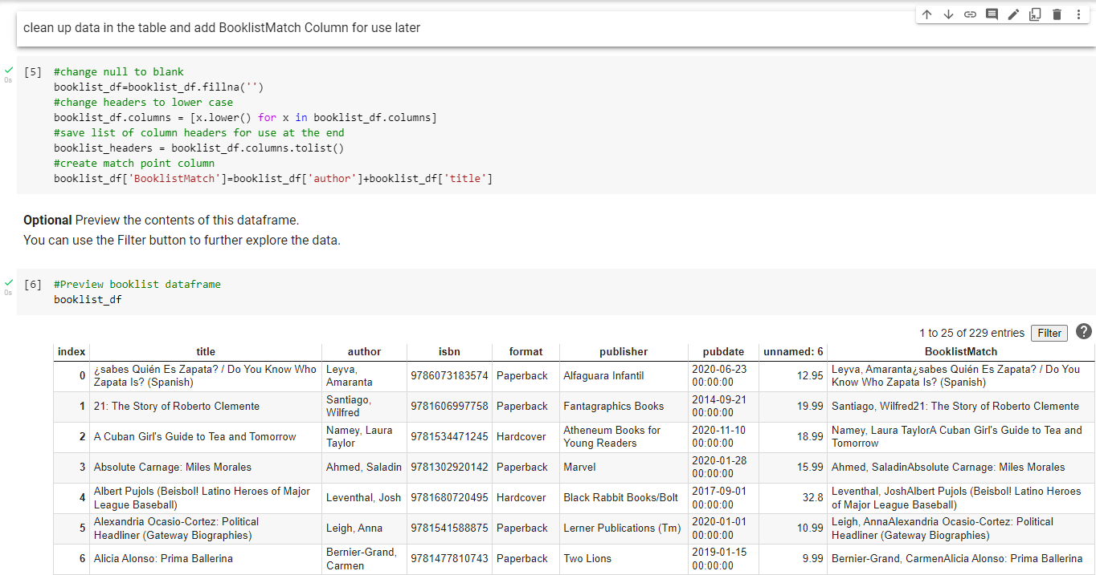
Notes:
Repeat for file of holdings, exported from create list in this demo
List of 229 Latinx teen titles from Ingram compared to holdings file of 30K records from Sierra

Slide 30
Notes:
Matches calculated in just over 3 seconds. Still don’t know how this works so well.

Slide 31
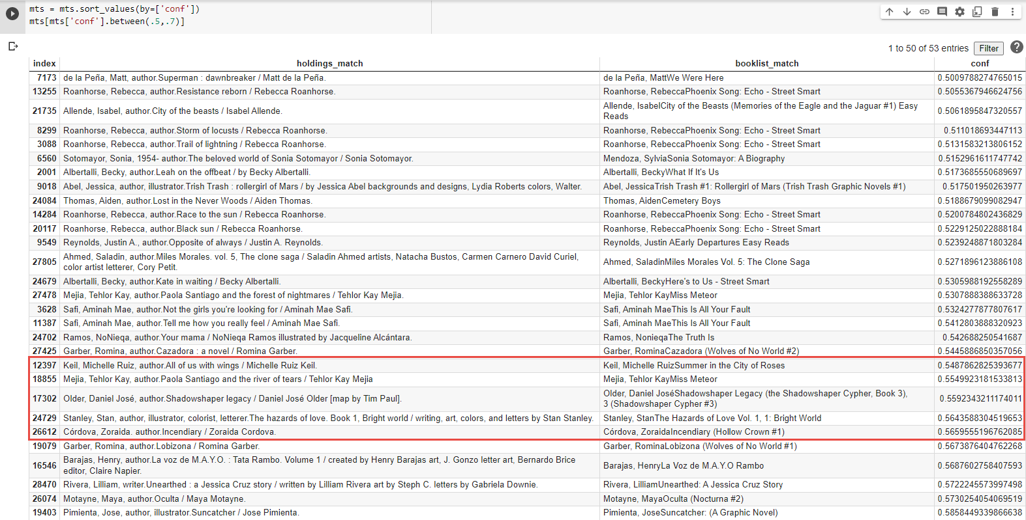
Identify Match Point
Notes:
For this data set, .559 seems to be the point at which the conf. value indicates a correct match. Shadowshaper Legacy and titles after it in the list seem to be correct matches while pair preceding it are less reliable.

Slide 32
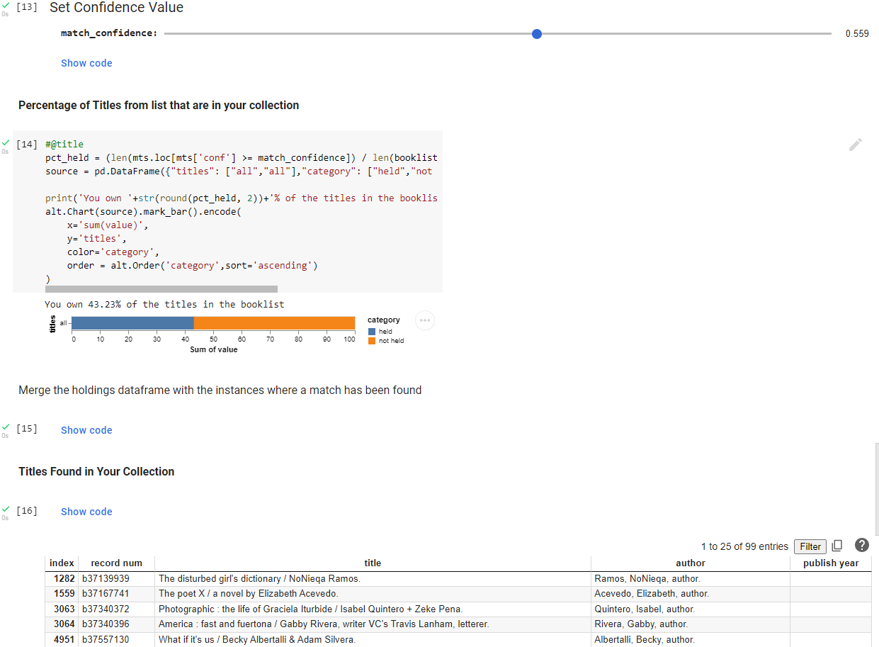
Notes:
Use slider to set confidence value to use for determining correct matches, based on browsing the results of the prior step

Slide 33
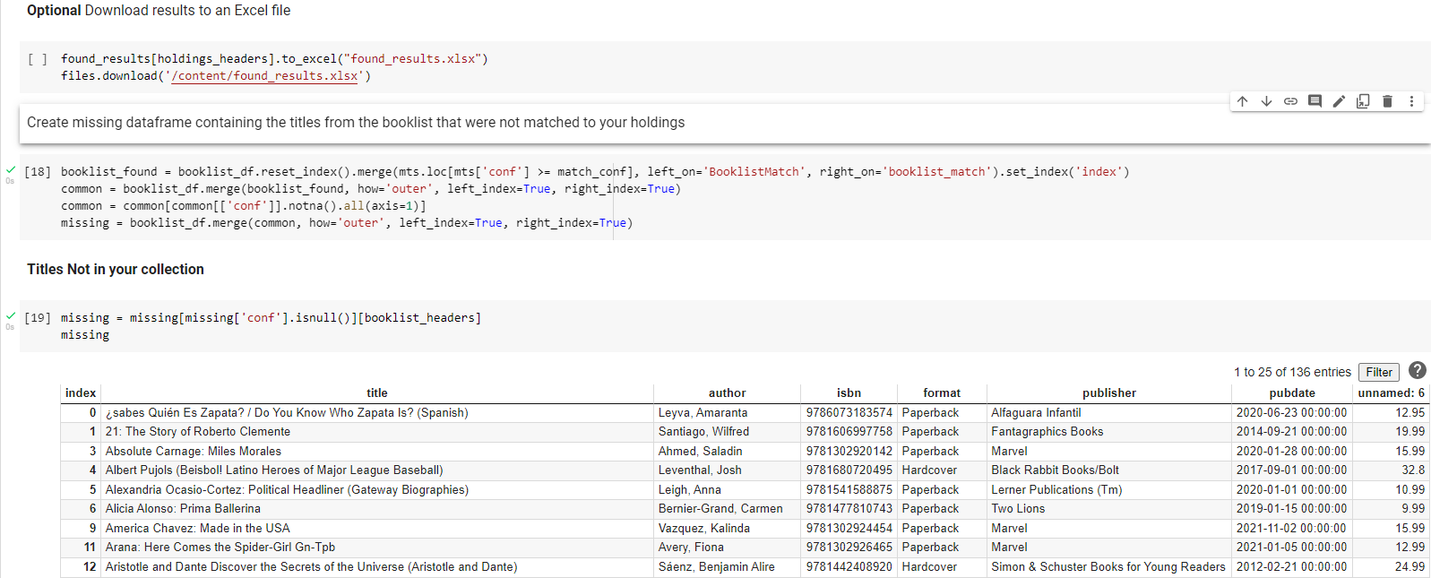
Purchase Suggestions

Slide 34
Use Cases
Compare holdings to curated list of representative diverse titles
If collection lacks x% of these in an area, that is an area in need of further development
Duplicate check purchase suggestions
Ingram provides some excellent lists of recent titles

Slide 35
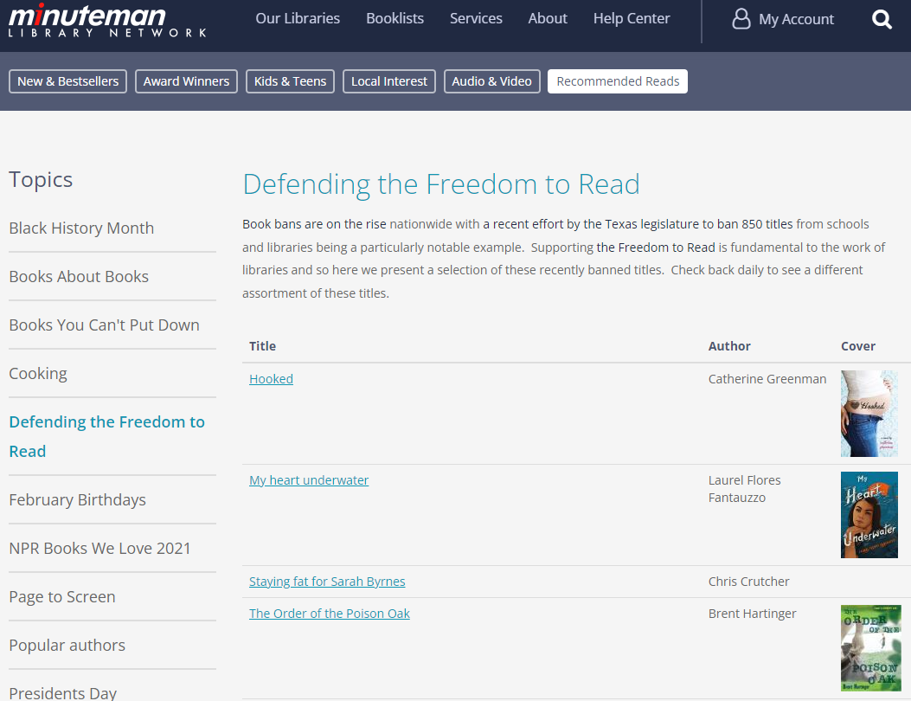
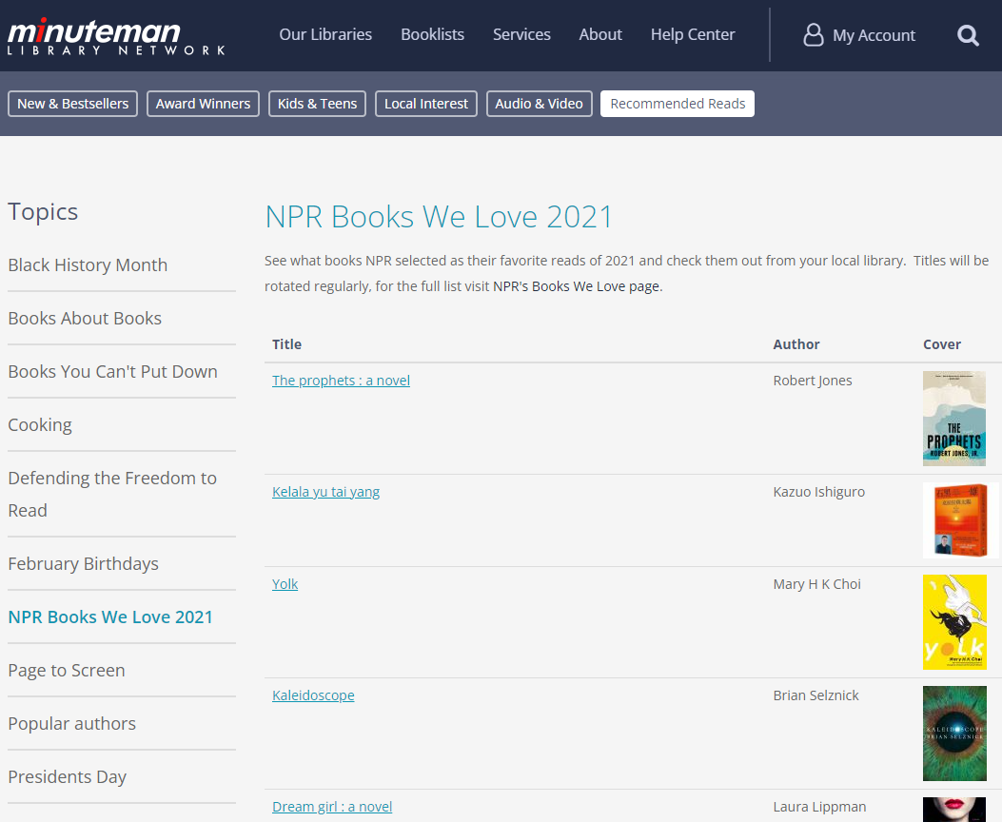
Other Uses
Notes:
When NPR released their Books We love list for the year (formerly the book Concierge) we were able to quickly match their list against our holdings to pull together this list with a minimal amount of effort. We also found a helpful list of the banned books that were proposed by the Texas legislature and built a list around those titles.

Slide 36
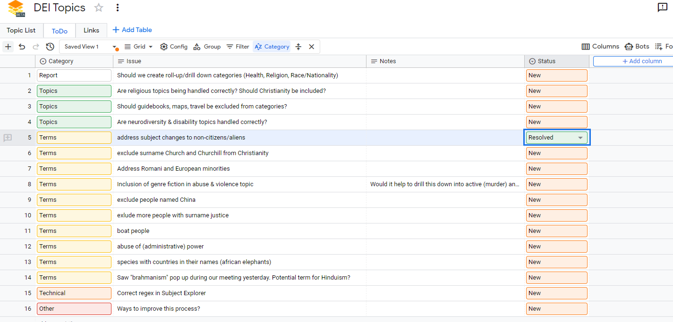
Next Steps
Formed a DEI Reports Task Force to refine our tools
Notes:
Using Google’s Beta Tables product to track and discuss issues and developments

Slide 37
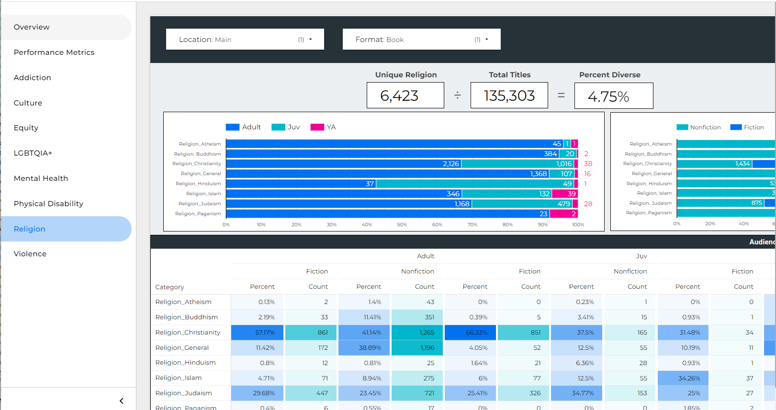
Considering Hierarchies

Slide 38
Jeremy Goldstein
jgoldstein@minlib.net
https://github.com/jmgold/DEI-Collections

