Slide 1
Automating Booklist Curation With SQL
Jeremy Goldstein
Data Curation Librarian
Minuteman Library Network

Slide 2
Who Am I?
Cataloger & Acquisitions Librarian turned self-taught data enthusiast
Minuteman Library Network
41 Member consortia
MetroWest area outside Boston
Both Public and Academic members
This is Rufus #DogsOfIUG
Notes:
First a bit of context. I am the data curation librarian at the Minuteman Library Network outside Boston. We’re made up of 41 member libraries, both academic and publics, with a fairly wide variety of local needs. It’s also worth noting that my own background is in tech services and acquisitions. So the sorts of skills we’ll be covering here are ones that can absolutely be learned on the job. And this is Rufus. He’s a Catahoula Leopard Dog and I bring him up to curry favor and because I got a lot of joy last year out of the DogsOfIUG thread that started up on the last day of last year’s conference and this seemed like the best chance to start that again.

Slide 3
Background
October 2017 formed web redesign taskforce to update public and staff web pages
Design was last refreshed in 2013
In discovery found that our booklists received the most traffic beyond our home page by far
Had begun to pursue automated lists for our old site and wished to expand on those efforts
Notes:
This presentation is going to cover work that began as part of the overhaul of our public website. We formed a taskforce to update both our public and staff sites in October of 2017. As part of the discovery phase of that project we looked at our sites analytics and found that the booklists we were maintaining were far and away the most visited portion of the site, other than the home page. In FY18 the next most visited page had less than half the traffic of the booklists. Around this time I had also begun to do some experiments with automating booklist pages based on a presentation given by Gem Stone Logan at the 2017 IUG (https://www.gemstonelogan.com/presentations.html)

Slide 4
Prior Website
Lacked a content strategy
Overwhelmed by awards lists
More popular lists fell to bottom of navigation
Notes:
To give you a taste of our old site, this is how we were presenting our booklists there. We had one long list, which was predominantly made up of various awards. But we lacked a content strategy for them. In this screen shot you can see a number of Mystery awards, but we didn’t have lists for other genres. We had a few random lists such as the working together for justice one, which was I believe was a one off produced by YALSA and which was never intended to be a permanent fixture like it became here. And then there were the more current lists on our site such as the bestsellers and especially the top requests list that wound up falling to the bottom of this page where they were quite difficult for patrons to find. Despite these flaws this portion of our site was still clearly successful for us.

Slide 5
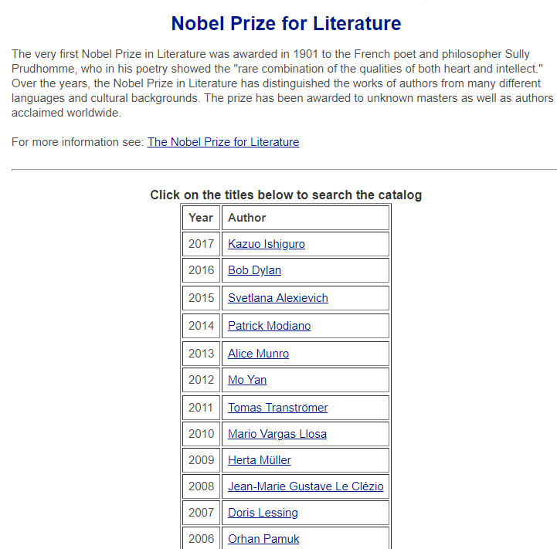
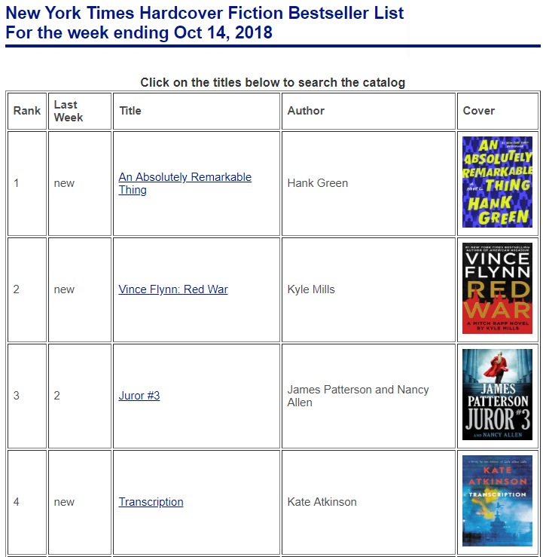
Prior Website
Notes:
Within the individual lists themselves you can also see the degree of variation that existed from list to list. Because there was not a firm plan in place to create these they tended to be updated when we remembered, or happened to catch an item in the news. So going forward we needed more of a style guide and an overall maintenance plan. Now before I more on its worth pointing out the NY Times bestseller list here on the right. That was our first successful automated list and very much a guide for our development.

Slide 6
New Website
Developed by
Launched Oct 2018
Booklists are now featured prominently
Notes:
Here you can see the website we eventually launched this past October. The site was built by the Atom Group, a web development firm based out of Portsmouth NH, using Drupal. As you can see our booklists were placed extremely prominently on the site, being the first thing you see on the home page and the second entry in the header after only the list of our libraries. That header is mirrored in Encore so these lists now have a spotlight across our platforms, and given the focus we now had an even greater need to properly maintain them

Slide 7
Goals for new site
Regularly provide new content
Limit staff time necessary for curation
Diversify lists
More formats, backlists, diverse authors and subject matter
Maintain design standards
Notes:
So we developed goals for the lists on the site. We need to provide regularly updated content to give patrons a reason to return to the site on a regular basis. We wanted to keep the staff time necessary to maintain these lists to as little as possible. We wanted to diversify the lists however we could. Our old site merely showed popular titles and books that won awards in fairly narrow areas. But on the new site we wanted to promote more formats, more authors, more subjects and just generally call attention to titles that actually needed the added publicity to aid patrons in discovering them. And finally we wanted to try our best to follow a consistant style guide across lists.

Slide 8
List types
Static Lists (drag and drop editor)
NYT Books API lists
SQL based
Data driven (new items, trending items)
Lazy curation (staff picks, books adapted to film)
Topical
Some are permanent (Mass Travel guides) most are temporary (Queen Victoria’s 200th Birthday)
Notes:
So what we came up with were a five different types of booklists that we would mix and match to accomplish our goals. And we’ll cover each of these in turn, with the main focus being on the 3 SQL based types.

Slide 9
Static Lists
Use Drupal drag and drop editor
Large investment of staff time
Only use with lists requiring few updates
Awards lists
Notes:
First of all we have static lists, which are created using the drag and drop editor in our Drupal instance. These lists are created manually and thus are the most labor intensive on an ongoing basis, largely just due to having to build in all the links to Title and author searches in Encore, as well as generating the cover images, which we do through Syndetics. The drag and drop editor is also incredibly finicky to work with, which doesn’t help matters. However, they do also come out looking the nicest, as we simply have more control over the page design than we do when using automated means for generating pages. Because of all that we limit these sorts of pages to just covering the various awards lists, as they require some custom arrangement on a page and only need an update once a year. To help maintain them I maintain an awards calendar that I check regularly. The vast majority of these lists migrated over from our old site, but in order to meet our diversification goal we did add quite a few to add depth to the site, the Stonewall, the Eisner, various awards for non-mystery genres, etc…

Slide 10
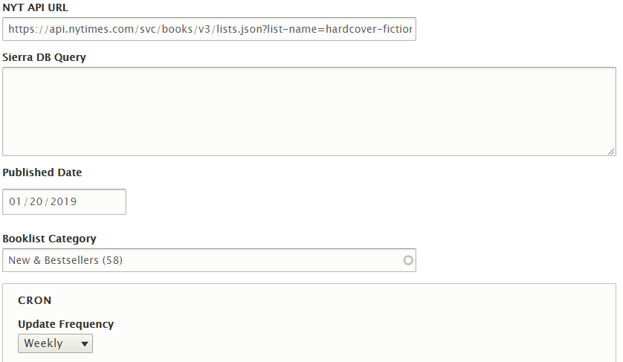
NYT Books API
Atom built custom booklist module
Run weekly via cron job
Defined most fields used to populate lists in new site
Notes:
Next we have lists that are built using the NY Times books API. These also migrated over from the prior site, with the big caveat that Atom built us a custom tool for generating these pages, which in the course of development wound up being shared with the SQL generator we wanted. (click) Here you can see the back end of the system in which there are simply two possible fields to enter data into. Either we can plug in an API call for the NYT API, or we can enter an SQL query that pulls in data from our Sierra database. Then the reports simply run via a regular cron job that we can schedule hourly, daily, weekly or monthly. Ultimately we would like to be able to utilize other APIs as well, namely Overdrive’s but that requires further development to accomplish. Before moving on to the SQL part of the presentation there is one more important thing to gather from this slide. Because our site was set up so that the API and SQL based lists share a content type, they both must use the same data fields to store the information retrieved by this tool. So the Times API wound up having a large influence on our approach to producing other lists.

Slide 11
NYT Books API
For more information:
https://developer.nytimes.com/
Notes:
If you’re interested in learning more about using the Times API, check out the link here. As far as API’s go it actually makes for a fairly nice entry point, far easier than the Sierra APIs. It’s free to use so long as you obey their terms of service, which are fairly standard. Don’t modify content, don’t transform the fundamental meaning of the content, don’t archive the content, don’t give the impression that the Times endorses your site or content, and include one of the various branded images they provide on any page that displays their content.

Slide 12
SQL Lists
All queries online at:
https://github.com/jmgold/SQL-Queries/wiki/Booklists
Direct links to specific queries in slide notes
Notes:
Now that brings us at last to our SQL pages. For all examples shown here you’ll be able to find the query used to generate them on my github repository, which includes all queries we use. Additionally if you look at the slide notes in the presentation materials online you’ll find direct links to the query used on any given slide.
Top Requests List code available here: https://github.com/jmgold/SQL-Queries/blob/master/top%20requests%20list.sql

Slide 13
Booklist fields
Standard fields
Title
Encore Link
defaults to keyword if blank
Author
Cover Image
Using Syndetics
Needs ISBN or UPC
Optional Fields
Location
Format
Publication Date
Rank
Last Week Rank
Notes:
Earlier I mentioned that due to how Atom built the backend of our site we have a somewhat limited selection of fields we can use in the output of our queries. Here you can see the full list of what’s available. Fortunately in SQL it’s easy to relabel fields so it’s simple to map our output to these in most cases, though we are forced to stick with these as column headings. As one nice additional feature, Atom also built the Title fields so that by default it will link to a keyword search of Encore for whatever text is contained in that field. But that can be overridden by including an explicit link we wish to use in our output, say to a particular bibliographic record for instances where specificity matters.

Slide 14
The Basic Query
SELECT
'https://find.minlib.net/iii/encore/record/C__R'||id2reckey(b.bib_record_id) AS field_booklist_entry_encore_url,
b.best_title AS title,
REPLACE(SPLIT_PART(SPLIT_PART(b.best_author,' (',1),', ',2),'.','')||' '||SPLIT_PART(b.best_author,', ',1) AS field_booklist_entry_author,
(
SELECT
'https://syndetics.com/index.aspx?isbn='||SUBSTRING(s.content FROM '[0-9]+')||'/SC.gif&client=minuteman'
FROM sierra_view.subfield s
WHERE
b.bib_record_id = s.record_id AND s.marc_tag = '020' AND s.tag = 'a'
ORDER BY s.occ_num
LIMIT 1
) AS field_booklist_entry_cover
FROM
sierra_view.bib_record_property b
GROUP BY 1,2,3,4 ;
Notes:
Now with that in mind, here is the basic query which forms the backbone of the vast majority of our SQL based lists. By and large the specific lists we’ll be covering from here on out will all be built off of this, adding details and filtering but still relying on this piece for their output. The query here only requires 2 tables in Sierra, only requires 2 tables, bib_record_property and subfield. Bib_record_property provides us a title, author, and record number, which can be useful for generating Encore links, and subfield provides an ISBN or UPC, depending on the format of a title, which we use for generating cover images. Over the next few slides I’ll go over some of the more complicated bit of this, but to boil this down the query can be read as Output URL, title, author, cover FROM the bib_record_property table and provide a row for each unique set of those 4 fields. Now there aren’t any limits specified so if you ran this query as is, you’d wind up with a list of every title in your database. But before we get into that let’s dig into this just a bit further.

Slide 15
Parsing the best_author field
b.best_author | Sharma, Robin S. (Robin Shilip), 1964- author.
SPLIT_PART(b.best_author,' (',1) | Sharma, Robin S.
SPLIT_PART(SPLIT_PART(b.best_author,' (',1),', ',2) | Robin S.
REPLACE(SPLIT_PART(SPLIT_PART(b.best_author,' (',1),', ',2),’.’,’’) | Robin S
REPLACE(SPLIT_PART(SPLIT_PART(b.best_author,' (',1),', ',2),’.’,’’)||' '||SPLIT_PART(b.best_author,', ',1) | Robin S Sharma
Notes:
Here we are looking at a series of nested string functions I’m using to take the best author field, which is essentially a normalized 100 field from the bib record and parsing its elements so that I can display the author’s name in first name last name order with all punctuation removed. To accomplish this I’m using two string functions Replace, which is should be fairly self explanatory, and split_part, which lets you break up a single string into multiple substrings at a specified character. So first of all I’m splitting the field on a space followed by an open parenthesis, and taking part 1, the string up to that point, which effectively leaves us with the last name, first name and middle initial. Now I’m splitting that again, this time on a comma and a space in and taking the second part, providing us just the first name and initial. Next I use a replace function to replace the period with an empty string, thus clearing out the last of our punctuation. Finally I use concatenation, which you can shortcut using those two pipes you see here to add on a space and the last name that we had previously split off, resulting in the name formatted as you see here. This method isn’t flawless but it works for us in most cases. You could also build it into a case statement to control for other possibilities if working with a collection more prone to exceptions (band names).

Slide 16
Building a cover image link
(SELECT
'https://syndetics.com/index.aspx?isbn='||
--Use substring to pull only the numeric characters from the field
SUBSTRING(s.content FROM '[0-9]+')||'/SC.gif&client=minuteman'
FROM sierra_view.subfield s
--linking to Marc field 020 |a to isolate ISBN
WHERE
b.bib_record_id = s.record_id AND s.marc_tag = '020' AND s.tag = 'a‘
--Order by occurrence and limit to 1 result to find first ISBN in record
ORDER BY s.occ_num
LIMIT 1) AS field_booklist_entry_cover
Notes:
The other somewhat complicated piece of our basic query is this chunk in which we are pulling an ISBN, or possibly a UPC code of av materials, in order to make a call to syndetics for a cover image. This is accomplished via a subquery to the subfield table in our select statement. Essentially we are selecting a content field from and 020 subfield a, which we have limited to via this where clause. We then order all the results, as their could be more than one ISBN on a given record, by their order of occurrence, and limit to just taking the first entry. So with that our select statement will only output a single 020 subfield a. However, we still need to manipulate that field a bit as what we need to get from this is ultimately a url. So we use the substring function and a regular expression to take only numeric characters from that field, as their can be a lot of non-standard qualifiers unfortunately. And then we use some concatenation, which we saw when we were building our author field on the last slide to place the resulting string into the url we wish to use.

Slide 17
Optional Filters
WHERE
b.material_code = 'a'
b.publish_year >= ‘2009’
item_record.is_available_at_library = ‘TRUE’
item_record.item_status_code NOT IN ('m', 'n', 'z', '$', '!',…)
SUBSTRING(item_record.location_code,4,1) NOT IN ('j','y')
bib_record.bcode3 != 'g'
ORDER BY SUM(item_record.checkout_total) DESC
ORDER BY COUNT(bib_record_item_record_link.item_record_id) DESC
LIMIT 50
Notes:
So now that we have our basic query, we can add on to that to start producing actual title lists. We’ll get into specifics in a moment but first here are some basic filtering options that can come into play for many such lists. Sticking with just the bib_record_property table we are already using you can limit to material types and publication years. If you link out to the bib_record_item_record_link table you can find a count of item records to help spotlight titles with a decent supply. From there you can also link out to the item_record table to build in location, availability, status, and total checkout based filters. It’s also good to always keep in mind the limit feature to control the size any list being generated. These are just a few examples of what is possible.

Slide 18
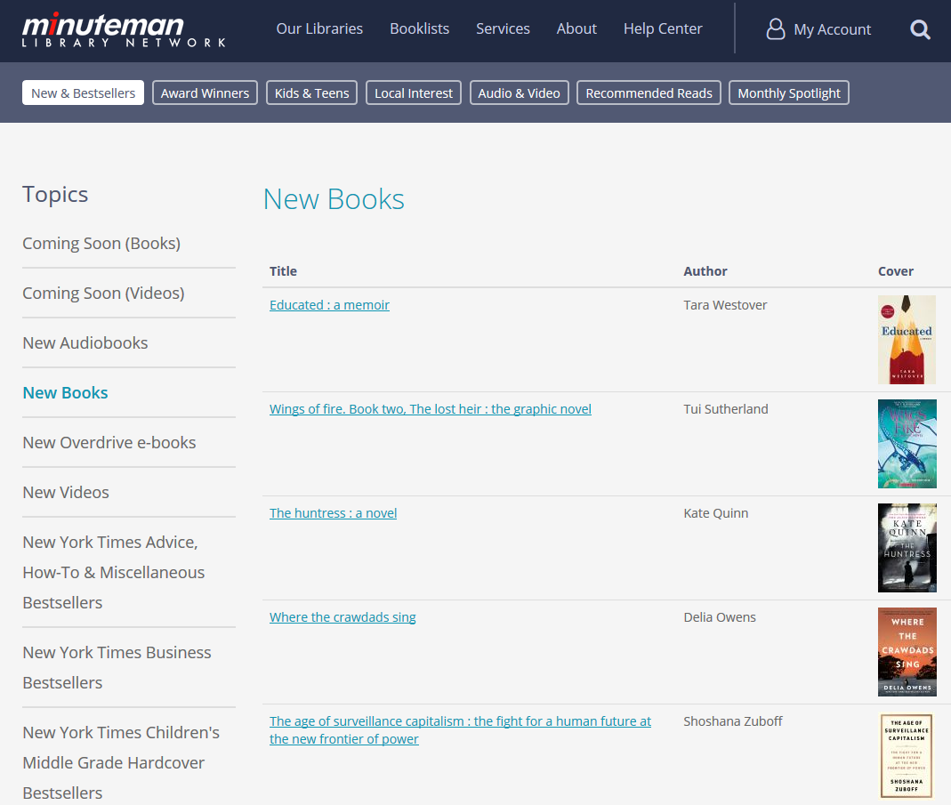
Data Driven Lists
New Titles
Coming Soon Titles
Top Requests
Trending Titles
Top Request By Location
Books You Can’t Put Down
Notes:
So now we’re finally ready to look at some specific report examples. If you recall from earlier I broke up the SQL queries we use into 3 basic types, first of which are data driven lists. These are reports that based around metrics in the system, such as the new book list shown here, which is looking at record created dates. Data driven lists form the backbone of our automated reports as their contents naturally update frequently and are sure to provide new content, for the most part, when patrons come back to them later. However, it’s easy to fall into the trap of just looking at new or popular titles, which can look nearly identical in a lot of cases, so to diversify these lists you want to think up some more creative data sets as well. Let’s take a look at a few of these.
Code for new book list is available here: https://github.com/jmgold/SQL-Queries/blob/master/new%20books%20list.sql

Slide 19
New Item List
JOIN sierra_view.bib_record_item_record_link bi
ON
b.bib_record_id = bi.bib_record_id
JOIN sierra_view.record_metadata m
ON
bi.item_record_id = m.id AND m.creation_date_gmt > (localtimestamp - interval '4 days')
Notes:
Here we see the additional code added to our basic query in order to make a new item list. We join our bib_record_property table to the bib_record_item_record link table, which contains all instances where there is an item attached to a given bib record. Then from there we join the record_metadata table in order to find the creation date of each item record. With that we can build a filter, in this instance ensuring that only items where the created date is greater than 4 days ago are returned. We have opted to set the filter to 4 days in order to ensure that the list is still populated when we hit a 3 day weekend when no work is conducted. If you wanted to make a coming soon list, all you would have to do is link out to order records instead of item records, and you could otherwise follow the same basic query.

Slide 20
Top/Trending Titles
JOIN
sierra_view.hold h
ON b.bib_record_id = h.record_id
--Include date filter to make trending titles
WHERE h.placed_gmt > (LOCALTIMESTAMP -
INTERVAL '2 days')
ORDER BY COUNT(h.id) DESC
Better but more complicated version available at
https://bit.ly/2IJg88I
Notes:
Along somewhat similar lines, here we have a simplified version of our top and trending titles reports, which look at holds placed as a measure of popularity. In this case we link to the holds table, optionally limit to holds placed within a certain time frame, and then order the records by the number of holds placed on each one. What is essentially a single query produces two surprisingly different lists. As I said this query would work, but not particularly well as it is only accounting for holds placed at the title level. If you look at the code we actually use via this link you will find a more complicated version that uses temp tables to reconcile both item and title level holds, and run more efficiently.

Slide 21
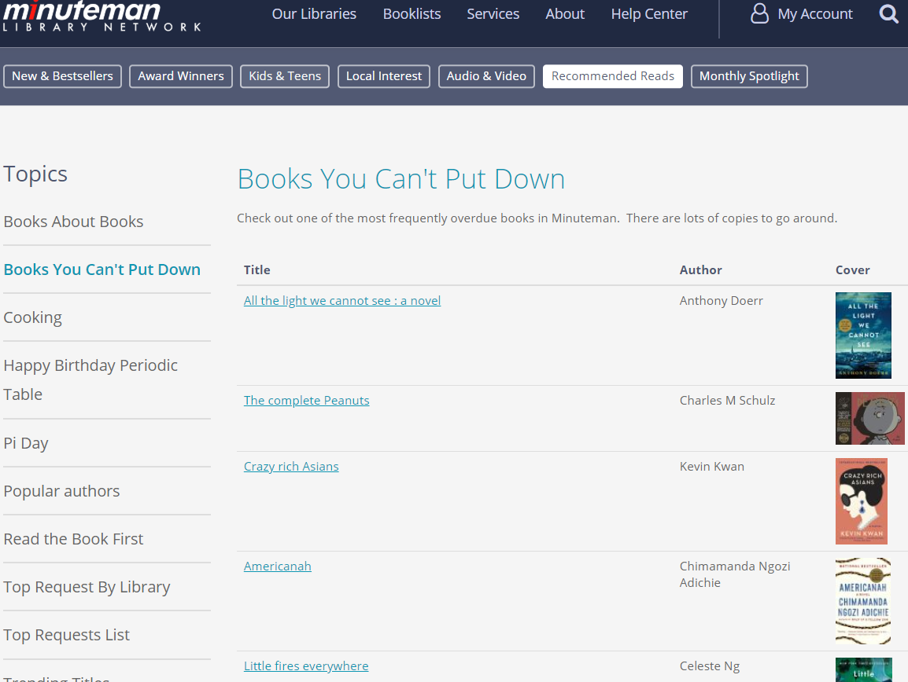
Books You Can’t Put Down
JOIN
sierra_view.item_record i
ON
bi.item_record_id = i.id
JOIN
sierra_view.fine f
ON
i.id = f.item_record_metadata_id
AND f.charge_code = '2‘
ORDER BY COUNT(i.id) DESC
Notes:
A bit further afield we have something like the books you can’t put down list, which has proven to be one of our most viewed lists, and which looks at books that most frequently appear on the overdue fines list. In this instance we link from item records to the fines table limit to fines with the charge_code of 2, equating to overdue fines, and then just count up the number of entries for each item record. This is a nice instance of looking at a further afield data set to vary up the sorts of data driven lists that can be utilized.
Code for this list available here: https://github.com/jmgold/SQL-Queries/blob/master/frequently%20overdue%20titles.sql

Slide 22
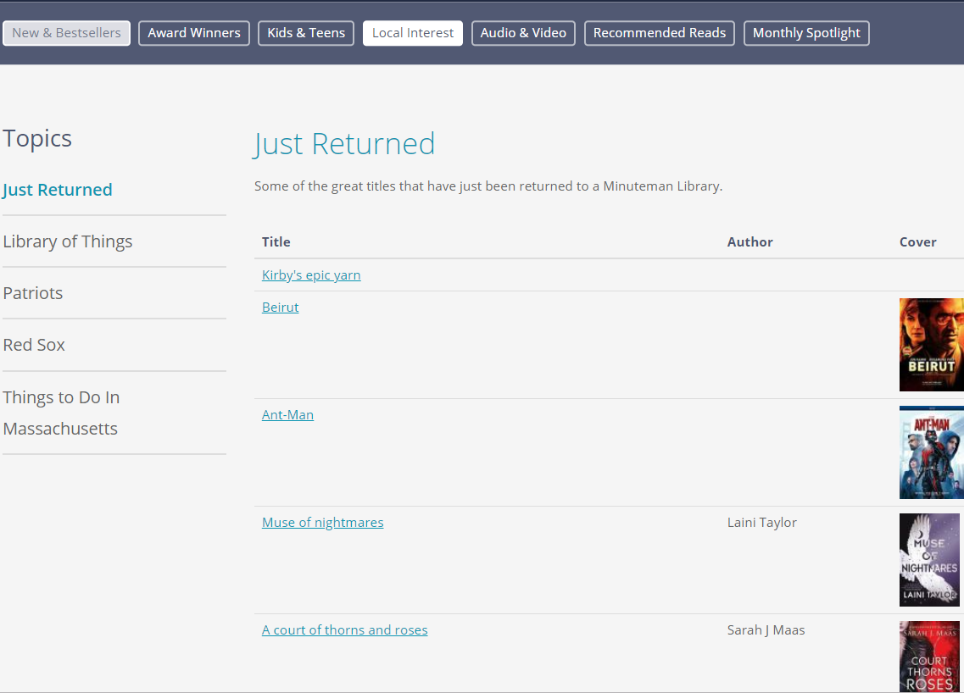
Just Returned
JOIN
sierra_view.circ_trans c
ON
b.bib_record_id = c.bib_record_id
AND c.op_code = ‘i’
AND c.transaction_gmt > (LOCALTIMESTAMP – INTERVAL ‘1 day’)
ORDER BY c.transaction_gmt DESC
Notes:
The just returned items list tends to be popular as well, though honestly not super useful in our context where we are producing lists that encompass the holdings of all the locations in our network. But the sheer randomness of the titles that can appear here can make it worth while even in that sort of case. To create this one we look at the circ_trans table, limit to operation code of I, for checkout and then look at transactions from the past day.
Code for this list available here: https://github.com/jmgold/SQL-Queries/blob/master/just%20returned.sql

Slide 23
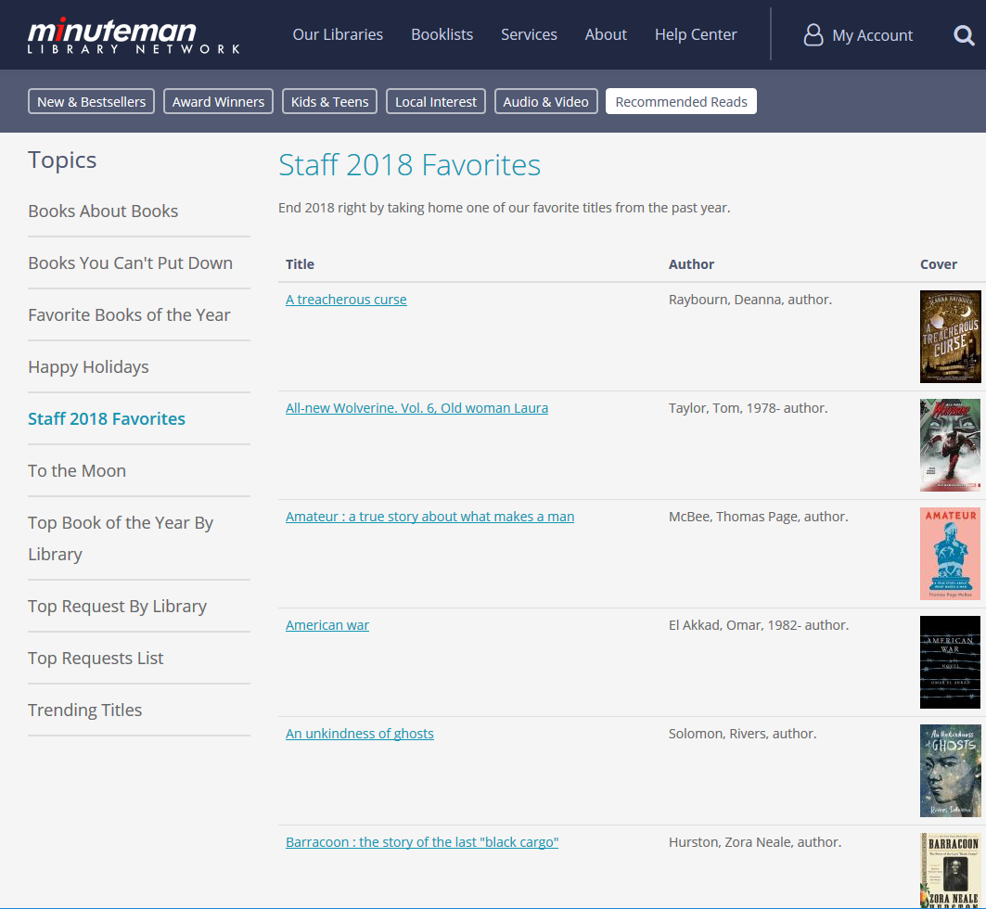
Lazy Curation
Curated list without all the data entry
Requires known record numbers
Query gathers title, author, Cover image and Encore link
Uses RANDOM and LIMIT to give appearance of regular updates
Each day query runs to produce a random subset of included records
Notes:
Now we move on to our lazy curation lists, which we use for instances where title curation from a staff member is necessary, but where we can get away with taking some shortcuts to speed up the process. We do this by taking advantage of the basic query we’ve already discussed to gather up all the details for a title, making it so staff simply need to gather up a list of record numbers and the query will handle the rest. This is idea for things like staff picks. You can also get some extra longevity out of these sorts of lists by using the Random and limit features of SQL to keep the page looking seemingly refreshed without staff intervening, as long as you start off with a lengthy list of possible titles. More on this in a moment.
Code for this list available here: https://github.com/jmgold/SQL-Queries/blob/master/staff%20picks_end%20of%20year.sql

Slide 24
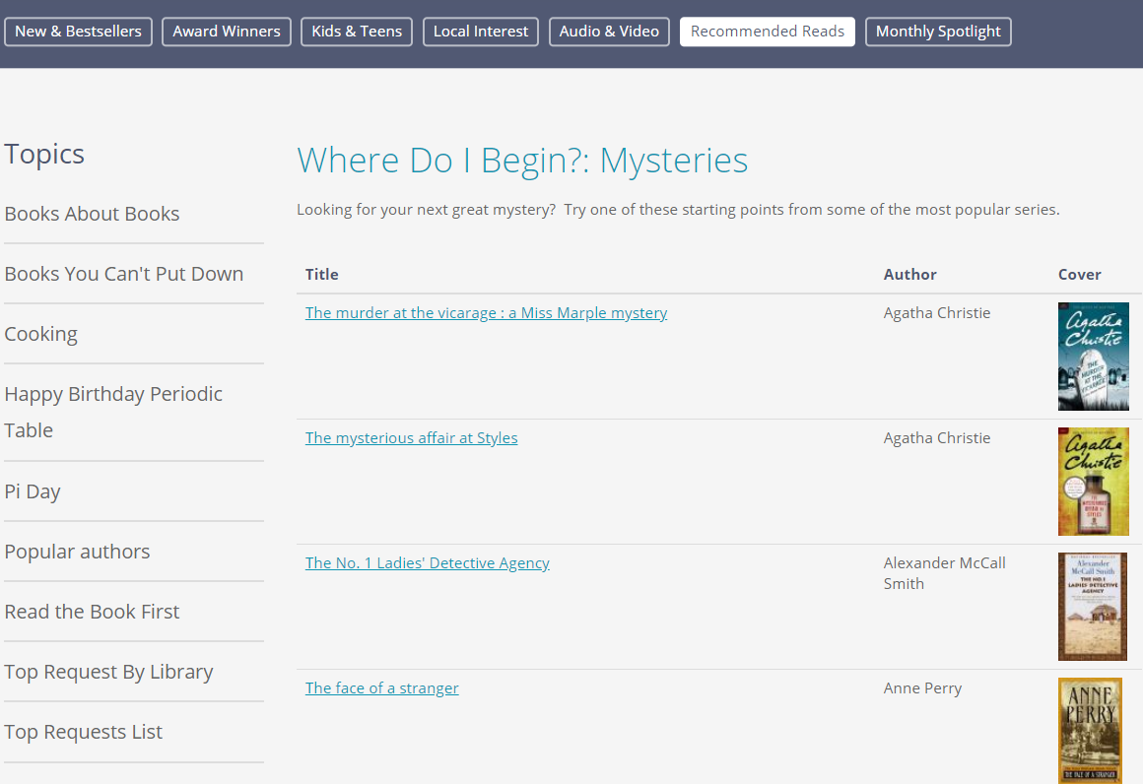
Lazy Curation Query
JOIN
sierra_view.bib_view v
ON b.bib_record_id = v.id
AND v.record_num IN (‘record1',‘record2',‘record3‘…’record50’)
GROUP BY 1,2,3
ORDER BY RANDOM()
LIMIT 25
Notes:
Here’s the basic query addition for these lazy curation lists. We join our basic query to the bib_view table and have it return records where the record number from that table is In our list of curated records. The additional trick we utilize is the Order by Random() feature of SQL. By using that in conjunction with a limit, we can provide a lengthy list of titles that could appear in one of these lists, and each day the cron job for this list runs a different assortment of titles is returned, providing the appearance of our updating the lists more frequently than we actually do. And then here’s anther example of what we use these kinds of queries for, with our first books in mystery series list.
Can get at record_num via other tables that may run faster than bib_view, selected here in interest of brevity
Code for this list available here: https://github.com/jmgold/SQL-Queries/blob/master/where%20do%20i%20start_mysteries.sql

Slide 25
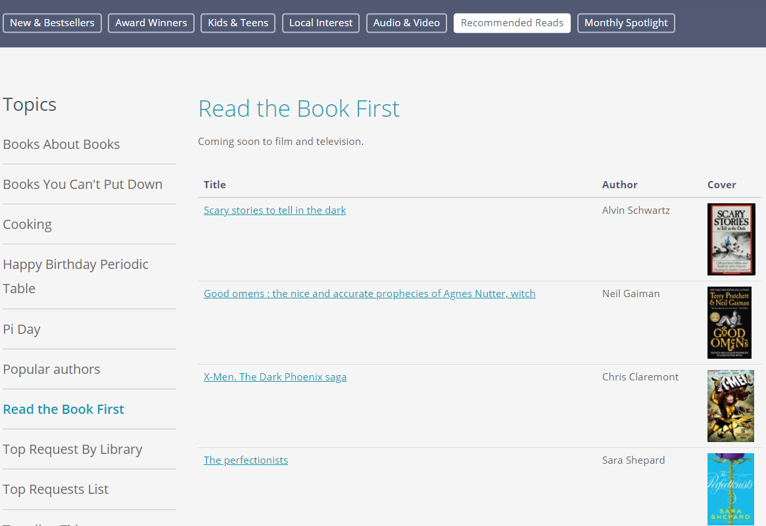
Read the Book First
v.record_num IN (
--FILMS
--Into the Spiderverse
‘3479082’,
--If Beale Street Could Talk
‘3779420’,
--TV
--Good Omens…)
Notes:
When working with these kinds of lists it helps to make good use of comments in order to make ongoing maintainance of these lists easier if they’re queries you wish to keep in use long term. Here you see our list of books that have been adapted to film and tv recently. So this is a case where we want to continuously update the curated list, and thus we’ve included comments to show which titles record numbers correspond to so they can be easily added or removed to later.
Code for this list available here: https://github.com/jmgold/SQL-Queries/blob/master/read%20the%20book%20first.sql

Slide 26
Topical
Query framework for quickly building subject based lists
Avoid labor of curated lists
Require testing to ensure expected results
Length of time posted will vary
Permanent (Things to Do In Massachusetts)
Annual (Pride Month, NaNoWriMo, Halloween)
“One-offs” (celebrate Victoria’s 200th birthday)
Notes:
Our final group of queries are our topical lists, which are ultimately subject keyword search based queries. These are an attempt to further automate but have a trade off with our lazy curation lists where staff must spend time building queries instead of selecting individual titles. They do require a decent amount of testing prior to going live in our experience in order to ensure that they yield the desired results. And these lists can vary a lot in regards to the permanence, which can certainly impact how cost effective the investment of time in a given list might be. For a one off list, such as the one we have up now that includes books about Queen Victoria and the Victorian era in honor of her 200th birthday this month, there is certainly a point at which we’ll abandon a list if it’s proving to be too much work to create. For permanent lists such as things to do in Massachusetts, or Annual lists, which mostly concern various holidays, that calculation is a bit different.

Slide 27
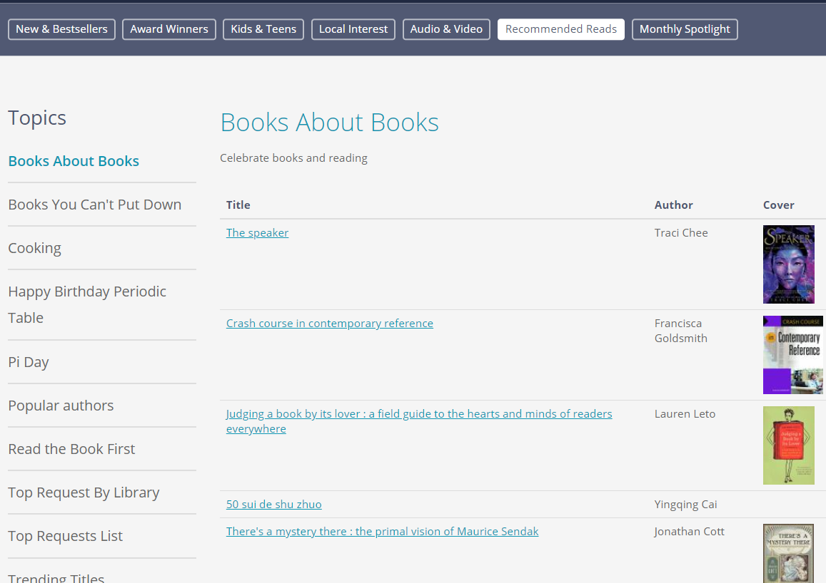
Books About Books
JOIN
sierra_view.phrase_entry d
ON
b.bib_record_id = d.record_id AND d.varfield_type_code = 'd'
AND (REPLACE(d.index_entry, ' ', '') LIKE '%booksandreading%' OR REPLACE(d.index_entry, ' ', '') LIKE '%bestbooks%' OR REPLACE(d.index_entry, ' ', '') LIKE '%libraries%')
Notes:
For one of our permanent such lists, here is our books about books page. Here we are looking at the phrase entry table, which includes all indexed fields, limiting to the varfield_type_code of d, which corresponds to our subjects, and then looking for entries using a series of Like operators.
Code for this list available here: https://github.com/jmgold/SQL-Queries/blob/master/books%20about%20books.sql

Slide 28
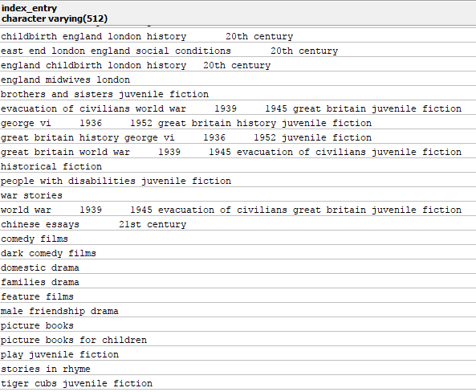
Parsing Subjects
REPLACE(d.index_entry, ' ', '') LIKE '%booksandreading%‘
REPLACE() function in this instance is used to remove all spaces
Like is used for simple string pattern matching
% = wildcard
Can also use regular expressions
Notes:
Like allows you to conduct a sort of streamline regular expression like search, so when you see Like %libraries% that is searching for entries where the word libraries, all lower case can be found with any number of wildcard characters appearing before or after it. You’ll notice all the keyword searches here are in lower case which is how those fields are normalized in the phrase entry table, which you can see on the right side here. You can also see that this particular table has a tendency to add extra spaces before numbers, and so I’ve used a Replace function to strip out all spaces in order to ensure I can reliably know what to expect from the data I’m searching against. It is possible to run subject searches against the varfield or subfield tables as well, which we’re already linked to in our query in order to extract ISBN’s. However, those tables do not contain normalized data and the data in them is not indexed, so searching against those tables is more difficult and can be more time consuming.

Slide 29
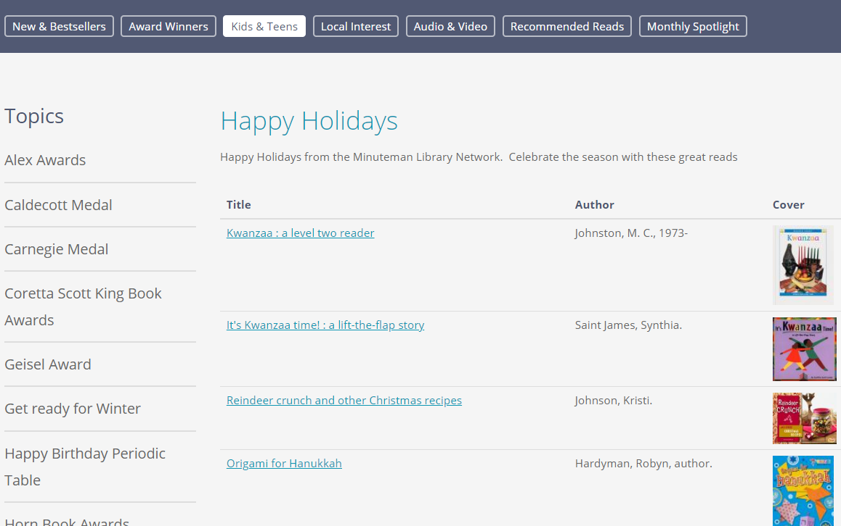
Happy Holidays
(SELECT * FROM
(SELECT…
REPLACE(d.index_entry, ' ', '') LIKE '%hanukkah%‘…) a
ORDER BY RANDOM()
LIMIT 15)
UNION
(SELECT * FROM (SELECT…
REPLACE(d.index_entry, ' ', '') LIKE '%kwanza%‘…) b
ORDER BY RANDOM()
LIMIT 10)…
Notes:
These sorts of queries can get quite complicated depending on what you’re looking for. Here we have an excerpt of the query we used over the holidays, where we wanted a single list for multiple holidays, and also ensure that the output didn’t result in nothing but Christmas books given that there are so many more of them. So our solution to that was run a separate query for each holiday, pull a limited number of results and then use a Union to join the results of each of those queries together into a single list. We also randomized the order of title in the resulting list to essentially hide the seems. We’ve since used this logic for other lists as well such as our one for new year’s resolutions
See full query here: https://github.com/jmgold/SQL-Queries/blob/master/Seasonal%20booklists/happy%20holidays.sql

Slide 30
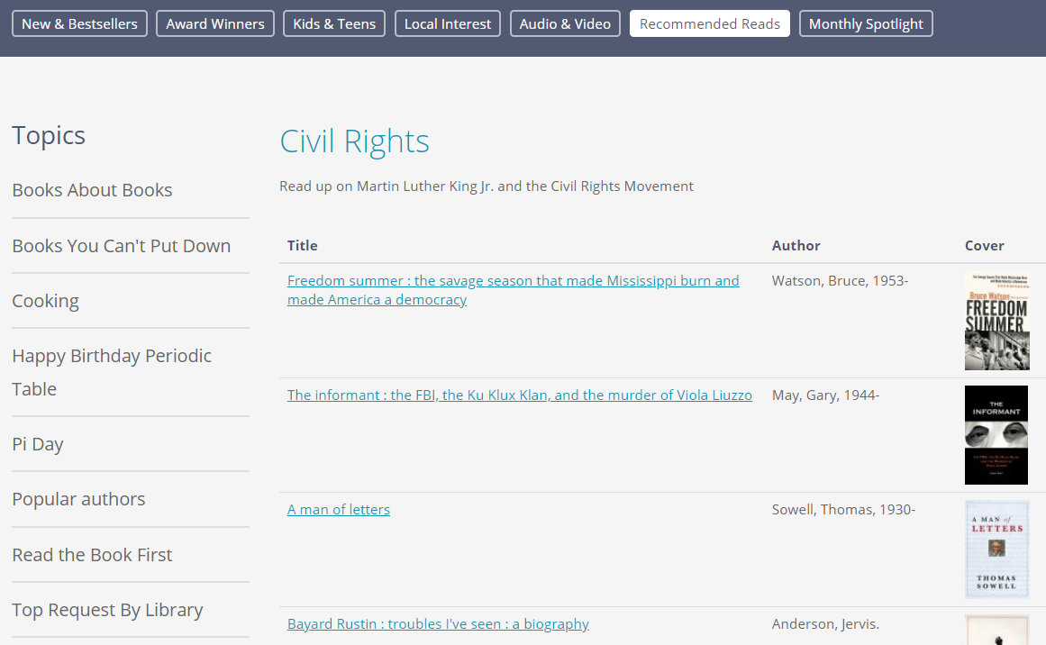
Civil Rights
Test your results
First run through of civil rights list returned Progressive racism : the collected conservative writings of David Horowitz
WHERE id2reckey(b.bib_record_id) != 'b3534522'
Notes:
Now a word of caution. Given that these sorts of broad keyword searches may yield unexpected results, testing in advance is important and so is providing a means to filter out unwanted titles if you do happen to discover them. Here you can see the Civil Rights list we put together for Martin Luther King Jr Day, which in our first run through produced a book on the conservative writings of David Horowitz, which we certainly didn’t want to be included. Fortunately you can easy add in a WHERE filter on record number to strip out these unwanted results, so long as there aren’t too many, which could happen. Last year we did scrap plans for an election day list when we found that the vast majority of titles returned were just about the 2000 recount, which wasn’t quite the sort of theme we were really aiming for.
Code for this list available here: https://github.com/jmgold/SQL-Queries/blob/master/Seasonal%20booklists/civil%20rights.sql

Slide 31
Top Request By Library
Notes:
Now very quickly I just wanted to show off a few lists that break a bit from our basic query, just to illustrate that other options are possible. Here we showcase the most popular title at each of our individual locations. The code for this one again gets a little complicated for a slide so if you’re interested check out the link in the notes.
See full query here: https://github.com/jmgold/SQL-Queries/blob/master/top%20request%20at%20a%20library%20v2.sql

Slide 32
Popular Authors
Notes:
We also have our popular authors report, which intentionally breaks our basic query a bit by forcing author names into the title field (note the column header) in order to take advantage of the feature Atom built for us where the CMS will automatically create a link to Encore using a keyword search of whatever goes into that field. Here again please see the notes later for the code.
For full query see: https://github.com/jmgold/SQL-Queries/blob/master/popular%20authors.sql

Slide 33
Automation
We use automated cron in Drupal along with custom development
Formerly used Python scripts based on Gem Stone-Logan’s 2018 presentation “Automating Reports with Python’
https://www.gemstonelogan.com/presentations/IUG2018AutomatingPython.pptx
Python makes it easy to generate HTML tables (or csv or Excel files)
Notes:
Now we’ve been talking about SQL for quite a while now, and I want to touch briefly on the automation portion of this presentation’s title before wrapping up. As I’ve been showing in our case now we have been using a cron job in Drupal and some custom development to our site to handle that portion of things, and clearly those may not be options for everyone, but solutions are available. The best starting point, which is what we had begun to work with on our old site prior to hiring Atom, is the presentation on automating reports with Python that Gem Stone Logan gave here in 2017 and 2018. She’s very sadly at non Innovative library now so could not make that presentation a trifecta, but it remains available on her website and I strong recommend it. Her basic code is a Python script that runs an SQL query, outputs it to excel then mails it off as an e-mail attachment. Now for a booklist on a website, that’s hardly the output you’ll want to have, but once you understand what this script does and how it works, it is fairly simple to modify. Then once you have a script that does what you wish, it’s simply a matter of making an entry for it in windows task scheduler and you have something that runs on a regular schedule.

Slide 34
CSV Generator
import psycopg2
import csv
from datetime import date
csvFile = 'NewBookList.csv'.format(date.today())
conn = psycopg2.connect("dbname='' user='' host='' port='1032' password='' sslmode='require'")
cursor = conn.cursor()
cursor.execute(open("new books list.sql","r").read())
rows = cursor.fetchall()
conn.close()
with open(csvFile,'w', encoding='utf-8') as tempFile:
myFile = csv.writer(tempFile, delimiter='|')
myFile.writerows(rows)
tempFile.close()
Notes:
To give you a quick taste of one approach, here is a variation on Gem’s code that runs a query and just saves the results to a csv. This works by defining the csvFile, executing the query and storing the results to a variable called rows, and then looping through those rows to write each one to the csv.
See: https://github.com/jmgold/SQL-Queries/blob/master/new%20books%20list_csv.py

Slide 35
HTML Table Generator
import psycopg2
import os
import io
conn = psycopg2.connect("dbname='' user='' host='' port='1032' password='' sslmode='require'")
cursor = conn.cursor()
cursor.execute(open("new books list.sql","r").read())
rows = cursor.fetchall()
conn.close()
with io.open('DemoNewBooks.htm','w', encoding='utf-8') as f:
f.write(‘[HTML for your page]<table border="1" cellpadding="5" align="center"><tr
align="left"><td>Titletd><td>Author</td></tr>')
for rownum, row in enumerate(rows):
f.write("<td><a href=" + row[0] + ">" + row[1] + "</a></td><td>" + row[2] + "</td></tr>")
f.write("</table>[Remaining HTML for your page]</body></html>")
f.close()
Notes:
Here we have another version that outlines how to use the same basic script to generate an HTML page instead, with the query output saved to a table. Where you see [HTML for your page] you will have to enter all the code for your page surrounding the table, but if you can accomplish that then all you have to do is take the resulting file and have it overwrite the existing page on your website and you can have an updated booklist page. This is in fact what we did with our popular titles list on our old site during the period we were transitioning.
See: https://github.com/jmgold/SQL-Queries/blob/master/new%20books%20list_html.py

Slide 36
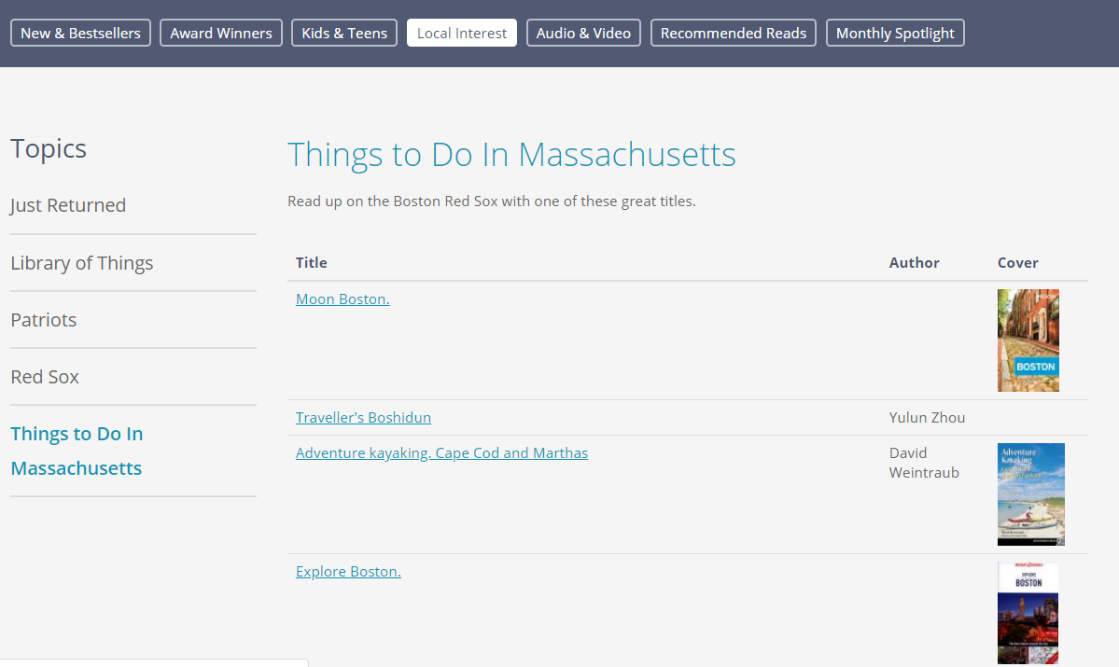
Failures Along the Way
Local Interest Category
Many topical lists fail
Music lists
Popularity by language
Election Day
Booklist importer
Adjusted all lists 3 times while crafting this presentation
Notes:
Now maintaining all these lists has taken a lot of experimentation and not all of those have led to results. Lists in our local interest category receive very few views. as do some of the topical lists we produce. We continuously play with the number of lists available in a month, the organization of those lists and the sorts of subjects we try out, and we’re still in the process of learning what works best. We tried a few times to run music lists, but found that CD’s are not longer purchased or requested enough to generate decent lists data sets. Similarly we sought to promote our world language collections but the data available from those item records was insufficient to find titles worth spotlighting in many cases. I spent a bunch of time trying to come up with a means to import a list of titles from a source, such as the NPR book concierge and generate a comma delimited list of record numbers that could be easily plugged into a lazy curation query. But I could never get that to work in a way that was worth the time it would take to clean up the data in advance. And of course as I work on lists new lists I continuously wind up coming up with ways to improve our existing code, and wound up adjusted all lists 3 times while crafting this presentation.

Slide 37
Successes
Booklist Unique Page views increased 60%
Q1 2018 v 2019
Average Time On Page Doubled
Patrons explore further
Views of 2nd most visited page tripled
3rd most quadrupled
Notes:
So that’s for the failures, as for the successes we’ve seen a 60% increase in unique page views compared to the prior year our new site launched in October. The average time spent on each booklist doubled, hopefully indicating that patrons are discovering more titles along the way. And we’ve found that patrons are digging into our content further, the landing pages for our booklist have seen page view counts that are relatively in line with what we had seen on our prior site, but pages that patrons have needed to drill down to find have had their views go up considerably.

Slide 38
Conclusion
Book Curation is a key service that patrons will seek out
Lists should aim to provide diverse contents with regular updates
SQL can help reduce staff time required to produce these lists
For even more on SQL please see the slides from the presentation How to SQL by Phil Shirley, Ray Voelker & Jeremy Goldstein
Notes:
So in conclusion book curation is a key library service that patrons expect to find their libraries providing. However, maintaining those lists, especially if you seek to provide a well rounded discovery tool for your patrons can take a lot of time and planning. Fortunately the SQL features within Sierra can go a long ways to providing you with a manageable workflow for accomplishing this, and the examples we’ve gone over today are merely a few suggestions as to the kinds of lists that are possible. If you’re interested in some more on where to start with SQL, please be sure to check out the slides from the How to SQL presentation that can be found on the conference website.

Slide 39
Questions?
jgoldstein@minlib.net
@jmgold
https://github.com/jmgold

