Slide 1
A Day Ending in “Y” in Florida
Handling Natural and Man-Made Disasters
Kristen Marshall, Lee County Public Library
Notes:
I’m going to be using this session to talk a bit about the numerous disasters that my library has been through since I started with them over the last several years and how the library and County responded to them. I plan to leave a lot of time at the end to hear about others’ experiences. The types of disasters we typically see in SWFL are likely different from other parts of the country. I won’t be showing any photos of the destruction some of these disasters caused; pictures are easy to find online if you’re interested

Slide 2
Introduction
Kristen Marshall
Electronic Resources Librarian
kmarshall@leegov.com
Notes:
Lee County Electronic Resources Librarian—deal mostly with ebooks/audiobooks and databases, create reports for staff. Been with Lee County since 2016. Previous job also with Polaris library
This is Domino, my bestie and sidekick and Baker & Taylor’s Miss November 2022. She’ll pop up a couple of times as a break from all the doom and gloom

Slide 3
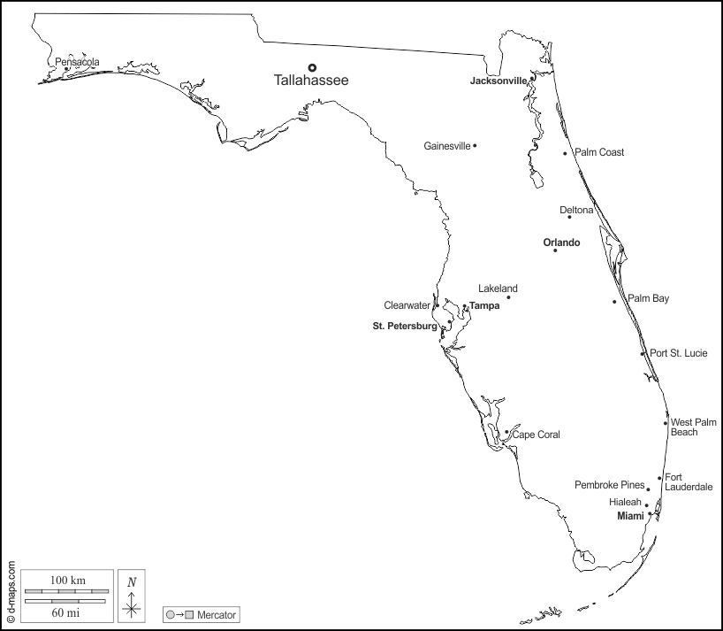
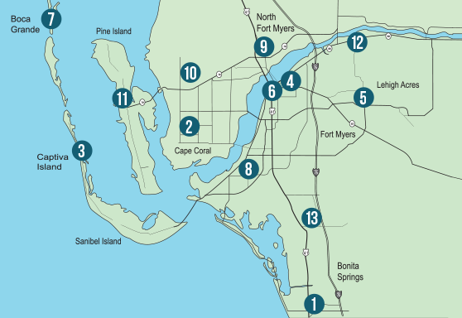
Overview of Lee County Public Library
Notes:
We have 13 branches across Lee County. Sanibel and Fort Myers Beach have their own libraries that are not part of our system. A population of ~880,000 (and growing!), many of them seasonal. A collection of ~1,000,000 physical items with circulation last FY at 2.6 million. Electronic circ (OverDrive, Hoopla, and Kanopy) at a little less than 2.1 million

Slide 4
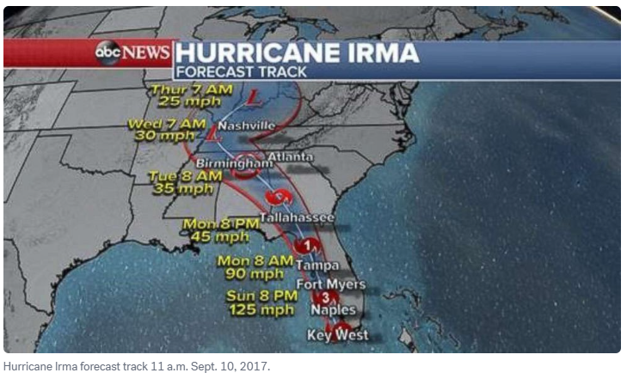
Hurricane Irma: September 10, 2017
Notes:
First major hurricane to hit Florida since Wilma in 2005. Category 4 at landfall. County opened 16 shelters that housed ~35,000 people and 3,550 pets during the storm. Harvey was just a couple weeks before, which probably contributed to high shelter population. The County asked for volunteers to staff shelters, but very few did, which led to County implementing E-Role program in aftermath.
E-Role assigns everyone in the County (with certain exemptions) a role that they need to take on if the County decides they’re needed for an emergency. Roles include setting up shelters, staffing shelters in various capacities (including assigning shelter managers and assistant managers), working in the Emergency Operations Center answering phones, distribution of supplies after emergency, and more. Program has been reworked a few times over the years.
Lost connection with ILS server—some angry people not able to check out ebooks
Most libraries reopened September 18. South County had limited power and no AC and remained closed a little longer
Bonita Springs Library experienced flood damage to the building and materials totaling over $158,000 and reopened December 26
2.7 million cubic yards of debris removed, damaged assessed at $832.7 million

Slide 5
County-Wide Cyberattack: September 20, 2019
Notes:
5 days with no access to any network services—email, phone, ILS. September 20 was a Friday, we were mostly up by the end of the following week (got my desk very clean during that time!) Still experienced problems with notices for a few days afterwards, ordering was backed up, IT needed to reimage all workstations and were in contact with III about what ports needed to be open for traffic. I was very glad I don’t work directly with the public.
Emergency services on different network and not affected and the County said no private information was stolen.
Not caused by a library staff member!
County implemented new security measures including KnowB4 training, multifactor authentication to log on to County computers, no more FTP.

Slide 6
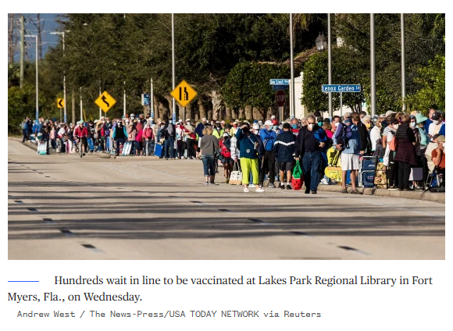
COVID: All libraries close March 18, 2020
Notes:
We all know this one!
Libraries did curbside holds pickup and ramped up e-resources. Larger branches reopened May 26, 2020 with limited services, hours, and capacity
Smaller branches reopened October 6, 2020
Larger libraries used as temporary vaccination centers starting December 2020
Some library staff were reassigned temporarily to help with County vaccination efforts as part of E-Role program once more permanent vaccination centers were set up
County staff were issued laptops during computer refresh

Slide 7
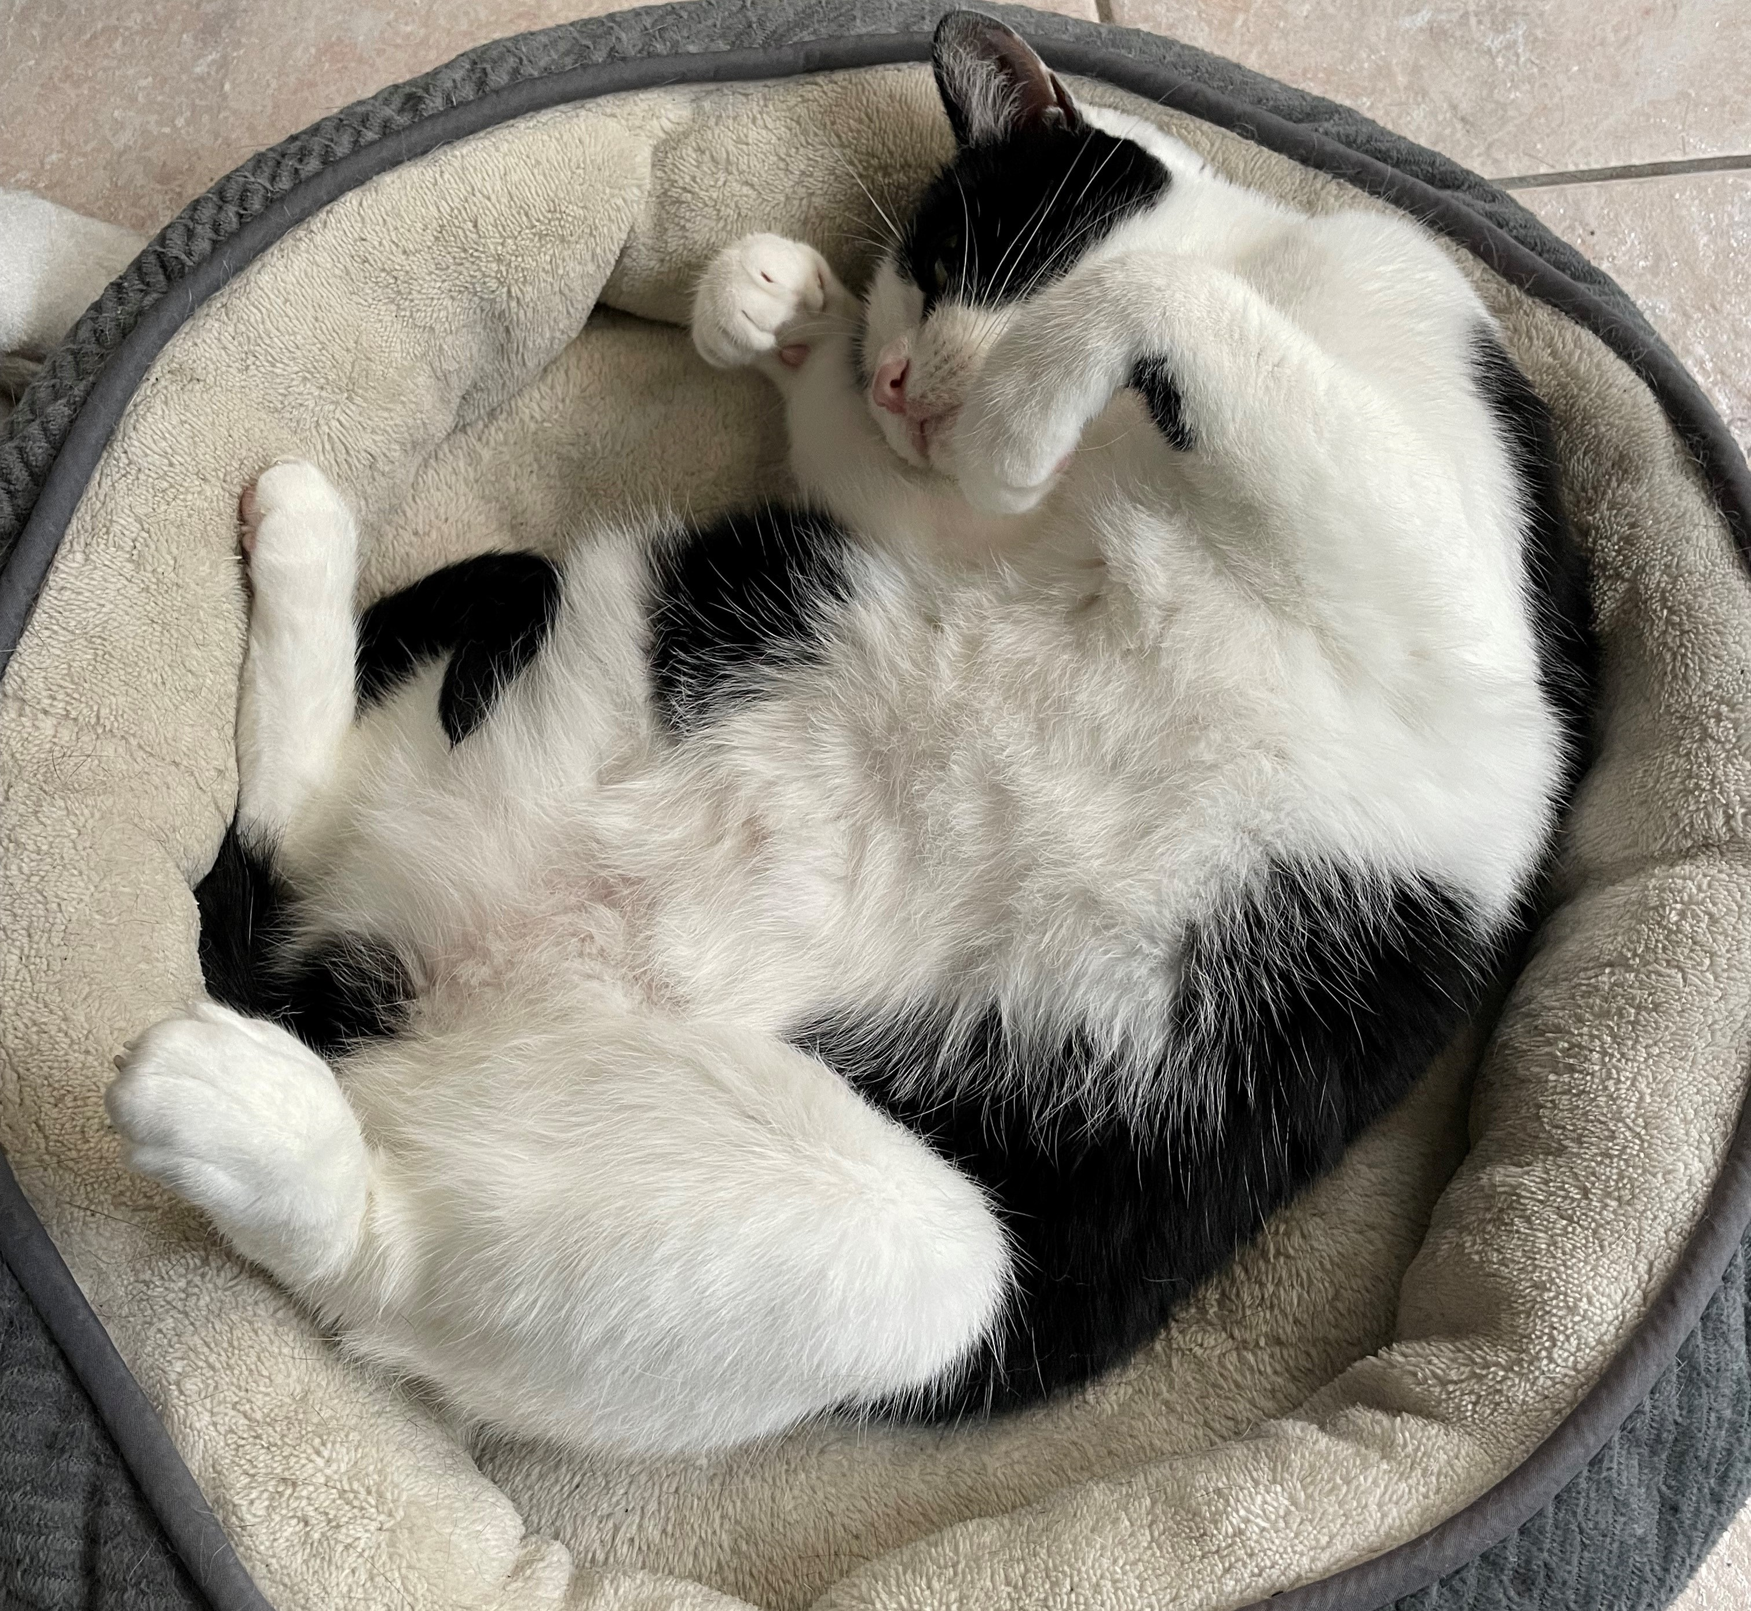
Domino Break

Slide 8
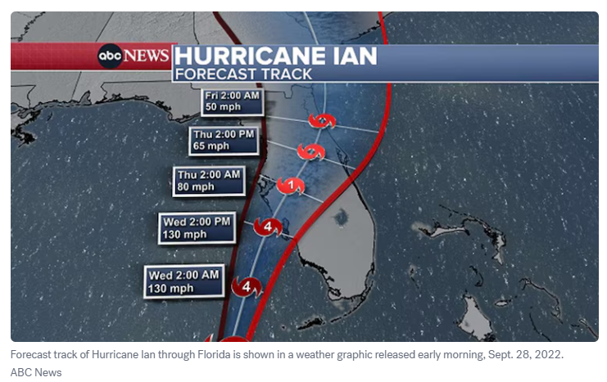
Hurricane Ian: September 28, 2022
Notes:
This was a really bad one for us. Technically a Category 4 (up to 156 mph) at landfall, but only 2 mph short of Cat 5
5,954 people, 240 pets sheltered
6.3 million cubic yards of debris removed (compared to 2.7 for Irma)
$112 billion in damages to County (compared to $832.7 million for Irma)

Slide 9
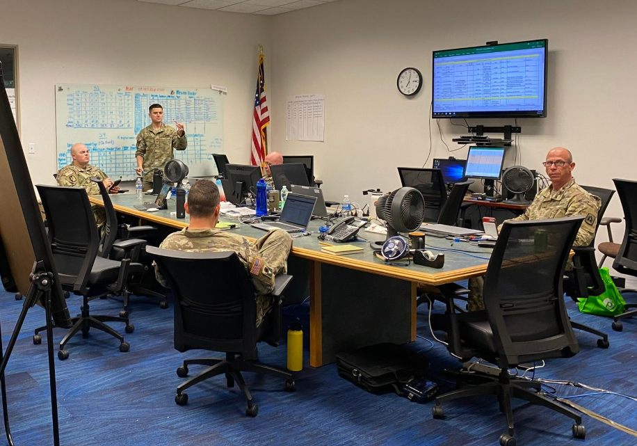
Hurricane Ian: September 28, 2022
Notes:
National Guard used some branches for planning, staging areas, and breaks
LP used as Covid quarantine area
ILS connection stayed up
Paused holds on OverDrive, made many titles “Lucky Day”
In aftermath, County established Employee Resource Center to provide food, water, clothes, and temporary housing assistance to affected employees

Slide 10
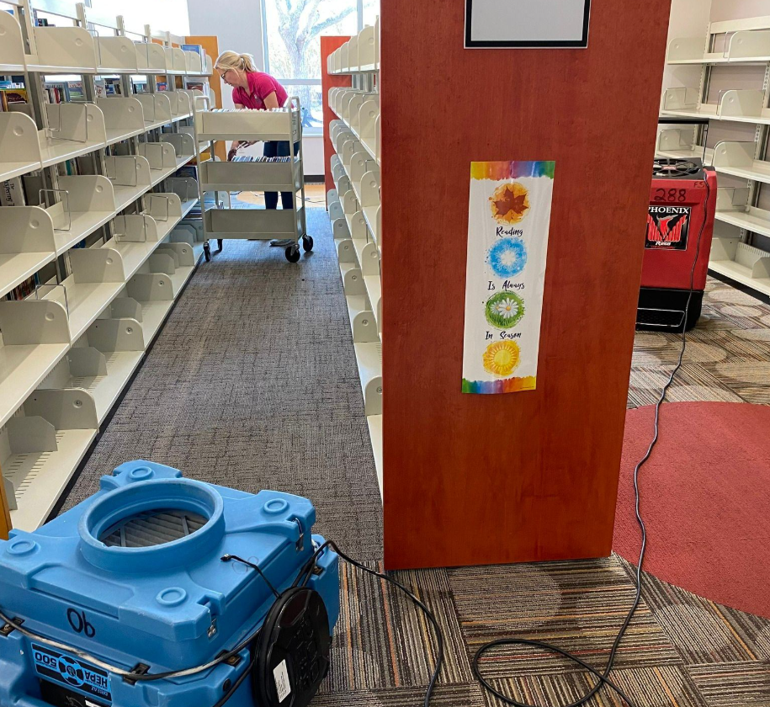
Hurricane Ian: September 28, 2022
Notes:
Most branches sustained at least some damage, mostly landscaping and minor exterior damage
Downtown Fort Myers more heavily damaged—first floor flooded (reopened November 16)
Received FEMA repair money early 2025. Library is closing March 17 through sometime in May for repairs. Because the campus is set up with the main library building separate from meeting rooms, they will still have limited service including holds pickups, a small collection of new adult books and children’s books, as well as some programming.

Slide 11
Hurricane Ian: September 28, 2022
Notes:
On October 6, guest wi-fi was set up outside some branches
5 libraries reopened October 12, with the rest opening sometime later
All due dates extended to November 15
Lakes Library (biggest, busiest branch) remained closed and used as Disaster Recovery Center by FEMA and other organizations until May 6. Other organizations included local and state agencies that could replace documents like birth certificates and drivers’ licenses, Small Business Association, Human and Veteran Services, Department of Children and Family Services, Catholic Charities, an Insurance Village, and more
Branch staff were assigned to help out through E-Role, mostly with logistics and maintaining building. E-Role assignments for shelters reworked; going forward instead of finding out assignment at last minute, staff are assigned to teams with specific roles at a specific shelter. County would also hire outside contractor to help staff shelters

Slide 12
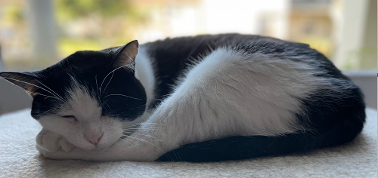
Domino Break

Slide 13
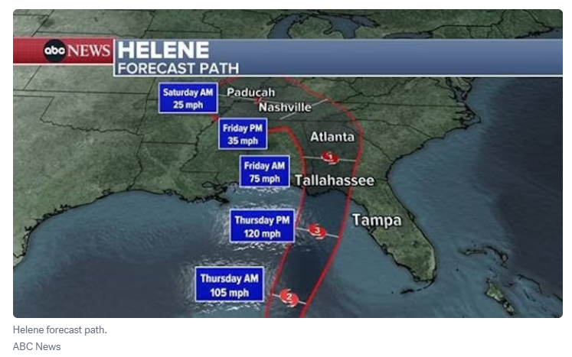
Hurricane Helene: September 26, 2024
Notes:
The libraries closed on September 26 with most reopening the next day
This one hit pretty far to the north of us, still received some damage at a couple of branches, mostly landscaping and siding. However, Boca Grande did receive some flooding which ruined about 400 books and some equipment.
Overall, not too terrible, but….

Slide 14
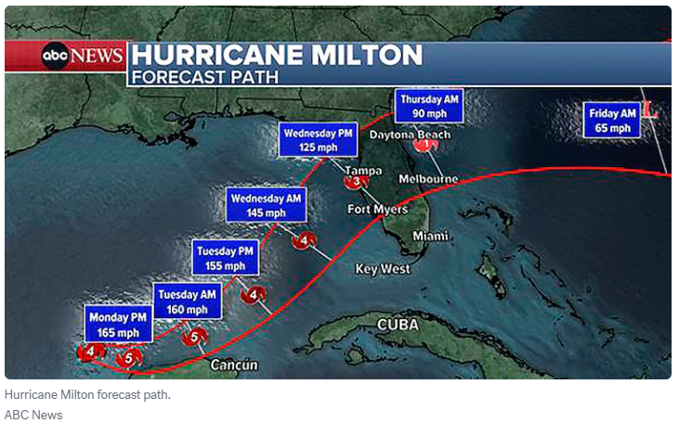
Hurricane Milton: October 9, 2024
Notes:
Libraries closed at noon October 7 and most reopened October 14
E-Role staff sent to prepare shelters on October 7 with shelter staff reporting October 8
553,000 cubic yards of debris removed
6,800 people sheltered

Slide 15
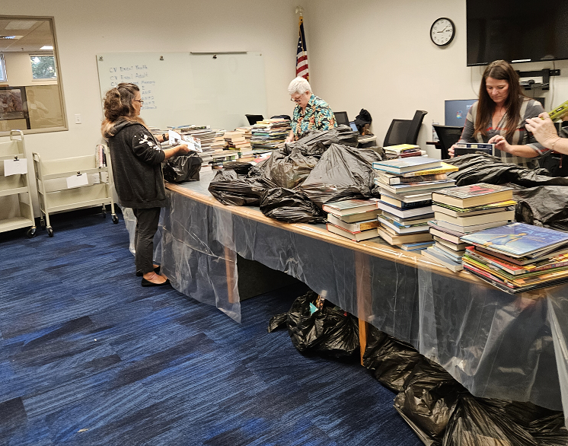
Hurricane Milton: October 9, 2024
Notes:
Boca Grande and Captiva were damaged. Boca reopened February 3, Captiva still closed
Pine Island branch conference room used as temporary permitting office October 16-November 22
Captiva lost about 430 books and Boca lost 650
County does not own Captiva building and ALL library materials needed to be removed (as in, building’s owner was threatening to dispose of everything) so all the books and DVDs were loaded up and brought to Library Processing to be sorted through. Thankfully, CV is a small branch. The collection total before Milton was around 8,100 items. This picture shows some of the process of sorting through CV items to see what’s fine and what’s damaged.
Since it’s not that huge of a collection, normally LP would store the CV items until it was ready to reopen, but we’re in the process of renovating another branch and so are already storing a lot of their items while they’re closed. We ended up putting most of the CV collection into totes are stored them in a Parks & Rec building. In the months after CV’s closure, it was decided to adjust the function of CV (make it more of a reading room than full-blown branch), so the collection was reduced to about 5,000 items. When we were finally able to get back into CV, a group of us came armed with lists of items to reassign to other locations. We were able to reshelve everything remaining over a couple of days and now CV is just waiting for things like furniture, computers, and trash cans before they reopen.

Slide 16
Plan ahead!
ALA Library Disaster Preparedness & Response LibGuide**: https://libguides.ala.org/disaster/home
**a lot of links are broken, but still some good info
https://www.ready.gov/
Amigos Library Services disaster plan template: https://www.amigos.org/sites/default/files/disasterplan_template.pdf
Become familiar with “Considerations If Your Library is Temporarily Closing” in Innovative Knowledge Portal
Have current pictures of library interiors and exteriors
Checklists
Notes:
ALA Library Disaster libguide has a lot of broken links, but those that work have good info (ALA has been emailed about this)
Ready.gov has info on all kinds of disasters, including cyberattacks. A lot of it is for individuals and families, but there’s a section for businesses as well
Amigos template is pretty basic, but it’s a start
Knowledge Portal has instructions you might want to take before closing and after reopening (things like pausing fines, holds, etc.)
Having pictures of how everything is supposed to look will help for insurance claims—do this for your own home, too
Checklists of things to do are great—list of who to notify if you’re closing (volunteers, people who’ve reserved your meeting room, etc.); outdoor items to check on (outdoor furniture should be moved inside; is there a library vehicle that should be moved to a safer location?); and last-minute indoor things (clean out the refrigerator of all food and empty/turn off ice maker; make sure staff have all personal items they might want; put signs up on the doors)
If you’ve got any rare or especially valuable items, have a plan for those. BG has things like a Gutenberg Bible page printed in 1454, a clay tablet with cuneiform script, and more. The JF Library Foundation owns them and have evacuated the items via helicopter before
Have all these plans and checklists printed out in an easily accessible binder, not just online. Put together a kit of supplies you might need after a disaster (disposable gloves, masks, trash bags, etc.)

Slide 17
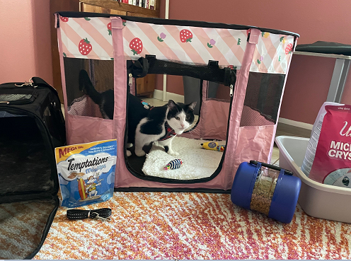
If You Have Time Before the Disaster
Prepare libraries for closing
Contact site manager
Contact other vendors if applicable
Will anyone else be using your building(s)?
Notes:
Prioritize safety for self and staff first
Go through steps from Knowledge Portal on previous slide, put out messaging on public catalog and social media. Turn your library off as a lending library for ILL
Contact site manager to let them know what’s going on
Might be worth contacting vendors like OverDrive and Hoopla to give them a heads-up, put ILS bypass in place if you want. OverDrive can put message on your site (but not on Libby)
If anyone else will be using your building (National Guard, etc.) make sure they know where important things are

Slide 18
After the Danger is Over
DOCUMENT EVERYTHING!!!
Notes:
Wear safety gear if appropriate (11 people died from flesh-eating bacteria in Ian aftermath and don’t forget mold and contaminated mud)
Use the checklists you made ahead of time to know what to look for and take lots of pictures
Especially important if a FEMA disaster is declared and you want reimbursement
Lots of rules for FEMA reimbursement—don’t repair non-emergency things without going through proper federal procurement regulations
You cannot over-document. Staff took pictures of each book that had to be thrown out from CV and BG and we’re having to get bids from 3 companies to replace them
FEMA reimbursement can take a LONG time. Library Fiscal Manager (who came from another municipality) said that 5 years after Irma, she received hundreds of files with discrepancies she had to try and reconcile. Things like Employee X said on his time card he used Chainsaw A all day, but equipment log for that day said he used Weedwhacker B. FEMA gives a chance to fix discrepancies, but you need back-up documentation to explain the error.
For your ILS, extend due dates and holds pickup dates longer if you need to, pause overdue fines, if individual locations are going to be closed longer, hide their items from the catalog and maybe turn them off as a holds pickup location if necessary

Slide 19
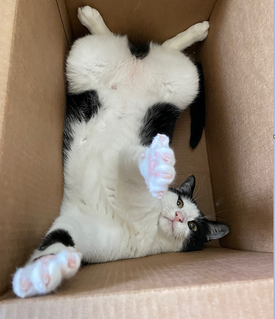
Take Care of Yourself and Your Staff
Flexible scheduling
EAP
On-site counselor
Acknowledgement/recognition
Give staff a chance to provide feedback
Notes:
Depending on the nature of the disaster, staff members may need to deal with insurance companies, contractors, etc and need some flexibility with their schedule
Make sure staff know about Employee Assistance Program if offered. Lee County offers 5 free counseling sessions per issue per year
If there was a particularly traumatic event, see if an on-site counselor can be brought in for a few days
Just acknowledging how difficult it’s been for staff and saying you appreciate their efforts is really helpful
Give staff a chance to provide feedback about disaster response and how it can be improved for next time

Slide 20
Discussion
Notes:
What are your experiences? Are your staff pulled into emergency roles?

Slide 21
THANK YOU

