Slide 1
Intro to Decision Center
Kathy Setter
Indianhead Federated Library System, Wisconsin

Slide 2
About IFLS
49 Public Libraries in West-Central Wisconsin
Includes many small libraries
First Access in July 2013
Early adopters for upgrades

Slide 3
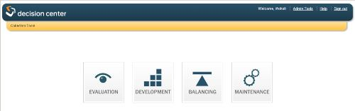
About Decision Center
Data to support decisions about patron services
Includes:
Historical reports
Collection “advice”: adding, weeding, and item tracking
Notes:
http://dc-indhd.iii.com/iii/dc-indhd/

Slide 4
Good to Know
Data goes back only as far as it’s been collected
Authorizations need to be assigned
Accounting unit must be associated with login
SCAT tables must be in good shape
Multiple SCAT tables cannot have duplicate Category numbers
Nothing to mess up, only misinterpret
We use for planning and estimating, not annual reports
Can see data across the system, or for location
Results dependent on setup
Decision Center has a good Guide and Reference

Slide 5

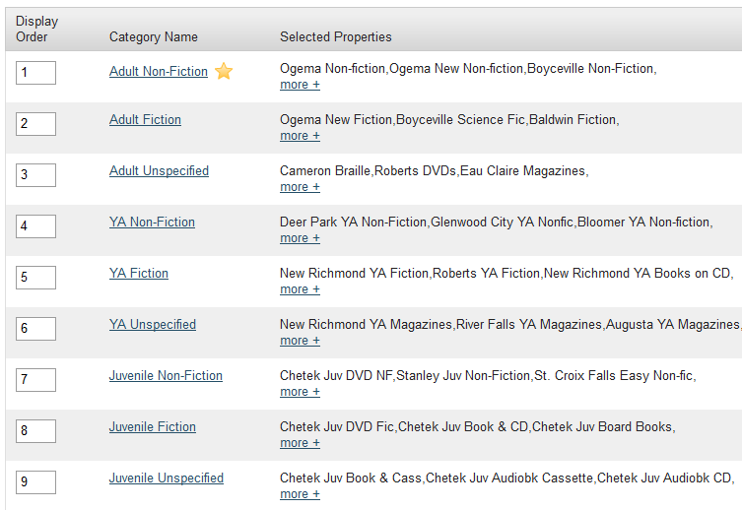
Set Up
Admin Tools
Code Categories
  Physical Format –
    mat type or itype
  Collections –
    itype or item location
Other Configuration
  Exclude item status
  Show/hide reports
  Scheduled reports
Our collections
Notes:
You choose what you want to use for each code category; itype cannot be used for both. Each code can only appear in one category.
Physical format is made up of groupings of our item types. For instance, we have one Books format, but it includes regular print books, board books, paperbacks, reference books, fragile books, big books, and braille books. We have separate formats for large print and graphic novels as librarians want separate information on those.
Exclude item status – we exclude lost, lost and paid, billed and with drawn.
We don’t hide any reports because this is a system setting and we don’t feel comfortable saying “no one will ever want to run this report.”

Slide 6
Getting Started
Data is available to all
  Only fiscal/Acq data is library specific
What do you want to know?
How does our system store that data?
In Decision Center:
Expand each report type
Scroll over report name to see description
Once selecting a report, choose parameters
Some reports take longer than others to display, depending on complexity
Reports can be exported; formats differ according to report: Excel, PDF or Review file
Trail follows where you are

Slide 7
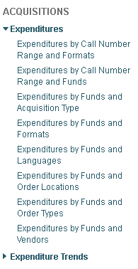
Evaluation Reports
Statistical Information
Historical Snapshot
Has the largest number of reports
When you find one that is useful, note the path to find it again
Acquisitions
Must be using Acquisitions
Shows data for Accounting unit assigned to login
Expenditures and Trends by various criteria
Data shown by quarter for current year
  By years for previous years
Can show % change

Slide 8
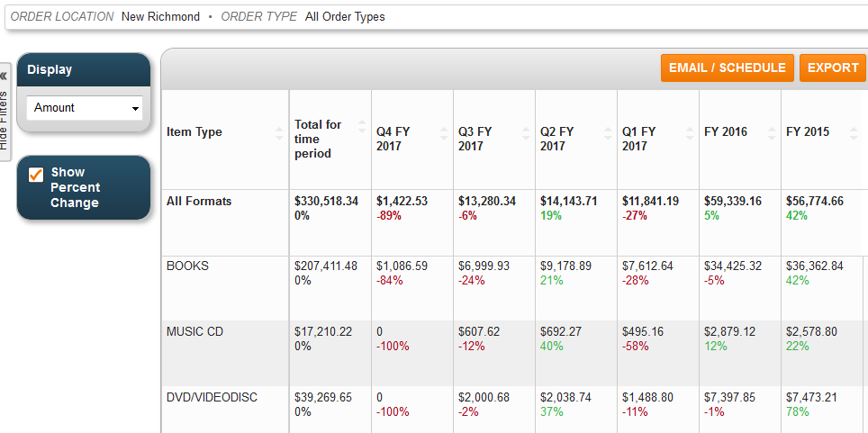
Expenditure Trends by Format
Compare to Circulation by format to see if spending follows use.

Slide 9
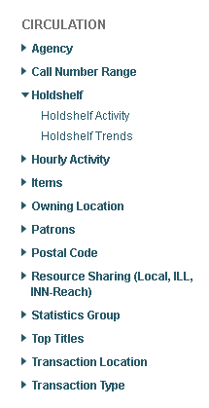
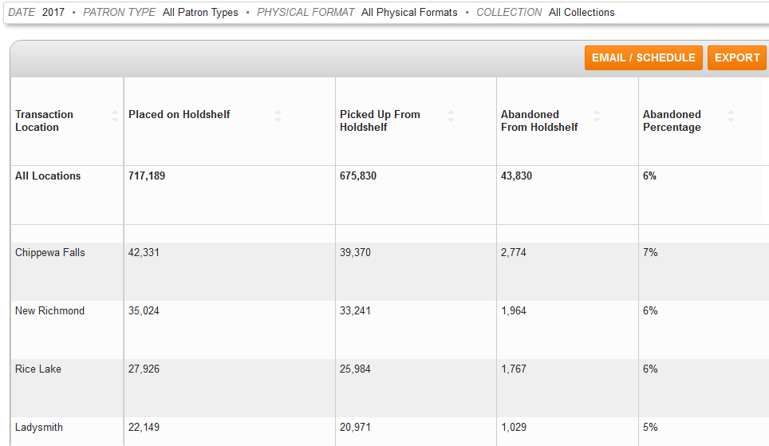
Evaluation - Circulation
Holdshelf Activity
  Limit by date, ptype, format and/or collections

Slide 10
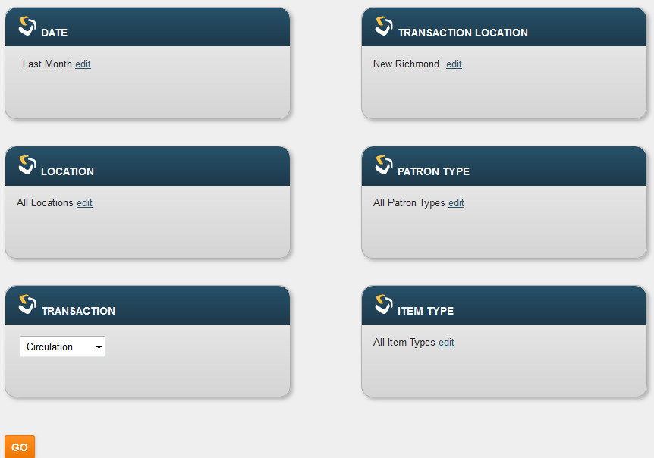
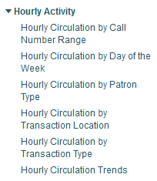
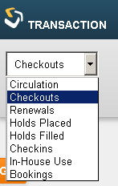
Evaluation – Circulation – Hourly Activity
Limit by date, ptype, format and/or collections
Broader range of dates
Can limit by locations
Can change transaction type
Does not do by number of patrons

Slide 11
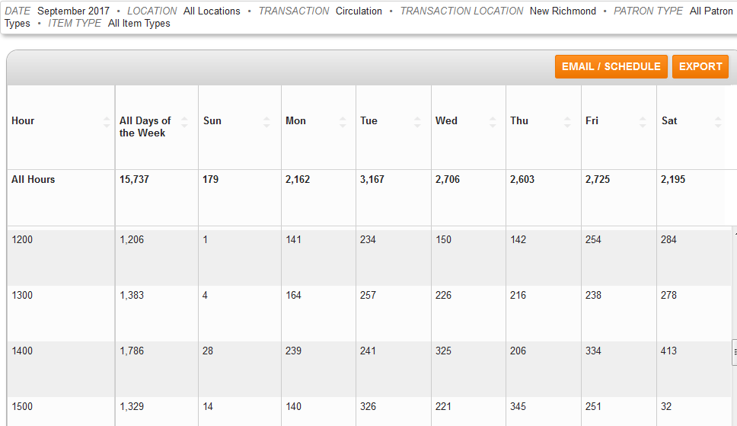
Hourly Circulation by Day of the Week

Slide 12
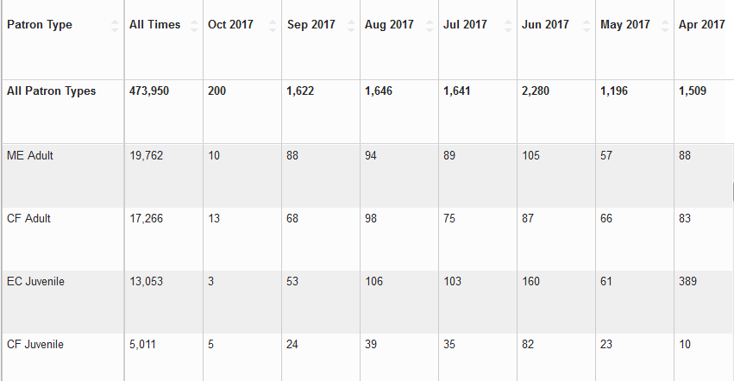
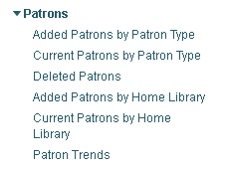
Evaluation – Circulation – Patrons
Added Patrons by Patron Type
Can limit by Home Library
Data by month for current and previous year
  By year before that
See trends between libraries

Slide 13
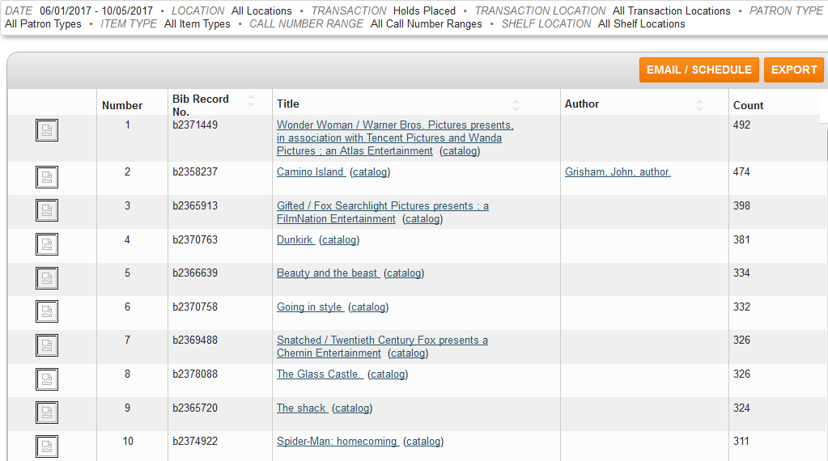
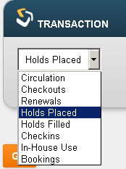
Evaluation – Circulation – Top Titles
    Popular titles
    Be aware of date implications
    Can choose item types
      Beware pairing with holds placed
    Choose transaction type
      By Holds Placed
    Transaction Location All for system stats
    Gives top 100 titles by chosen transaction type
    Takes time!
Notes:
Date implications – consider when the bib record was entered for holds, and when items were added for circulation
Item types are not present until item records are, so if you’re looking at holds placed do you want to include order records that have no items yet?
Catalog at end of title is a link to that record in the online catalog (ours goes to classic)

Slide 14
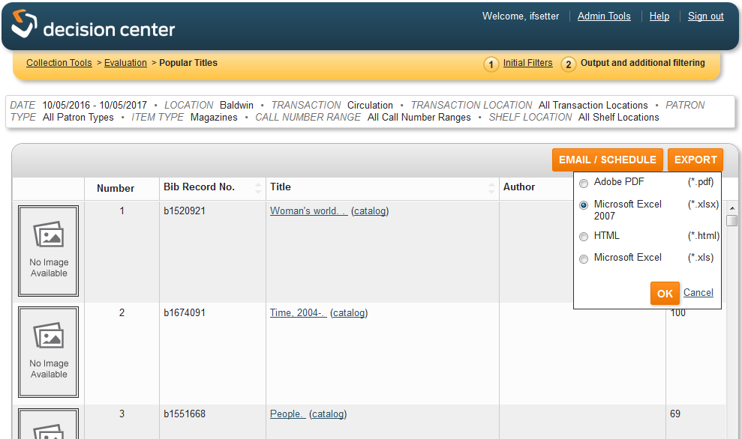
Use Case: Most checked out Magazines
Notes:
Our libraries want to know which of their magazines are circulating the most when they are considering which subscriptions to renew. This report gives them that information.

Slide 15
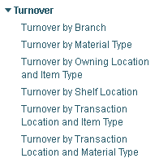
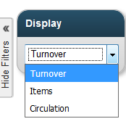
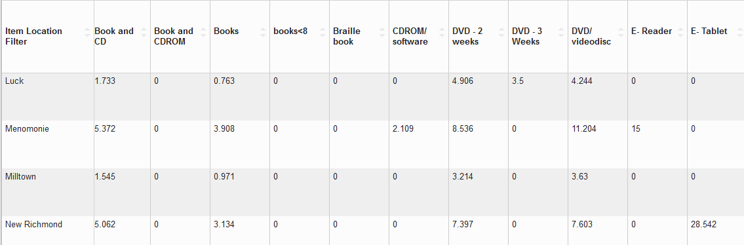
Evaluation – Collection - Turnover
By Owning Location and Item Type
Most are system reports
Turnover by Shelf Location can limit to one library
Notes:
Items will give the number of items each library has in that item type
Circulation will show the total circ for that item type in that library in the time frame stipulated

Slide 16
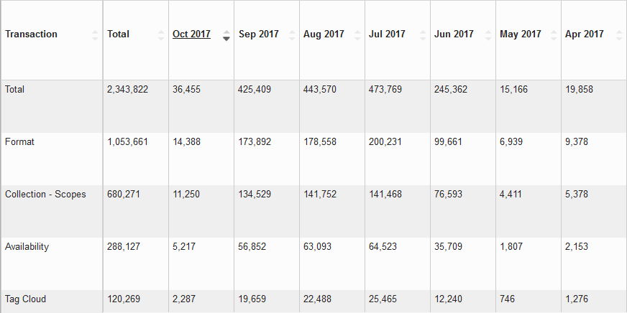
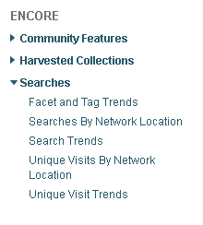
Evaluation – Encore – Facet and Tag Trends
Which facets are used most often?
Can see what is important to patrons
Notes:
Can sort by each column, but that sort affects the whole report.

Slide 17
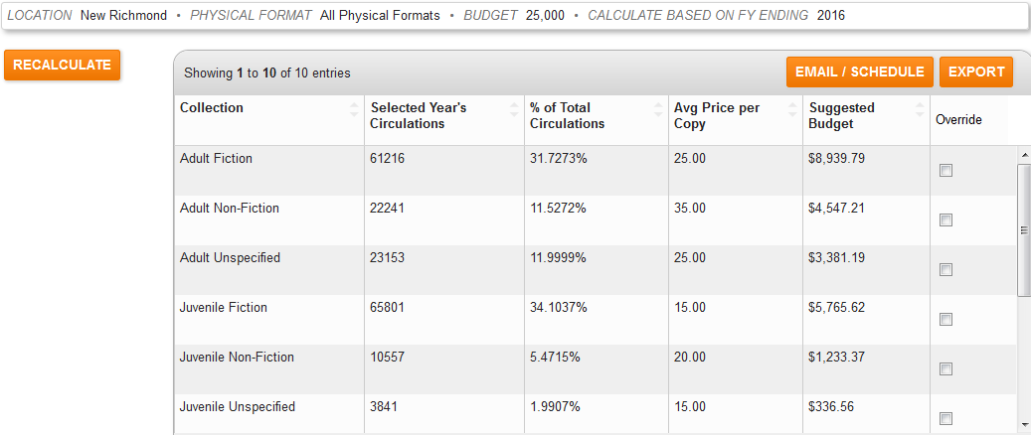
Development Reports
Information for adding to your collection
Budget Projection by Collection
  Based on circulation of the previous year
  Enter budget amount
  Divides budget by Collections
  Can limit to certain formats
  Can override suggested amounts
    Other values adjust (Recalculate)
Budget Projection by Subject uses SCAT tables
Popular Authors based on popularity of last title

Slide 18
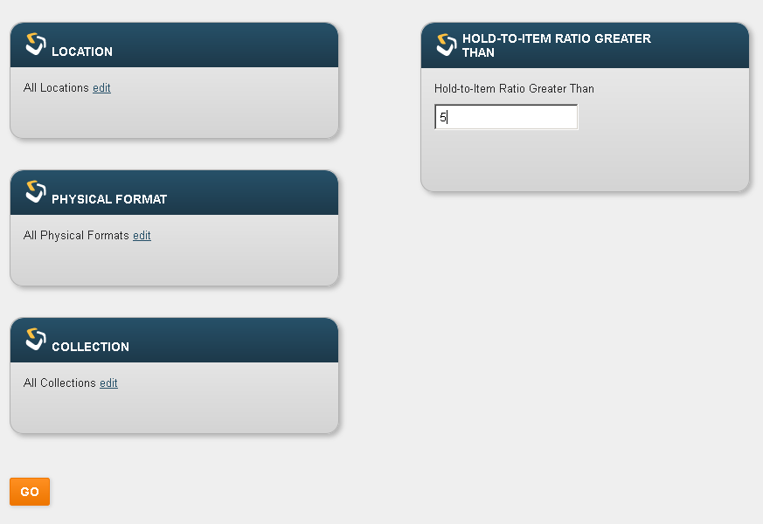
Development - Selection
Hold to Item Ratio Buying
  Choose On order or Current holdings
  Recommends purchases to satisfy demand
  Limiting to one location takes only that library’s items and holds into account
  In all locations report, On order copies refers only to those on order by login accounting unit

Slide 19
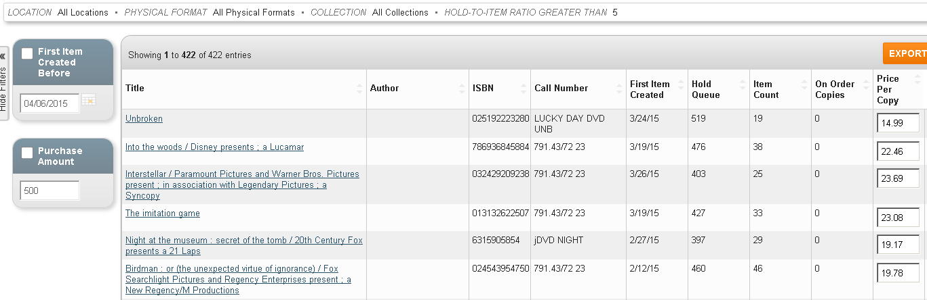
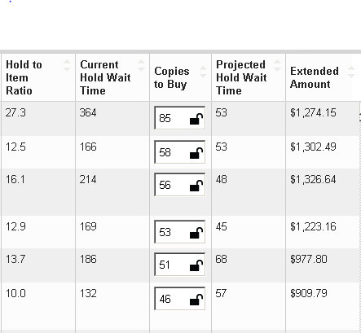
Hold to Item Ratio Buying
Hold to item ratio
Current hold wait time
Copies to buy
Projected wait time after purchase
Cost if recommended copies purchased

Slide 20
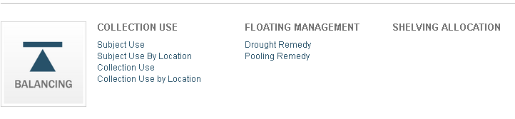
Balancing Reports
Collection Use
  Subject Use by Location
    All Locations report only
    Useful when limiting by Format and Call Number Range
    Recommends expanding or weeding by turnover rate
      Can set desired rates for each
  Floating Management
    For those using Floating Collections (we do not)
      Recommendations for redistribution of items

Slide 21
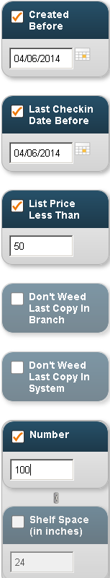
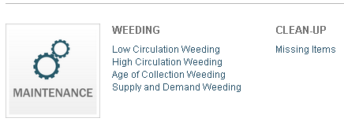
Maintenance Reports
Weeding
  Low Circulation Weeding
    Limit to Location
    Can also limit by format, collection, and call number range
    Take out non-circulating collections!
  Apply filters after report is run
    Created before to eliminate new books
    Last checkin date before to eliminate recently checked out items
    List price less than if you don’t want to weed expensive items
    Don’t weed last copy in Branch or System
    Number to limit the number in the list
    Shelf space bases on values in collections set-up

Slide 22
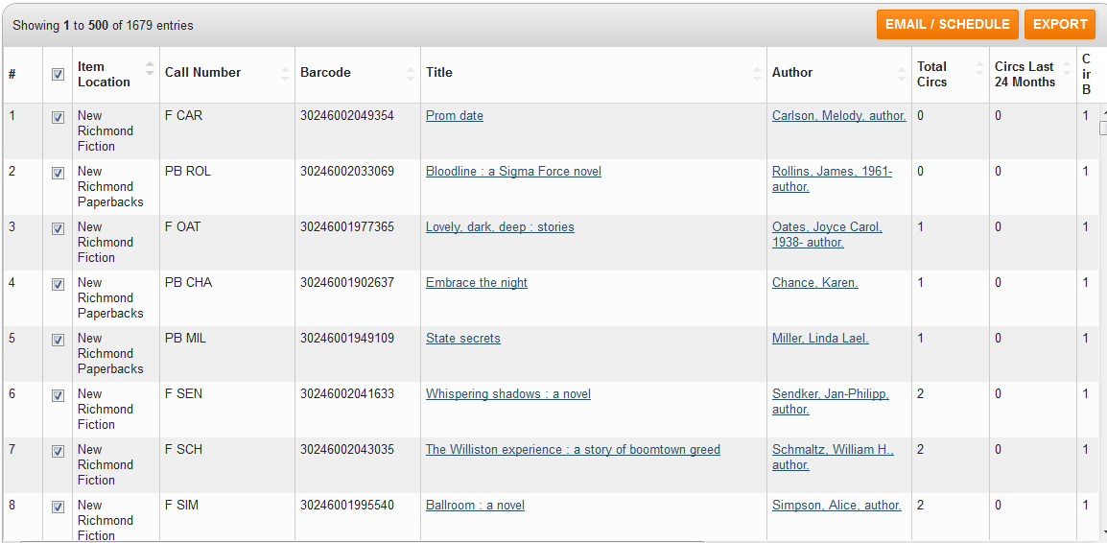
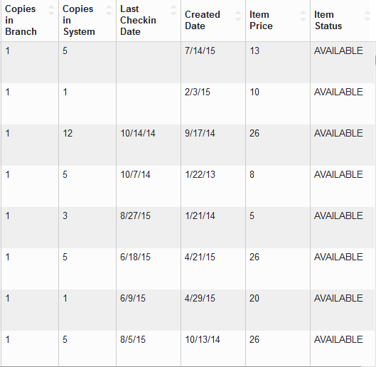
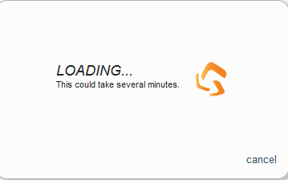
Low Circulation Weeding
See Total Circs, Copies in System, Created Date
Can Export to a Review File

Slide 23
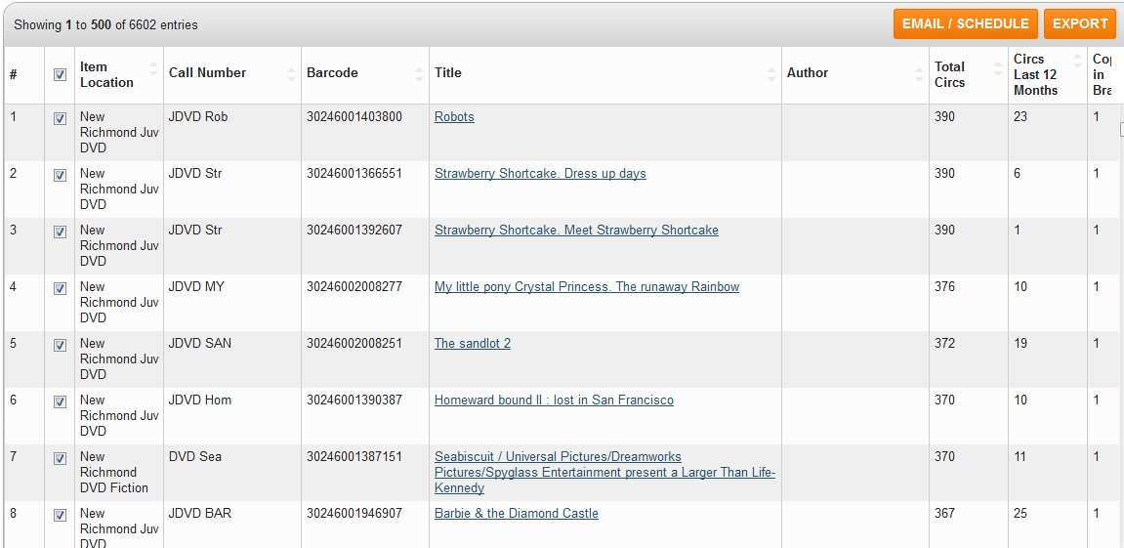
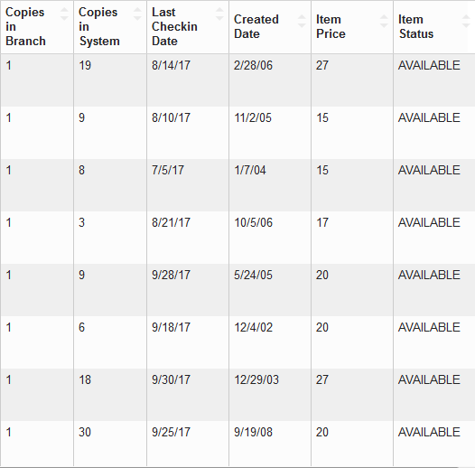
Maintenance - Weeding
High Circulation Weeding
See what is likely falling apart and needs replacement
Limit to one location
Choose number of circulations

Slide 24
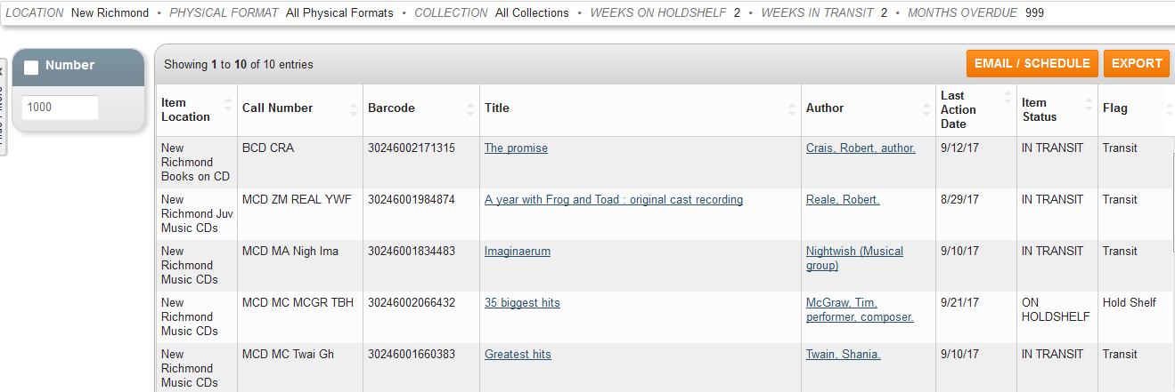
Maintenance – Clean up – Missing items
Finds items too long on Holdshelf
  Finds items on holdshelf with no item level hold
Lost in transit
Long overdue
Limit to one location
Designate timeframes
  999 to exclude
Notes:
Our procedure for items too long in transit is to search your library’s shelves first, then contact the library it was coming from (in transit message in item record), if neither can find it, it goes on a system wide missing list for everyone to search.

Slide 25

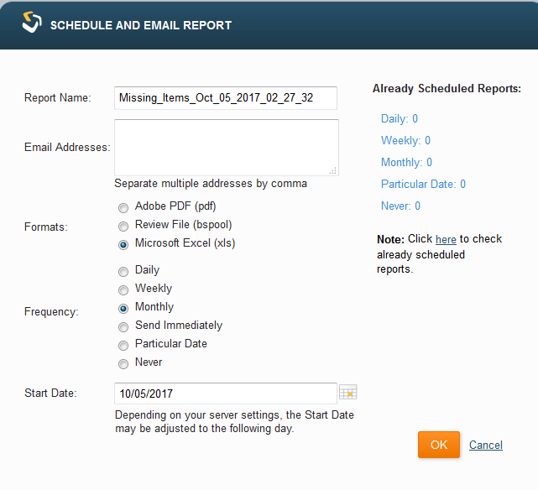
Schedule!
Fairly recent addition
Have the report sent to you on a regular basis
Once you decide what you want, you don’t have to go through the steps again

Slide 26
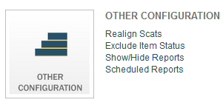
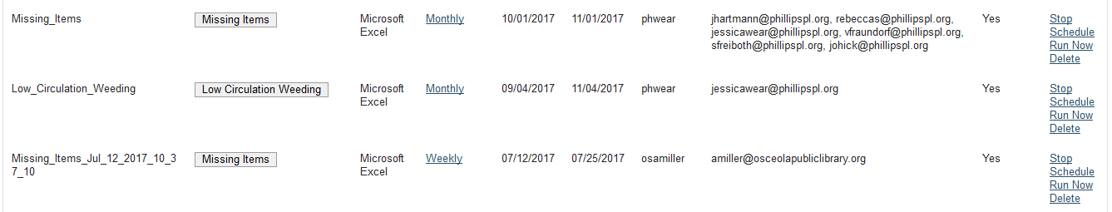
Scheduled Reports
Can view scheduled reports at any time
Choose Stop to unscheduled the report
Schedule to start it again after stopping
Run now to do just that
Delete to delete the report
To change frequency, click the Schedule type

Slide 27
Conclusions
User friendly – Click and Go
Best way to learn is to use it – click and see what you get!
  Remember, you can’t hurt anything
Big advantage is totally custom dates
Schedule option very useful
Questions?

Slide 28
Kathy Setter setter@ifls.lib.wi.us
Thank you!

