Slide 2
Cost Effective Resource Sharing
Donna Bacon, Executive Director MOBIUS
Nathan James, Senior Library Relations Manager

Slide 3
Calculating cost-effective resource sharing
Value = (Fulfillments – Costs) x Community Benefit
Notes:
How does one calculate cost-effective resource sharing?
What we really want to do is measure the value of resource sharing, just looking at $ costs doesn’t provide the entire picture.
Here’s a formula we might use to calculate that value,
Value =
Dollar value of filled requests (not all requests, but filled requests; the higher the fill rate, the better the value of fullfillment)
Minus our real dollar costs (composed of software costs, courier costs, and staff time)
MULTIPLIED by the benefit of being part of a sharing community

Slide 4
The three Cs of resource sharing
Costs
Courier
Community
Notes:
With our formula in mind, we want to discuss three major components of cost-effective resource sharing
Thoughts on how to quantify and compare Costs
Courier, which is a component of costs but is so important if resource sharing is to work well that it deserves separate consideration
And perhaps the most important part of the formula, building a resource sharing Community with all the benefits that implies, many of which cannot be expressed in terms of dollars

Slide 5
Cost
Quantifying Resource Sharing

Slide 6
Collections Savings
In 2015, our libraries saved $9,676,334.14 by borrowing books through MOBIUS instead of purchasing them for their libraries.
Based on the average price of $72.77 for an academic book and $15.32 for a public library book.

Slide 7
What’s the dollar value of resource sharing?
Costs
Costs of resource sharing software
Costs of courier
Costs of staff time
Fullfillments Value
Dollar value of borrowed materials: fulfillments
Fulfillment rate
Fullfillments – Costs = Effective $ value of resource sharing materials
To get the best effective value
Higher numbers are better for fulfillments
Lower numbers are better for costs
Notes:
Costs vs Value
It is possible to quantify some elements of the resource sharing formula as specific dollar values: software costs, courier costs, staff time.
The cost shouldn’t outweigh the value, but we too often focus just on costs rather than the value that resource sharing brings to our customers
So how to put a dollar figure to the value of resource sharing? One method would be to use the costs to acquire all borrowed materials.
I would also argue that fulfillment rate should be considered in the equation; a resource sharing with a low fulfillment rate isn’t going to satisfy customers as well as one with a high fulfillment rate.
Let’s focus on calculating value for the next few slides

Slide 8
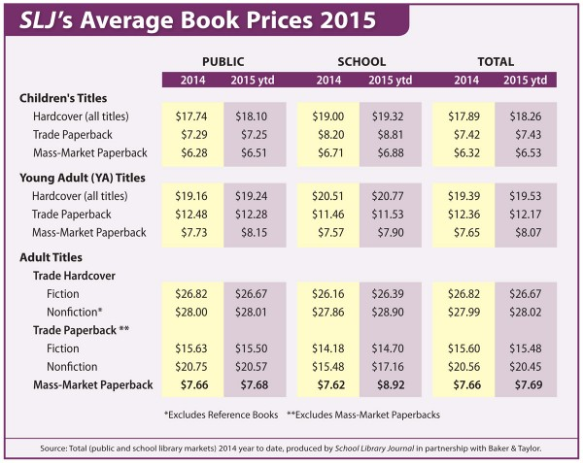
Notes:
To calculate the value of borrowed materials we need to get an average cost to acquire a copy of a title. School Library Journal has a handy average book price guide that we can use as a simplified example. We’ll take public library trade hardcover as our guide and use $27 per copy as a close-enough figure for our purposes.
Naturally the real costs to acquire materials also includes staff time, shipping, and processing costs, so the real cost to acquire will be higher than the price of the material itself.
Source: http://www.slj.com/2015/03/research/sljs-average-book-prices-2015/#_ (Data from Baker & Taylor. Method: Averages are calculated by total number of all book sales divided by the number of books sold.)

Slide 9
Value calculation for the top borrower in MOBIUS
MOBIUS | 2015
Fulfillments | 26,735
Cost per copy | $27
Value of fulfillments | $721,845
Notes:
Using the top borrower in MOBIUS for 2015, Springfield Greene County. This library provides their patrons nearly three-quarters of a million dollars worth of materials through resource sharing, year after year. That’s an incredible deal!
And remember, the cost per copy here is low since it doesn’t include staff, shipping, processing, tax, and other extra costs; it’s just the average cost of a public library hardback book.

Slide 10
Value calculation for all MOBIUS libraries
MOBIUS | 2015
Total fulfillments | 177,581
# of libraries | 76
Fulfillments per library | 2,337
Cost per copy | $27
Value of fulfillments per library | $63,099
Value of all fulfillments | $4,794,687
Notes:
Using the total fullfillments for MOBIUS for 2015, divided by number of libraries, we still get a huge number. Imagine adding 63,000 dollars to your materials budget every year.
And if you work out the value of the shared materials for MOBIUS as a whole, it’s a whopper of a figure!

Slide 11
Fill rate affects value
OCLC
Total REQUESTS | 8,858,368
OCLC ILL Users | 9,867
REQUESTS per library | 898
Cost per copy | $27
Value of REQUESTS | $24,246
Value with 75% fill rate | $18,185
Value with 90% fill rate | $21,821
Notes:
Let’s use some numbers from OCLC to show how fill rate impacts the costs. Staff still have to do some work and thus the library incurs some costs even from unfilled requests. Getting a very high fill rate reduces the cost of processing for unfilled requests so fill rate is an important factor.
I’ve yet to find fulfillment numbers for OCLC, but using some numbers from their annual report we can guess at number of requests per library using OCLC ILL. Admittedly the numbers here are wishy-washy but we’ll use them as an example.
OCLC didn’t provide fulfillment statistics on their ILL statistics page (although they might be available after logging in) but they do provide data on number of requests placed. Using their numbers if we had a 100% fill rate (which we know isn’t true) we’d have a value of $24,246 per library. Assuming a couple of different fill rates you can see that the value of fullfillments could be much lower. INN-Reach typically has a 90% or higher fill rate, so it delivers a great request to fulfillment ratio.
Source: https://www.oclc.org/worldshare-ill/statistics.en.html (“OCLC Resource Sharing Facts and Statistics” - Time-frame uncertain.)

Slide 12
Courier
Can someone buy us some planes?
Notes:
I don’t know how many of you manage courier systems—but they can be complicated and challenging.
Used to tease Kim Masana that I just wanted him to buy us some planes!
All this resource sharing, setting up InnReach can actually be the easy part. But you need courier-someone has to move the materials from library to library, something you never learned in library school. We learned the hard way---get your courier system going first! It will save you money. Cheaper than using USPS or Fedex or UPS. Our libraries pay about $3800 annually for 5 day per week delivery. No limit on the number of materials.

Slide 13
Courier Savings
Resource Sharing brought unexpected savings by expanding courier service to other states.
Courier costs about $1.30 per book vs $2.45 via USPS
Notes:
As we started expanding our membership out of state-we added connections to other states. This not only allowed us courier service to those libraries connecting to our INN-Reach system but also those using traditional OCLC ILL. In stead of paying for postage, they could place an item in a courier bag and send it along. Costs are lower. And we increased our connections.

Slide 14
Notes:
MOBIUS is based in Missouri but by adding INN-Reach libraries in Texas, Kansas, and Oklahoma we increased access. 300 libraries via Trans-Amigos Express.
We connect our InnReach system using the peer to peer software from III to Prospector’s INNReach system so we can have patron initiated borrowing across systems giving our patrons access to an additional 32 million items. But we had to reach across Kansas to do so. Still cheaper than ILL and it is patron initiated. Connect with CliC which runs their couier and now an additional 300 libraries.
Soon connecting to Illinois and in negotiations with Iowa.

Slide 15
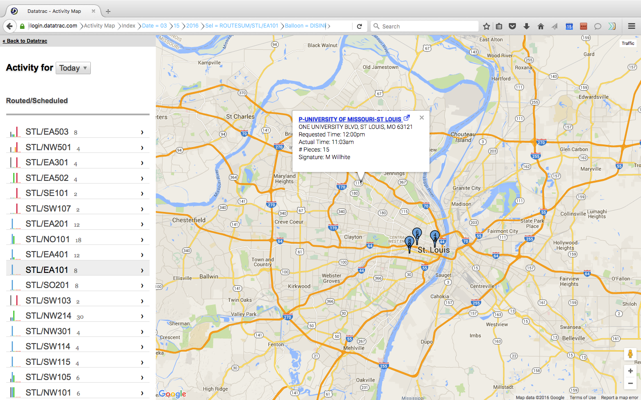
Notes:
Our courier drivers scan each bag they pick up and each bag they deliver. This allows each library to track their materials and to gather statistics to help us determine not only where items are at any given time but also how much it is costing us per item.

Slide 16
Community
Building the sharing community
Notes:
Building the Sharing community. Libraries are all about community, no matter the type of library. Consortia inherently create a very collaborative library community. Once you join and you realize not only the financial benefits, but the sharing and networking as well, you won’t want to leave. Once you provide resource sharing to your community, they won’t want you to leave either. I have often told new member libraries…one you join, your users won’t let you leave. Our libraries agree.

Slide 17
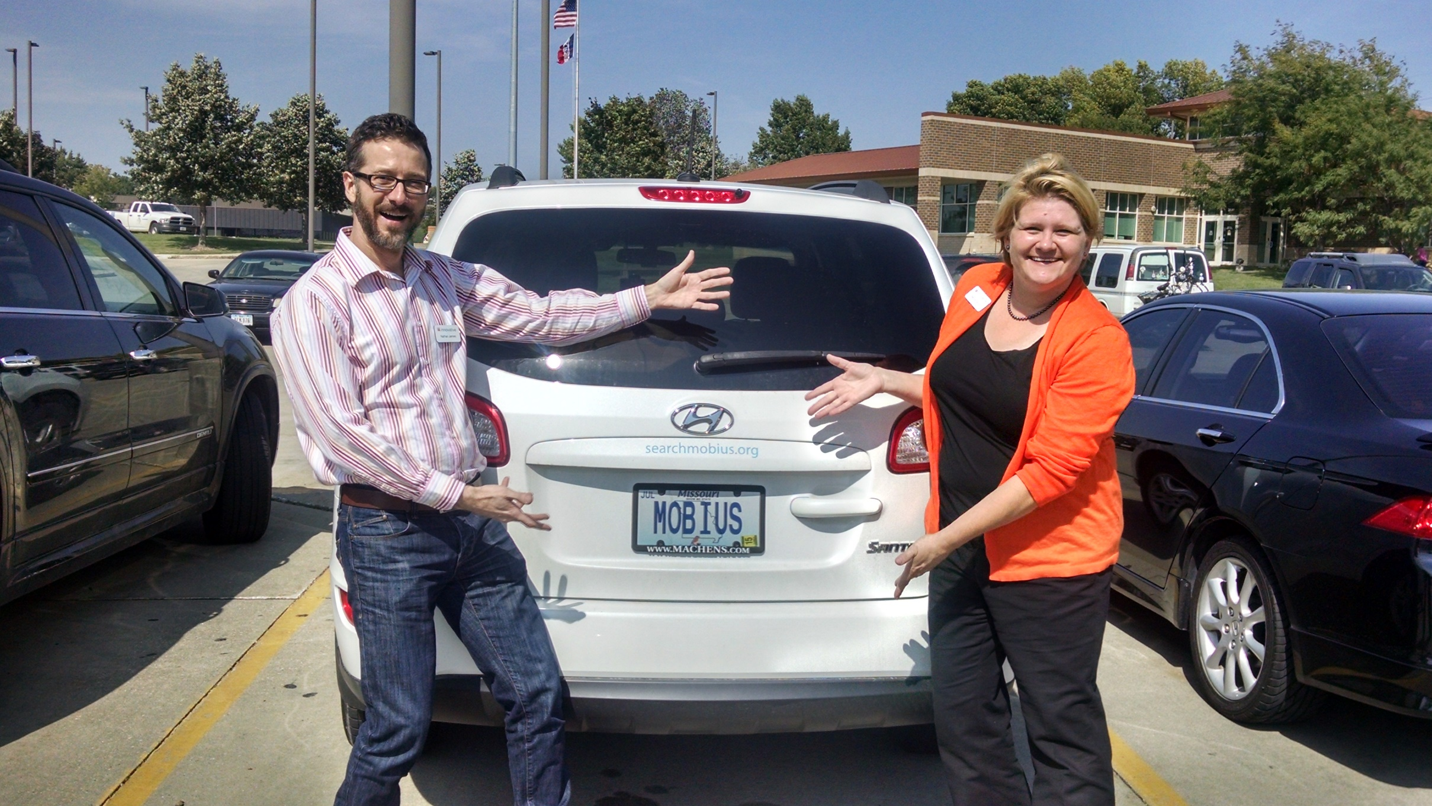
Notes:
Here you have a picture of the MOBIUS car (or as we call it the MOBImobile) with Nathan and Maruta. We were visiting Iowa libraries to talk about Inn-Reach and we just had to have a picture.
We were traveling so much that had to buy a car so of course we put our logo on the sides and on our license plate. Driving this car, and in particular around Missouri, where we have been based for almost 20 years, reinforced for me how much of an impact MOBIUS has had on our community of users. We have an annual conference for our libraries and I often have a new story to tell about something that happened to me while driving the MOBIUS car.
One time I was at Starbucks in the drivethru—lady with baby carriage
Another time I stopped at a Starbucks—as I was getting out of the car, a guy walks out and yells, MOBIUS rocks!
Another time, I was walking to the MOBIUS car that was parked and saw a man and a woman walk up to the car—wow they have a MOBIUS car. What a great service—you can anything you want in a few days. I couldn’t have made it through school without it.
And finally, you know you are really successful, when your consortia name becomes a verb—I heard someone say they were going to “Mobius” a book.

Slide 18
MOBIUS -- We are ALL about Resource Sharing
We are a nonprofit 501(c)(3) organization based in Columbia, MO.
We were formed for the purpose of resource sharing and to create a shared ILS in 1998.
We manage 11 Sierra systems for 68 libraries in Missouri (primarily academic) and an Inn-Reach system.
We partner with 8 additional Sierra libraries for resource sharing for a total of 76 member libraries with over 190 physical branches.
Our union catalog has more than 27 million items with over 10 million unique items.
http://searchmobius.org
Notes:
So, who is MOBIUS? Why were we formed? How did we become so successful?

Slide 19
MOBIUS Libraries
27 Four Year Private
14 Four Year Public
6 Two Year Public
6 Community Colleges
10 Seminaries
4 Medical Libraries
4 Law Libraries
5 Public Libraries
4 Special Libraries

Slide 20
INN-Reach Allows Us to Expand
New Members Out-of-state: Texas, Iowa, Kansas, Oklahoma
Polaris Libraries—Altoona Public Library in Iowa will be our first in the coming months.
We partner with the Colorado Alliance of Research Libraries (Prospector) so our users have direct access to their 32 million items

Slide 21
Vision for Collaboration
Reducing Costs
Sharing Expertise
Enhancing Services
Notes:
Our vision is all about resource sharing and collaboration. We help our libraries reduce costs by sharing expertise and enhancing services.

Slide 22
MOBIUS Union Catalog
Resource Sharing
Cost Effective
Rich catalog with
unique resources
Continuous Growth
Integration with Discovery Interfaces
Open access resources
Notes:
We work because our libraries are committed to our vision and to our organization. They believe in what we do. They see the results every single day. It’s cost effective. It offers a rich catalog with resources from ARL libraries to public libraries, special libraries, small and large. We have to keep growing in order to stay relevant. Continuous growth, no matter how you define that, is important for any organization, including a library consortium.

Slide 23
Value Proposition for the Consortium
Creates cohesiveness among members
Supports collaborative programs
Creates a strong return on investment (ROI) for consortial membership
The cost for lending returnables is greatly reduced
The single point of discovery assists patrons in finding and getting what they want
Creates strong branding for the consortium as most other activities are behind-the-scenes and not seen or understood by the end-users
Cost savings for libraries---costs about $0.47 for an INN-Reach loan as opposed to $20 to $30 for traditional ILL.

Slide 24
Value Proposition for the Local Library
Much lowered cost for borrowing and lending
Patron initiated
Less expensive staff or students can fulfill most functions
Faster – Better -- Cheaper
A unified workflow that is integrated with the ILS
Most libraries can have 90%+ of ILL requests met for returnables through INN-Reach
Political advantages for cooperation – town-and-gown – cooperation between municipalities
Coordinating collection development activities

Slide 25
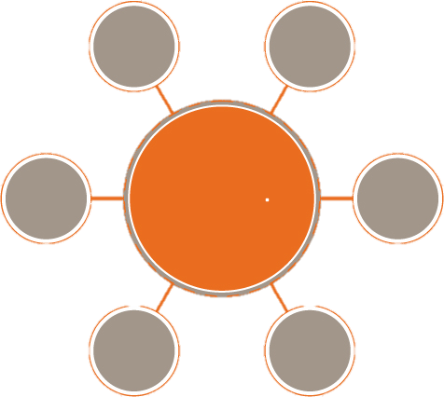
Peer to Peer Environment
Notes:
All works in the same way as if the patron started their search in their local library catalog. If the patron is unable to find available copies or is unable to locate the resource in their primary network, they have the option of passing the search to the secondary network.

Slide 26
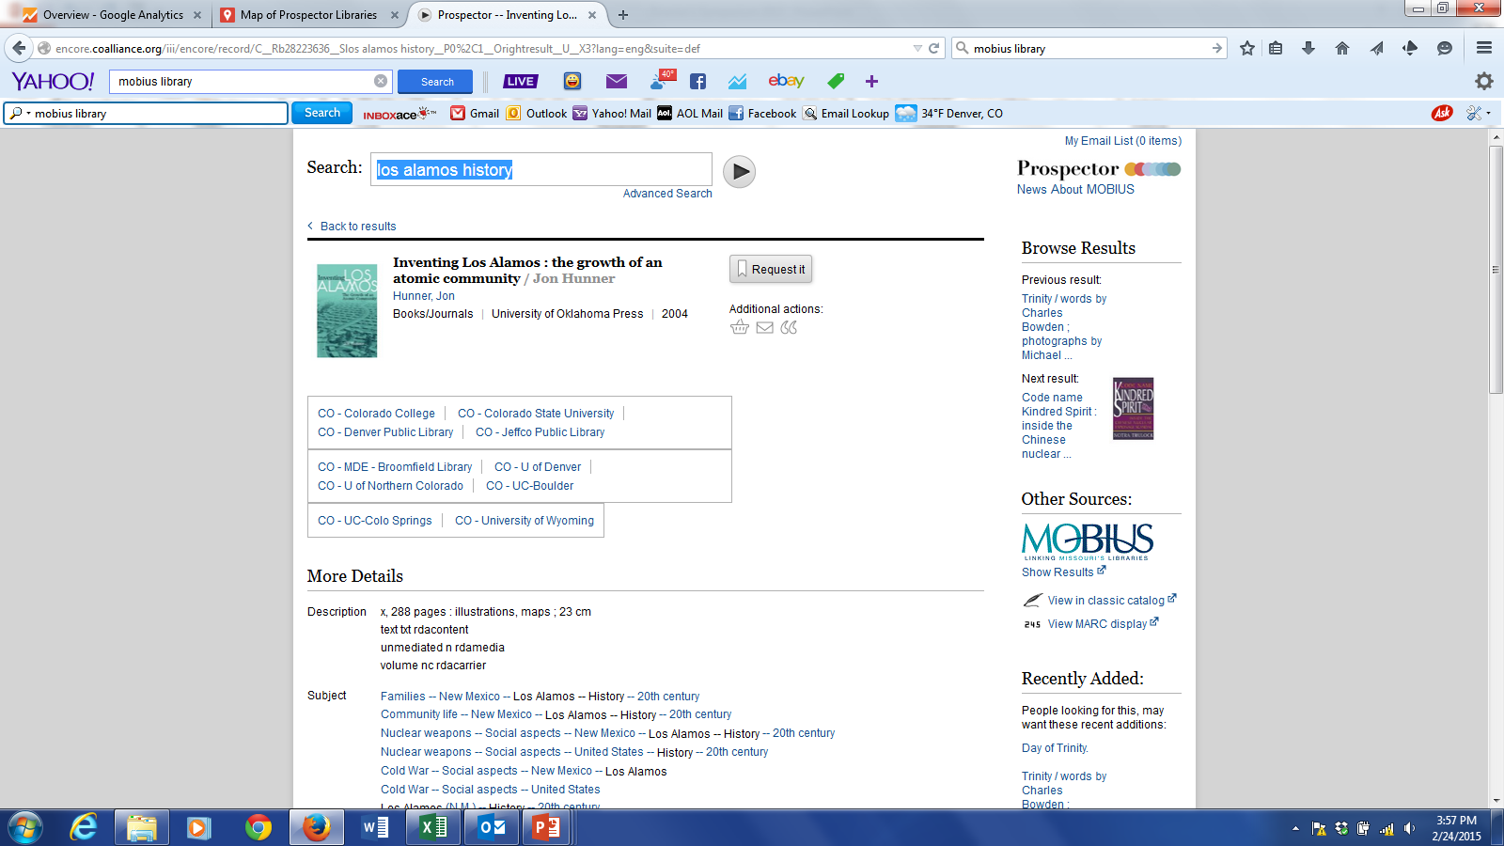

Slide 27
Peer to Peer Requesting
Value to Members
Challenges
Both systems maintain their own union catalog (branding is important)
All patrons can request equally from either union catalog
Staff receive and process requests from both systems in the same way
Over 60 million items from Prospector and MOBIUS combined!
Why?
More stuff
All checked out regionally
Regional specialties
Rare & unusual items
Better than traditional ILL
Delivery of materials
Getting the courier to perform
We have Kansas in between!
Reconciling policies between the systems
Loan periods, fines, lost item fees
Adjustments to workflow with doubling of participating libraries
Notes:
More public libraries for MOBIUS.
More seminaries for Prospector.
Challenges—Keep it simple. Rubber bands—courier the most challenging part. Peer to Peer works perfectly.

Slide 28
Prospector – 3% of all MOBIUS Fulfillments

Slide 29
Successful Journey Since 1998…
MOBIUS has been a huge success with patrons and library staff!
It is playing an important role in delivering materials in a time of declining budgets
It leverages and promotes inter-institutional cooperation
It is being used as a tool for shared collection development and other related projects
I knew we were successful the moment we became a verb!

Slide 30
Questions?

