Slide 1
Better Than I Found It
Preparing for your successor
Pam Skittino Deerfield Public Library, IL
Kathy Setter IFLS Library System, WI
Notes:
Take steps now to prepare *things* so someone can transition into your role. Should you retire or leave your position, it's very helpful for those remaining to have clear documentation on what you do and how you do it. Learn what we're doing pre-retirement to help ease the transition for the people who will be taking on our roles.
I’m Pam Skittino from the Deerfield Public Library in Illinois, I work at a medium-sized library doing both Sierra System Administration and managing the Support Services Department (which is TS), My co-presenter today is Kathy

Slide 2
The greatest thing you will ever give to the world is your commitment to leave what you find in better condition than the way you found it. Leave a single light in a place where there once was darkness so those coming behind you may see further and begin where you left – Tonny K Brown

Slide 3
Why Succession Plan?
Development and Retention
Notes:
Pam
What is succession planning and why do you want to leave your library or system better than you found it? Succession planning is both a method to develop others to fill your shoes and a way to ensure that what you leave behind is relevant and prepared for someone else to do your work…
When you and your library make a commitment to develop staff, identify potential successors and ensure that people have the knowledge, skills and training that they need to fill a vacant position, not only will you save time and money during the time of transition, the valuable institutional knowledge, expertise and awareness of local practices and software will benefit everyone.
As most of us at this conference know, we have to continuously develop ourselves to remain relevant and informed with the constant changes in the library field. The fact that our intuitions are willing to send us to this conference to make connections, learn new things, is an investing that they are making in you. They likely believe that this is adding value to your work, and that should feel pretty good.

Slide 4
Why Succession Plan?
Development and Retention
Morale
Notes:
Pam
Your morale is important and it also is to those who are just starting their career, or those who having found their perfect niche within the library. If you are planning a vacation, or need time off for other reasons, you will likely have someone who can cover your essential duties (if you don't please talk to your administration!). Creating documentation and training someone else on your critical tasks can make both you and the person you are training more comfortable and confident that the library can and will go on without you. In addition, it allows the person you trained to actually complete those critical tasks without you there watching. On the flip side, it also helps that person learn if they really have NO INTEREST or absolutely loved doing that work on a regular basis.

Slide 5
Why Succession Plan?
Development and Retention
Morale
Commitment
Notes:
Pam
You don't want to have either party make a commitment to do your work, if they have never had the chance to try it.
Having buy-in from your administration to do succession planning – whether or not they are planning to consider internal candidates, gives you a direction to head for your preparation efforts.
At Deerfield, our previous IT manager left in a hurry due to a fantastic opportunity – the things left behind did not make it easy for the new person, hired externally, to be competent on day one. What should you leave behind?

Slide 6
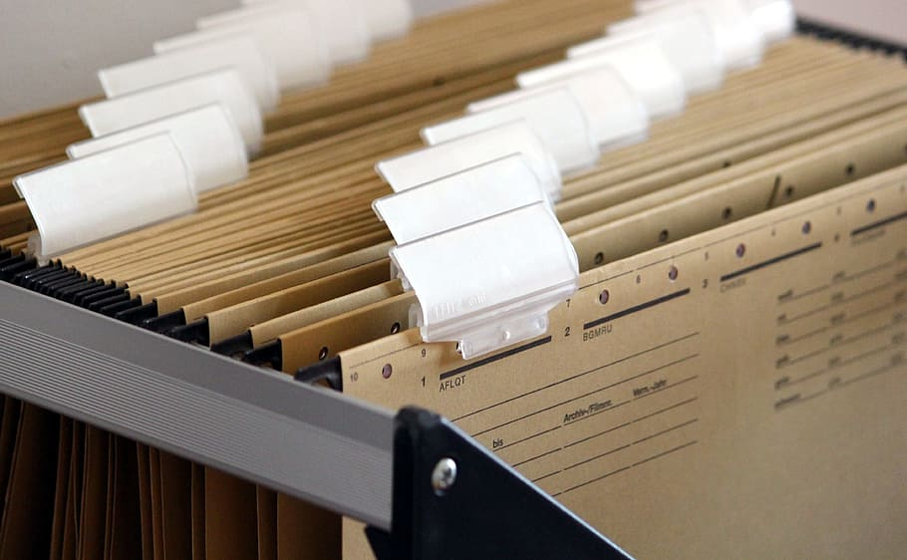
Document, Document, Document
Things cannot live only in your brain!
Types of documents
Procedures
Policies
Directions
Contacts
Order history
Routine tasks (those “automatic” things)
Ensure that files are in a shared folder and that they will be retained once your user profile is eliminated
Notes:
Kathy story then bullets System stats done first of the month

Slide 7
Document, Document, Document
Service Contacts - Maintain a list of representative and account managers for various services making it easier for the next person to reach out to representatives. Also keep track of the admin URLs that they point to.
Notes:
Pam story then bullets Also, have you given them Sip, NCIP, API access or access thru the firewall to your ILS?

Slide 8
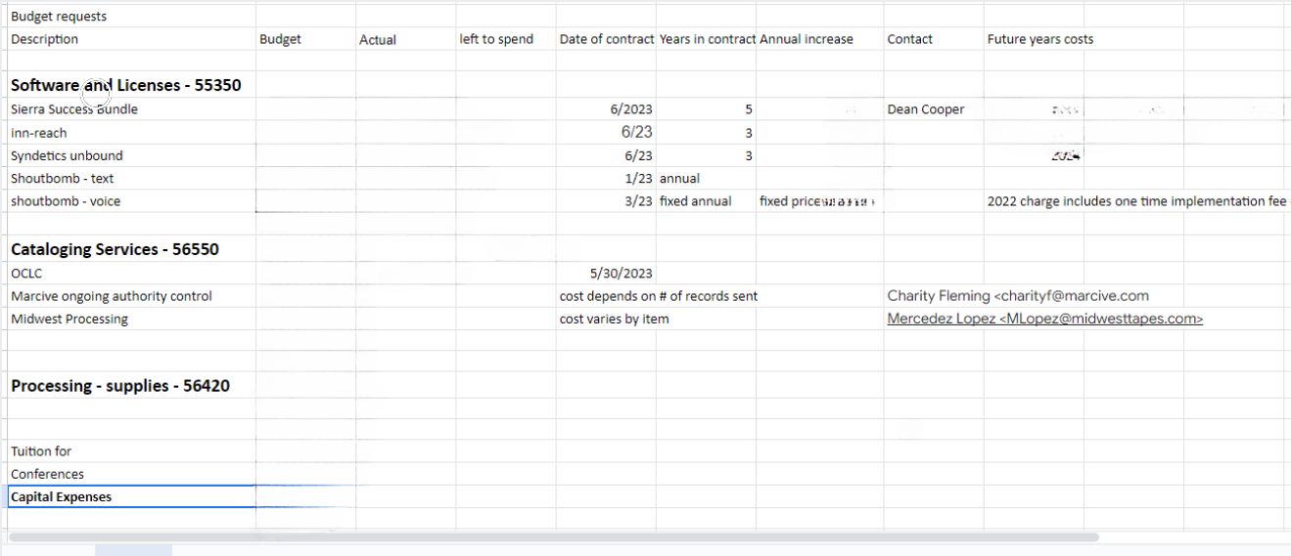
Document, Document, Document
Software Contract start and end dates and contact persons details
Notes:
Pam – record as much detail as will help you plan your department budget for upcoming years (numbers removed from this example)

Slide 9
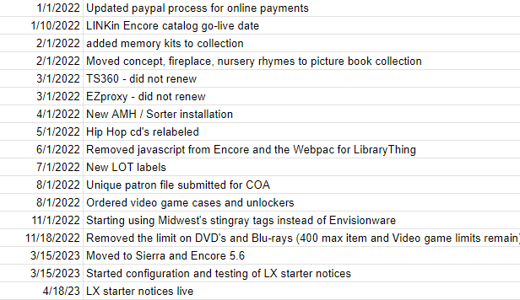
Document, Document, Document
Digital Organization - creation of a structure in file (and email) storage.
Change Log - make notes when things are changed or why certain things were done the way they were.
Organize Physical Paperwork
Originals of templates; things on your laptop hard drive
Notes:
Kathy story,
Pam bullets
Digital Organization - creation of a structure in file (and email) storage. Much like libraries decide which subject headings or classification system they are going to use, you need to choose a method of filing that works for you – yes, storing everything in your Google Drive for keyword searching and retrieval IS a decision but you may want to actually use folders and subfolders. Maybe you want to organize something by the company name and then the product, maybe you want to organize by the function – like SQL or Print Templates, maybe you want everything from 2023 together. Whatever system you can maintain is the system to use. There is no one right manner. However you organize you files, you should treat your email the same way.
Change Log - make notes when things are changed or why certain things were done the way they were. Case in point, no documentation anywhere related to how the Public catalogs were set up and configured. - Pam change log screenshot
Kathy bullets
Organize Physical Paperwork - Kathy +story+document retention policy (Illinois https://www.ilsos.gov/departments/archives/records_management/faqlocal.html#:~:text=Under%20the%20Illinois%20Local%20Records%20Act%2C%20each%20unit%20of%20local,must%20have%20their%20own%20application.)
Originals of templates; things on your laptop hard drive - Kathy

Slide 10
Digital Footprint
Email Clean-up
Passwords
Start
Start unsubscribing now
Don’t use
Don’t use work email for personal reasons or files
If you do, stop now!
Organize
Organize into folders
Name them so contents are clear
Use a password manager
Create strong passwords
Use 2-factor authentication when offered
Beware use of personal cell phone here
Document shared logins/passwords
Notes:
Whatever you are saying Kathy and then segue either here or after your story on the next slide with "now you are organized and prepared for someone else to do your work, what next?"

Slide 11
Talk about it!
Identifying potential internal candidates (unofficially)
Analyzing strengths and weaknesses
Training to fill skill gaps
Be honest about what needs to change
Prioritizing the skills/practices to learn first
Notes:
Kathy story , Pam story about discussion with administration (fluff this yet)
Be honest about what needs to change – Kathy
Prioritize the skill/practices to learn first – Kathy
Identifying potential internal candidates (unofficially) - Pam
Analyzing their skills, institutional knowledge – Pam
Training to fill their skill gaps – Kathy

Slide 12
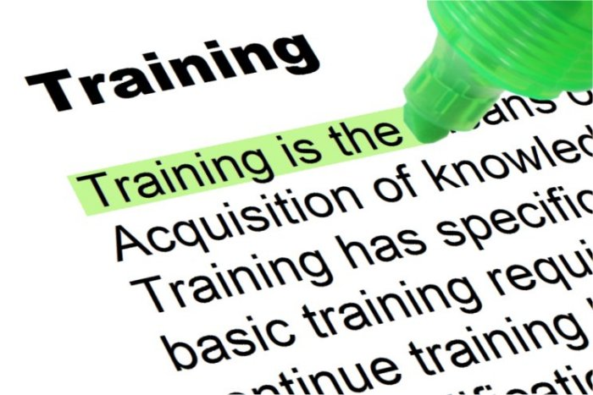
Potential Candidates
Don’t overwhelm with too much information at once
Allow candidates to take the lead on new projects with you as a supporting member of the team
Make sure the candidates have also done the above steps so they are prepared to advance without leaving a gap
Since retirements are often time to reorganize duties and responsibilities, you’ll know what will shift
Don’t be offended if the work you think is important is not considered important by others
Be kind and helpful if given the opportunity
Notes:
Kathy story -new employee lasted 3 weeks, Pam story then bullets
Don’t overwhelm with too much information at once
Allow candidates to take the lead on new projects with you as a supporting member of the team - Pam
Make sure the candidates have also done the above steps so they are prepared to advance without leaving a gap – Pam Since retirements are often time to reorganize duties and responsibilities, you’ll know what will shift – Kathy Don’t be offended if the work you think is important is not considered important by others Be kind and helpful if given the opportunity

Slide 13
A leader's lasting value is measured by succession - John Maxwell

Slide 14
THANK YOU
Questions?
Pam Skittino pskittino@deerfieldlibrary.org
Kathy Setter setter@ifls.lib.wi.us

Slide 15
Additional Resources
(n.d.). Succession Planning: A Step-by-Step Guide. National Institutes of Health. Retrieved March 17, 2023, from https://hr.nih.gov/sites/default/files/public/documents/2021-03/Succession_Planning_Step_by_Step_Guide.pdf
Gillis, A. S., Snider, E., & Daniel, D. (n.d.). Succession planning. Tech Target HR Software. Retrieved March 17, 2023, from https://www.techtarget.com/searchhrsoftware/definition/succession-planning
Atwood, C. G. (2020). Succession Planning Basics (2nd ed.). Association for Talent Development. https://www.hoopladigital.com/title/15689605
Weldin, S. (2023, January 17). What is “Quiet Hiring” and Are You Doing It? HR Source. Retrieved March 17, 2023, from https://www.hrsource.org/MAiMIS/HRS/Articles/2023/01/17/What_is__Quiet_Hiring__and_are_you_doing_it_.aspx?_zs=hn5sc1&_zl=n39m8 (paywall)

