Slide 1
Implementing Pins for Max Security
Brandon Cole
Marmot Library Network, Colorado

Slide 2
“I like libraries. It makes me feel comfortable and secure to have walls of words, beautiful and wise, all around me. I always feel better when I can see that there is something to hold back the shadows.”
Roger Zelazny

Slide 3
Concerning Headlines
Notes:
Patron data security is more important than ever
In 2024, as an industry we saw a increased number of successful attacks on batches of library data. These headlines tend to focus on large breaches. Not so much on the individual breaches that occur.

Slide 4
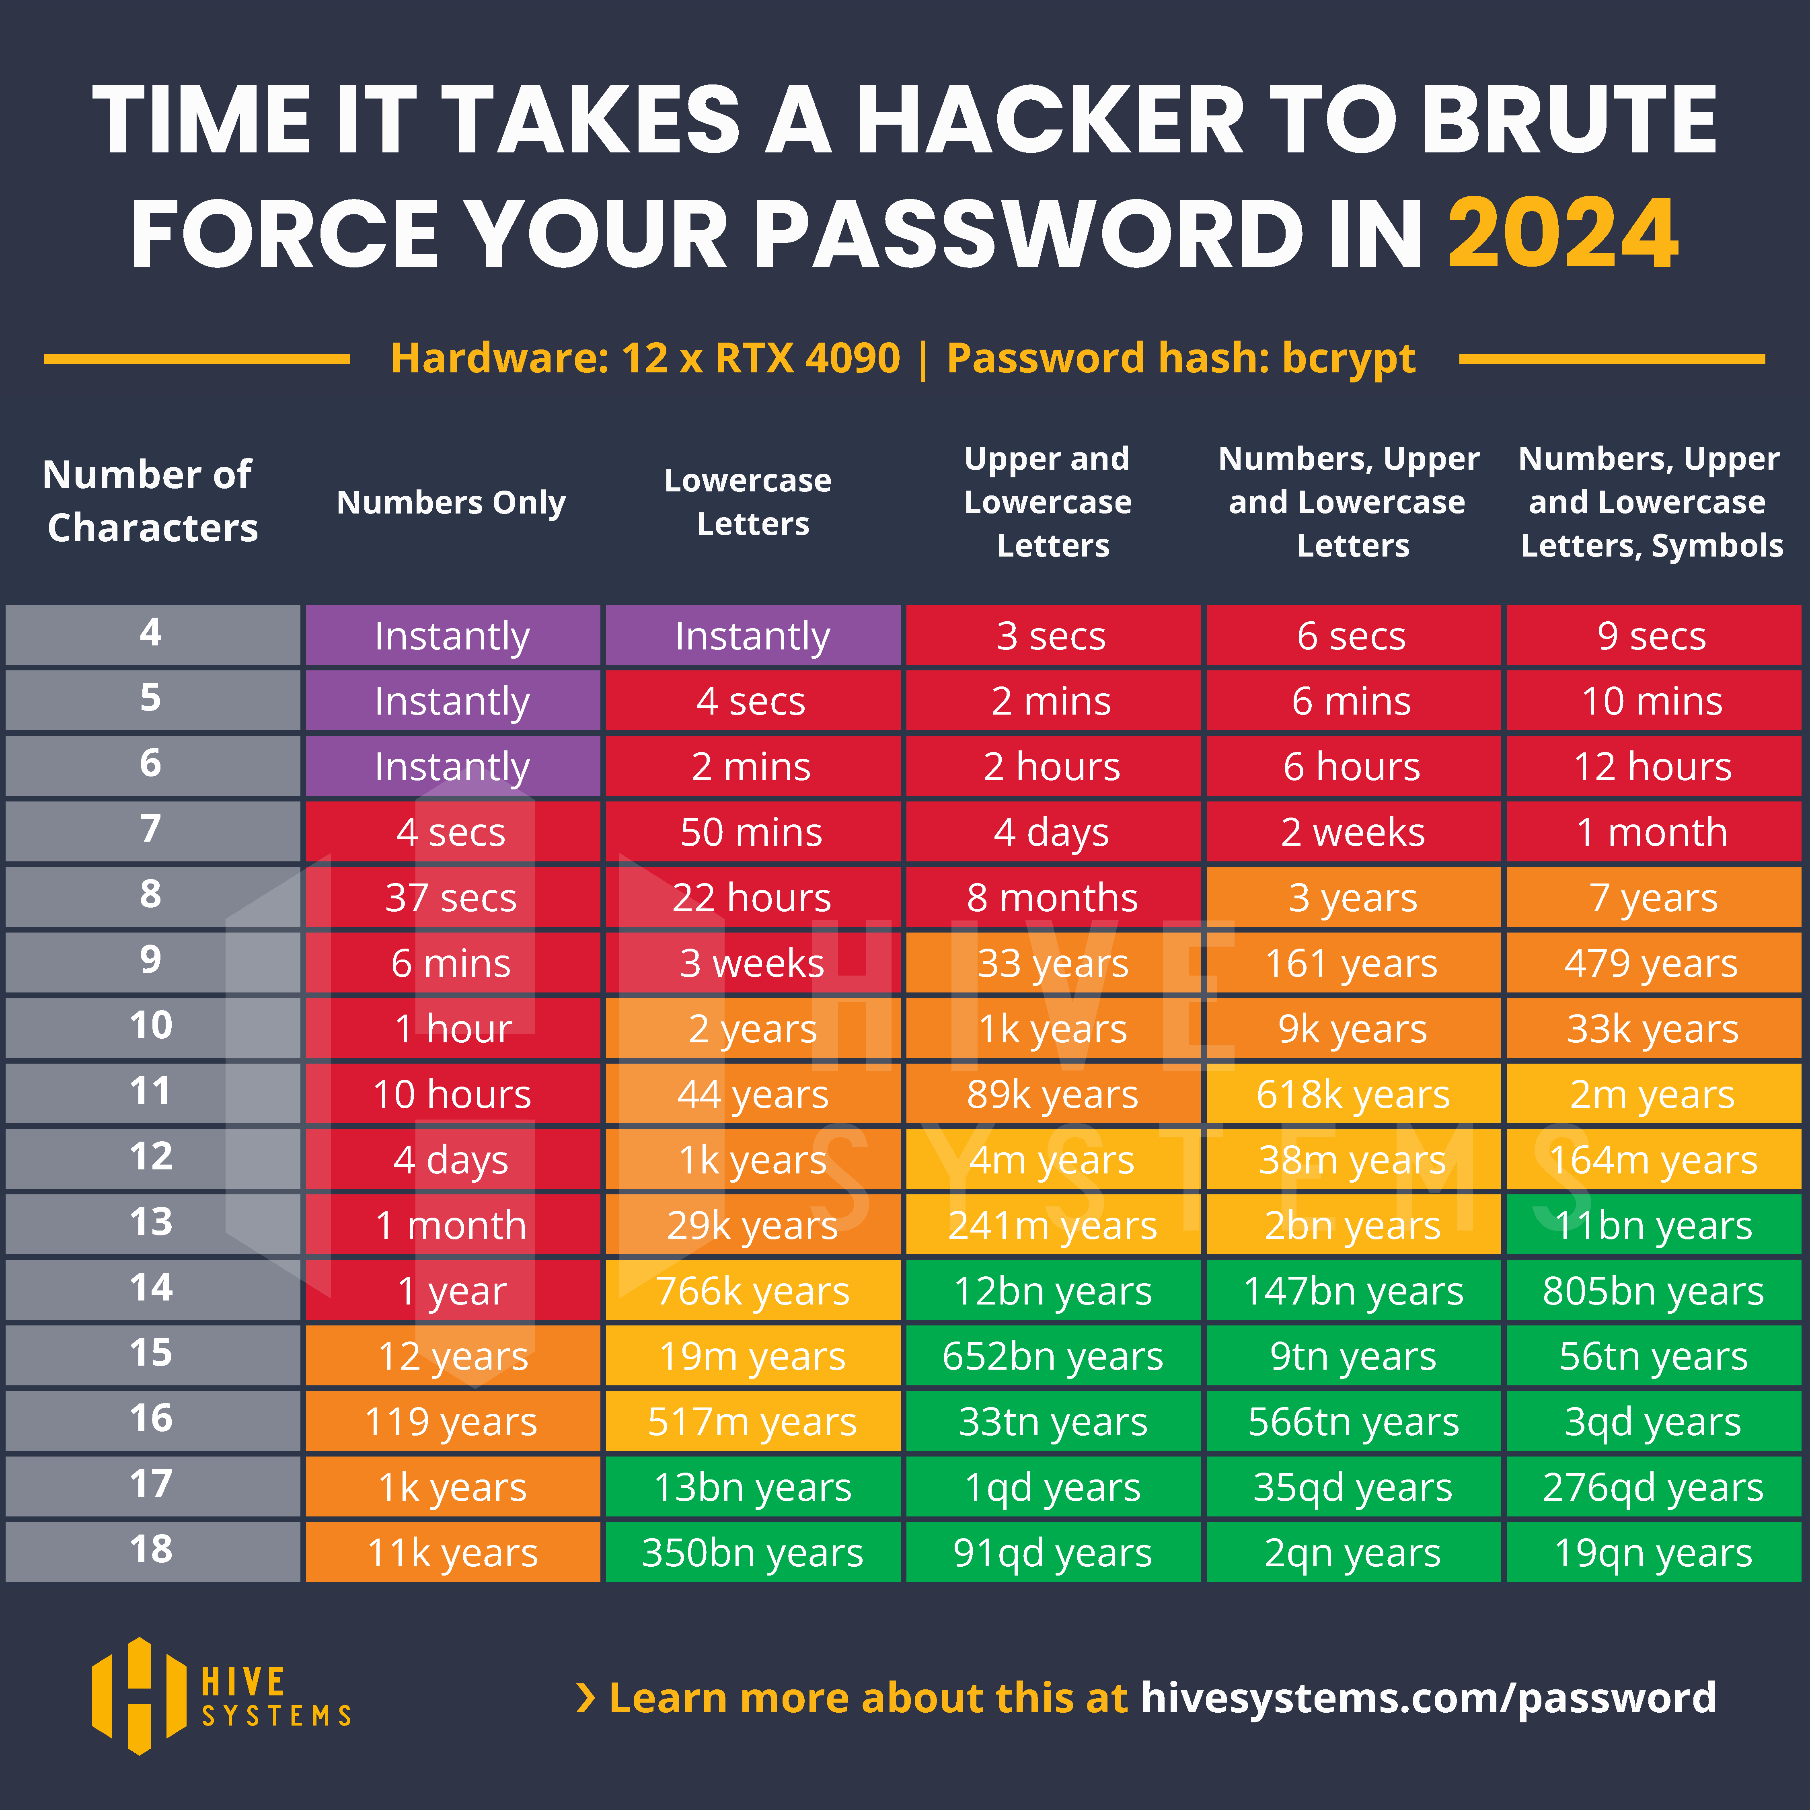
Hive Systems Annual Password Table
https://www.hivesystems.com/blog/are-your-passwords-in-the-green
Notes:
This indicates that if your library uses 4 number pins and has some system that allows for brute forcing a attacker could realize access to every patron’s record by just using public interfaces.

Slide 5
Problem Statement and Security Risks
Attack Vectors
Phishing
Data Mining
Lost Cards
Brute Force
Social Engineering
Identity based violence
Reading History
Our Problem Statement
“In today’s cybersecurity landscape, all organizations face an increasing threat. Libraries are warehouses of valuable PII information. Patrons entrust that our policies will keep them safe. We must adopt security standards that allow us to exceed this expectation while balancing obstacles to access.”
Notes:
Brute Forcing
- Marmot staff demonstrated successful brute forcing of our non password auth in less than 5 minutes.

Slide 6
Planning Phase
First efforts started in 2021
Security committee formed
Meetings and Open Houses
Presentations
Central Marketing Materials
This Photo by Unknown Author is licensed under CC BY-SA
Notes:
First efforts started in 2021
Partially driven by third-party authentication requirements (LinkedIn Learning and others)
More people using online logins
Security committee formed
Every member library encouraged to provide a representative
Working group (Everyone has a job)
Meetings and Open Houses
Idea generation.
Questions
Discussion
Committee involvement (This isn’t just a consortia office mandate)
Presentations
- User Group presentations
Central Marketing Materials
Created by a committee members library marketing department with input from committee members
Central communication timeline created
Campaigns for marketing centered around themes
Winter Passwords are coming
We love your privacy
Take action

Slide 7
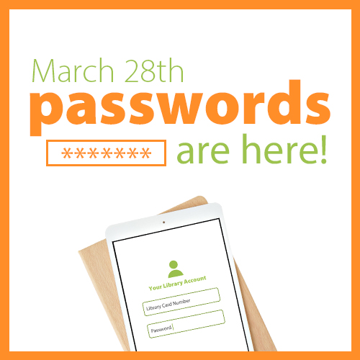

Slide 8
Planning Phase
Surveys
Question parking lots
Training
Research
Notes:
Surveys
Communication and feedback saturation
Question parking lots
Place to put questions between open house meetings
Training
Provides step by step instructions that gave library staff a blueprint on how things would look.
Used test systems to demonstrate
Research
Reached out to other Colorado libraries with a set of questions generated by library staff.
Questions like ”How have Pins impacted your circulation?”

Slide 9
Implementation Steps
Default password
Tools for implementation
Python, SQL, CSVed, REST, Patron loads
Password Complexity requirements
Enforced change
Randomization of unchanged defaults
Training
This Photo by Unknown Author is licensed under CC BY
Notes:
Default password
In weeks leading up to go live we generated the default password for each library using one of two options.
First three letters of name and last 4 digits of barcode
First three letters of name and last 4 digits of phone number
Identified the problem records for libraries to clean up
Tools for implementation
Python, SQL, CSVed, Patron loads
Password Complexity requirements
At least 8 characters. Alpha numberic
Enforced change
Defaults were just temporary. When logging into the catalog patrons were met with a screen to change their password
Randomization of unchanged defaults
I didn’t want to know the passwords.
Patrons would still be able to change their password via a forgot my password link
Contact library to assist with password change (one time)
Training/Support
Day of go live our teams at the consortia office took calls, responded to emails, support tickets, and offered live support via zoom.

Slide 10
Challenges
Late nights (after hours)
Getting agreement among members
Convincing Libraries 4 numbers was not enough
Providing Shared resources
Identifying which systems would be impacted
This Photo by Unknown Author is licensed under CC BY-SA
Notes:
Late Nights
Breaking load files into 100,000 ended up with about 10 files.
Two computers loading
Each file took about 40 minutes to load
Started at about 10 pm and finished around 3 am
Agreement
- Each library had slightly different needs/wants.
Finding the balance between customization and feasibility
Convincing
The argument: “ATM cards use four numbers; why can’t library cards?”
Does anyone in the audience know the answer to this question?
The answer: “ATM cards use a token approach where the card is the token. This works when the only place you use those is when you plug your card into an ATM. A hacker has a limited number of places to go to hack an ATM card. When there is an online login, the token approach doesn’t work.”
Providing Shared Resources
Took a lot of efforts to design marketing materials that each library could customize.
A entire sub committee dedicated to this effort.
Which systems would be impacted
We had a hard time determining all the systems that would be impacted or that had optional configuration on a per library basis.
SIP2 connections
Third party vendors

Slide 11
Challenges
Writing and testing python code
Program to check for updated passwords
Program to generate default passwords and randomization
Patron load limitations
Notes:
Python Files:
Slow processing of large number of records.
Multithreading Python programs
Patron load limitations
Figuring out how to split CSV files

Slide 12
Security Impact and Results
Passwords set to at least 8 characters.
Library cards less of a risk if shared/lost
Patron/Library feedback minimal
Smooth transition
Lots of communication
Brute forcing is much less successful
Overall patron security increased
This Photo by Unknown Author is licensed under CC BY-SA
Notes:
Developers for discovery layer created a mechanism to allow library staff to masquerade as patrons
Developed a easy method for patrons to be prompted to set a password the first time they log in to the catalog

Slide 13
Future Enhancements and Best Practices
Multi-factor authentication
SAML/SSO options
On going training and education
KnowBe4
Cybersecurity monitoring systems
Minimum security standards for third-party integrations
Secure SIP connections
This Photo by Unknown Author is licensed under CC BY-NC-ND
Notes:
Minimum security standards for Third-parties
Brute forcing protection?
Data stored?
Encryption?

Slide 14
Questions?

Slide 15
THANK YOU
Want to chat?
- brandon@marmot.org
- Brandon Cole – Marmot (CO) on IUG Discord

