Slide 2
The Limits of Customer Self-Sufficiency:
Filling the Gaps When Request Failures Happen

Slide 3
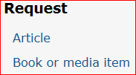
Requesting services
Express Retrieval (paging items with a status of “In library”)
Recalls (placing hold on item checked out to another user)
Inter-library Loan (requesting material from another library)
Customers can and are encouraged to place these requests for themselves. They can do so through
our OPAC,
our discovery tool (Summon),
or directly into the ILL account

Slide 4
Promoting customer self-sufficiency
To promote life long learners
Shrinking budgets mean Shrinking human resources

Slide 5
When things go right …
ILL Requests
Customer places request
We confirm we do not own it (or it is checked out)
We forward request to another institution
Paging requests for UA-owned material
Customer places request
We pull the item from our shelves
Customer notified item is available in 24 hours or less

Slide 6
Things don’t go quite so right …
ILL Requests
We confirm we do own item and has a status of “In library”
We cancel ILL and instruct customer to place paging request
Customer has to do additional work to get item
Paging requests for UA-owned material
We cannot find item on our shelves
Customer notified original hold cancelled and directed to request through ILL
Customer has to do additional work to get item

Slide 7
When things go very wrong ILL…
ILL Requests
After we cancel ILL request, and customer places a paging request
We cannot find UA-owned copy, customer is notified hold is cancelled and instructed to request via ILL
Customer has entered a confusing circle, and delays in getting them material increase

Slide 8
When things go very wrong paging …
Paging request for UA own material
Customer is unsure about how to place ILL request and just gives up
Due to various staff errors request is not completely processed, customer never notified and hold automatically expires after set date

Slide 9
Solutions for ILL Requests
Once we determine we own item and it has a status of “In library” we still cancel ILL hold
But then we place the paging request in Millennium for customer, saving them effort
This is done using a special login not associated with any library location in order to trigger request being put on paging item list
If all goes well and we find the item, customer able to pick up item within 24 hours

Slide 10
Solutions for Paging Requests for UA-owned material
If we have to cancel the original hold we now inform customers that they simply have to respond to hold cancellation notice and we will place ILL request for them. This saves them time and effort
Developed a process for catching “Unfilled holds” that would otherwise not be resolved.

Slide 11
Why need to follow up on “Unfilled holds”
For our paging process an unfilled hold is one that should have been pulled and had the status changed to “On holdshelf,” but did not. These are items with status of “In library” and have a hold on them.
If we do not follow up on these items the holds will expire automatically after 4 weeks (our not-wanted-after-date setting)
Customers will be waiting weeks to hear about the resolution of an item that we guarantee will be resolved in 24 hours and potentially lose a hold that is available for them

Slide 12
Determining “unfilled holds”
Go into View Holds
(Remember View Holds is a snapshot of items with holds and their status for a moment in time. Usually sometime in the early morning hours)
Leave date as is
Change drop down on left-hand side to “Status” and type in “In library”
For Pick Up Location choose the location served, specific area location or all as appropriate
This will get you a list of all items with holds but with a status of “In library” but should have been filled that you need to follow up on.
Sort list by Date Placed

Slide 13
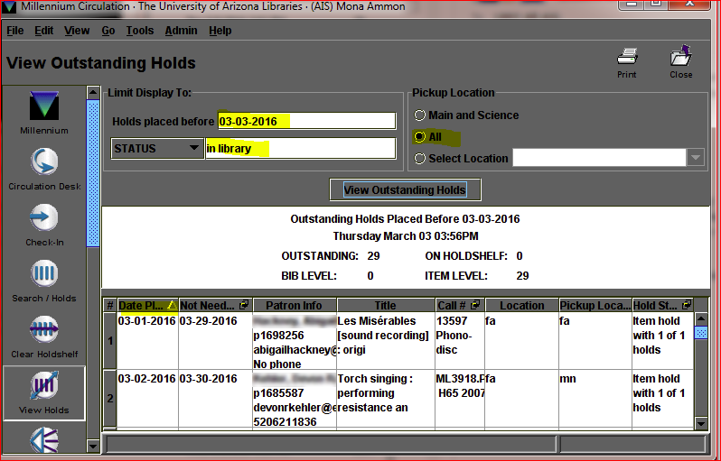
Snap Shot of View Outstanding Holds for In Library

Slide 14
We only pay attention to items that had holds placed prior to the last time we ran our paging list (slips)
Those items are the ones that will likely have holds expire unnecessarily if not dealt with
The items that have holds placed after the last time we ran our paging list (slips) will be caught the next time we run the paging list
You may need to right click to view the item record, click on the holds tab to view the exact time the hold was placed
For older items right click to view item record to determine if the status changed since the View Holds snapshot in the system was taken
If the status in no longer “In library” we do not have to do any more follow up
Print View Holds list
Note on printed list
the time hold was placed (so we know what paging list to check)
if hold note indicates the item originated from an ILL request and the TN #

Slide 15
Not on paging list?
Check the appropriate paging list based on date/time hold was placed and date/time list was run to see if item listed
If request on the list check for notation made by student
Found –found during paging but still has status of “In library” (instead of “On holdshelf”)
Check holdshelf and if not there then regular stacks for item matching exact barcode. When found “check-in” to trigger hold notice and change status to “On holdshelf”
If you find a copy but not the exact copy you can transfer the hold and then process new hold.
Note on printed View Holds list where found and what student initially pulled item so as to follow up with them about this error
Not found (NOS) –not found by student but still has status of “In library” (instead of missing)
Note on printed View Holds list that student indicated item NOS
Cancel hold and send customer hold cancellation notice
Follow up with student who made the error

Slide 16
Under what login hold was placed?
If request not found on paging list determine under what login request was made
We do this by checking a reformatted searchable copy of the circulation transaction file
It gives information about all check-outs, check-ins, renewals and holds placed
You can search by item, patron or bibliographic number
It tells you the date, time hold was placed and the terminal code used

Slide 17
Holds, Millennium vs the OPAC
If terminal code associated with desk logins this means desk staff not following proper procedure. Use terminal code and date/time to check schedule to know who to follow up with
If terminal code associated with a behind the scenes staff login determine which department and follow up with them
If terminal code is one of the OPAC logins or the special ILL holds login and request not on paging list we have a potential system problem

Slide 18
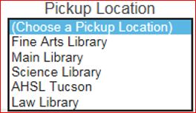
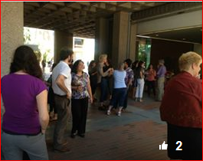
Items stuck “In transit” context
The University of Arizona Libraries has 5 circulating libraries
Customers can choose to have an item with a hold sent to a location other than the owning location
Materials are delivered once a day between sites in the morning (except weekends)
We have 35 staff members and approximately 50 students who work our service desks and check-in material

Slide 19
Determining items stuck “In transit”
Go into View Holds
(Remember View Holds is a snapshot of items with holds and their status for a moment in time. Usually sometime in the early morning hours)
Leave date as is
Change drop down on left-hand side to “Status” and type in “In transit”
For Pick Up Location choose the location served, specific area location or all as appropriate
This will get you a list of all items with holds but with a status of “In transit” that have holds
Sort list by Date Placed

Slide 20
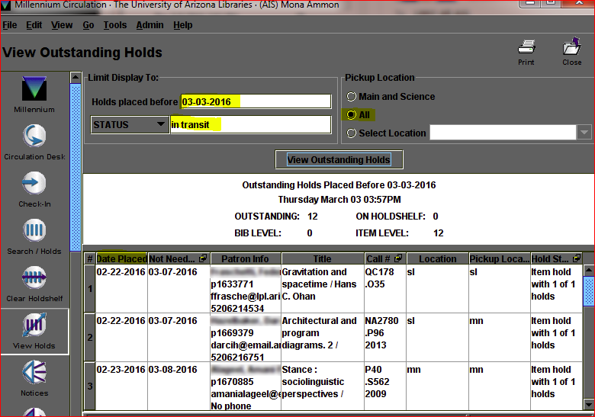
Snap Shot of View Outstanding Holds for In Transit

Slide 21
Print View Holds list
Right click to view item record to determine if the status changed since the View Holds snapshot in the system was taken
If the status in no longer “In transit” we do not have to do any more follow up
If the status still is “In transit” note on the printed list from where and to an item is “In transit”
Check holdshelf, the regular stacks, and the re-shelving carts for item matching exact barcode. When found “check-in” to trigger hold notice and change status to “On holdshelf”.
Using information in item record about the location, date and time an item was checked-in follow up with the appropriate staff person
If despite your best efforts you cannot find the item, cancel hold and mark item missing

Slide 22
Why Go to All this Effort?
INTEGRITY
To fulfill our promise to our customers
Particularly when the breakdown was due to our error or negligence we need to make it right
CONTINUOUS LEARNING
Our customers are using this material for educational and research purposes that have deadlines. We need to get them what they need in as timely manner as possible
We need to understand how mistakes are happening to keep them from continuing to happen. The mistakes waste time, effort and negatively impact our customers

Slide 23
QUESTIONS?

