Slide 1
How to SQL
Part 2
Jeremy Goldstein: Minuteman Library Network
Ray Voelker: The Public Library of Cincinnati and Hamilton County

Slide 2
Meet Jeremy and Ray...and Rufus and Audrey

Slide 3
Agenda
Part 1
SQL Basics
Relational Databases
Joins
SQL Overview
Statements
SELECT
WHERE
GROUP BY / HAVING
Subqueries
CASE
Part 2
Sierra_view schema
Previewing data
Data Types
Casting
Functions
Aggregate/Filter
String Functions
Window Functions
Combining Queries
EXISTS
INTERSECT/EXCEPT/UNION

Slide 4
Sierra_View

Slide 5
Overview
Views Not Tables
360 tables
2780 columns
How to reference a field
schema.table.column
sierra_view.item_record.id
Only other schema you can access is pg_catalog
Notes:
Views are virtual tables made up of data from the actual underlying tables via their own queries. Keeping the data at a remove aids in keeping server data secured
Many tables simply replicate a single underlying table. Using the more complicated ones can lead to less efficient queries.
So that’s a lot of fields to memorize but hopefully by the end of this presentation you’ll at least learn where to look for the data you wish to access
Pg_catalog provides metadata and system tables for postgres

Slide 6
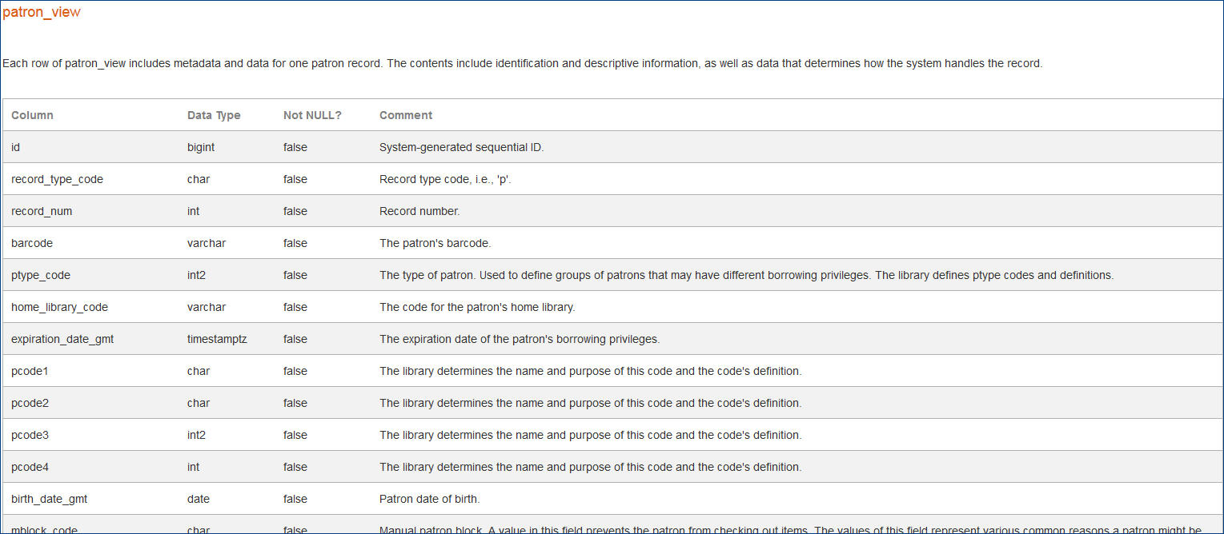
Sierra DNA
Sierra DNA (Database NAvigator)
http://techdocs.iii.com/sierradna/
Uses the same username & password as Supportal / CSDirect
The Sierra DNA describes all the SQL tables and the columns in those tables.

Slide 7
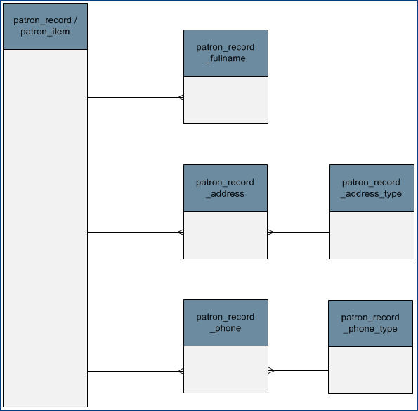
Documentation
ERD (Entity Relationship Diagram) View
This shows which tables are linkable – there is an column in one table that matches a column in another.
In this example, you can link patron_record_address_type to patron_record via patron_record_address

Slide 8
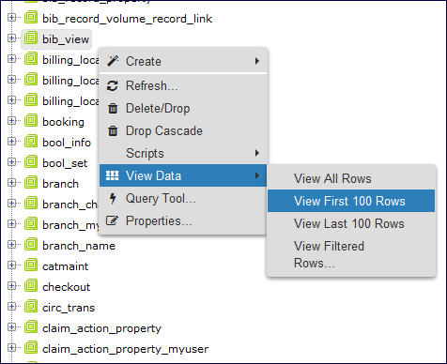
Previewing Your Data
To see sample data from a table, right click on the table (bib_view in this example) and then View Data and then View Top 100 Rows
Screen using PGAdmin https://www.pgadmin.org/
Notes:
Many clients have some means of browsing available tables, this is what you see in PGAdmin

Slide 9
Explore your data
Screens using HeidiSQL https://www.heidisql.com/
Notes:
I personally like using HeidiSQL as a client which has a more direct data previewing feature.

Slide 10
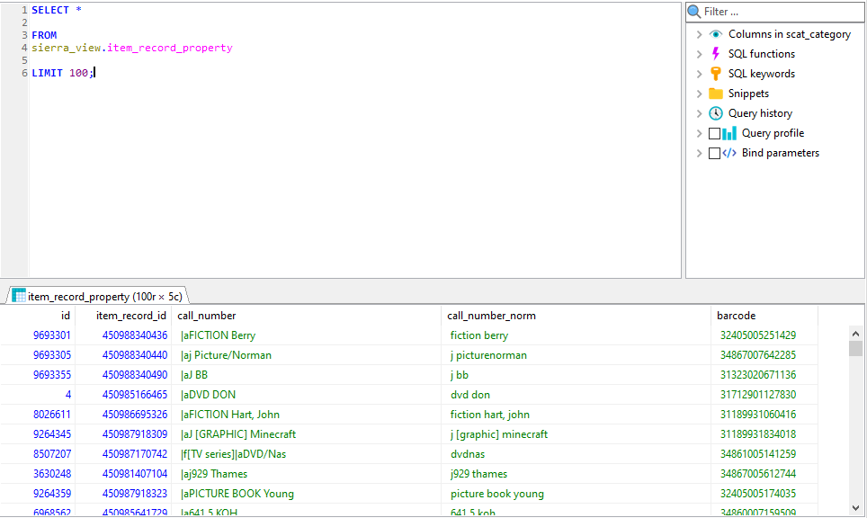
The Query Based Approach
Notes:
Show me the first 100 rows of data from a given view.

Slide 11
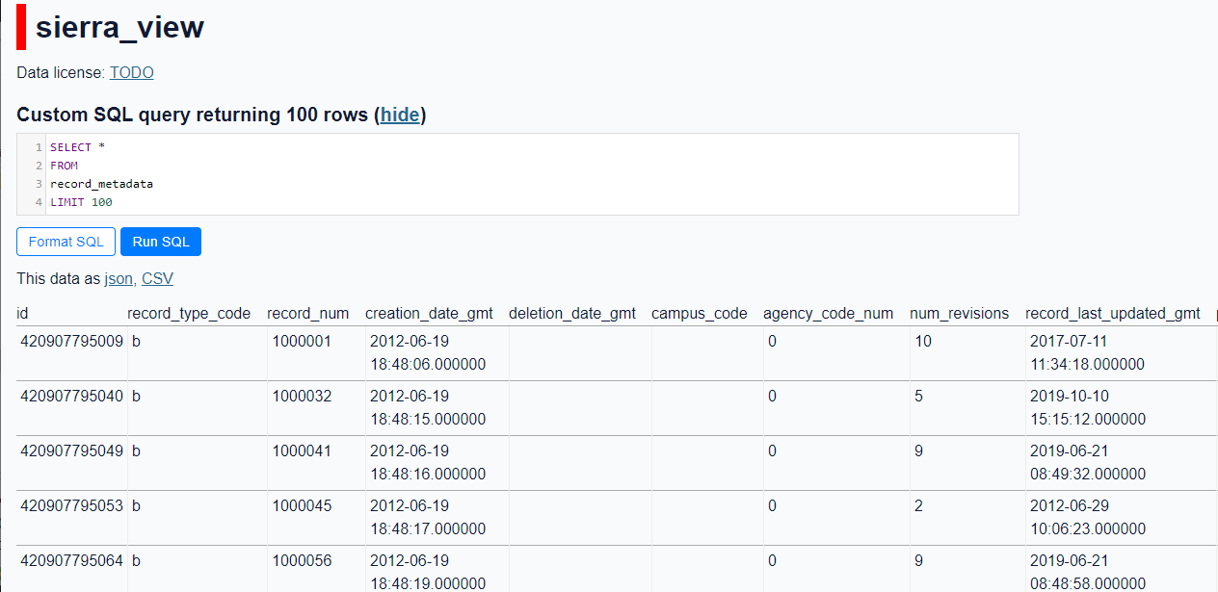
The Query Based Approach
Works with the SQL Sandbox from Part 1 too
Notes:
Note on this site there is no sierra_view schema to specify

Slide 12
A Shameless Plug
For more see 2020 presentation:
The Unofficial Guide to Sierra's SQL Views

Slide 13
Casting and Data Types

Slide 14
Data Types
https://www.postgresql.org/docs/current/datatype.html
Some important and common PostgreSQL data types to understand
INTEGER: signed, four-byte integer (`1`, `-1`, `42`, etc)
NUMERIC: real number or NUMERIC(p,s) with p digits with s number after the decimal point
MONEY: Numeric value to 2 decimals places including dollar sign
CHAR: single character, or `CHAR(n)` fixed-length of `n` characters with space padded
VARCHAR(n): variable-length character string of `n` characters with no space padded
TEXT: character string with unlimited length
BOOLEAN: true or false values (can use special `IS TRUE` or `IS FALSE` clause to test)
Notes:
Note no data is stored as MONEY in Sierra as its 2 decimal point limitation makes it poor for precision, however it's very useful to cast fields to this type to present a nicer output.

Slide 15
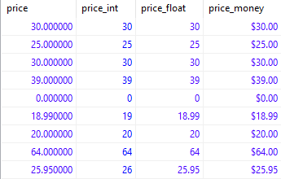
CAST()
CAST() will allow you to change the data type of a field
:: is a shortcut for the CAST() function
SELECT
i.price,
CAST(i.price AS INT) AS price_int,
i.price::FLOAT AS price_float,
i.price::MONEY AS price_money
FROM
sierra_view.item_record i
Notes:
The price field is a numeric value with a decimal precision of 6, which is not how you would ever wish to display that data
Here we can see the different outputs if we convert that field to an integer, floating point value, or to money.

Slide 16
Date Types
https://www.postgresql.org/docs/current/datatype-datetime.html
Date / Time Types:
DATE: ISO 8601 (`YYYY-MM-DD`): `2019-03-17`
TIMESTAMP: ISO 8601 date with time (24-hour clock): `2019-03-17 11:41:13.979849` Time zone is optional
TIMESTAMP WITH TIME ZONE: `2019-03-17 11:41:13.979849-04`
INTERVAL: defines periods of time
Traditional Postgres format: `1 year 2 months 3 days 4 hours 5 minutes 6 seconds`

Slide 17
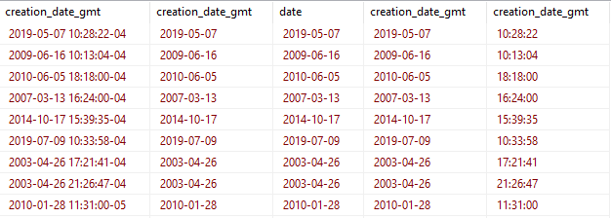
Timestamps
SELECT
rm.creation_date_gmt,
CAST(rm.creation_date_gmt AS DATE),
DATE(rm.creation_date_gmt),
rm.creation_date_gmt::DATE,
rm.creation_date_gmt::TIME
FROM
sierra_view.record_metadata rm
Notes:
Nearly all dates in Sierra are stored as timestamps, and can be identified as such by the _gmt suffix on their field names. In many case that's not the output you'll want. Ignore the gmt part of those names, timezones are coded as the offset from gmt (which yes has been UTC instead since 1972). Note that some the time zone differs on that last entry due to daylight savings.
In addition to the two casting options used previously it's also possible to cast timestamps to dates and times via the functions named as such

Slide 18
TO_CHAR()
NOW() will return current timestamp
TO_CHAR() can be used for date and timestamp formatting
SELECT
NOW(),
TO_CHAR(NOW(), 'MM-DD-YYYY'),
TO_CHAR(NOW(), 'Day Month DD, YYYY') AS date_long,
TO_CHAR(NOW(), 'J') AS julian,
TO_CHAR(NOW(), 'HH:MI AM TZ') AS time
Template Patterns for Date/Time Formatting can be found here: https://www.postgresql.org/docs/current/functions-formatting.html
Notes:
Quite a few methods exist for formatting dates to your needs and these are just a few. Also note the NOW() function here which will grab the current system time stamp

Slide 19
Additional Datetime Functions
SELECT
rm.creation_date_gmt,
AGE(rm.creation_date_gmt),
DATE_TRUNC('minute', rm.creation_date_gmt),
DATE_PART('hour', rm.creation_date_gmt),
EXTRACT(HOUR FROM rm.creation_date_gmt)
FROM
sierra_view.record_metadata rm
List of available datetime functions can be found here: https://www.postgresql.org/docs/9.1/functions-datetime.html
Notes:
Age() will compare the input timestamp to the current time by default, but you can also provide it with two values and it will calculate the difference. The end result is an interval value.
DATE_TRUNC will round the timestamp to the specified level of precision.
Date_part and Extract are parallel functions

Slide 20
Functions

Slide 21
Functions()
Take the form of function_name(argument(s))
Allow you to perform actions on your data
Introduced Aggregate Functions in Part 1
Used along with GROUP
COUNT()
SUM()
STRING_AGG()
Full list of Postgres Aggregate functions available here: https://www.postgresql.org/docs/9.5/functions-aggregate.html
Notes:
Saw a few functions in part 1 when groups were introduced

Slide 22
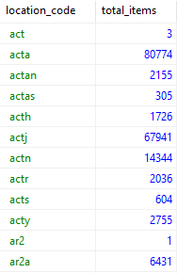
COUNT()
SELECT
i.location_code,
COUNT(i.id) AS total_items
FROM
sierra_view.item_record i
GROUP BY 1
ORDER BY 1;
Notes:
Here we have a query that counts the number of items in each location, sorted alphabetically, but what if we want to subdivide this total, say by status

Slide 23
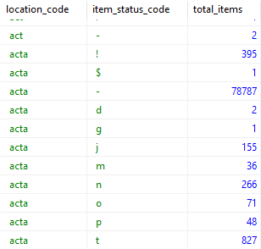
COUNT() Count By Location and Status
SELECT
i.location_code,
i.item_status_code,
COUNT(i.id) AS total_items
FROM
sierra_view.item_record i
GROUP BY 1,2
ORDER BY 1;
Notes:
We could add in a column for the status codes, which provides the totals but yields an additional row for each code and loses us the grand total for each location

Slide 24
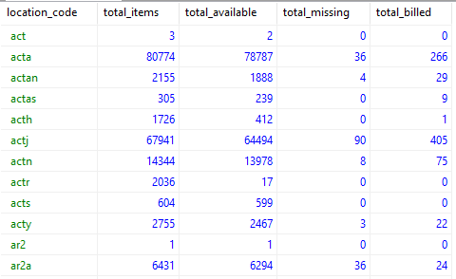
FILTER()
SELECT
i.location_code,
COUNT(i.id) AS total_items,
COUNT(i.id) FILTER(WHERE i.item_status_code = '-') AS total_available,
COUNT(i.id) FILTER(WHERE i.item_status_code = 'm') AS total_missing,
COUNT(i.id) FILTER(WHERE i.item_status_code = 'n') AS total_billed
FROM
sierra_view.item_record i
GROUP BY 1
ORDER BY 1;
Notes:
Filter allows you to apply a WHERE statement that only affects a single column, only for use with aggregate functions.

Slide 25
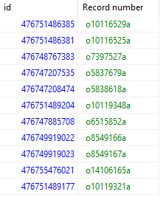
ID2RECKEY()
SELECT
o.id,
ID2RECKEY(o.record_id) AS "Record number"
FROM
sierra_view.order_record o;
Notes:
One place you may use concat option is when using the id2reckey() function that is unique to Sierra.
id2reckey takes any record id and returns the record number (minus the check digit as that is not stored). Technically it is returning the concatenated values of the record_type_code and record_num fields from the record_metadata table.

Slide 26
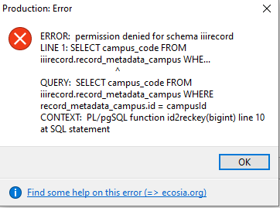
ID2RECKEY()
Notes:
Using it may generate this error. This happens when the function is called on a virtual record that has a nonstandard record number format. Can be avoided by going directly to the record_metadata table to gather the record number instead when this becomes an issue.

Slide 27
String Functions()
Take the form of function_name(argument(s))
Allow you to perform actions on your data
A few examples
LOWER(string) - convert to lowercase
LENGTH(string) - count characters in string
REPLACE(string, from text, to text) - replace all
Full list of Postgres String functions available here: https://www.postgresql.org/docs/9.1/functions-string.html
Notes:
Saw a few functions in part 1 when groups were introduced

Slide 28
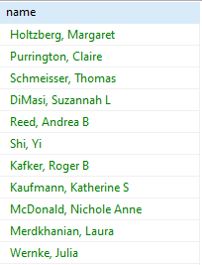
CONCAT()
Use CONCAT() to combine strings into a single string
SELECT
CONCAT(p.last_name,', ',p.first_name, ' ', p.middle_name)
AS name
FROM
sierra_view.patron_record_fullname p;
Notes:
Function chains together strings with each string separated by a comma. Those strings can either be entered in quotes such as the spaces and commas or reference table fields such as last_name

Slide 29
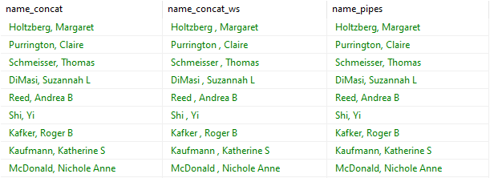
More on Concatenation
SELECT
CONCAT(p.last_name,', ',p.first_name, ' ', p.middle_name) AS NAME_concat,
CONCAT_WS(' ',p.last_name,',',p.first_name, p.middle_name) AS name_concat_ws,
p.last_name||', '||p.first_name||' '||p.middle_name AS name_pipes
FROM
sierra_view.patron_record_fullname p;
Notes:
Concat will chain together any strings provided.
Concat_ws will add a default separator, in this case a space, between the provided strings so you don't have to type that yourself.
|| often uses the fewest characters to enter, however null values if they are present will lead to improper results

Slide 30
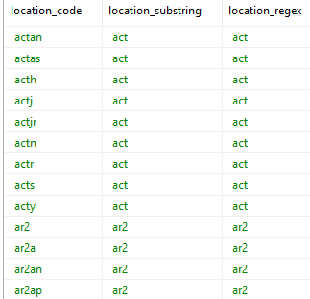
SUBSTRING()
Use SUBSTRING() to pull out parts of a string by their position
SELECT
i.location_code
SUBSTRING(i.location_code,1,3) AS location_substring,
SUBSTRING(i.location_code,'^.{3}') AS location_regex
FROM sierra_view.item_record i
ORDER BY 1;
Notes:
Here I’m pulling the first 3 characters of the location codes (starting from position 1, take three characters).
Can also use regex matching with this function
Incidentally many functions exist that are specifically for working with regular expressions

Slide 31
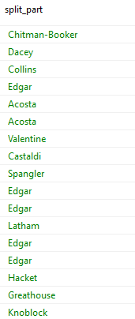
SPLIT_PART(): Author Last names
Use SPLIT_PART() to parse strings on a specified delimiter
SELECT
SPLIT_PART(b.best_author, ‘, ‘, 1) AS last_name
FROM sierra_view.bib_record_property b;
Notes:
Here I’m splitting the string when it sees a comma followed by a space, and take the portion of the string before the split (section 1)

Slide 32
Nesting String Functions
Using string functions to display an author in first name, last name order

Slide 33
Window Functions

Slide 34
Window Functions
Window Functions allow you to perform calculations across related rows
Use the Syntax [function]() OVER (field)
Some examples of window functions are:
row_number()
rank()
ntile()
The list of available window functions can be found here: https://www.postgresql.org/docs/9.3/functions-window.html

Slide 35
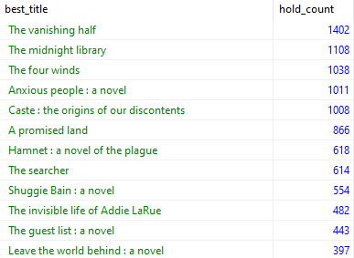
Top Requested Titles
SELECT
b.best_title,
COUNT(h.id) AS hold_count
FROM
sierra_view.hold h
JOIN
sierra_view.bib_record_property b
ON h.record_id = b.bib_record_id
GROUP BY 1
ORDER BY 2 DESC
Notes:
Here we have a query that will gather up the bib level holds attached to each title and sort by the count of holds to provide a top requests list.

Slide 36
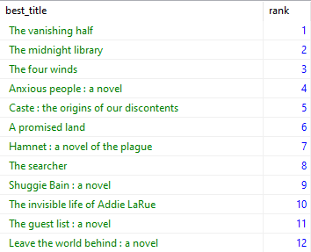
RANK()
SELECT
b.best_title,
RANK() OVER (ORDER BY COUNT(h.id) DESC) AS rank
FROM
sierra_view.hold h
JOIN
sierra_view.bib_record_property b
ON h.record_id = b.bib_record_id
GROUP BY 1
ORDER BY 2
Notes:
Now we've replaced the holds count with a rank instead.
The Over function that goes along with rank defines what we are basing the ranking on. In this case it is the count on each title from most to least.
Unlike a standard function that only looks at its own row of data RANK() is determined by the value in that row relative to all other rows in the output.

Slide 37
PARTITION
The PARTITION clause allow us to subdivide a table into smaller sets of rows
In combination with a window function we can then apply that function to subsets of our data
RANK() OVER (
PARTITION BY b.material_code
ORDER BY COUNT(h.id) DESC
) AS rank
Notes:
Now we can gather the most requested titles for each mattype/format

Slide 38
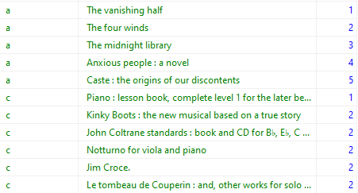
Top Requested Titles By Format
SELECT *
FROM (
SELECT
b.material_code, b.best_title,
RANK() OVER (PARTITION BY b.material_code ORDER BY COUNT(h.id) DESC) AS rank
FROM
sierra_view.hold h
JOIN
sierra_view.bib_record_property b
ON h.record_id = b.bib_record_id
GROUP BY 1,2
)inner_query
WHERE inner_query.rank < 6
ORDER BY 1,3
Notes:
Now we can see the top 5 titles for each format, with books and scores displaying here.
Note however that we had to cheat a little to accomplish this and now have moved our query into a subquery. The reason for this is that we cannot include a window function as part of a where statement, and so could not limit our results to just the top 5. The solution to that is to make the whole query a subquery so that the new outer query can now see the rank field as just another standard field, which can be included in a Where clause as normal.
Also note that scores included a 5 way tie for the second ranked title and so they all appear here.

Slide 39
LAG() & LEAD()
LAG() & LEAD() allow you to utilize a field from a neighboring row
LAG(COUNT(id), 1)
Retrieves the value of the id field from 1 row prior.

Slide 40
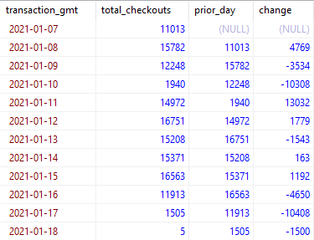
Daily Checkout Comparison
SELECT
c.transaction_gmt::DATE,
COUNT(c.id) AS total_checkouts,
LAG(COUNT(c.id),1)
OVER (ORDER BY c.transaction_gmt::DATE) AS prior_day,
COUNT(c.id) - LAG(COUNT(c.id),1)
OVER (ORDER BY c.transaction_gmt::DATE) AS change
FROM sierra_view.circ_trans c
WHERE c.op_code = 'o'
GROUP BY 1
ORDER BY 1;
Notes:
Here we have set the lag to 1, in order to look at the previous row in the output table. Now that we can do that we can also compare that result to the current row of the table to calculate the change in value
LEAD() works the same way just for subsequent instead of previous rows

Slide 41
Combining Queries

Slide 42
EXISTS / NOT EXISTS
The Exists operator tests for the existence of a row in a subquery
If there is a result then TRUE else FALSE
Use it within a WHERE clause to limit results based on a subquery

Slide 43
Titles Where All Items Share an Itype
SELECT id2reckey(b.id)||'a' AS bib_number
FROM sierra_view.bib_record b
WHERE EXISTS (
SELECT l.id
FROM sierra_view.bib_record_item_record_link l
JOIN sierra_view.item_record i ON l.item_record_id = i.id
WHERE b.id = l.bib_record_id AND i.itype_code_num = '21')
AND NOT EXISTS (
SELECT l.id
FROM sierra_view.bib_record_item_record_link l
JOIN sierra_view.item_record i ON l.item_record_id = i.id
WHERE b.id = l.bib_record_id AND i.itype_code_num != '21')
ORDER BY 1
Notes:
In our network we have a policy governing dvds designated for speed view/lucky day collections/browse only collections where you can only have one if you also own copy that obeys our standard circulation rules.
This query looks for titles that where that policy is not being followed and all copies restrict access.
The first query subquery identifies bibs where all items have itype 21. The second identifies records where no items have and itype of 21, and then the primary query spots the records that are present exist in one list but not the other.

Slide 44
Titles Where All Items Share an Itype

Slide 45
Intersect/ Except/ Union
UNION
Query 1
Query 2
INTERSECT
EXCEPT
UNION returns the combined results of the two queries.
INTERSECT returns the results shared by the two queries
EXCEPT returns the results in the first query, but not in the second
All 3 follow two rules – the queries must have the same number of columns and each column must match data type.

Slide 46
Intersect/ Except/ Union
To combine the two queries, we insert UNION between them. This takes the results of each query and displays the results of both as if they were part of one query. In order for this to work, UNION the combined queries must follow two rules:
The queries must produce the same number of columns
Each column must match on data type.
One ORDER BY command may be applied to the combined results at the end of the last query to sort the entire set of results.
Col 1 | Col 2 | Col 3
int | varchar | date
Query 1
Col 1 | Col 2 | Col 3
int | varchar | date
Query 2

Slide 47
INTERSECT: Bibs with both Items and Orders
SELECT
ID2RECKEY(il.bib_record_id)||’a’ AS bib_num
FROM
sierra_view.bib_record_item_record_link il
INTERSECT
SELECT
ID2RECKEY(ol.bib_record_id)||’a’ AS bib_num
FROM sierra_view.bib_record_order_record_link ol
ORDER BY bib_num;
Notes:
Same results as prior query
Order By sorts on the combined results
The columns for each query must match

Slide 48
Time for One Last Query

Slide 49
Previously: Item Count By Location and Status
SELECT
i.location_code,
COUNT(i.id) AS total_items,
COUNT(i.id) FILTER(WHERE i.item_status_code = '-') AS total_available,
COUNT(i.id) FILTER(WHERE i.item_status_code = 'm') AS total_missing,
COUNT(i.id) FILTER(WHERE i.item_status_code = 'n') AS total_billed
FROM
sierra_view.item_record i
GROUP BY 1
ORDER BY 1;
Notes:
Filter allows you to apply a WHERE statement that only affects a single column, only for use with aggregate functions.

Slide 50
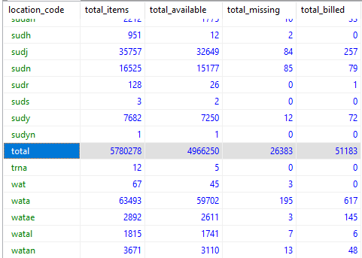
UNION: Adding a Total Row
SELECT
i.location_code,
COUNT(i.id) AS total_items,
COUNT(i.id) FILTER(WHERE i.item_status_code = '-') AS total_available,
COUNT(i.id) FILTER(WHERE i.item_status_code = 'm') AS total_missing,
COUNT(i.id) FILTER(WHERE i.item_status_code = 'n') AS total_billed
FROM
sierra_view.item_record i
GROUP BY 1
UNION
SELECT
'total',
COUNT(i.id) AS total_items,
COUNT(i.id) FILTER(WHERE i.item_status_code = '-') AS total_available,
COUNT(i.id) FILTER(WHERE i.item_status_code = 'm') AS total_missing,
COUNT(i.id) FILTER(WHERE i.item_status_code = 'n') AS total_billed
FROM
sierra_view.item_record i
ORDER BY location_code
Notes:
There are a few things of note happening here.
Similar to our previous example with intersect we are using Union to work with the result of two distinct queries with similar columns. The first query is what we had before, while the second produces a single row with a total
In the first column we we created a string 'total' which works because the location_code from the top query is also a string. As this query only produces a single row of results we also do not need to use a GROUP BY statement.
However our sorting is off as we want to shift total to be the last row.

Slide 51
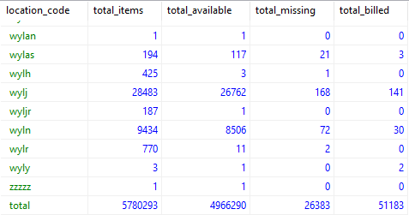
UNION: Adding a Total Row
SELECT *
FROM(
SELECT
i.location_code,
COUNT(i.id) AS total_items,
COUNT(i.id) FILTER(WHERE i.item_status_code = '-') AS total_available,
COUNT(i.id) FILTER(WHERE i.item_status_code = 'm') AS total_missing,
COUNT(i.id) FILTER(WHERE i.item_status_code = 'n') AS total_billed
FROM
sierra_view.item_record i
GROUP BY 1
UNION
SELECT
'total',
COUNT(i.id) AS total_items,
COUNT(i.id) FILTER(WHERE i.item_status_code = '-') AS total_available,
COUNT(i.id) FILTER(WHERE i.item_status_code = 'm') AS total_missing,
COUNT(i.id) FILTER(WHERE i.item_status_code = 'n') AS total_billed
FROM
sierra_view.item_record i
)inner_query
ORDER BY CASE
WHEN location_code = 'total' THEN 2
ELSE 1
END,
location_code
Notes:
We can correct for that by using CASE within our order statement
We assign the total row a value of 2, end everything else a value of 1, which will take care of moving it to the bottom of the list
Then we can do a secondary sort on the actual values of the location code to alphabetize them as normal
However due to a quirk of how unions operate you cannot naturally create a custom sort like this against the results of a union. The work around for this is to treat the unioned query as a subquery and Selecting everything from within. Then we can simply apply our custom sort to that resulting outer query instead

Slide 52
Additional Resources

Slide 53
Additional Resources
Presentation Site
https://site-checker.cincy.pl/iug2021/
PostgreSQL Official Documentation
https://www.postgresql.org/docs/
Stackoverflow
https://stackoverflow.com/
SQL Cookbook by Anthony Molinaro
O’Reilly, 2005
SQL Murder Mystery
https://mystery.knightlab.com/

Slide 54
Find Us on Slack
Jeremy & Ray can be found along with many other Sierra SQL experts, on the Sierra-ILS Slack workspace
Invite link will be available on the presentation site page:
https://howtosql.cincy.pl/iug2021/
Or e-mail Jeremy or Ray

Slide 55
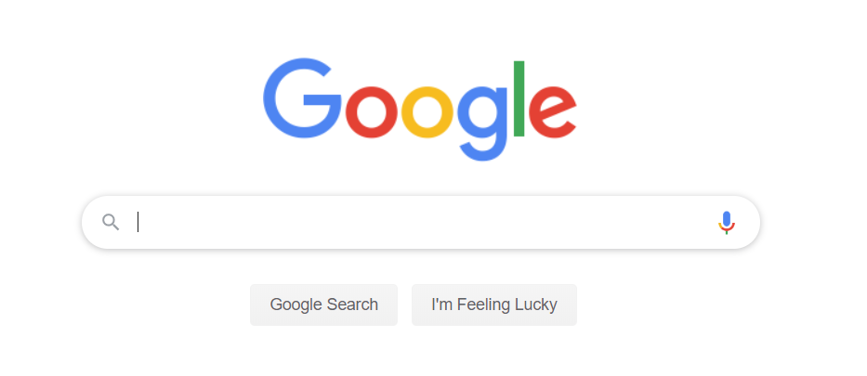
JGI

Slide 56
Thank You!
Jeremy Goldstein
jgoldstein@minlib.net
Ray Voelker
ray.voelker@cincinnatilibrary.org

