Slide 1
JQuery (Javascript) to lift your catalog to another level.
Kwangsoo Han
Systems Librarian
Community College of Baltimore College
khan@ccbcmd.edu

Slide 2
About CCBC
3 libraries on 3 campuses
FTE : 6,000
100,000 volume in total
Millennium - WebPAC
About myself
Systems Librarian with multiple duties
Am I a real expert of JQuery?
No, not at all.
And, you don’t need to be an expert to use it.

Slide 3
Javascript (Parent of JQuery)
JavaScript is the programming language of HTML and the Web run within a Web browser
Basic Trio of the Web
HTML to define the content
CSS to specify the layout and presentation
Javascript to program the behavior

Slide 4
Structure of Trio [1]
<html>
<head>
</head>
<body>
</body>
</html>
<style> p {color: red;}
</style>
<script language=“javascript”>
alert(‘Hello’);
<script>
<p> Hello, World! </p>
Notes:
Internal CSS and Internal Javascript

Slide 5
Structure of Trio
<html>
<head>
<head>
<body>
</body>
</html>
<link rel="stylesheet" href=“/screens/styles.css">
<script src=“/screens/myjavascript.js"></script>
<p> Hello, World! </p>
Notes:
External CSS and External Javascript

Slide 6
JQuery
JQuery is a fast, small, and feature-rich Javascript library.
Cross-platform
JQuery makes things easier: to perform many common scripting functions
Element Selection (Traversal) / Manipulation
Event Handling
Animation
Ajax
Notes:
https://jquery.com/

Slide 7
How to use JQuery:
Starting with the load of the jQuery library
Local load
<head> <script src=“/screens/jquery-1.12.0.min.js"></script> </head>
Remote load
<head> <script src="//code.jquery.com/jquery-1.10.2.js"></script> </head>

Slide 8
jQuery vs Javascript : element selection
JavaScript
document.body
jQuery
$ (‘body’)
Notes:
Excerpt from https://blog.udemy.com/jquery-vs-javascript/

Slide 9
JQuery Selectors : $( )
Selector | Example | Selects
* | $("*") | All elements
#id | $("#lastname") | The element with id="lastname"
.class | $(".intro") | All elements with class="intro"
element | $("p") | All <p> elements
:first | $("p:first") | The first <p> element
:last | $("p:last") | The last <p> element
:even | $("tr:even") | All even <tr> elements
:odd | $("tr:odd") | All odd <tr> elements
:eq(index) | $(“td:eq(3)") | The fourth element in a list (index starts at 0)
Notes:
Excerpt from http://www.w3schools.com/jquery/jquery_ref_selectors.asp

Slide 10
simple element selection [1]
<html>
<body>
<div> Hello. </div>
<div>I love IUG </div>
</body>
</html>
I’d like to select the second ‘div’.
JQuery code?
I love IUG
$(‘div:last’)
Or
$(“div:eq(1)”)
.css(‘color’,’red’)
Notes:
jQuery HTML / CSS Methods : https://www.w3schools.com/jquery/jquery_ref_html.asp

Slide 11
simple element selection [2]
<html>
<body>
<div>
<span>Hello. </span>
<span> I love IUG </span>
</div>
</body>
</html>
I’d like to select the second ‘span’.
JQuery code?
I love IUG
$(‘div span:last’)
Or
$(“div span:eq(1)”)
.css(‘color’,’red’)
Notes:
jQuery HTML / CSS Methods : https://www.w3schools.com/jquery/jquery_ref_html.asp

Slide 12
complex element selection
<table id=“mytable”>
<tr>
<td> </td>
<td> </td>
</tr>
<tr>
<td> </td>
<td> </td>
</tr>
</table>
$(
“#mytable
tr:last
td:eq(1)
”)

Slide 13
Examples in the CCBC catalog
Hide an Element
Replace Text/HTML
Form behavior
Facet Interface
AutoComplete
‘Did you mean?’ (SpellChecker)

Slide 14
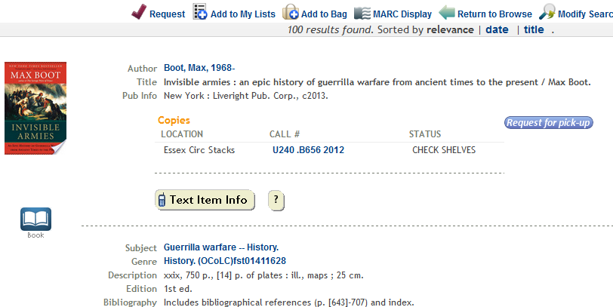
Hide an element (1)

Slide 15
Hide an element (2)
* Target element in HTML to select:
<span class="button" id="holdthisitem">……………..</span>
jQuery :
var targetbutton= $("span[id='holdthisitem']");
targetbutton.css('visibility','hidden');
Or
$(“#holdthisitem”).css(‘visibility’,’hidden’);

Slide 16
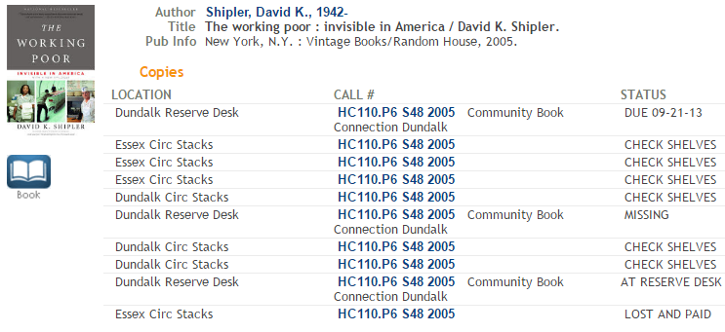
Replace a Text/HTML (1)
- Changed the status from ‘Check Shelves’ to ‘At Reserve Desk’.
Notes:
We use a text “Check Shelves” for available items on status. However, there is a case which confuses patrons. When a book is reserved, the book is located at the reserve desk. But, the default system’s status says ‘Check Shelves’, patrons go to the regular circulation stack instead of the reserve desk. So, we want to change it to ‘At Reserve Desk’ to give a correct location information.

Slide 17
Replace a Text/HTML (1-1)
//this code works for bib_display.html
var itemTrs = $(".bibDisplayItemsMain tr.bibItemsEntry");
if(itemTrs.length >0) {
var itemLocation = "";
var itemStatus = "";
for(k=0;k<itemTrs.length;k++) {
itemLocation = $(".bibDisplayItemsMain tr.bibItemsEntry:eq(" + k + ") td:eq(0)").text();
itemStatus = $(".bibDisplayItemsMain tr.bibItemsEntry:eq(" + k + ") td:eq(2)").text();
if(itemStatus.indexOf("CHECK") > 0 || itemStatus.indexOf("ON") > 0)
itemStatus = "Avail";
else
itemStatus = "";
//display change for status 'At Reserve Desk' when an item location is a Reserve item
if(itemLocation.indexOf("Reserve") >= 0 && itemStatus == "Avail") {
$(".bibDisplayItemsMain tr.bibItemsEntry:eq(" + k + ") td:eq(2)").text("AT RESERVE DESK")
}
}//End of for
}//End of if

Slide 18
Replace a Text/HTML (2)

Slide 19
Replace a Text/HTML (2)
[1] Add ‘id’ on the fly
$("div.bibDisplayUrls table.bibLinks td").attr('id','catEbook');
selection
action
[2] ‘catEbook’ defined in CSS
td#catEbook { height: 25px;
background-color: #09C; }
Notes:
/* Jquery to add an id to td in bib_display.html and this id will be treated in style.css */
$("div.bibDisplayUrls table.bibLinks td").attr('id','catEbook');
/* CSS (style.css) To make ebook link more visible */
td#catEbook { height: 25px;
background-color: #09C; }
td#catEbook a:link{font-size: 14px;
color: #FFF;
text-decoration: underline;
font-family: Verdana, Geneva, sans-serif;
font-weight: bold; }
td#catEbook a:hover{
color: #CCC;
text-decoration: none;
}

Slide 20
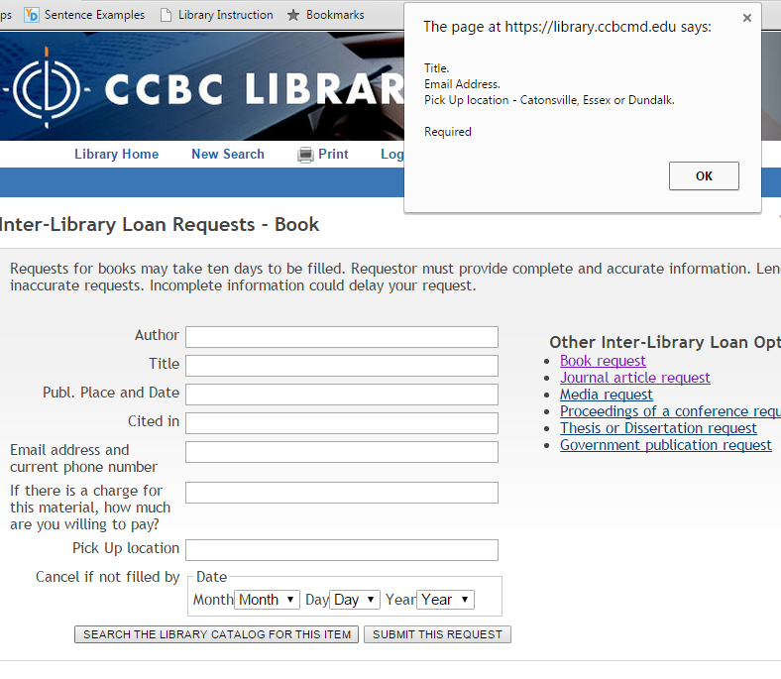
Manipulate Form Behavior
Notes:
$(document).ready(function(){
$( "form:first" ).submit(function( event ) {
var errorMsg = "";
//$( "form:first" ).submit();
if($.trim($("#main1").val()).length == 0)
errorMsg = "Title. \n"
if($.trim($("#info0").val()).length == 0)
errorMsg += "Email Address. \n"
if($.trim($("#info2").val()).length == 0)
errorMsg += "Pick Up location - Catonsville, Essex or Dundalk. \n"
if(errorMsg == "")
$( "form:first" ).submit();
else
alert(errorMsg + "\nRequired");
event.preventDefault();
});
})

Slide 21
Facet Interface (Narrow search results)
Notes:
//part of codes in http://library.ccbcmd.edu/screens/ccbcJavascript2.js
filter_dundalkonly_URL = baseURL
+ rawKeywords + "&searchscope=2"
+ "&Da=" + (yearExists=='no' || yearExists==null || yearExists==''?"":startYear)
+ "&Db=&SORT=D"
+ (materialtype!=''?'&m='+materialtype:"");
var numofdandalkResults = getNumofResults(filter_dundalkonly_URL);
filter_dundalkonly = "<a href='"
+ filter_dundalkonly_URL
+ "' onclick=\"javascript: ga('send','pageview','/narrowresults/dundalk');\""
+ ">Dundalk Only (" + numofdandalkResults + ")</a><br />";
strOutput = (searchscope!=2&materialtype!='q'? "<dd>"+ filter_dundalkonly+ "</dd>":"");
targetFacet.append(strOutput); //push out a line ‘Dundalk Only’ under ‘Narrow your results’
//function to get a number for a query
function getNumofResults(targetURL)
{
var outstring = "0";
$.ajax({
url: targetURL,
type: 'get',
dataType: 'html',
async: false,
success: function(data) {
var htmlString = data;
var $htmlDoc = $( htmlString );
var itags = $htmlDoc.find('i');
var placeholderlabel = "td[title='briefcit_facet_placeholder']";
var placeholder = placeholderlabel + ':eq(0)';
var targettd = $(placeholder);
for(i=0;i<itags.length;i++)
{
outstring = itags.eq(i).text();
if(outstring.indexOf("results") >= 0)
{
var strPos = outstring.indexOf("results"); // strip off the number of results i.e. "<i>27 results found.</i>"
outstring = $.trim(outstring.substring(0,strPos));
break;
}
else if(outstring.indexOf("result found") >= 0 )
{
var strPos = outstring.indexOf("result found");
outstring = $.trim(outstring.substring(strPos-2,strPos-1));
break;
}
else
outstring = "0";
}//End of for
}
});//End of ajax
return outstring;
}

Slide 22
Autocomplete (1)
Autocomplete (Google, Bing API, typehead.js, Bloodhound)
Other college sites: NCSU (home grown), Rutgers (very small pool), University of Illinois Undergraduate Library (Apparently Google)
Notes:
//the base code that I used found at http://jsfiddle.net/LxXJz/
$(function () {
$("#hulk").autocomplete({
source: function (request, response) {
console.log("source");
$.ajax({
url: "http://api.bing.net/qson.aspx?Query=" + encodeURIComponent(request.term) + "&JsonType=callback&JsonCallback=?",
dataType: "jsonp",
/*data: {
"Query": request.term,
"JsonType": "callback",
"JsonCallback" : "?"
},*/
success: function (data) {
console.log("success!");
var suggestions = [];
$.each(data.SearchSuggestion.Section, function (i, val) {
console.log("suggestion: " + val.Text);
suggestions.push(val.Text);
});
response(suggestions);
}
});
}
});
});

Slide 24
Notes:
//Fully developed code is in mainmenu.html
//functions are in http://library.ccbcmd.edu/screens/ccbcJavascript6.js
<script type='text/javascript'>//<![CDATA[
$(window).load(function(){
$(function () {
$("#ebscohostsearchtext").catcomplete({
select: function( event, ui ) {
checklocalentry(ui.item.value, 'y');
},
minLength: 3,//search after three characters typed in
source: function (request, response) {
var suggestions2 = [];
if(request.term.length >2)
{
suggestions2 = getLocalCourses(request.term);
response(suggestions2);
}
$.ajax({
url: "//api.bing.net/qson.aspx?Query=" + encodeURIComponent(request.term) + "&JsonType=callback&JsonCallback=?",
dataType: "jsonp",
/*data: {
"Query": request.term,
"JsonType": "callback",
"JsonCallback" : "?"
},*/
success: function (data) {
$.each(data.SearchSuggestion.Section, function (i, val) {
var bingSingleData = [];
bingSingleData["category"] = "Popular Keywords";
var modifiedSuggestion = applyStopWords(val.Text, request.term);
if(modifiedSuggestion != "" && modifiedSuggestion != request.term)
{ bingSingleData["label"] = modifiedSuggestion; suggestions2.push(bingSingleData);
}
if(i>9)
return false;
}); //end of each
response(suggestions2);
} //end of success
});//end of ajax
}
});
});
});//]]>
</script>
<!-- End Autocomplete for Smart Search Box -->

Slide 25
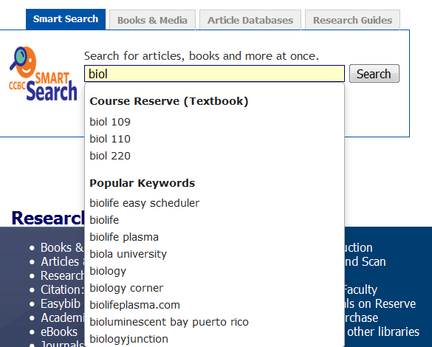

Slide 27
Did you mean? (SpellChecker) [1]

Slide 28
Did you mean? (SpellChecker) [2]
Notes:
//code in srchhelp_X.html
<div class="pageContentInner">
<!--{msg}-->
<!-- Start: javascript for 'Did you mean' -->
<div id='spellsuggest'></div>
<script type="text/javascript">
$(document).ready(function(){
if($("div.pageContentInner h2").text() == "NO ENTRIES FOUND")
{
var currentURL = document.URL;//get the current URL
var arr_URLpieces = currentURL.split("&");// split the current URL
var searchkeyword = '';
for(i=0;i<arr_URLpieces.length; i++)
{
var URLpiece = arr_URLpieces[i];
var temp01 = URLpiece.split("=");
if(temp01[0].indexOf('SEARCH') > 0)
{
searchkeyword = temp01[1];
searchkeyword = searchkeyword.replace("(", "");
searchkeyword = searchkeyword.replace(")", "");
searchkeyword = searchkeyword.replace(/%20/g, ' ');
}
}//end of for
//run Google Analytics
ga('send','pageview','/NO ENTRIES FOUND/' + searchkeyword);
//alert(searchkeyword);
//var spellService = "http://api.bing.net/json.aspx?AppId=APIKey&Query=" + encodedText + "&Sources=Spell&Version=2.0&Market=en-us&Options=EnableHighlighting&JsonType=callback&JsonCallback=SearchCompleted";
// $.getScript(spellService);
//event.preventDefault();
$.ajax({
url: "http://api.bing.net/qson.aspx?Query=" + encodeURIComponent(searchkeyword) + "&JsonType=callback&JsonCallback=?",
dataType: "jsonp",
/*data: {
"Query": request.term,
"JsonType": "callback",
"JsonCallback" : "?"
},*/
success: function (data) {
// console.log("success!");
//console.dir(data);
var suggestions = [];
var outputString = "";
//add local suggestions by kwangsoo
var localsuggestion = addLocalSuggestions(searchkeyword);
if(localsuggestion != '')
suggestions.push(localsuggestion);
//add suggestions from bing
$.each(data.SearchSuggestion.Section, function (i, val) {
//console.log("suggestion: " + val.Text);
var modifiedSuggestion = applyStopWords(val.Text, searchkeyword);
if(modifiedSuggestion != "" && modifiedSuggestion != searchkeyword)
suggestions.push(modifiedSuggestion);
});//end of $.each
if(suggestions.length > 0)
{
var countSuggestion = 0;
var totalnumberofsuggestions = suggestions.length;
if(totalnumberofsuggestions >= 1)
totalnumberofsuggestions = 1;
for(i=0;i<totalnumberofsuggestions;i++)
{
if(suggestions[i].toLowerCase() != searchkeyword.toLowerCase() && searchkeyword.split(' ').length >= suggestions[i].split(' ').length )
{
outputString += composeURL(suggestions[i]) + "&nbsp;&nbsp;" ;
if(i%5 == 0 && i > 0)
outputString += "<br /> " ;
countSuggestion++;
}
}
if(countSuggestion > 0)
$("#spellsuggest").append("Did you mean:" + outputString);
}//end of if
}//end of success:function
}); //end of ajax
}//end if
function composeURL(keywords)
{
var currentURL = document.URL;//get the current URL
var start_keywords = currentURL.indexOf("(") ;
var end_keywords = currentURL.indexOf(")") ;
var firstpart_URL = currentURL.substring(0,start_keywords+1);
var endpart_URL = currentURL.substring(end_keywords);
var newURL = firstpart_URL + escape(keywords) + endpart_URL;
var newLink = "<a href='" + newURL + "' onClick='javascript: ga(\"send\",\"pageview\",\"/Did you mean/" + keywords + "\");'>" + keywords + "</a>";
return newLink;
}
})//end $(document).ready(function()
function applyStopWords(bingSuggest,userKeyword)
{
var newText=bingSuggest;
if(userKeyword.indexOf('used ') < 0 && bingSuggest.indexOf('used ') == 0)
{
newText = bingSuggest.substr(5);
}
if(newText.match(/pdf$/) != null || newText.match(/quizlet$/) != null || newText.match(/book$/) || newText.match(/edition$/) != null || newText.match(/edition\ssolution[s\b|\b]$/) || newText.match(/edition\s[0-9]+rd|nd|th$/) || newText.match(/edition\sanswer[s\b|\b]$/) || newText.match(/answer\skey$/) != null || newText.match(/[0-9]+th$/) != null || newText.match(/[0-9]+nd$/) != null || newText.match(/[0-9]+e$/) != null || newText.match(/ ed$/) != null || newText.match(/[0-9]+$/) != null || newText.match(/^movie/) != null || newText.match(/test bank$/) != null || newText.match(/pdf free$/) != null || newText.match(/torrent$/) != null || newText.match(/free download$/) != null)
{
newText = "" ;
}
newText = newText.replace("you ve ", "you've ");
//return newText;
return newText;
}

Slide 29
On-going and future project
To smartly handle punctuation to avoid getting ‘No Entries Found’. (Plan for an out-of-box solution)
To rewrite ‘Autocomplete’ and ‘Did You Mean’ as an out-of-box solution.

Slide 30
Thank you! Kwangsoo Han khan@ccbcmd.edu

