Slide 1
Two More Weird Tricks From Marmot
Fix bad images in Sierra and Marcive Process
Lloyd Chittenden
Union Catalog Coordinator
Marmot Library Network

Slide 2
First Weird Trick
DVD cover image problem

Slide 3
Sierra cover image problem
Sierra takes the first “i” tagged field to use for cover image
It will use the first “i” tagged field regardless of being 020 or 024
This is fine if the number is an ISBN, but it does not work with UPCs
ISBNs are either 10 digits or 13 digits, but UPCs are 12 digits
A 12 digit number will have the last 2 digits cut off and be sent as a 10 digit number
Usually this returns nothing, but now an then it returns a wrong cover
Note: if your 024 is not in the “i” tagged field, you don’t have this problem, you also don’t have any cover art for DVDs

Slide 4
Example
The UPC for “Maybe I do” is 843501040645
Cover art should be:

Slide 5
Example
If you cut off the last 2 digits you get 8435010406
Now the art is:

Slide 6
In Sierra
This is confusing for staff

Slide 7
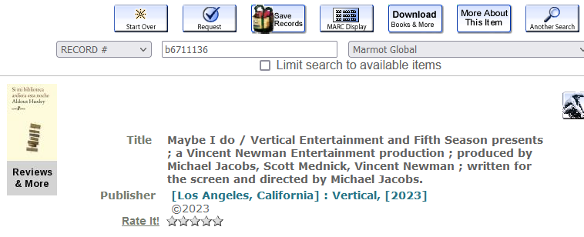
In Classic Catalog
This is confusing for patrons

Slide 8
Solution
If you add a zero in front of the 12 digit UPC, Sierra will send all 13 digits
The system at Syndetic Solutions will remove the leading zero, recognize a UPC and sent the correct art
However, adding a the leading zero will effect searching and matching in Sierra so you need a copy of the number with the zero and one without
Since Sierra will send the first i tagged number, you have to make sure the one with the zero is first

Slide 9
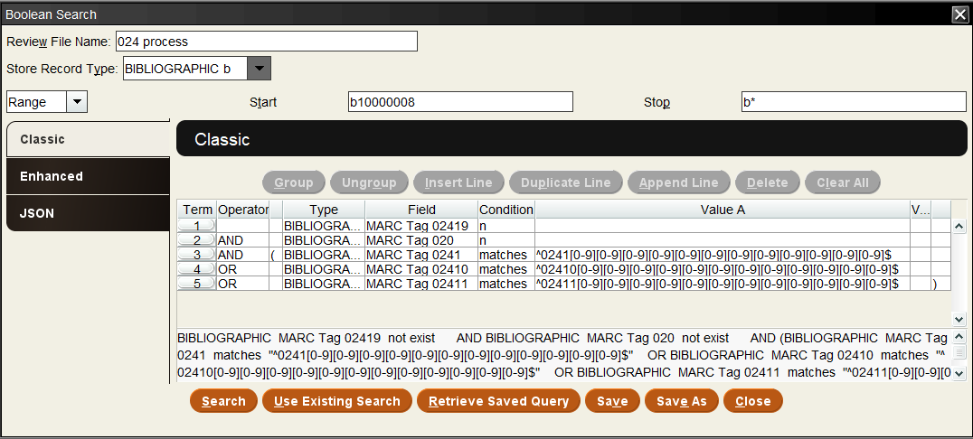
Process to fix
Create this list:

Slide 10
Search JSON
{ "queries": [ { "target": { "record": { "type": "bib" }, "field": { "marcTag": "024", "ind1": "1", "ind2": "9" } }, "expr": { "op": "not_exists", "operands": [ "", "" ] } }, "and", { "target": { "record": { "type": "bib" }, "field": { "marcTag": "020" } }, "expr": { "op": "not_exists", "operands": [ "", "" ] } }, "and", [ { "target": { "record": { "type": "bib" }, "field": { "marcTag": "024", "ind1": "1", "ind2": " " } }, "expr": { "op": "regex", "operands": [ "^0241[0-9][0-9][0-9][0-9][0-9][0-9][0-9][0-9][0-9][0-9][0-9][0-9]$", "" ] } }, "or", { "target": { "record": { "type": "bib" }, "field": { "marcTag": "024", "ind1": "1", "ind2": "0" } }, "expr": { "op": "regex", "operands": [ "^02410[0-9][0-9][0-9][0-9][0-9][0-9][0-9][0-9][0-9][0-9][0-9][0-9]$", "" ] } }, "or", { "target": { "record": { "type": "bib" }, "field": { "marcTag": "024", "ind1": "1", "ind2": "1" } }, "expr": { "op": "regex", "operands": [ "^02411[0-9][0-9][0-9][0-9][0-9][0-9][0-9][0-9][0-9][0-9][0-9][0-9]$", "" ] } } ] ]}

Slide 11
Process
The list will exclude 024 fields with second indicator 9, that means they have been though this process already
It will also exclude records with an 020 field, which usually will come before an 024
These have an ISBN, which usually processes correctly
It will get records with a 12 digit number in an 024 with second indicator blank, 1 or 2

Slide 12
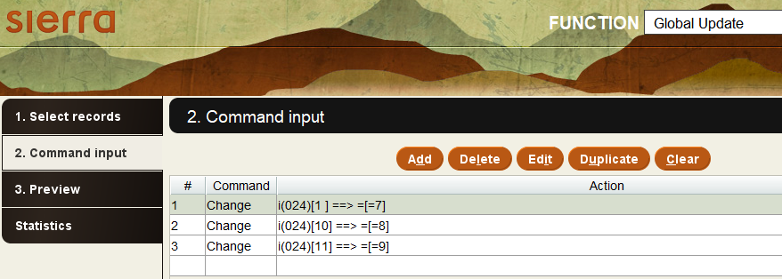
First global update
1st change the second indicators (difference indicator)
Blank to 7
0 to 8
1 to 9

Slide 13
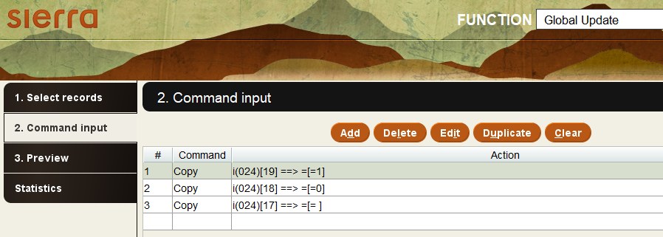
Second global update
Copy the 024s
Change the indicators back to 1, 0 and blank in the copies

Slide 14
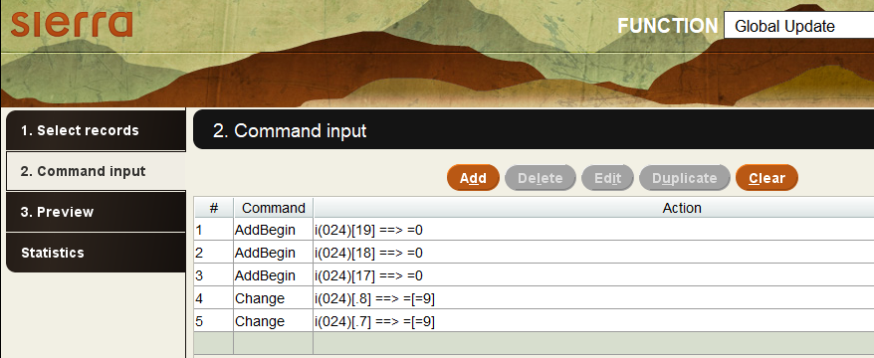
Third global update
Add leading zeros
Change second indicators

Slide 15
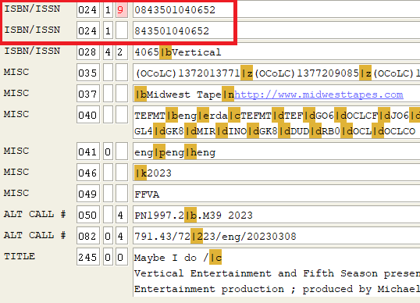
Result
Now there are two 024 fields and the first one has 13 digits

Slide 16
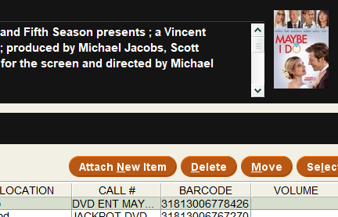
Result
And now we have the correct cover art

Slide 17
Second Weird Trick
Marcive updates

Slide 18
Marcive problem
We send new records to Marcive monthly to update their copy of our database
Most of these records are returned the next day with updates
If these records happen to get changed locally in the day it takes to get the records back from Marcive, then those changes can be lost

Slide 19
Send records toward the end of the month
We send the records from the previous month, using “CAT DATE within last month”
By the end of the following month most libraries will have cataloged their copies and will be done with overlays and edits

Slide 20
Add a note that they are being modified by Marcive
Perform a global update on the list to add a 900 note to let people know the record is out for authority updates and changes made that day may be lost

Slide 21
Don’t reload those record that did get updated
Keep the review file of records sent, so that when they come back you can search for any that have been updated in the last day (new CAT DATE)
Create a second list of the records sent that now have a new CAT DATE
Export the .b numbers of those records that have been updated
Use MarcEdit (extract selected records) to remove those updated records from the file coming back from Marcive before reloading them
(they will go to Marcive again next month because they now have a new CAT DATE)

Slide 22
Remove the 900 note from the records
After loading the records, remove the 900 note about them being at Marcive
Remove it from all the records, including the ones that didn’t get the Marcive overlay

Slide 23
THANK YOU
Questions?

