Slide 2
Getting started with Project Management

Slide 3
About me – Trevor Smith
Monograph Acquisitions and Metadata Librarian
Douglas College, Vancouver, BC Canada
We recognize and acknowledge the Kwikwetlem First Nation, as well as all Coast Salish Peoples, on whose traditional and unceded territories we live, we learn, we play, and we do our work.
Teach Project Management at UBC, School of Library, Archival and Information Studies (SLAIS)
UBC’s Point Grey Campus is located on the traditional, ancestral, and unceded territory of the Musqueam people.
http://activehistory.ca/2017/08/150-acts-of-reconciliation-for-the-last-150-days-of-canadas-150/
Notes:
pronounced "Kee-Kite”
https://students.ubc.ca/ubcfyi/what-land-acknowledgement

Slide 4
My Goal
For you to understand some of the basic principles
Give some great tricks, formulas, and documents for your projects
10 areas of traditional PM – Project Management Body of Knowledge (PMBOK)
Agile

Slide 5
By the end
Understand the different components of a project
Understand the terminology used
Know the difference between “Waterfall” and Agile PM
Hopefully want to learn more …

Slide 6
You can’t learn to
Catalogue in 1 hour
And
You can’t learn Project Management in 1 hour

Slide 7
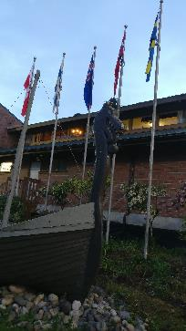
Fictional Project
Scandinavian Cultural Centre Library
The 5 members have libraries in respective languages and English titles
“Project” is to expand the library, provide an ILS, and catalogue all titles

Slide 8
Projects start with ….
Projects are driven by a problem or an opportunity
Trigger event – identifies need for a project
Opportunity
Business need
Customer need
Technology change
Policy change
Legislation change
Need for improvements or changes

Slide 9
What is a project?
Working towards a goal
Coordinated tasks
Needs resources
Has timelines
It is not ongoing work

Slide 10
Why do they fail?
Poor communication between groups
Fuzzy expectations
Not enough resources
Working on too many other projects
We want to do the fun stuff first

Slide 11
Project Life Cycle
Initiating
Executing
Monitor & Controlling
Closing
Planning
Sequential steps that go through the life of a project that connect over Knowledge areas. Processes flow and repeat depending on progress of project activities

Slide 12
Project Management Knowledge areas
Integration
Scope
Procurement
Time
Cost
Quality
Human Resource
Communication
Risk
Stakeholder
Notes:
AO – to the end.

Slide 13
Project life Cycle, Integration Management
Integration
Stakeholder
Scope
Procurement
Project Management Knowledge areas
Time
Risk
Cost
Communication
Quality
Human Resource

Slide 14
Projects & Organizations
Projects take place in organizations that are bigger than your project
How do you align your project with the organizations values?
What influence will the culture have on staffing, managing, and executing?
Motivation / reward systems
Risk tolerance

Slide 15
Project Charter
Key document in project planning phase
Provides a high-level “big picture” for the project
Describes WHAT the project is about
Aligns the project’s goals to the organizations’ goals
About 2- 3 pages
Authorizes the project manager to begin work

Slide 16
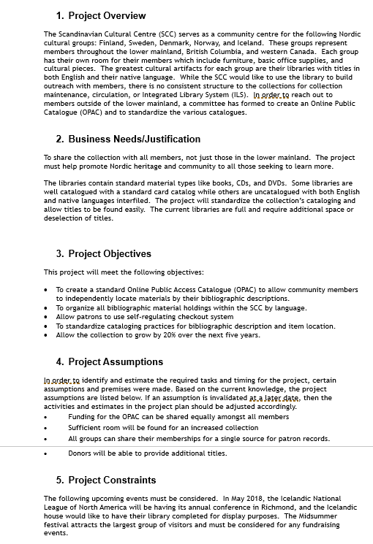
Charter
Project Overview
Business Needs/Justification
Project Objectives
Project Assumptions
Project Constraints
Related Projects
Project Sponsors
Project Organization
Responsibility of the Project Manager
Authorization to Proceed

Slide 17
Scope
Integration
Stakeholder
Scope
Procurement
Project Management Knowledge areas
Time
Risk
Cost
Communication
Quality
Human Resource

Slide 18
Triple Constraint
Time
Cost
Quality
Scope
https://commons.wikimedia.org/wiki/File:Deathly_Hallows_Sign.svg
Notes:
It is easier to think of this in smaller elements
Draw this on the board.

Slide 19
Scope
Defining all the work needed for the project and ONLY the work needed for the project.

Slide 20
Scope Document
Created after the project is approved
Takes the WHAT from the Charter and starts to describe HOW
Still high level
Breaks ideas into Deliverables ~ 5
Provides a high-level “big picture” for the project
About 5 - 10 pages

Slide 21
Good Deliverables are SMART Deliverables
Specific
Measurable
Assignable / Achievable
Relevant
Time-bound
“Allow the collection to grow by 20% over the next five years.”

Slide 22
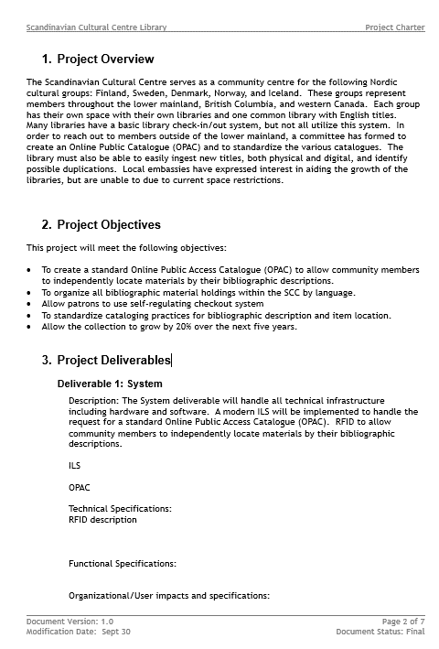
Scope Statement
Project Overview
Project Objectives
Project Deliverables
Deliverable 1: System
Deliverable 2: Items
Deliverable 3: People
Deliverable 4: Space
Deliverable 5: Library Grand Opening
Acceptance Criteria
Scope Exclusions
Detailed Assumptions
Detailed Constraints
Scope Management

Slide 23
Time Management
Integration
Stakeholder
Scope
Procurement
Project Management Knowledge areas
Time
Risk
Cost
Communication
Quality
Human Resource

Slide 24
Scheduling
What you need done
Who is going to do it
How long it will take
Tasks
People / Tools
Time

Slide 25
Activity Management AKA Scheduling
Activity Definition breaks deliverables into work packages.
AKA define the work needed to achieve the goal or results listed in the Scope Statement
Work packages are decomposed into smaller tasks called schedule activities.
Work packages create a fancy, scheduled “to do” list Work Breakdown Structure (WBS)

Slide 26
Decomposing 101
How far do I break it down???
8-80 hours of effort
10-20 days
0.5-2.5% of total project budget

Slide 27
Program Evaluation and Review Technique (PERT)
If you don’t know how long it will take, try PERT
Take values for the pessimistic, optimistic, and most likely guesses
Pessimistic + Optimistic + 4 (Most Likely)
____________________________________
6
“Probably 4 days, maybe 2 days if we’re lucky, but maybe 2 weeks if things go bad.”
“We have to update the proxy for all the databases. How long will it take?”
“Thanks. With my PERT analysis, I’m going to schedule 37 hours.”
=(80+16+4(32))/6

Slide 28
Duration Estimation
OK cool but what do we do when we have lots of people on a project?
Resource Effort (Work) RE
Resource Productivity (Units) RP
Resource Availability (Working Time) WT
Effort
Resources
Working Time
Tasks
People / Tools
Time

Slide 29
Duration Exercise
Resource Effort (Work) RE
Resource Productivity (Units) RP
1 unit is counted at 100%
Resource Availability (Working Time) WT
Bay of shelves takes 8 hours for inventory
1 person will take a day
If you have 40 bays = 40 days
Add more people, say 9, take 4 days
=(RE/RP)/WT

Slide 30
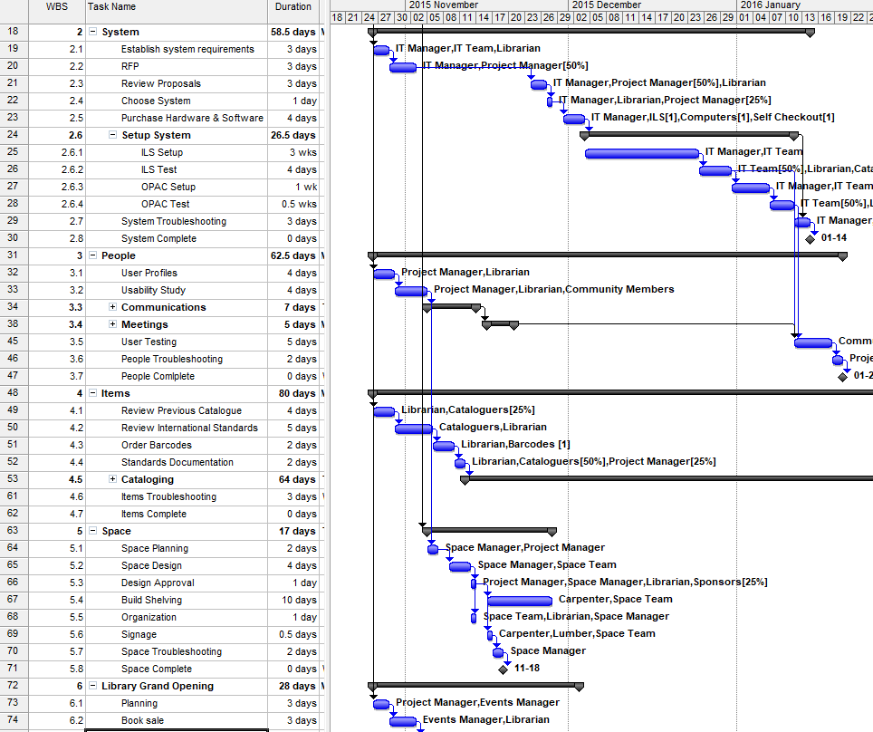
WBS
Deliverables
Tasks
Estimate time
Estimate resources
Link together in sequence

Slide 31
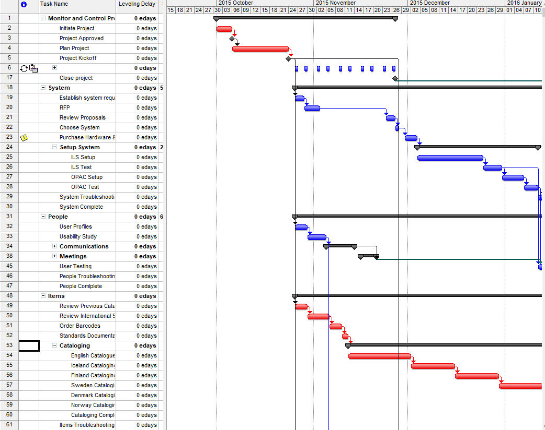
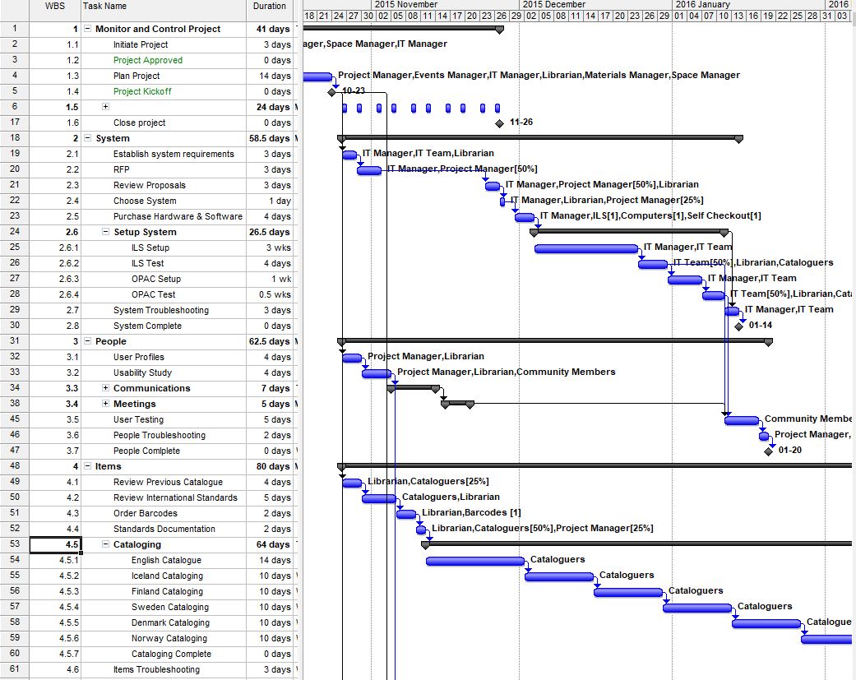
Critical Path
The critical path is the shortest route through your schedule where there is no float.

Slide 32
Cost
Integration
Stakeholder
Scope
Procurement
Project Management Knowledge areas
Time
Risk
Cost
Communication
Quality
Human Resource

Slide 33
Estimating
Analogous Estimating
AKA “Ball park” or “Top Down”
Expert historical judgement
Take the cost of the last project, consider the scope, and other known variables
Parametric
AKA “Per Unit” “Parameters”
Ie. cost per cubic yard, cost per unit, cost per installation, etc.
Simple formulas sometimes as simple as a residential home costs $X per square foot
Bottom-Up
Take your WBS, assign resources, time, and cost to them
Details are summarized or “rolled up” to higher levels for reporting and tracking

Slide 34
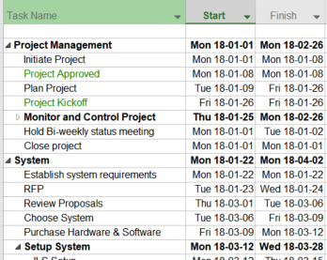
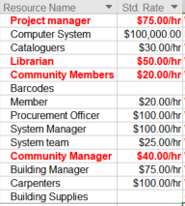
Budgeting with your WBS
Task & Duration
Resources (and costs)
+

Slide 35
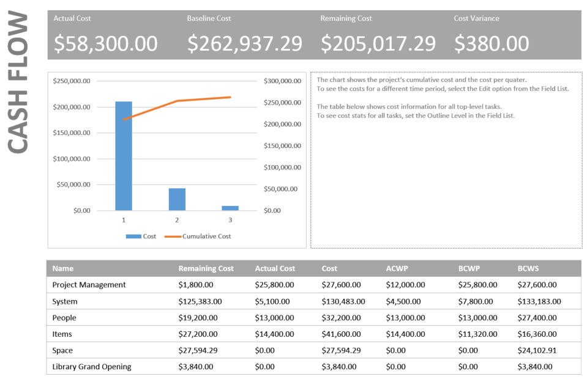
Budget
Baseline budget
What You’ve spent
What You’ve got left
How much you’re over

Slide 36
Quality
Integration
Stakeholder
Scope
Procurement
Project Management Knowledge areas
Time
Risk
Cost
Communication
Quality
Human Resource

Slide 37
Quality Management
Scope, time, cost = QUALITY
Time
Cost
Quality
Scope
Notes:
planning process, tools or outputs are created to illustrate how project tasks will be sequenced and allocated. The controlling and monitoring process is concerned with tracking and reporting on the progress of work, as well as adjusting time outputs to address shifts and changes in the project plan. Finally, the closing process includes an audit of time targets. Project managers reflect on what contributed to time estimates being accurate, too liberal, or conservative. This reflective process helps them to build better time plans for future projects.

Slide 38
Quality sez who???
Defined by the customer
Talk to your sponsor
Talk to your patrons

Slide 39
Why Quality Management?
Quality may suffer if the project team is too over worked to complete the project
Quality may also suffer if the project is too rushed and produces unacceptable deliverables
Quality is planned in, not inspected in
Notes:
Quality planned in not inspected in:
Planning for quality is more cost-effective than inspecting work results and doing the work over, or correcting problems to adhere to quality demands.

Slide 40
W. Edwards Demming & Continuous Improvement
Phase 1
Phase 2
Phase 3
Plan
Do
Check
Act

Slide 41
Pareto Principle
AKA the 80/20 rule
80% of the problems are due to 20% of the causes
Focus on the items that hit 20%

Slide 42
Human Resources
Integration
Stakeholder
Scope
Procurement
Project Management Knowledge areas
Time
Risk
Cost
Communication
Quality
Human Resource

Slide 43
Plan Human Resource Management
Identify staffing requirements
What skills will the project team require?
When will people with different skills be needed in the project schedule?
Identify skilled staff available
Fill gaps through hiring, training or procurement

Slide 44
Stages of Team Development
Forming
Storming
Performing
Adjourning
Norming
Notes:
Testing period: Polite stage/ Inclusive / Quiet / Guarded / Unemotional / Formal / Impersonal
Storming: Infighting: Control conflict / Confrontational / Difficulties / Feeling ‘stuck’ / Competition for position or assignments / Assess other members commitment to the project
Norming: Alignment Stage / Organizing / Resolve conflict / Confront issues / Develop norms / Feedback forthcoming / Cooperate and collaborate / Working together towards a goal
Performing: Openness and Caring Stage / Maturity / Trust / Openness / Supportive / Helpful / Fun
Adjourning: Team members may be worried about next job / Mixture of accomplishment and loss

Slide 45
Conflict is inevitable
Conflict is natural and forces a search for alternatives,
Conflict is a team issue,
Openness resolves conflict,
Conflict resolution should focus on issues, not personalities, and
Conflict resolution should focus on the present, not the past.

Slide 46
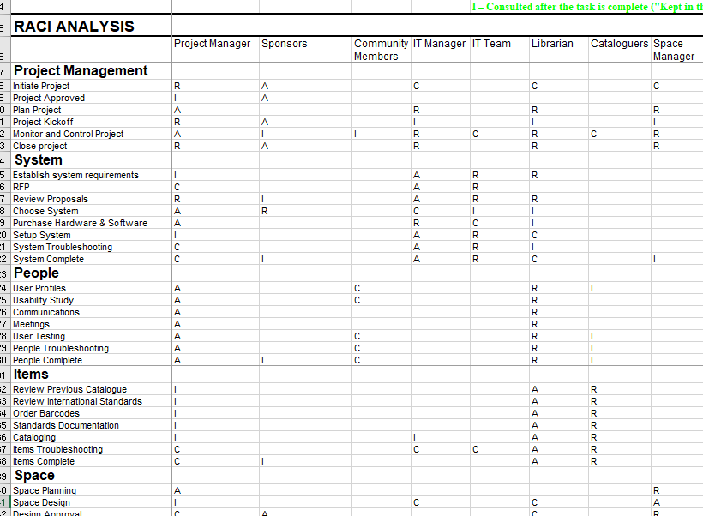
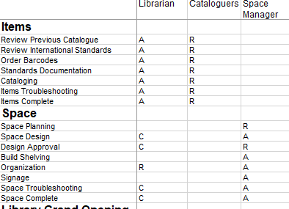
RACI Chart
Responsible
Accountable
Informed
Consulted
PMBOK 5th Ed. Figure 9.5

Slide 47
Communication
Integration
Stakeholder
Scope
Procurement
Project Management Knowledge areas
Time
Risk
Cost
Communication
Quality
Human Resource

Slide 48
Remember
It is estimated that 80-90% of a Project Managers’ time is spent in communication.
If you can’t communicate clearly with your team, stakeholders, and sponsors, it will be difficult for your project to succeed.

Slide 49
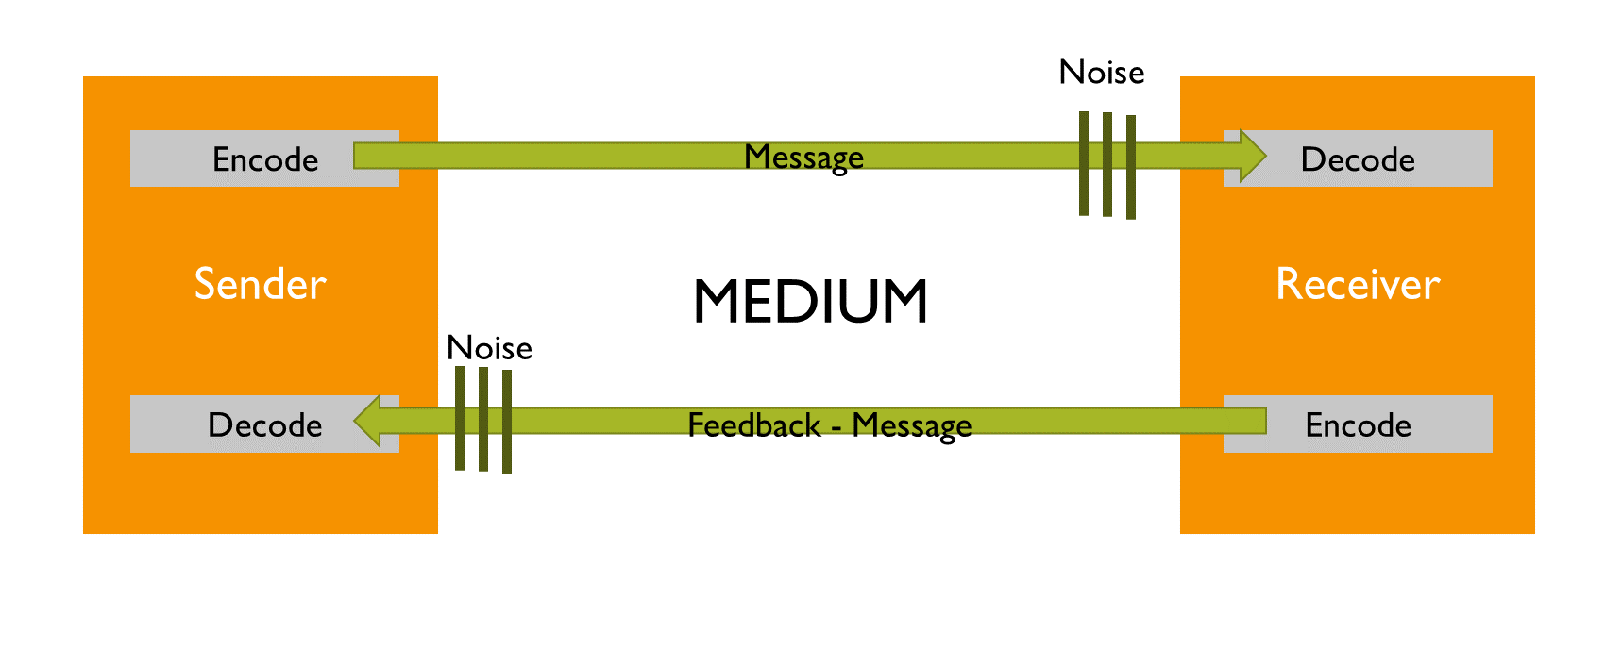
Communication Basic Model
Encode – translating thoughts or ides into a language (English, MARC, HTML) that is understood by others
Message – Output of the encoding
Medium – method used to convey the message
Noise – anything that interferes with the transition or understanding of the message – distance, telephone line, air
Decode – translating the message back into meaningful thoughts or ideas

Slide 50
Communication channels
n(n-1)/2
n = number of stakeholders
With 3, you have 3 channels
With 5 TS folks, you have 10 channels
With 12 Librarians, you have 66 channels
Notes:
Our class 28
Class of 20 = 190

Slide 51
Audience
Perspective / Attitude | High | EXECUTIVES | EXPERTS
 | Low | GENERAL/LAY PEOPLE | TECHNICIANS
 |  | Low | High
 |  | Technical
EXPERTS – formally qualified and prefer sufficient information to understand the detailed status
EXECUTIVES – decision makers who prefer “bottom line” information and conclusions
TECHNICIANS – varying qualifications/skills but prefer to have more technical information
GENERAL/LAY PEOPLE– non-specific and non-technical who want general info

Slide 52
Risk Management
Integration
Stakeholder
Scope
Procurement
Project Management Knowledge areas
Time
Risk
Cost
Communication
Quality
Human Resource

Slide 53
Risk Identification
When you start to figure out the worst case scenarios or awesome opportunities
Remember it is an iterative process
Your goal is to create the “Risk Register”

Slide 54
Some Categories of Risk
Safety
Financial
Reliability
Market Efficiency
Relationships
Organization & People
Environment
Schedule

Slide 55
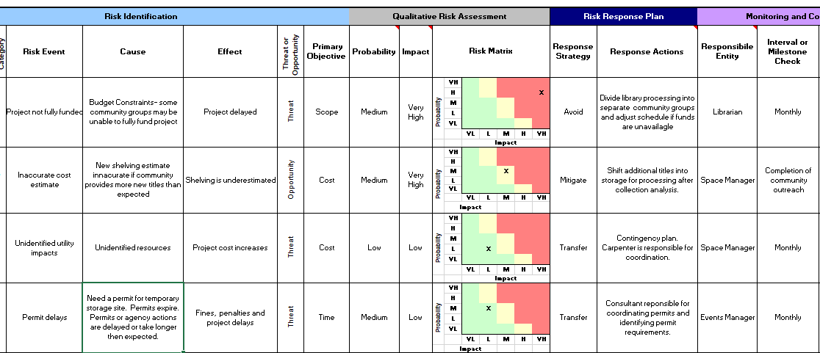
Risk Registry
Risk Identification
Qualitative Risk Assessment
Risk Response Plan
Monitoring and Control

Slide 56
Procurement
Integration
Stakeholder
Scope
Procurement
Project Management Knowledge areas
Time
Risk
Cost
Communication
Quality
Human Resource

Slide 57
Make-or-buy Analysis
How much does it cost to build it yourself vs. buying it?
Also includes renting or leasing items
Need new library shelves? Easier to buy them or have your facilities department build some?
Local bookstore/video store going out of business with low prices. Extremely cheap, but how much will it cost to do original cataloging? Ie is it better to go for the deal vs your standard vendor?

Slide 58
Resources to help
Library Technology Reports, Vol. 39, No. 4, July – August 2003 – Model RFP
Techsoup for Libraries - http://www.techsoupforlibraries.org
10 tens for working with vendors
Developing RFPs for libraries
Analyzing RFPs for libraries
www.librarytechnology.org/procurement
International Journal of Procurement Management
Library Technology Buying Strategies Edited by Marshall Breeding
http://www.alastore.ala.org/detail.aspx?ID=11769

Slide 59
Procurement department
There is probably a department who does this for you – let them handle it

Slide 60
Stakeholders
Integration
Stakeholder
Scope
Procurement
Project Management Knowledge areas
Time
Risk
Cost
Communication
Quality
Human Resource

Slide 61
Stakeholders
People or organizations that are ACTIVELY involved in the project or whose interests may be affected by the project.
Will have varying levels of responsibility and can be very hard to identify
Influence can be positive or negative

Slide 62
Stakeholder types
PM – you! The one REPSONSIBLE for the project
Sponsor – person with $$$
Customer/user/patron – the person who will USE the project’s product
Project team members – people doing the work ON the project
Project management team – members of the team responsible for the MANAGEMENT activities. In a library: Systems librarian, Circulation librarian, Technical Services librarian.
Influencers – People or groups who aren’t directly related to the project but have positive or negative INFLUENCE over it

Slide 63
Stakeholder Analysis – Power & Interest Grid
Groups stakeholders based on their authority (“power”)
and level or concern (“interest”)
PMBOK 5th Ed. Figure 13.4

Slide 64
Interpersonal Skills
You need to:
Build trust with your stakeholders
Resolve conflicts
Use your active listening
Work on any resistance to change

Slide 65
Closing

Slide 66
Closing
Scope statement had general descriptions and requirements
Follow it
Sign-off

Slide 67
Get Sponsor
to Sign-Off!!!

Slide 68
Thank your team
For their work.
PARTY!!!

Slide 69
Agile

Slide 70
Triple Constraint
Time
Cost
Quality
Scope
https://commons.wikimedia.org/wiki/File:Deathly_Hallows_Sign.svg
Notes:
It is easier to think of this in smaller elements
Draw this on the board.

Slide 71
Waterfall vs Agile
Estimated Features
Estimated Resources
Estimated Schedule
Estimate-driven
Priority-driven
Fixed Resources
Fixed Schedule
Fixed Requirements
Adapted from: Lynch, Patrick J., and Sarah Horton. 2016. Web style guide : foundations of user experience design. 4th Ed. New Haven : Yale University Press, 2016 , p. 73

Slide 72
Agile Manifesto
http://www.agilemanifesto.org/
Individuals and interactions over processes and tools
Working software over comprehensive documentation
Customer collaboration over contract negotiation
Responding to change over following a plan

Slide 73
5 Process Management Areas
Initiating
Planning
Executing
Monitor & Controlling
Closing
Project procurement processes starts with Planning through to Closing

Slide 74
Lifecycle
Envision
Speculate
Explore
Adapt
Close
Notes:
Lifecycle

Slide 75
Agile & Scrum in 4 steps
The team and the project sponsors create a prioritized list of all the things the team needs to do. This can be a list of tasks or a list of features. This is known as the product backlog.
Each month, the team pulls off the top section of the list, which they estimate to be one month’s worth of work. They expand it to a detailed task list, called the sprint backlog. The team promises to demo or deliver the results to the sponsors at the end of the month.
From: Alistair Cockburn, Agile Software Development: The Cooperative Game, 2nd Edition (Boston: Addison Wesley, 2006).

Slide 76
Don’t go Chasing waterfalls
From: https://www.flickr.com/photos/dinomite/4126196827/in/photolist-9C5ySq-7hBQyB-5vM7gB-9C5mRo-87afpr-4VfwB7-6Vno36-72km4i-72pmnC-6WjY8C

Slide 77
Scrum in 4 steps
Each day, the team meets face-to-face for five to ten minutes to update each other on their status and on any roadblocks that are slowing them down. This is called the daily standup meeting.
One particular person is designated the Scrum Master. It is this person’s assignment to remove, or get someone to remove, whatever roadblocks the team mentions in the standup meeting.
From: Alistair Cockburn, Agile Software Development: The Cooperative Game, 2nd Edition (Boston: Addison Wesley, 2006).

Slide 78
Daily Stand up
5-15 minutes
What they did yesterday
What they are doing today
What problems they are encountering
Not where you fix issues
Talk after the meeting and resolve the problem.
Bring response to the next meeting

Slide 79
When to use Agile
Doesn’t have to be delivered on X date
You expect requirements to change
Your organization is willing to let team members work on it continuously

Slide 80
In Closing

Slide 81
My Goal
For you to understand some of the basic principles
Give some great tricks, formulas, and documents for your projects
10 areas of traditional PM
Agile

Slide 82
At the end
Understand the different components of a project
Understand the terminology used
Know the difference between “Waterfall” and Agile PM
Hopefully want to learn more …

Slide 83
Thank you
Trevor Smith MA, MLIS Monograph Collections and Metadata Librarian Douglas College Library (604) 527-5259
smitht7@douglascollege.ca
http://www.douglas.bc.ca/library.html
@Douglas_Library
@trevordsmith100

