Slide 2
NO CODE? NO PROBLEM
Session K07
Tuesday 10:30 – 11:30
Sheryl VanderWagen
ILS Manager
Lakeland Library Cooperative

Slide 3
During this session we will:
Examine 3 Count Use Fields (IUSE3, INTL USE, COPY USE)
Talk about the ICODE1 Field
Talk about OPACMSG and IMESSAGE
Discuss the use of Create Lists to gather records
Discuss how to apply Rapid or Global Update to files
See some special projects done by Lakeland members
Talk about yours

Slide 4
COUNT USE EXPLAINED

Slide 6
System basics
Default value of all Count Use fields is 0
The value in each is incremented by scanning barcodes
Select a Count Use option from the Sierra dropdown menu
Scan barcodes of items with which you are working
This action increments the value in the selected field by 1 (one)
Determine how you are going to use this field and use it for one purpose/project only. Choose another Count Use field for another purpose with the same end results or have all values reset to 0 in the selected field

Slide 7
Getting Started
Select one of the Count Use fields for your project
Create a Review file to check for item records with values not equal to 0
Create list query: Item record [selected count use field] > 0
If any are found update those records in Rapid Update to 0
Caution: Check with your system administrators to make sure that these fields are not being used to collect ongoing data for your library.
Now you may begin your project!

Slide 8
Choose selected field Begin scanning barcodes

Slide 9
After scanning barcodes:

Slide 10
Gather the “marked” records in Create Lists
Create Search Query:
Name the Query (example: LL IUSE3 updates)
Store Item Records (change the dropdown menu option from Bibliographic to Item)
Query structure: Item IUSE3 = 1 or IUSE3 > 0
Search records
If you used INTL USE or COPY USE fields, structure your query with the field you selected for your project

Slide 11
SEARCH QUERY

Slide 12
Records are now ready for updating
Start Global or Rapid Update
Update the records in the review file as needed
Note: Make sure you also tell the system to reset the value in the IUSE3 field to 0 so that you can use the field for your next project
OR
Delete records if this is a weeding project

Slide 13
RAPID UPDATE SETUP

Slide 14
IDEAS FOR IUSE3, INTL USE, COPY USE
Mark items to be weeded/deleted
Update location codes, status or other fields
Create a new collection (i.e. Tweens)
Track shelf checks on missing or claims returned items
Track In-house use of materials
Inventory if you don’t have another product such as RFID, Inventory Control or Circa, etc.

Slide 15
ICODE1
Your organization determines the name and purpose of this field, its codes and the codes’ definitions. Commonly used as a statistical field.
Also useful for designating records for short loans, special collections, holidays, new materials, rotating collections, etc.
The field allows a maximum of 5 numeric characters

Slide 16
Lakeland ICODE1 table (Full table available at http://www.llcoop.org/ilsinfo/icode1.pdf)
19 | Halloween
20 | Veteran's Day
21 | Ramadan
22 | Thanksgiving Day
23 | Hanukkah
24 | Christmas Day
127 | Read Across America
128 | Leased Audio Books
129 | Michigan Author
130 | Discovery Packs
131 | Brown Bag Program
877 | MADL DVD Packet 8
878 | MADL DVD Packet 9
879 | MADL DVD Packet 10

Slide 17
Holiday Collections Restricted Circ
Designated items are assigned ICODE1 for a specific holiday
Create a review file of items with the appropriate ICODE1
In Lakeland we use itypes and location codes to determine loan periods (http://www.llcoop.org/ilsinfo/i-types.pdf)
We have a designated itype with a “short loan” loanrule that allows checkout for 7 days and no holds. This allows us to restrict circulation for a period of time before a designated holiday.
Use rapid update to change the itype to the short loan rule and to change it back after the holiday is over

Slide 18
New Books
We restrict holds on new books for the first 6 months
We do this with location codes for new materials combined in the Rule Determiner Table with ptypes and itypes
As new books are added we also have an ICODE1 range for each month of the year which libraries may use to mark new items so their location codes/itypes can be converted to their permanent codes at the end of the six month period
201 | January
202 | February
203 | March

Slide 19
New Books updated
Create a review file of the new books added for a specific month, (i.e. January)
Using Global Update, update groups of records in the file to their permanent location codes.
At the end, update the entire file to reset the ICODE1 to 0

Slide 20
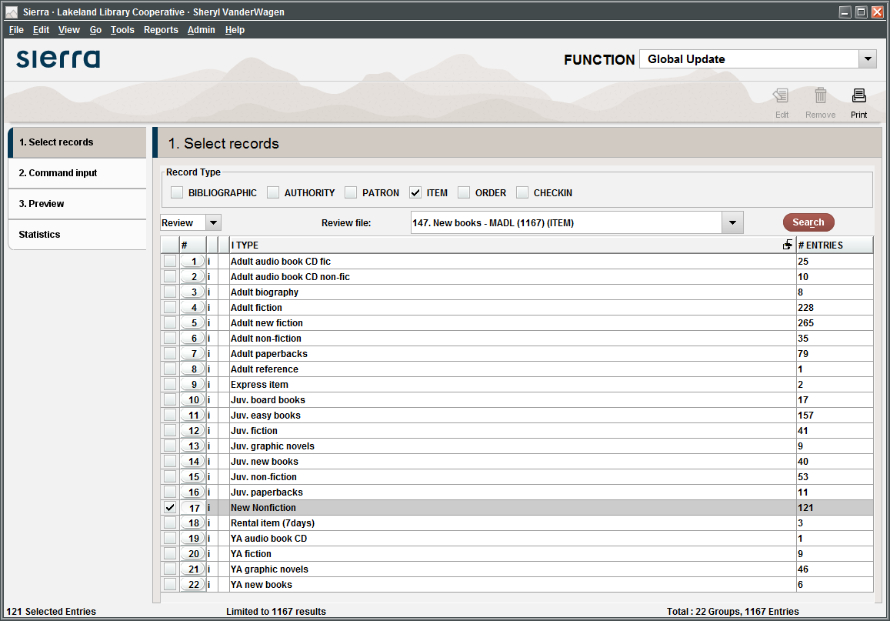

Slide 21
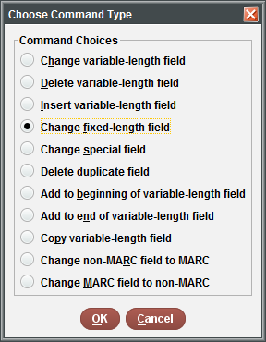
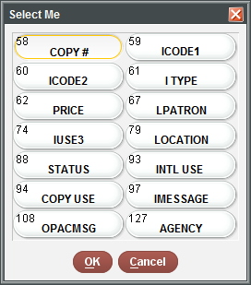
Set Up Changes in Global Update
At this point you can change:

Slide 22
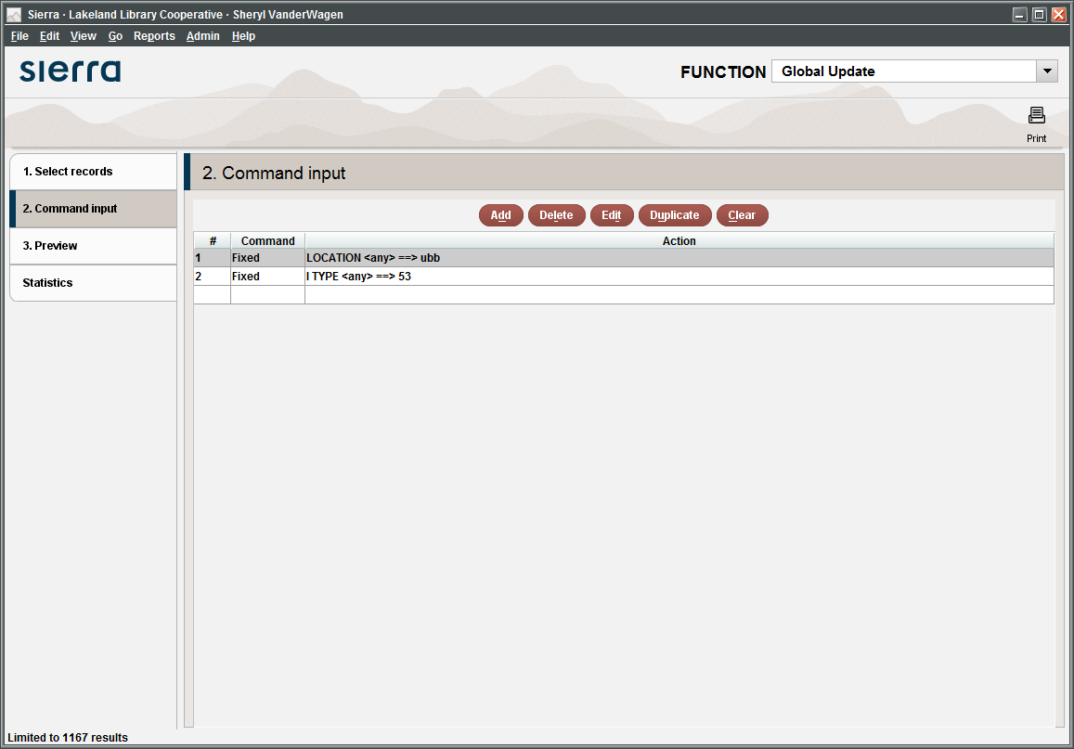

Slide 23
Rotating Collections
Each collection is assigned a specific ICODE1
On a scheduled rotation date each packet is put into a review file (ICODE1 = xxx) and the location codes are updated and rotated to the next branch.
Rapid update is used to update the location code field
810 | MADL Video Packet 1
811 | MADL Video Packet 2
812 | MADL Video Packet 3
813 | MADL Video Packet 4

Slide 24
Grant Materials Circulation
Create an ICODE1 Value for purchased grant materials
Web Management Reports will display circulation statistics by ICODE1
In Create Lists, compile a list of items purchased with specific grant funds
In Millennium or Sierra Statistics run field statistics or periodic reports against the review file to gather data to report to the funding agency
5002 | Reynolds Township Panhandle Grant mat.

Slide 25
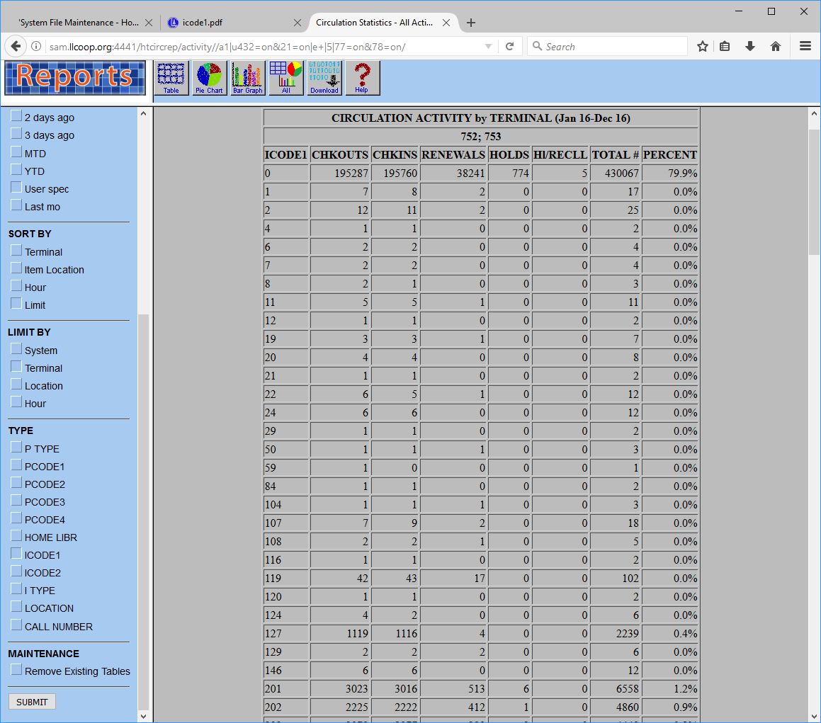
Web Management Reports Using ICODE1

Slide 26
Set Up Statistical Report

Slide 27
View the Report

Slide 28
Brown Bag Programs
Assign your brown bag items an ICODE1
Create a review file of items with ICODE1 = assigned code
At the end of the program, compile circulation statistics in Web Management Reports displayed by ICODE1 and gather other stats in Millennium/Sierra Statistics
Reset the ICODE1 field to 0
Repeat next year
This can also be done with Battle of the Books programs and other types of programs where patrons read specific titles

Slide 29
OPACMSG/IMESSAGE info
The system allows 32 alpha-numeric characters in OPACMSG and IMESSAGE fields
Maximum label length is 14 characters
Use IUSE3 field to mark items that you want to display or use for a program
Use Create Lists to gather the marked items and update OPACMSG and/or IMESSAGE in Rapid Update
Note: If you use the IUSE3 field to mark the items, don’t forget to reset the IUSE3 field to 0 in your Rapid Update command

Slide 30
OPAC MESSAGE

Slide 31
Displays in classic catalog like a call number prefix

Slide 32
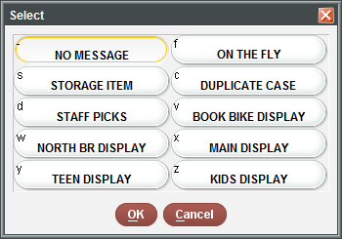
May be used in conjunction with IMESSAGE

Slide 33
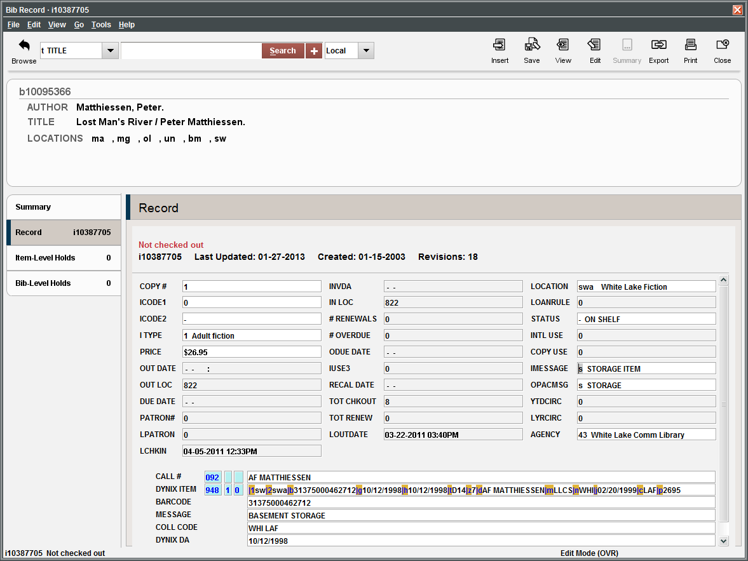

Slide 34
TEMPORARY DISPLAYS/PROGRAMS

Slide 35
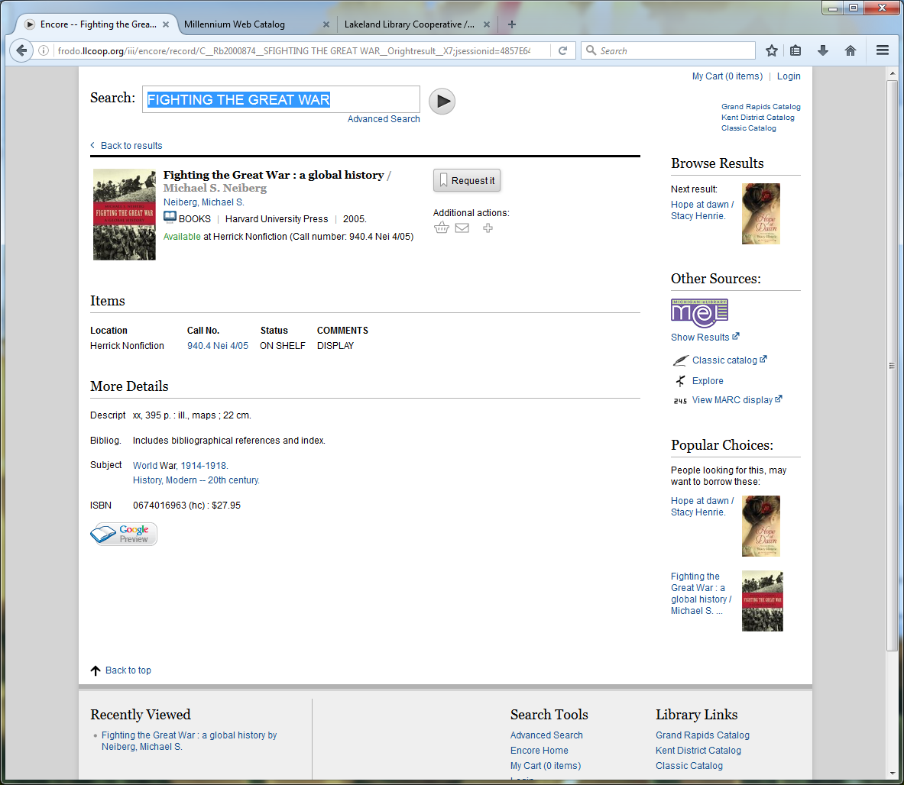

Slide 36
Let’s talk about your projects
Can I help you?

Slide 37
CONTACT ME
SHERYL VANDERWAGEN
ILS Manager
Lakeland Library Cooperative
616-559-5253 x210
sheryl@llcoop.org
http://www.llcoop.org

