Slide 1
Fear and Loathing in Polaris
How the pandemic sharpened our SQL skills
and streamlined our organization.
Diane Perry & Paul Delaney

Slide 2
PRESENTER INTRODUCTION
Diane Perry – Business Systems Department Specialist
Tampa-Hillsborough County Public Library
phone: 813-204-2670
email: PerryDi@HillsboroughCounty.org
web: https://www.hcplc.org
Paul Delaney – Library Services and Technology Guide 2
Tampa-Hillsborough County Public Library
phone: 813-422-3224
email: DelaneyP@HillsboroughCounty.org
web: https://www.hcplc.org

Slide 3
FEAR AND LOATHING…
“We were somewhere around Tampa on the edge of the Bay when the pandemic began to take hold. I remember saying something like, “I feel a bit overwhelmed; maybe we need to regroup…” Then suddenly there was a terrible administrative directive to shut down NOW. In the blink of an eye our library system was filled with closed locations, all who needed their holds and check outs extended, which BTW was almost 30 libraries.”

Slide 4
THE PANDEMIC
Preparation for sudden location closure, generating custom SQL reports and heat maps, customizing Borrow By Mail, utilizing notifications and modifying System Administration settings.
January 2020 – tested Borrow By Mail
April 2020 – temporarily closed 30 library locations
Some re-opened, some didn’t for quite a while, and one won’t ever again. And then some temporarily closed again due to construction, COVID, and general staffing shortages. In any instance, we asked:
What do we do about items out?
What do we do about Held items and existing holds?

Slide 5
HOLD REQUESTS

Slide 6
HOLDS REQUESTS
A handful of locations were permitted to do curbside for holds and returns.
What to do with Held items?
Use SQL to create a holds call list for each location so staff can contact their patrons and ask if they want their holds available for curbside (at select locations) or make Borrow By Mail.
Temporary Policy Change:
Extend the days held for pickup from 5 to 7.

Slide 7
HOLDS REQUESTS
What to do with all other existing holds?
Write/schedule an UPDATE script to change the pickup location for Pending and Shipped holds going to closed or non-curbside locations.
Some locations were masked from being a pickup location.

Slide 8
ITEMS OUT

Slide 9
ITEMS OUT
What to do with items currently checked out?
As needed, use SQL UPDATE to push out due dates.
Temporary Policy Change:
Extend the max items out from 35 to 75.

Slide 10
ITEMS OUT
The library’s circulation policy has been temporarily updated to grant more items on a patron’s card. How to do we quickly update our system?
Write an UPDATE script to permit checkout and hold request limits from 35 to 75.

Slide 11
CARD REGISTRATION

Slide 12
CARD EXPIRATION
What to do with library cards expiring?
As needed, use SQL UPDATE to push out expiration and address check dates.

Slide 13
COLLECTIONS

Slide 14
COLLECTIONS
What to do with library collections?
Collections were set to Unavailable via Item Record Sets for closed locations not able to pull their Pending list.

Slide 15
FEAR AND LOATHING…
“You want me to, uh, throw this into SQL when the pandemic peaks?”

Slide 16
DISCLAIMER
The remaining slides include scripts that can only be run in SQL Server.
We maintain a spreadsheet of all relevant integers for quick reference and script creation. Some integers are unique to our organization, such as Patron Code, Organization, etc.
These were first run in a test, development server before being applied to a live, production environment.
Update scripts, if done incorrectly, can cause major issues to your databases.
So, in other words…DO NO TRY THIS AT HOME…or WORK!

Slide 17
SQL | HOLD REQUESTS

Slide 18
SQL | UPDATE | HOLD REQUESTS
--REVERT Unclaimed REQUESTS BACK to Held
UPDATE
Polaris.Polaris.SysHoldRequests
SET
SysHoldStatusID = '6', --HELD STATUS
HoldTillDate = '2024-07-01 23:59:59' --NEW UNCLAIMED DATE
WHERE
PickupBranchID IN (3,13) AND --AFFECTED LIBRARIES
SysHoldStatusID = '8' --UNCLAIMED STATUS

Slide 19
SQL | UPDATE | HOLD REQUESTS
--Update Unclaimed Date FOR HELD ITEMS
UPDATE
Polaris.Polaris.SysHoldRequests
SET
HoldTillDate = '2024-07-01 23:59:59' --NEW UNCLAIMED DATE
WHERE
SysHoldStatusID = '6' AND --HELD STATUS
HoldTillDate < '2024-07-01 23:59:59' AND --OLD UNCLAIMED DATE
NewPickupBranchID IS NULL AND --NOT HELD FOR TRANSFER
PickupBranchID IN (3,13) --AFFECTED LIBRARIES

Slide 20
SQL | UPDATE | HOLD REQUESTS
--MAKE HELD FOR TRANSFER TO NEW LOCATION
UPDATE
Polaris.Polaris.SysHoldRequests
SET
NewPickupBranchID = '15' --NEW PICKUP LOCATION
WHERE
PickupBranchID IN (4,14) AND --AFFECTED LIBRARIES
SysHoldStatusID = '6' AND --HELD STATUS
NewPickupBranchID IS NULL --NOT HELD FOR TRANSFER

Slide 21
SQL | REPORT | HOLDS CALL LIST (PART 1)
--HOLDS CALL LIST FOR ALL HELD ITEMS AT SPECIFIC LOCATION WHERE PICKUP IS PERMISSABLE
--COPY RESULTS TO EXCEL, PRINT, CALL PATRONS
SELECT DISTINCT
shr.SysHoldRequestID,
pr.PatronFullName AS "PATRON NAME",
cs.Description AS "PATRON CODE",
p.Barcode AS "BARCODE",
pr.PhoneVoice1 AS "PHONE",
a.StreetOne AS "STREET ONE",
pc.City AS "CITY",
pc.PostalCode AS "POSTAL CODE",
br.BrowseTitle AS "ITEM",
mt.Description AS "ITEM TYPE",
hs.Description AS "HOLD STATUS",
o.Abbreviation AS "PICKUP LOCATION"

Slide 22
SQL | REPORT | HOLDS CALL LIST (PART 2)
FROM Polaris.Polaris.Patrons p (NOLOCK)
JOIN Polaris.Polaris.PatronRegistration pr (NOLOCK)
ON p.PatronID = pr.PatronID
JOIN Polaris.Polaris.PatronAddresses pa (NOLOCK)
ON pa.PatronID = p.PatronID
JOIN Polaris.Polaris.Addresses a (NOLOCK)
ON a.AddressID = pa.AddressID
JOIN Polaris.Polaris.PostalCodes pc (NOLOCK)
ON pc.PostalCodeID = a.PostalCodeID
JOIN Polaris.Polaris.SysHoldRequests shr (NOLOCK)
ON shr.PatronID = p.PatronID

Slide 23
SQL | REPORT | HOLDS CALL LIST (PART 3)
JOIN Polaris.Polaris.CircItemRecords cir (NOLOCK)
ON cir.ItemRecordID = shr.TrappingItemRecordID
JOIN Polaris.Polaris.BibliographicRecords br (NOLOCK)
ON br.BibliographicRecordID = cir.AssociatedBibRecordID
JOIN Polaris.Polaris.MaterialTypes mt (NOLOCK)
ON mt.MaterialTypeID = cir.MaterialTypeID
JOIN Polaris.Polaris.PatronCodes cs (NOLOCK)
ON cs.PatronCodeID = p.PatronCodeID
JOIN Polaris.Polaris.SysHoldStatuses hs (NOLOCK)
ON hs.SysHoldStatusID = shr.SysHoldStatusID
JOIN Polaris.Polaris.Organizations o (NOLOCK)
ON o.OrganizationID = shr.PickupBranchID

Slide 24
SQL | REPORT | HOLDS CALL LIST (PART 4)
WHERE
PickupBranchID = '20' AND --PICKUP LOCATION
shr.SysHoldStatusID = '6' AND --HELD STATUS
p.PatronCodeID NOT IN (17) AND --OMIT STAFF CARDS
shr.LastStatusTransitionDate BETWEEN '2024-05-25 00:00:00' AND '2024-05-25 23:59:59' --PER DAY
ORDER BY
o.Abbreviation,
pr.PatronFullName,
br.BrowseTitle
ASC

Slide 25
SQL | UPDATE | HOLD REQUESTS
--FOR CLOSED LOCATION, CONVERT PENDING & SHIPPED HOLDS to NEW LOCATION
--SCHEDULED JOB
UPDATE
Polaris.Polaris.SysHoldRequests
SET
PickupBranchID = '12' --NEW PICKUP LOCATION
WHERE
SysHoldStatusID IN (4,5) AND --PENDING, SHIPPING STATUSES
PickupBranchID = '19’ --CLOSED/AFFECTED LIBRARy

Slide 26
SQL | UPDATE | HOLD REQUESTS
--CONVERT PENDING & SHIPPED MOBILE SERVICES HOLDS TO BORROW BY MAIL
--SCHEDULED JOB
UPDATE
Polaris.Polaris.SysHoldRequests
SET
PickupBranchID = '45', --BORROW BY MAIL ORGANIZATION ID
BorrowByMailRequest = '1', --CHECKS “BORROW BY MAIL” BOX
StaffDisplayNotes = 'Request is for Borrow by Mail.',
PACDisplayNotes = 'Request is for Borrow by Mail.'
WHERE
SysHoldStatusID IN (4,5) AND --PENDING, SHIPPING STATUSES
PickupBranchID = '6' --MOBILE SERVICES

Slide 27
SQL | ITEM DUE DATES

Slide 28
SQL | UPDATE | ITEM DUE DATES
--PUSH OUT Due Date FOR ALL ITEMS, All Locations
UPDATE
Polaris.Polaris.ItemCheckOuts
SET
DueDate = '2024-07-01 23:59:59' --NEW DUE DATE
WHERE
DueDate BETWEEN '2024-03-09 00:00:00' AND '2024-06-30 23:59:59' --OLD DUE DATE RANGE

Slide 29
SQL | UPDATE | ITEM DUE DATES
--PUSH OUT Due Date FOR ALL ITEMS FROM Specified Location(s)
UPDATE
Polaris.Polaris.ItemCheckOuts
SET
DueDate = '2024-07-01 23:59:59' --NEW DUE DATE
WHERE
DueDate BETWEEN '2024-03-09 00:00:00' AND '2024-06-30 23:59:59' AND --OLD DUE DATE
OrganizationID IN (6,10) --MOBILE SERVICES LOCATIONS

Slide 30
SQL | CIRCULATION

Slide 31
SQL | UPDATE | PATRON LOAN LIMITS
--Update PATRON LOAN LIMITS TABLE
UPDATE
Polaris.Polaris.PatronLoanLimits
SET
TotalItems = '75', --WAS 35
TotalOverDue = '75', --WAS 35
TotalHolds = '75' --WAS 35
WHERE
PatronCodeID IN (1,10,13,14,18,19,20,21,23)

Slide 32
SQL | UPDATE | MATERIAL LOAN LIMITS
--Update MATERIAL LOAN LIMITS TABLE
UPDATE
Polaris.Polaris.MaterialLoanLimits
SET
MaxItems = '75', --WAS 35
MaxRequestItems = '75' --WAS 35
WHERE
PatronCodeID IN (1,10,13,14,18,19,20,21,23) AND
MaterialTypeID IN (2,3,4,5,6,7,10,12,13,17,19,20,21,24)

Slide 33
SQL | REPORT | CIRCULATION STATS
--TOTAL CIRCULATION (CHECK OUT + RENEWAL + BORROW BY MAIL)
SELECT
COUNT(DISTINCT irh.ItemRecordHistoryID) AS "CKO ITEMS",
COUNT(DISTINCT irh.PatronID) AS "CKO PATRONS",
SUM(ird.Price) AS "TOTAL VALUE"
FROM Polaris.Polaris.ItemRecordHistory irh (NOLOCK)
JOIN Polaris.Polaris.ItemRecordDetails ird (NOLOCK)
ON ird.ItemRecordID = irh.ItemRecordID
WHERE
irh.ActionTakenID IN (13,75,81,89,90,91,45,28,73,74,76,80,82,93) AND
irh.TransactionDate BETWEEN '2024-01-01 00:00:00' AND '2024-01-31 23:59:59'

Slide 34
SQL | REPORT | CIRCULATION STATS
--CHECK INs / RETURNS
SELECT
COUNT(DISTINCT irh.ItemRecordHistoryID) AS "CKI ITEMS",
COUNT(DISTINCT irh.PatronID) AS "CKI PATRONS"
FROM Polaris.Polaris.ItemRecordHistory irh (NOLOCK)
WHERE
irh.ActionTakenID IN (11,12) AND
irh.TransactionDate BETWEEN '2024-01-01 00:00:00' AND '2024-01-31 23:59:59'

Slide 35
SQL | PATRON REGISTRATION

Slide 36
SQL | UPDATE | EXTEND CARD EXPIRATION
--EXTEND PATRON REGISTRAITON EXPIRATION/ADDRESS CHECK DATES for SPECIFIC PATRON CODES
UPDATE
Polaris.Polaris.PatronRegistration
SET
ExpirationDate = '2025-01-02 23:59:59', --NEW EXPIRATION DATE
AddrCheckDate = '2025-01-02 23:59:59' --NEW ADDRESS CHECK DATE
WHERE
(ExpirationDate BETWEEN '2024-01-01 00:00:00' AND '2024-12-31 23:59:59')
OR
(AddrCheckDate BETWEEN '2024-01-01 00:00:00' AND '2024-12-31 23:59:59') AND
PatronID IN
(
SELECT DISTINCT
p.PatronID
FROM Polaris.Polaris.Patrons p (NOLOCK)
WHERE p.PatronCodeID IN (1,10,23) --INCLUDED PATRON CODES
)

Slide 37
SQL | REPORT | CARD REGISTRATION STATS
--CARD REGISTRATIONS PER MONTH
SELECT COUNT(DISTINCT td.TransactionID)
FROM PolarisTransactions.Polaris.TransactionDetails td (NOLOCK)
JOIN PolarisTransactions.Polaris.TransactionHeaders th (NOLOCK)
ON td.TransactionID = th.TransactionID
WHERE
th.TransactionTypeID = '2001' AND
th.TransactionDate BETWEEN '2024-01-01 00:00:00' AND '2024-01-31 23:59:59'

Slide 38
SQL | REPORT | CARD REGISTRATION STATS
--CARD REGISTRATION RENEWALS PER MONTH
SELECT COUNT(DISTINCT td.TransactionID)
FROM PolarisTransactions.Polaris.TransactionDetails td (NOLOCK)
JOIN PolarisTransactions.Polaris.TransactionHeaders th (NOLOCK)
ON td.TransactionID = th.TransactionID
WHERE
th.TransactionTypeID = '2003' AND
th.TransactionDate BETWEEN '2024-01-01 00:00:00' AND '2024-01-31 23:59:59'

Slide 39
BORROW BY MAIL

Slide 40
BORROW BY MAIL
Testing:
Performed pre-COVID for a temporarily closed location. Converted all remaining holds (not going to other locations) to Borrow By Mail. Used SQL UPDATE to batch change those holds. Tested the process from start to finish.
Configuration:
Made “Borrow By Mail” its own location in Polaris. Due to website overlay, BiblioCommons, a SQL UPDATE job was created to convert holds with “Borrow By Mail” as the pickup location to a BBM hold. Overlay did not display the BBM checkbox.

Slide 41
BORROW BY MAIL
Processing:
Centralized location with dedicated staff. They contact the patron pertaining to check out, such as blocking conditions. Utilize USPS tracking numbers.
Postage:
County department that picks up and meters our parcels.
Missing Parcels:
Items set to Missing, Assigned Branch “Borrow By Mail,” new hold request placed at top of the queue.

Slide 42
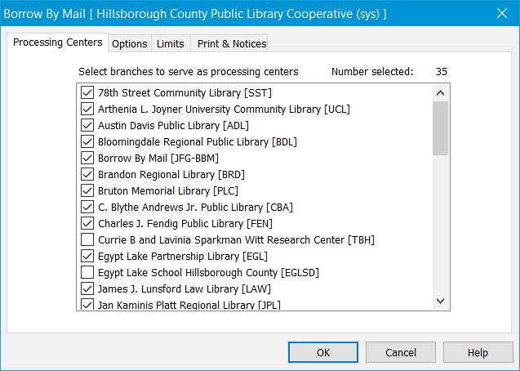
BORROW BY MAIL
Polaris Admin >
System > Parameters >
Request >
Borrow By Mail
Select the Processing Centers / participating locations.

Slide 43
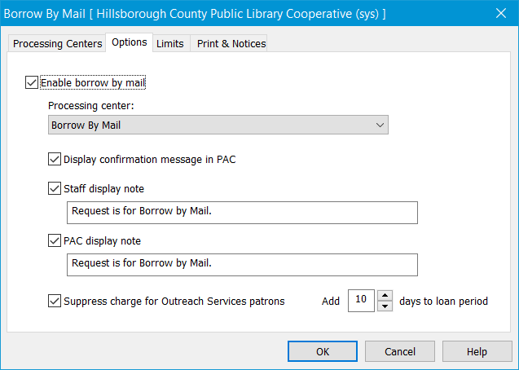
BORROW BY MAIL
Check “Enable Borrow By Mail.”
Our Processing Center is “Borrow By Mail.”
PAC messages and notes enabled.
We do not charge.
An extra 10 days is given to loan period to allow for shipping and handling time.

Slide 44
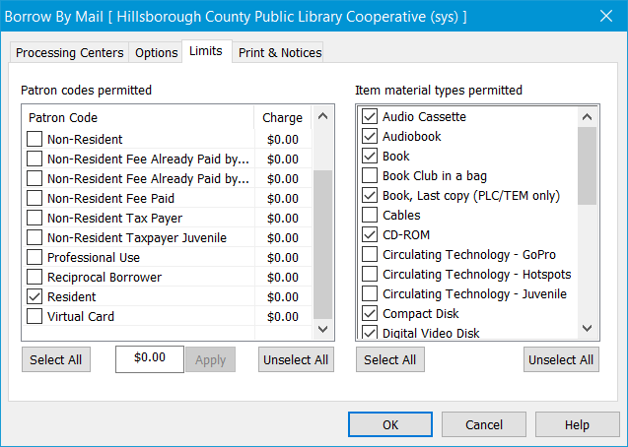
BORROW BY MAIL
Select the permitted Patron Codes and applicable charge.
Select the permitted Material Types. This can be further configured in the Item Record using the “Do Not Mail to Patron” checkbox.

Slide 45
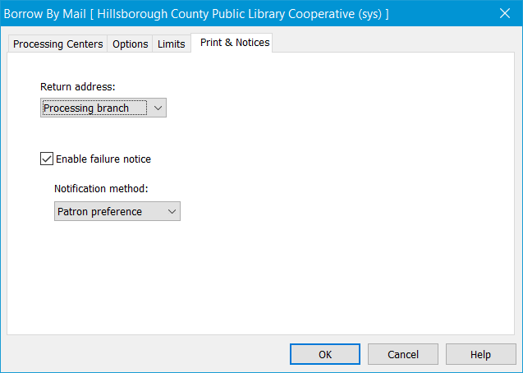
BORROW BY MAIL
Select the Return Address .

Slide 46
SQL | UPDATE | BORROW BY MAIL
--CONVERT TO BORROW BY MAIL HOLD REQUESTS (CREATED in BIBLIOCOMMONS)
UPDATE
Polaris.Polaris.SysHoldRequests
SET
BorrowByMailRequest = '1', --CHECKS “BORROW BY MAIL” BOX
StaffDisplayNotes = 'Request is for Borrow by Mail.',
PACDisplayNotes = 'Request is for Borrow by Mail.'
WHERE
(PickupBranchID = '45' OR NewPickupBranchID = '45')
--BORROW BY MAIL ORGANIZATION ID
AND
BorrowByMailRequest = '0' AND --IF “BORROW BY MAIL” BOX IS UNCHECKED
SysHoldStatusID <> '17'--OMITS “OUT” STATUS

Slide 47
SQL | UPDATE | BORROW BY MAIL
--CONVERT TO REGULAR HOLD IF CHANGED FROM BORROW BY MAIL TO LIBRARY LOCATION
UPDATE
Polaris.Polaris.SysHoldRequests
SET
BorrowByMailRequest = '0', --UNCHECKS “BORROW BY MAIL” BOX
StaffDisplayNotes = NULL, --REMOVES NOTE
PACDisplayNotes = NULL --REMOVES NOTE
WHERE
(PickupBranchID <> '45' OR NewPickupBranchID <> '45') AND --BORROW BY MAIL LOCATION
BorrowByMailRequest = '1' AND --IF “BORROW BY MAIL” BOX IS CHECKED
SysHoldStatusID <> '17' --OMITS “OUT” STATUS

Slide 48
SQL | REPORT | BORROW BY MAIL STATS
--CHECK OUTS + VALUE
SELECT
COUNT(DISTINCT irh.ItemRecordHistoryID) AS "CKO ITEMS",
COUNT(DISTINCT irh.PatronID) AS "CKO PATRONS",
SUM(ird.Price) AS "TOTAL VALUE"
FROM Polaris.Polaris.ItemRecordHistory irh (NOLOCK)
JOIN Polaris.Polaris.ItemRecordDetails ird (NOLOCK)
ON ird.ItemRecordID = irh.ItemRecordID
WHERE
irh.ActionTakenID IN (45) AND --BULK CHECK OUT ACTION ID
irh.TransactionDate BETWEEN '2024-01-01 00:00:00' AND '2024-01-31 23:59:59'

Slide 49
HEAT MAPS

Slide 50
SQL | REPORT | CIRCULATION HEAT MAP (PART 1)
--CIRC MAP OF TOTAL CIRCULATION PER COUNTY POSTAL CODE
--COPY RESULTS TO EXCEL, CONVERT TO MAP
SELECT
pc.City,
pc.State,
pc.PostalCode,
COUNT(DISTINCT irh.ItemRecordHistoryID)

Slide 51
SQL | REPORT | CIRCULATION HEAT MAP (PART 2)
FROM Polaris.Polaris.Patrons p (NOLOCK)
JOIN Polaris.Polaris.PatronRegistration pr (NOLOCK)
ON p.PatronID = pr.PatronID
JOIN Polaris.Polaris.PatronAddresses pa (NOLOCK)
ON pa.PatronID = p.PatronID
JOIN Polaris.Polaris.Addresses a (NOLOCK)
ON a.AddressID = pa.AddressID
JOIN Polaris.Polaris.PostalCodes pc (NOLOCK)
ON pc.PostalCodeID = a.PostalCodeID
JOIN Polaris.Polaris.ItemRecordHistory irh (NOLOCK)
ON irh.PatronID = p.PatronID
JOIN Polaris.Polaris.CircItemRecords cir (NOLOCK)
ON cir.ItemRecordID = irh.ItemRecordID
JOIN Polaris.Polaris.BibliographicRecords br (NOLOCK)
ON br.BibliographicRecordID = cir.AssociatedBibRecordID

Slide 52
SQL | REPORT | CIRCULATION HEAT MAP (PART 3)
WHERE
irh.ActionTakenID IN (13,75,81,89,90,91,28,73,74,76,80,82,93) AND
irh.TransactionDate BETWEEN '2024-01-01 00:00:00' AND ‘2024-01-31 23:59:59' AND
pc.State LIKE '%FL%' AND pc.County LIKE '%HILLSBOROUGH%'
GROUP BY
pc.City,
pc.State,
pc.PostalCode
ORDER BY
pc.City,
pc.State,
pc.PostalCode
ASC

Slide 53
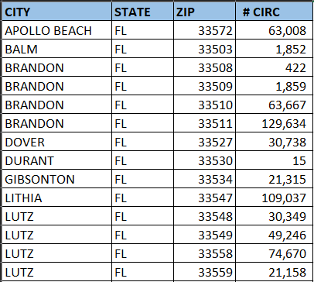
EXCEL | MAPS
Paste results into Excel.

Slide 54
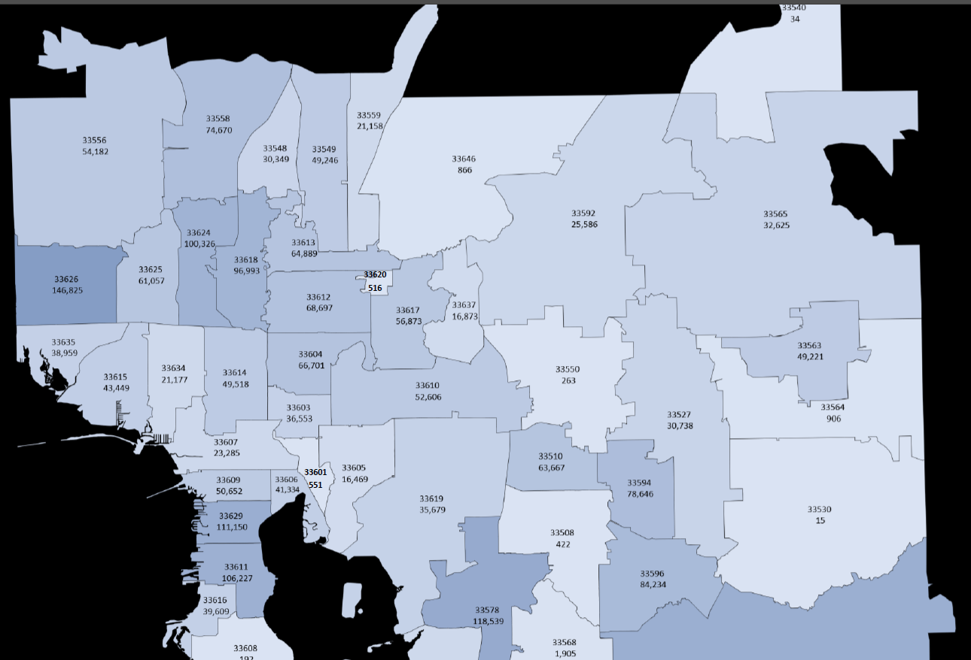
EXCEL | MAPS
Insert > Charts > Maps

Slide 55
SQL | REPORT | CARD REGISTRATION HEAT MAP (PART 1)
--CIRC MAP OF CURRENT CARD HOLDERS BY COUNTY POSTAL CODE
--COPY RESULTS TO EXCEL, CONVERT TO MAP
SELECT
pc.City,
pc.State,
pc.PostalCode,
COUNT(DISTINCT p.PatronID)

Slide 56
SQL | REPORT | CARD REGISTRATION HEAT MAP (PART 2)
FROM Polaris.Polaris.Patrons p (NOLOCK)
JOIN Polaris.Polaris.PatronRegistration pr (NOLOCK)
ON p.PatronID = pr.PatronID
JOIN Polaris.Polaris.PatronAddresses pa (NOLOCK)
ON pa.PatronID = p.PatronID
JOIN Polaris.Polaris.Addresses a (NOLOCK)
ON a.AddressID = pa.AddressID
JOIN Polaris.Polaris.PostalCodes pc (NOLOCK)
ON pc.PostalCodeID = a.PostalCodeID

Slide 57
SQL | REPORT | CARD REGISTRATION HEAT MAP (PART 3)
WHERE
pc.County LIKE '%HILLSBOROUGH%' AND pc.State LIKE '%FL%'
GROUP BY
pc.City,
pc.State,
pc.PostalCode
ORDER BY
pc.City,
pc.State,
pc.PostalCode
ASC

Slide 58
FEAR AND LOATHING…
“So now, less than three years later, you can go up on a steep hill in Tampa and look West, and with the right kind of SQL you can almost see the high-water mark…that place where Polaris finally broke and rolled back.”

Slide 59
THANK YOU
Questions?

