Slide 1
Assessing Diversity, Equity and Inclusion in Rural Library Collections
Jocie Wilson & Laina Kelly

Slide 2
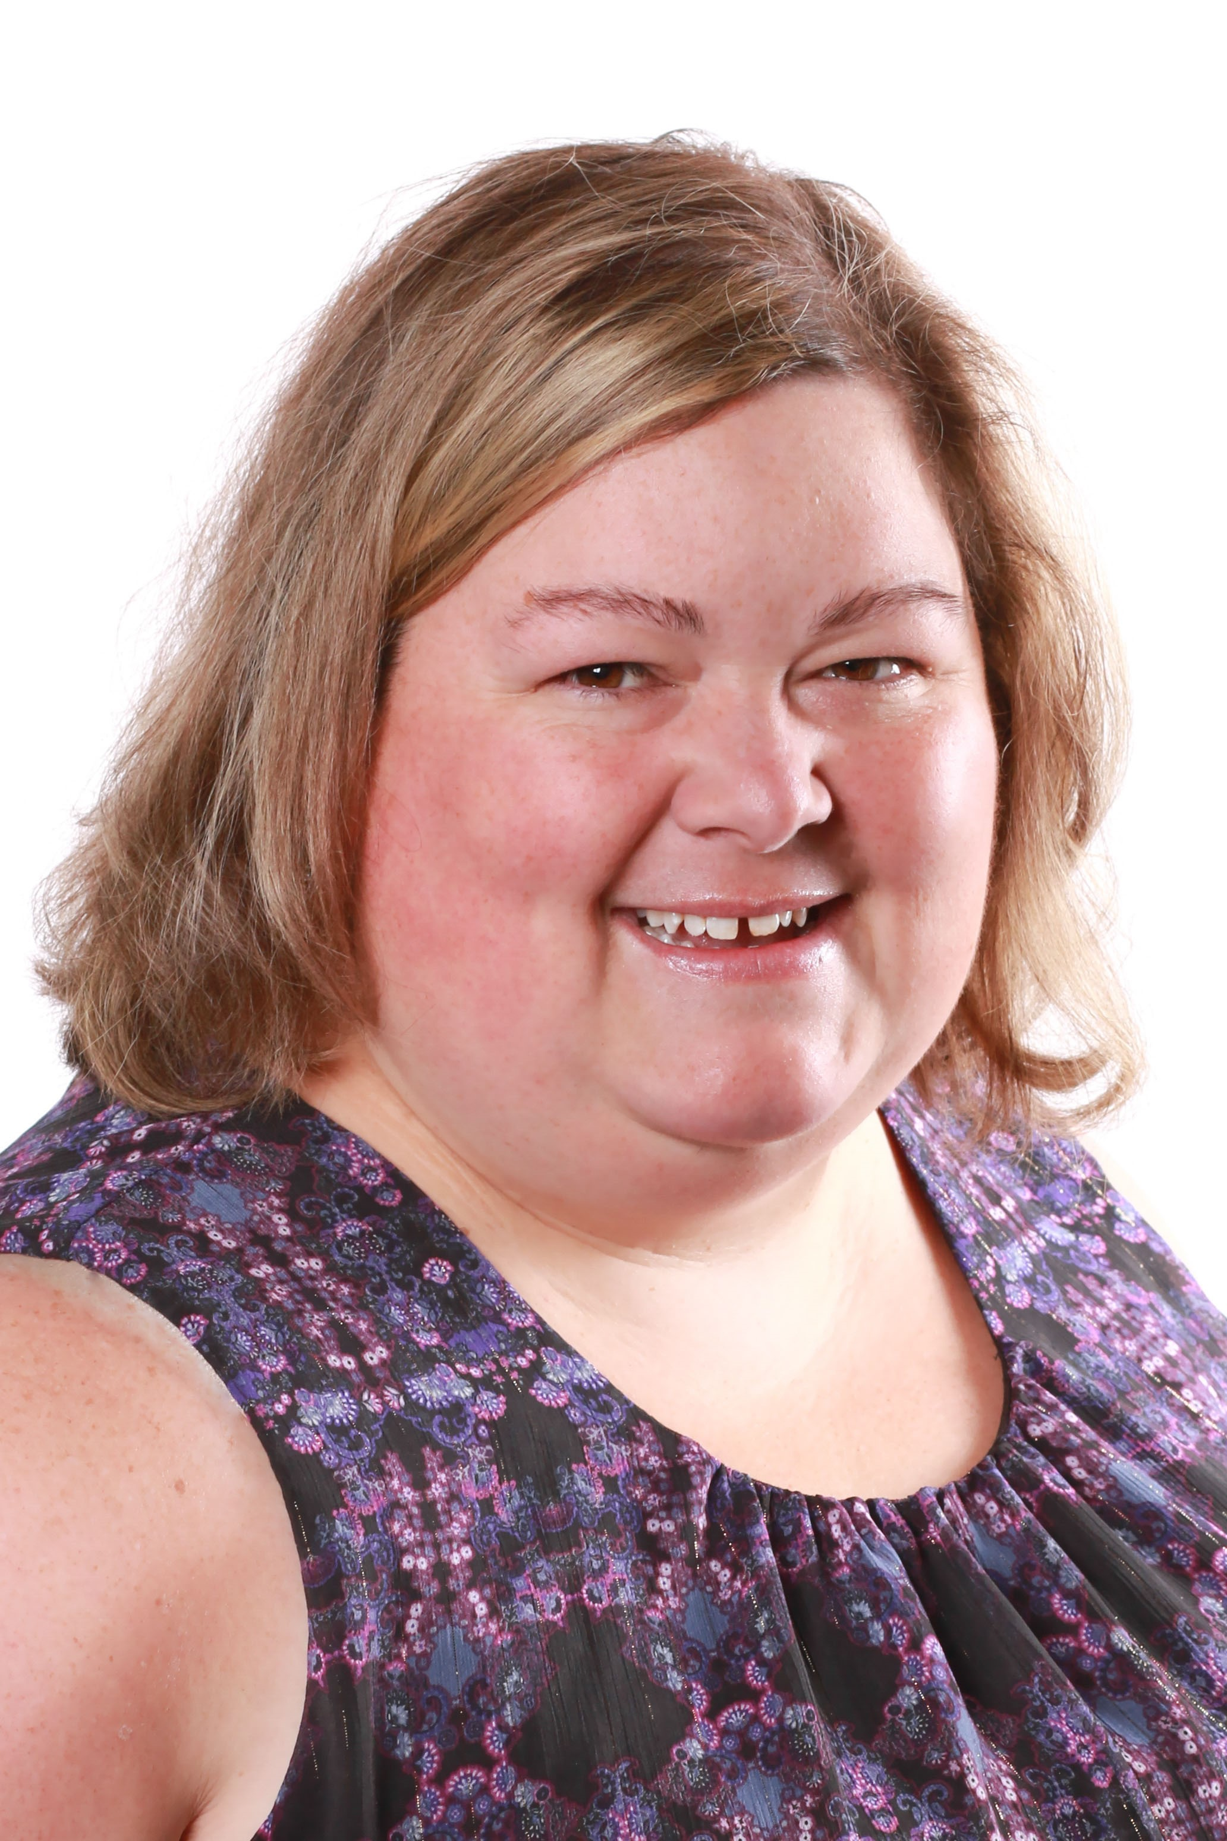
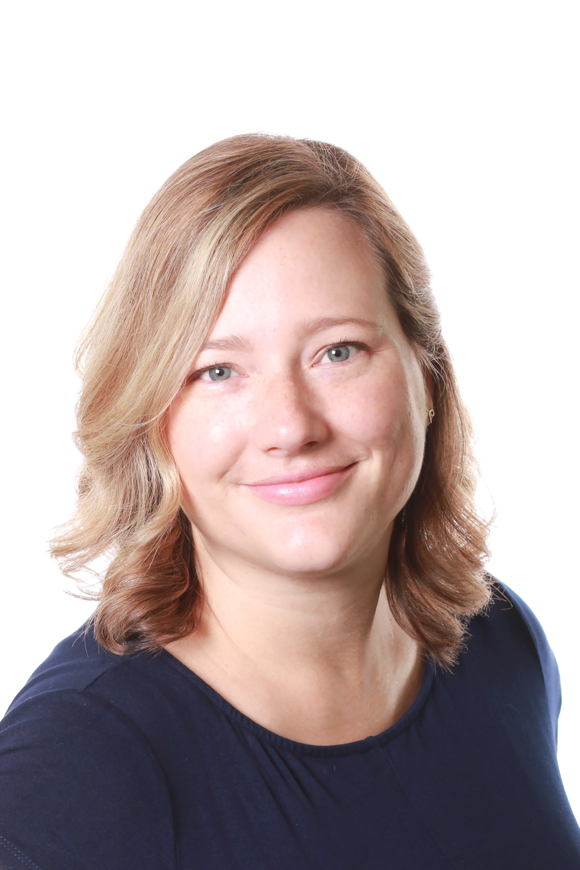
Introductions
Jocie Wilson
Manager, Collections & Resource Sharing
Yellowhead Regional Library
Laina Kelly
Manager, Technology Services
Yellowhead Regional Library

Slide 3
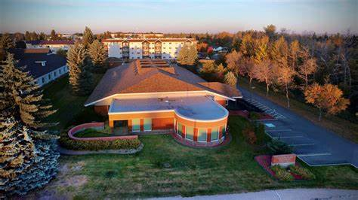
Yellowhead Regional Library
Spruce Grove, Alberta
43 member libraries (rural/semi-rural)
Provide bibliographic, technology and consulting services
Members are independent
Notes:
YRL = central site for Polaris
YRL = 44 school and 44 public member libraries
YRL = small (insert collection size), medium, large libraries
YRL = autonomous libraries
YRL = two cataloging technicians, moving over 35,000 items into and out of the building a year

Slide 4
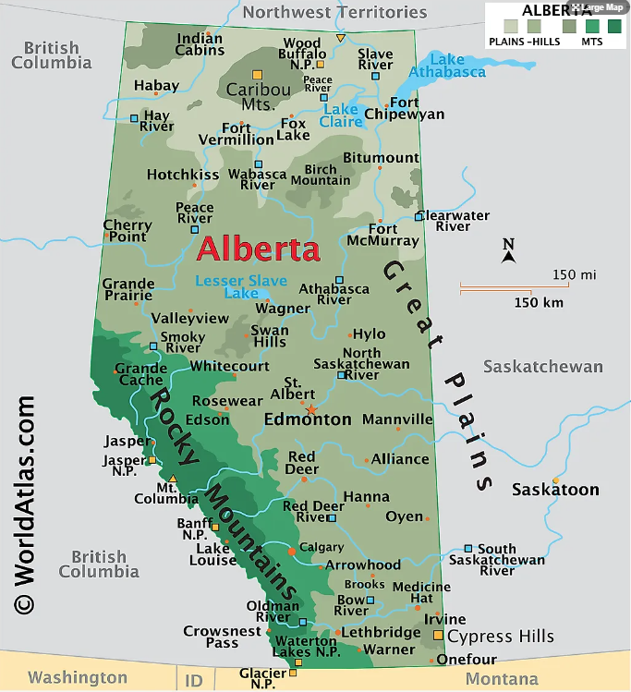
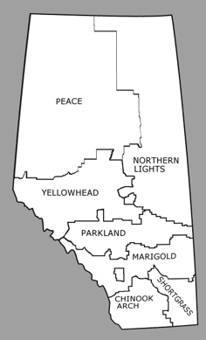
Notes:
TRAC = one catalog, one instance of Polaris
TRAC = over 180 libraries in Northern and Central Alberta

Slide 5
Diversity Assessments
Jocie – Collections and Resource Sharing
Authorities, Polaris and SimplyReports
Laina – Library Development Services
Diversity Benchmarking using Stats Canada

Slide 6
The Record Set Method: Using Authorities, Polaris and Simply Reports

Slide 7
How it started: 2019 - 2021
Laina’s DEI method and presentation
Increased conversations about how to do DEI work in different contexts, with different goals and different amounts of staff time/expertise
Pandemic closures = collection work
YRL organizational review – moved knowledge of Polaris around the building into different contexts
New teams = new ideas, new ways of tackling problems

Slide 8
Expanding our Polaris knowledge
2019 - using item record sets extensively, using Simply Reports extensively
2019 – 2021 – beginning to understand the relationship between Item > Bibliographic record sets and using them in our work
2021 – started thinking about authorities, record sets and the authorities tab in simply reports. What were the possibilities?
2021 – 2022 – completed four projects using this method for medium and large library collections
2023 – refining, updating and training the method

Slide 9
The Method
Polaris
Create authority record sets on a topic/subject area
Simply Reports (SR)
Run an authority list report off that record set for a specific library
Excel
Download report, organize data as needed

Slide 10
1. Polaris
Building authority record sets
Handout – get a card at the end of the presentation!
Our record sets (so far)
Indigenous people
Visible minorities
LGBTQ2S+
Social issues
Mental health
Genres (using both 650 and 655)
Notes:
A few notes about authorities
We made the decision to pull Indigenous out of the visible minorities record set, in our context in Canada Truth and Reconciliation work is a priority in libraries and this work has been ongoing since t 2017, specifically in my department with Decolonize Access and Classification by addressing the structural biases in existing schemes of knowledge organization and information retrieval arising from colonialism by committing to integrating Indigenous epistemologies into cataloguing praxis and knowledge management; Our libraries continue to add items from indigenous perspectives and creators, weed inappropriate items out of their collections and strive for representation of Indigenous voices and culture in their collections, staff/volunteers and programming.
One of the things you might be asking yourself is "how much time did it take to make these record sets?!" Well the first time record set that was made....I didn't even track the hours because we had so much discussion about parameters, what to include and not include that it was hard to track the time. This process was done mostly by one of my cataloging technician staff members and it was a challenge to pull them up and out of the rabbit hole and to practice "it does not need to be perfect." Since I knew I would get the 'but how much time question' I asked a different cataloguer to re-do the Indigenous record set from scratch last week just before this conference. I gave her fairly general guidelines and told her that tracking time was even more important that making the record set perfect. She pulled together a record set with approximately 5000 authorities in three hours. Personally, I do not think that was a lot of time. And now we have the record set up to date to use for 44 different sites this year.
I know the genres record set was really fast to create, under an hour as we didn't go too deep into subdivisions for that record set.

Slide 11
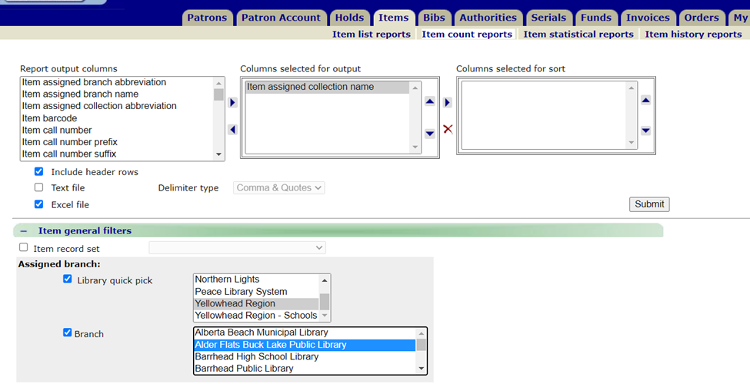
Notes:
I did an example on a small school-house public library collection for this presentation. This is Alder Flats Buck Lake Public Library, they are part of Wetaskiwin County, their collection size is approximately 10,000 items and they serve a population of 4,000 people (about 1/3 of the county).
I'm not sure how you organize your item records, but in TRAC and specifically YRL we use collection codes as our baseline, we control the vocabulary for collection codes, which means that we libraries cannot add anything they want, we do give them autonomy for shelf locations because that is where something is physically shelved in their library.
I always start with a collection count by code report before I start any collections project or reporting. We are lucky that we have a custom report for this report in Polaris but you can also easily get the same information from Simply Reports as an item count report.

Slide 12
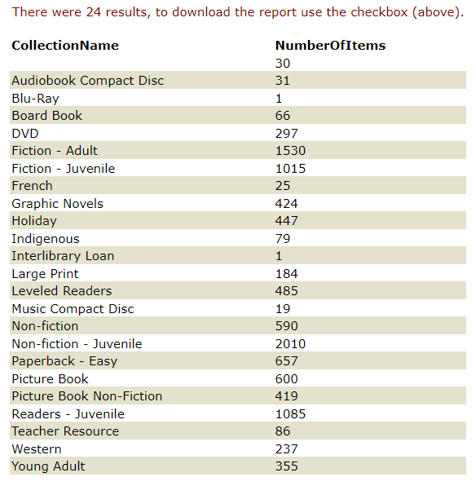
Notes:
This gives me a baseline of the number of items in their collection, I can see what types of items they collect and how granular or generalized their collection codes are assigned. You can see here that they might need a bit of a clean-up as they have a few random things like one blu-ray and an ILL book.
You can also tell from this that they have a lot of juvenile materials (hence the school-housed public library) and that they have a separated out Indigenous collection.

Slide 13
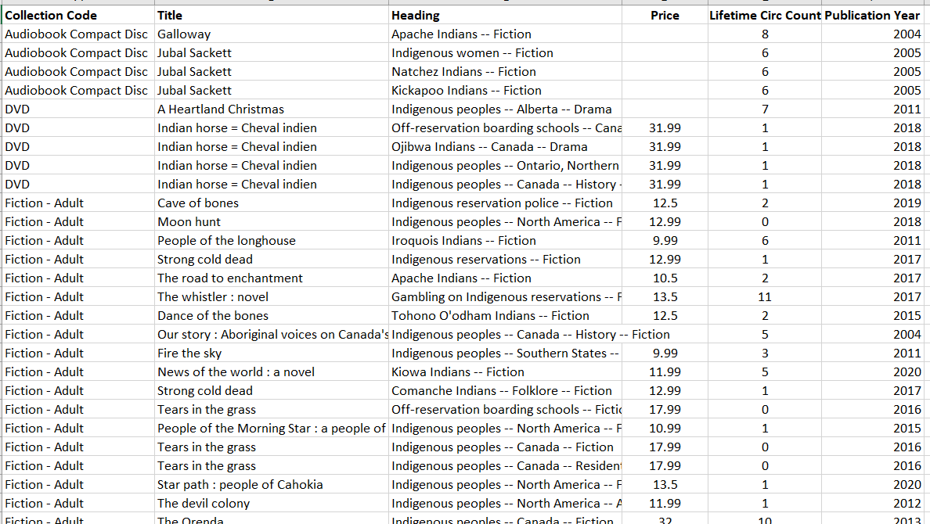
2. Simply Reports
Notes:
I'm going to apply the Indigenous authorities record set to this collection to see how many titles have Indigenous authorities in their collection. What I did here once my cataloguer created the record set was take a fairly close look at the you could outputs you could pull from an item and bib level. I was pleasantly surprised the number of item options there are including price and circ counts. Then the report is literally two parameters that you don't even have to think about. Choose your record set and then under item general filters choose the library collection you want it applied to.
This report gave me 592 results.
I organized it by collection code for easier comparison to the collection count by code. Now I know this is hard to see but do yo notice anything odd about this data? Each authority is showing for the title. Which means that these numbers are inflated if you are looking at how many items have Indigenous authorities because we asked for the authorities in this output.

Slide 14
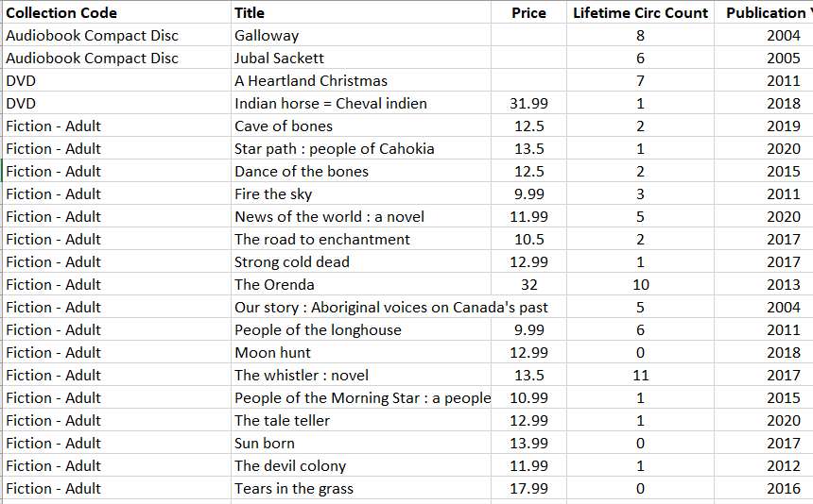
Simply Reports
Notes:
I made a slight change to this dataset, giving me 269 results and you can see now that this is by title. I can now see that 269 items out of their collection of 10,000 items have an indigenous authority.
I was hoping to do a direct comparison in a count code to the count report I did earlier but the count is counting authorities, so essentially the count report outputs a count of what we saw in the first report by collection code and number of authorities, not items.
You could do a pivot table for this and then get a comparison to figure that out here. What I like about this is I can do a mean, median and mode for publication date to see if there are years that maybe they got an influx of case and purchased more and to make sure that there aren't outliers that are throwing off my data for average age of collection. The mean (average) of a data set is found by adding all numbers in the data set and then dividing by the number of values in the set. The median is the middle value when a data set is ordered from least to greatest. The mode is the number that occurs most often in a data set.
A presentation on its own!
Pivot tables
Google is your friend
Is there Excel expertise elsewhere in your organization?
I had originally looked at

Slide 15
Applying the Method
Beaumont Public Library
Indigenous perspectives
Applied to the whole collection
Hybrid method
Used the list as a starting point
Physically looked at each title
Collection size: 33,000
591 items identified
Notes:
You can do an overview, see how you’re doing overall, look at just one type of representation or even do this by topic/subject. It allows you to be a bit more technical using excel to describe and express your data description, which may be more effiecient for you depending on the size of your collection.
This gives you a ‘whole library view’ instead of just one collection or age group.
You may decide to do a hybrid approach, such as going through book-by-book in your picture book or teen section and then doing a broader data description with your adult fiction and nonfiction.

Slide 16
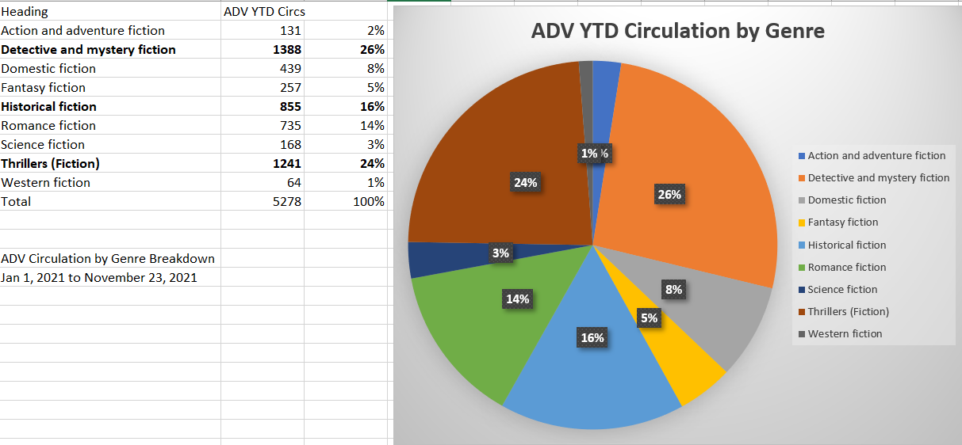
Circulation by genre
Notes:
Drayton Valley Municipal Library and Westlock Library
Genre projects
Paperbacks and other collections rather than just Fiction – Adult, need to look at collection count by code!

Slide 17
Lessons Learned
Item > Bibliographic > Authority
Reverse
Training on SimplyReports for all CRS staff
Balance the need for perfection with efficiency
Notes:
Thinking about this simple flow of information from record set to record set has really opened up our minds into what can be possible for data gathering and manipulation when it comes to collections. There are too many examples to include in this presentation and I believe that it’s not the exact application of the knowledge that is important in this case but the possibilities the knowledge can create. Many of my staff and colleagues tell me cataloging is an art then in the same breath an exact science lol! I believe that we follow a set rules that seems scientific because it is logical and has to be followed in order for data to display properly, but how we get the data back out and think about expressing it is an artform. This workflow has significantly impacted the way I think about, generate and manipulate data between Simply Reports and Polaris. It seems really simple and it is but it can be very powerful.
This is one of my biggest lessons learned to date, especially in bibliographic services. How many of you do cataloging? How many of you also work in Simply Reports often? In our organization Simply Reports was though more of as a public services tool, not a technical or bibliographic services tool. Since 2019 I have been working on training my cataloging technicians on SR as well as my library assistants (in a different context). I have found that it significantly changed their perspective of their work. They’ve always understood the importance of description for accurate records in the OPAC but they didn’t understand the data side, generating collection development data to help future acquisitions work or DEI collections projects. This understanding now and practice of pulling the information out has impacted how they put the information in and allowed them to apply more creative problem solving to everyday questions from our member libraries.
This work is not perfect and my staff have been on a journey away from perfection these last few year. I credit events in the last three years for propelling us forward in this journey. It was definitely a bit of a golden opportunity that we seized. We had to let go of a lot of expectations and ‘how we’ve always done things’ in many areas of our lives and we were able to apply these same principles to our work. One thing I wanted to mention, as you are probably asking yourself “how does this department have time to think/do this work” we started buying cataloging records for our regular orders from our main print vendor in 2021. This was a journey in itself (and another whole project/presentation) but it eventually led to some efficiencies in our work to allow for these projects to come to fruition.

Slide 18
Diversity Benchmarking a Canadian Rural Library

Slide 19
Diversity Benchmarking a Canadian Rural Library
Why?
The Process
Evaluation
Results
Diversity benchmarking: Improving diversity and inclusion in library collections (Youtube)
Notes:
Won't go into granular details – if you're curious about numbers, you can watch a more in-depth video about this presentation from Booknet Canada's 2020 Tech Forum

Slide 20
Why?
Stories are powerful.

Slide 21
Hypothesis
Do library collections reflect the diversity we see in Canadian communities?
Hypothesis:
Library collections are based upon what is available from publishers, both large and small.
Most of our vendors work with large publishers, while smaller Canadian publishers must work hard to reach folks who do purchasing for our libraries.
Since most large publishers are American, I think that while librarians are searching for books that reflect diversity to add to their collections, they are largely influenced by American trends in publishing and therefore their collections may reflect American populations more than Canadian.

Slide 22
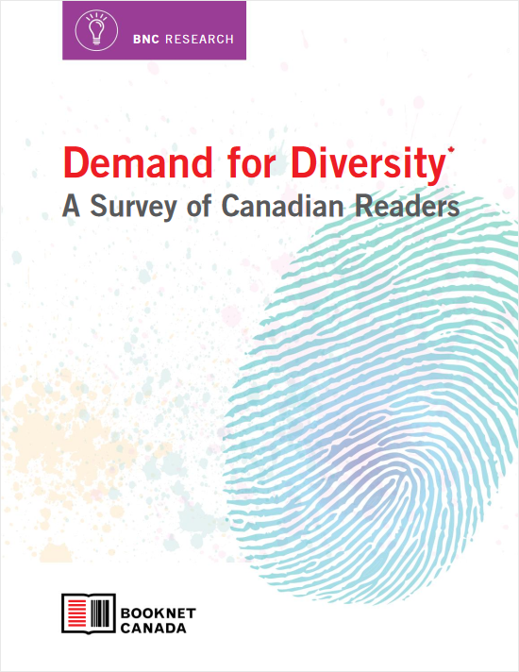
Motivation
45%
Of readers from underrepresented backgrounds seek out books that represent them
46%
Were interested in reading books by BIPOC authors
62%
Actively seek out books about diverse topics or experiences or by diverse authors
31%
Stated they would read more if they could access more diverse books
Notes:
Booknet Canada released a report in May 2019 called Demand for Diversity: A Survey of Canadian Readers. One of the questions we ask ourselves is whether there is a demand for diverse books among Canadian readers. This report suggests that yes, people are interested in reading about people who are different than them. Additionally, people from underrepresented groups do seek out books that represent who they are too.
Survey of 500 readers (154 of which came from underrepresented groups)
Majority of respondents did not identify as being part of an underrepresented group
Surveyed Canadians who had read at least one book or listened to at least one audiobook in the past year
Half of all respondents purchased a book in the past year, 43% borrowed a book from the library
Something I really like about this report is that they looked at a variety of areas related to diversity, not just race. They asked people about whether they would be interested in reading books by and/or about BIPOC, LGBTQ+, disabled or differenly abled and religious minorities.

Slide 23
The Process

Slide 24
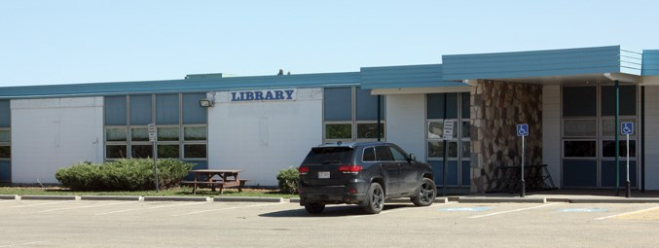
Westlock Intermunicipal Library
Population (2016): 5101 (in town)
Collection: Young Adult, ~1000 books
Notes:
Our volunteer sample library
Medium sized rural library
53 miles north of Edmonton – not really a bedroom community
2016 census: 5101 in town, serves the surrounding county and smaller communities (hamlets and other towns)
In town, sales and service, healthcare and hospitality. Serves a primary agricultural county area. Lots of retirement homes.

Slide 25
A Note on Language
Terms and definitions come from 2016 Census
Comparing apples to apples
Might not be preferred terminology – lumps some groups together
Improvement in 2021 census

Slide 26
The Process
SimplyReports
Item list report: Barcode, ISBN, Title, author
Excel Spreadsheet
Create your columns
My columns correlated with Stats Canada demographics
Visible minorities, Indigenous people, Religion, Disabled/differently-abled, gender identity, sexual orientation
Notes:
Excel spreadsheet
Followed Karen Jensen’s work
Originally I defined my own categories
Also helps for when authors/characters fall into more than one minority category - intersectionality

Slide 27
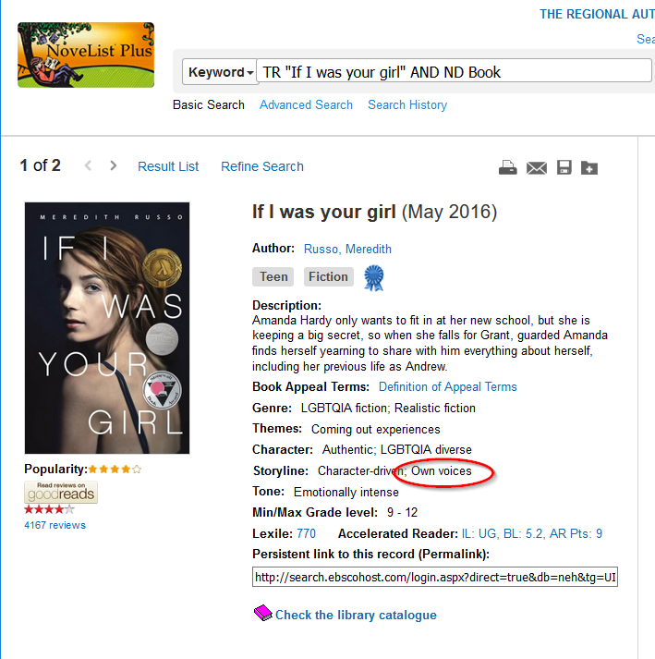
The Process
Novelist
“Own Voices” tag
Amazon
Customer comments
Reviews
Google
Author websites
Twitter
Interviews
Notes:
The two major tools I used when looking at the diverse content of a book were Novelist and good old google. I looked at every single title in Worldcat, Novelist or through online searching. In WorldCat, I would look at the subject headings, which often alerted me to diverse content that was not otherwise immediately obvious, and I would also sometimes use the bib record in Polaris and related subject headings. This is why including the ISBN was so helpful! Sometimes I could find what I needed just in Novelist, but sometimes I needed to look further into a book, especially books published by small presses, which many diverse books are.
Tallies as you go.
That way you can add it all up in the end, and it also allows you to account for people with more than one identity or background.
As I mentioned earlier, I made notes as I went for future reference. We are applying relatively broad categories to people, and notes were my way preventing losing that insight. It also helped with finding intersectional authors. This also helped if I didn’t know where an author fit. For example, you can see a number 1 in the “other” column here for a book with a character who is a Pacific Islander.
As you can see from the screenshot here, the book is own voices as per the tag in Novelist. However, not everything is tagged correctly in Novelist. If I found out the book had diverse content, I double-checked that information on author websites or other places like twitter to ensure that the protagonist was the OwnVoices character. LGBTQ and trans author especially might not disclose for safety and privacy reasons.
Goes without saying -- not all minority authors are writing within their own experience. Watch out for this if it matters to your data. For example, one of the authors I found in the collection was Filipino, but writing about Japanese characters. A diverse book, but not OwnVoices
Also, you can access Novelist with your library card! Here are the instructions

Slide 28
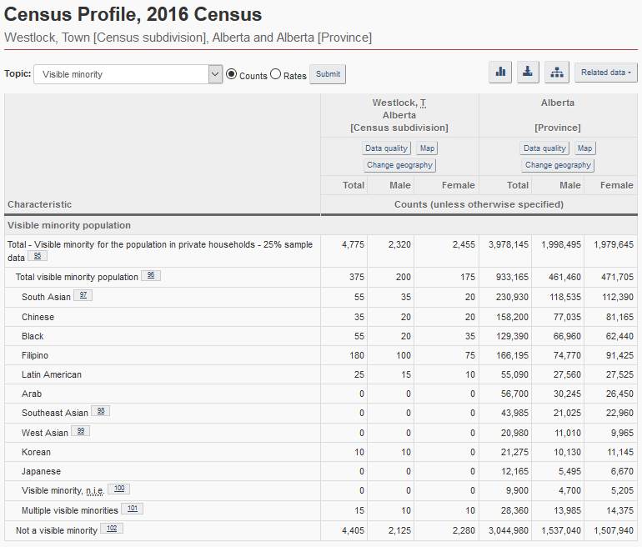
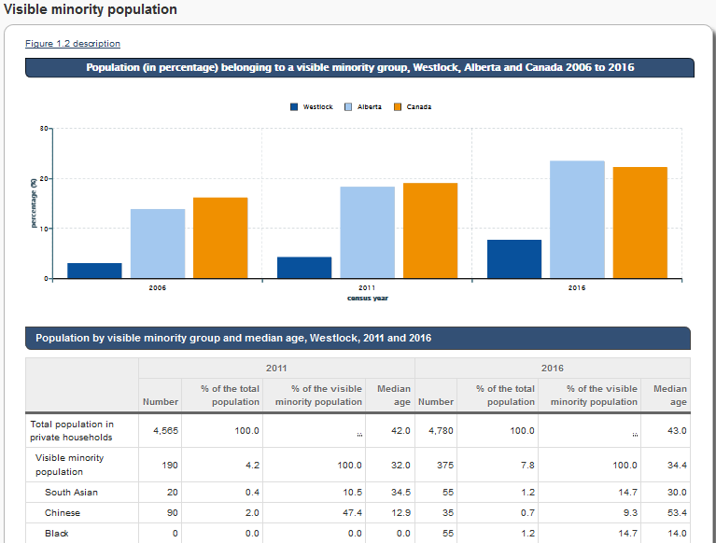
Data Sources
Largest visible minority populations in this community (2016):
Filipino
South Asian
Black
Chinese
New (2021) census data
Better age, sex at birth and gender
Focus on Geography: Indigenous Peoples, Visible minorities, country of origin, languages spoken
Notes:
Where possible I used data for the community
Stats Canada - Census Profile
Census profile - lots of data, be prepared to look at raw numbers (click)
Nice because it has comparables to Alberta
Raw numbers to work with
This is where I got my headings from
Visible minorities
These are defined by the employment act
I chose to use Stats Canada’s visible minority groups as my categories for the ease of comparing apples to apples
Ethnicity vs visible minority
May want to also look at immigration in the Focus on Geography series to get an idea of your community
Here’s what I learned about visible minorities in the study community (read slide)
If someone asks, the categories are: South Asian, Chinese, Black, Filipino, Latin American, Arab, Southeast Asian, West Asian, Korean, Japanese, Visible minority NIE

Slide 29
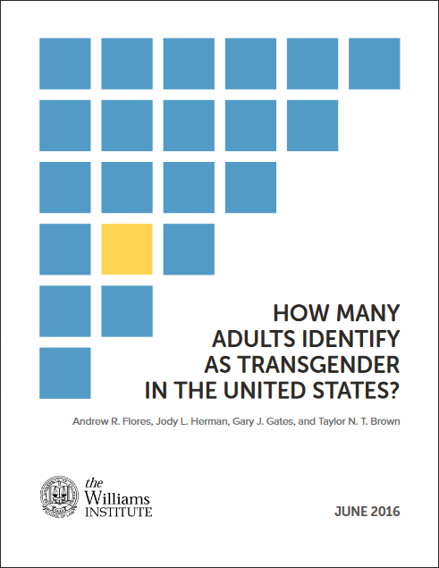
Data Sources
2014 Canadian Community Health Survey – Sexual Orientation
2021 Census – first to collect data on gender identity
1.7%
Canadians aged 18 to 59 who reported in 2014 that they consider themselves to be homosexual (gay or lesbian).
1.3%
Canadians aged 18 to 59 who reported in 2014 that they consider themselves to be bisexual.
4-10%
Canadian youth who consider themselves either homosexual or bisexual (ages 15-34)
0.58%
Adult population in the United States who identify as transgender (2016)
Notes:
2014 Canadian Community Health Survey
First Stats Canada survey to ask about sexual orientation
Likely underreported
Could only find Canada-wide stats
A Portrait of Canadian Youth - 2018
4-10% of Canadian youth consider themselves either homosexual or bisexual
2016census - Participants asked to choose male or female, choose gender with which they most identified
Could leave it blank and comment
Could not access a number for how many participants left it blank
Lack of data for Canada until 2021
New census did ask about sex assigned at birth and gender but results are distributed so as not to single out peple in small communities. Overall finding was in line with the Williams Institute Report, which Stats Canada mentions in their summary of the findings
US Stats - Williams Institute Report Younger age group more likely to identify (p. 2)
Estimated 0.58% of the adult population in the US identify as transgender (p. 3)

Slide 30
Data Sources
Canadian Survey on Disability – 2017 (Canada-wide)
13%
Canadian youth with one or more disabilities
Mental health and learning disabilities are the most common among youth.
National Household Survey – Religion – 2011 (Canada-wide)
67.3%
Christian
1.5%
Hindu
1%
Jewish
23.9%
1.4%
None
Sikh
3.2%
Muslim
1.1%
Buddhist
Notes:
Canadian Survey on Disability - 2017
Youth aged 15-24 - 13% had one or more disabilities (physical, cognitive, mental health)
Mental health and learning disabilities are most common among youth
More than 40% of Canadians with disabilities have a severe or very severe disability
Religion in Canada: 2011 National Household Survey

Slide 31
Evaluation
Notes:
After I looked at each book, it was time to aggregate totals and compare the collection with statistical data about the population.

Slide 32
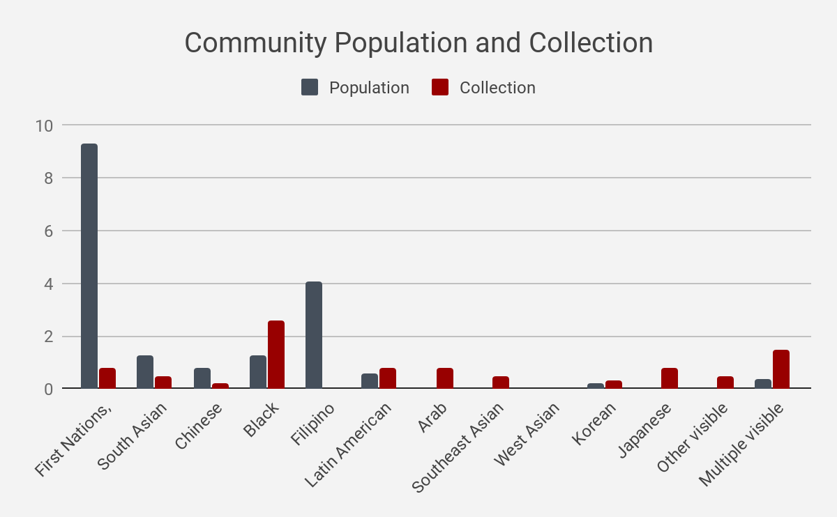
Findings – Indigenous People and Visible Minorities in Westlock
Notes:
Breakdown of how collection compares to community stats - visible minorities
Black bar is percent of total population, blue is percent of total collection. Largest visible minority populations in this community were: Filipino, South Asian, Black, Chinese. The Indigenous and Metis population were larger than all visible minorities put together. Jsut to be clear, Indigenous people are not considered a visible minority. I have included them in this graph because visible minorities and Indigenous people were the only groups for whom I had stats for the community, Alberta and Canada, so for the purposes of keeping this presentation a bit shorter, I will talk about them alongside visible minorities, but I don’t want you to think that they are lumped into the same group.
The least well-represented group were Metis and Indigenous protagonists, followed by Filipino, which had no books at all in the collection. Looking at the donut graphs, we can see that the representation of visible minorities in the collection closely mtaches the number of visible minorities overall in the community. That’s great! The bar graph on the left shows us how that representation breaks down, and shows us that there is some room for improvement in terms of increasing representation of some underrepresented communities, such as books with Filipino protagonists, as I mentioned before.
The most well-represented minority group, comparatively speaking, is Black people. WHen examining my data, most of these books, 15/26 (57%) had Black-American protagonists. Of the other books, 1 was by a Jamaican-born Canadian authors, and others were from first generation immigrants from a variety of countries to the US.

Slide 33
Findings – Indigenous People and Visible Minorities in Westlock

Slide 34
Findings – Sexual Orientation in Canada
Notes:
Tiny slice represents all books with gay, lesbian or bisexual protagonists - 2.5% of the collection. (Bisexual =blue, Lesbian = green slices).
Population stats - only canada-wide, estimate 4-10% of the population is lesbian, gay or bisexual. Lesbian and bisexual representation is very low.

Slide 35
Findings – Gender Identity in America
Notes:
0.58% of the US population is estimated to be transgender. Representation is pretty good -- hot topic for past few years, lots of publishing coming out with transgender protagonists as collective awareness grows.

Slide 36
Findings – Disability in Canada
Notes:
This is where the notes column came in handy -- keeping track of represented disabilities. 16 books had character with disabilities, and only one of these books had a protagonist that had a disability and was a member of a racial minority
Disabilities represented:
depression
brain injury
autism
ADHD
learning disability
Deaf/HOH
OCD
mental health (unspecified)
bi-polar disorder
amputation
schizophrenia

Slide 37
Findings – Religion in Canada
Notes:
Another area for growth would be representation of religious minorities. About 8% of Canadians come from a religious minority, while less than 1% of the books in the collection featured a protagonist from a religious minority. However, most books don’t talk about religion in general, so this number is unsurprising.
In the collection, only 6 books featured a protagonist from a religious minority. 17 books had explicitly Christian protagonists. Not surprising given the community, but interesting information.

Slide 38
Results

Slide 39
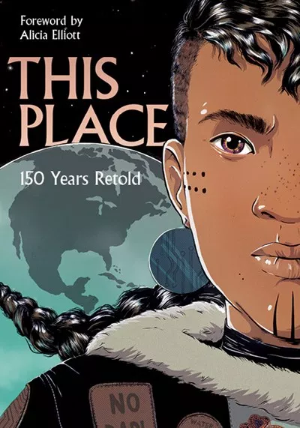
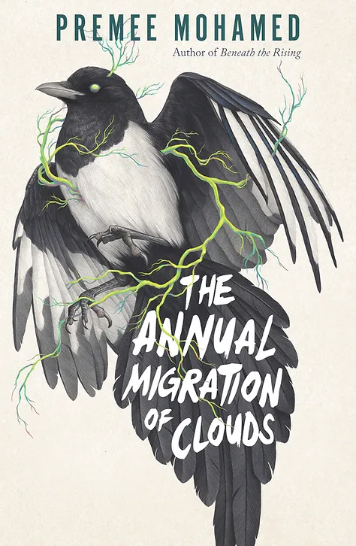
Recommendations for Westlock
More Canadian authors
Indigenous representation
More disabled/differently abled representation
More books with Black Canadian, Filipino, Chinese and South Asian characters
More books with Lesbian and bisexual protagonists
Intersectional representation
Regular part of conscious collection development

Slide 40
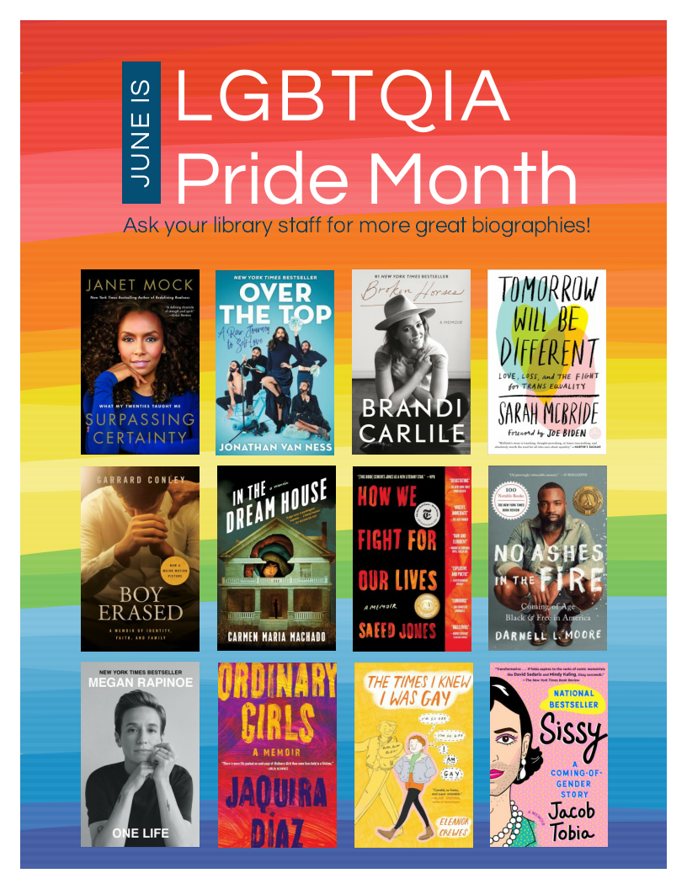
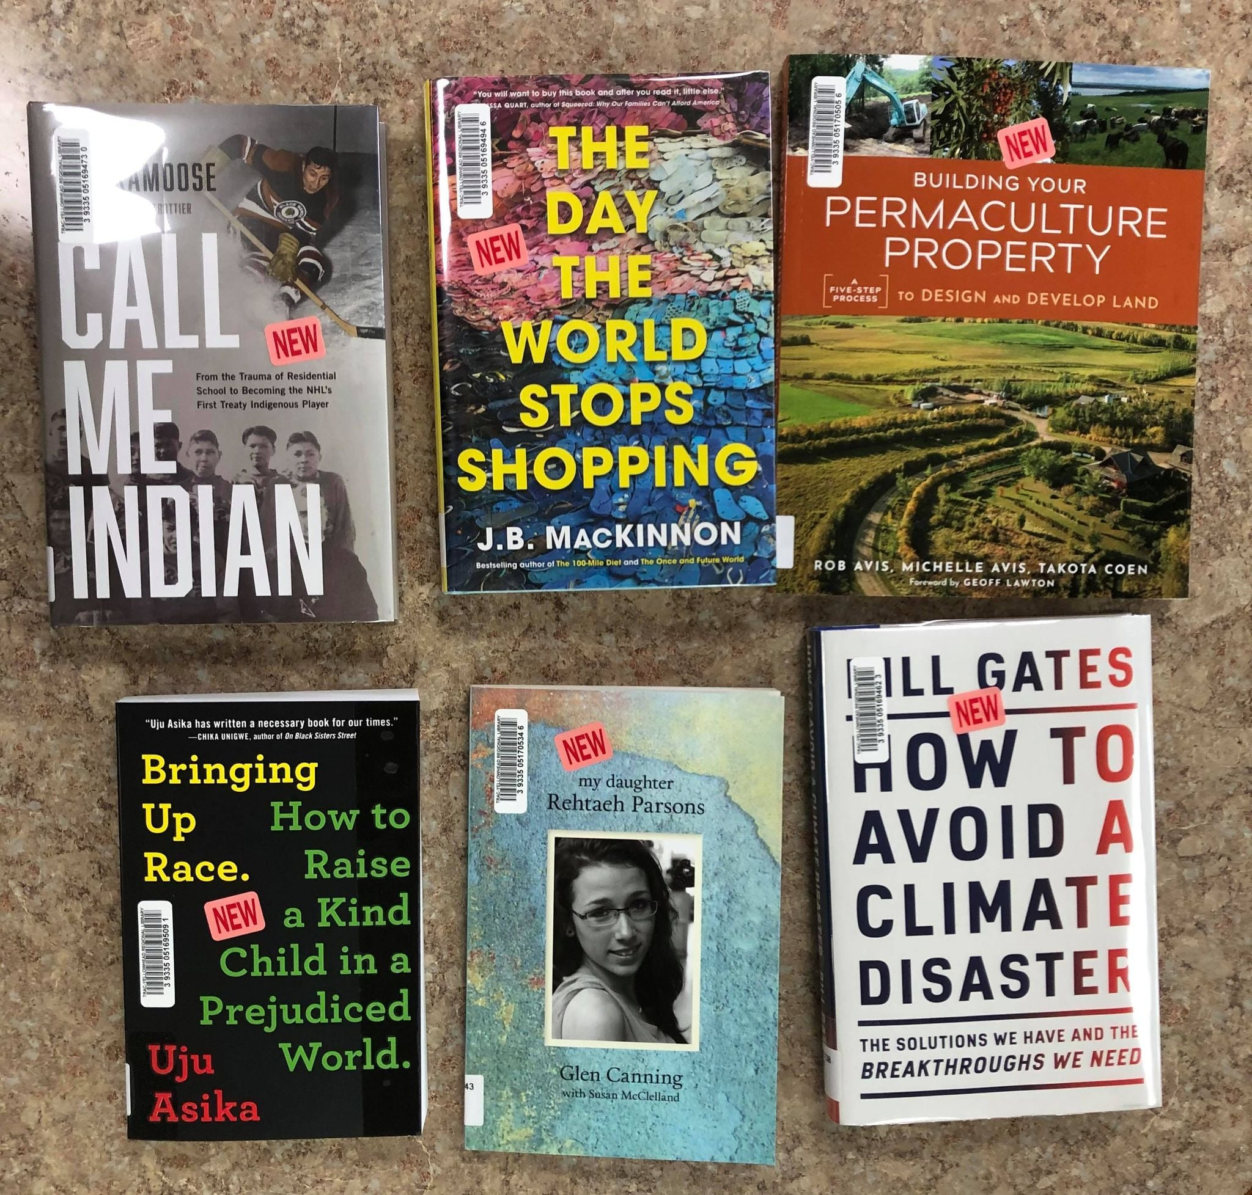
Outcomes
Promoting the collection
What books do we promote?
Where do we promote them?
Programming
What books do we choose for storytime and book club?
Who do we nominate for YRCA, or other awards?
Awareness of who lives in your community
Who is the library not reaching?
Change in collection development practices
Systemic change in Canadian publishing

Slide 41
Lessons Learned
Diversity isn’t the same across all geographical areas
Who are we including or forgetting?
No maximum quota for diverse books
Time consuming process
Good project for practicum student
Good process for smaller, fiction collections
School libraries
Children’s, YA or Adult fiction

Slide 42
THANK YOU
Questions?

