Slide 1
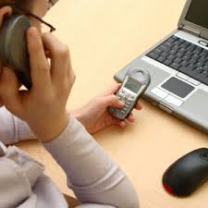
A lack of your attention has come to our attention…
Please, when working at the desk be sure people know you are available to help them. You are not being paid to do your homework, listen to music or surf the internet. You are here to help the person across the desk!

Slide 2
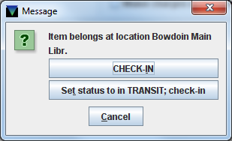
What would you do with this pop-up?
What should you do with this pop-up?
Click “Set status to in Transit: check-in”

Slide 3
Why do Moodle docs print so slooooowly?
It depends on how the professor put them there, how clean the copy is, and the source
Always download before printing
Some of them have large dark borders and gutters
Some are malformed PDFs

Slide 4
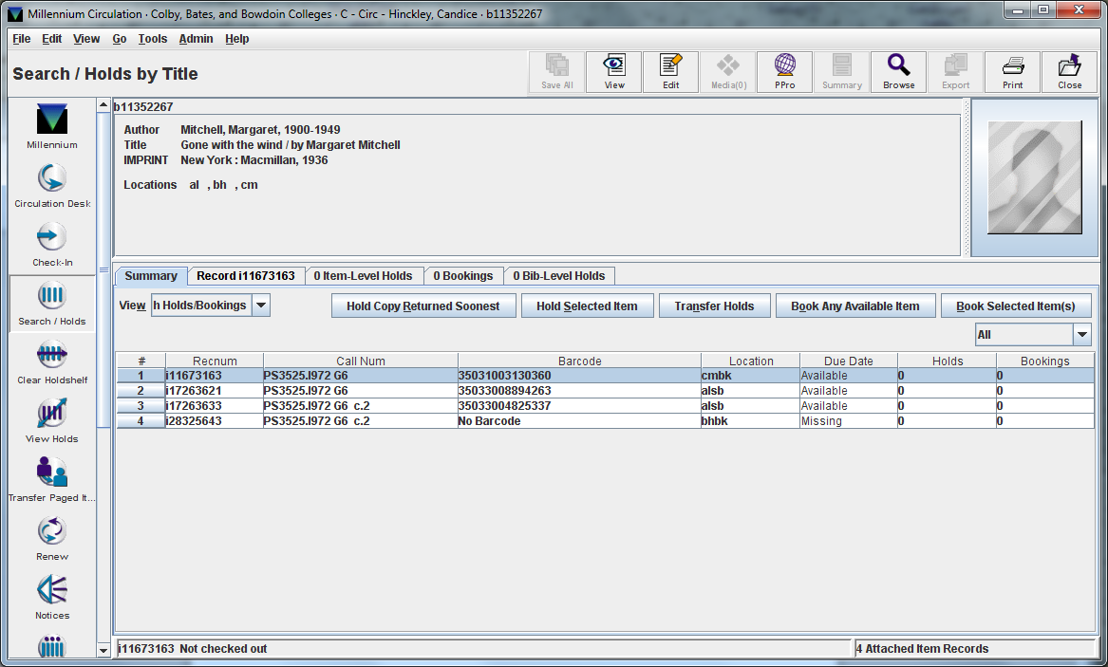
Colby, Bates, and Bowdoin may own the same title

Slide 5
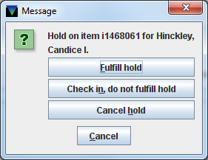
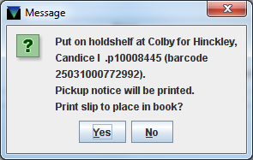
Click “Fulfill hold” and put in the bin to go to Miller.
“Yes”
Print the slip, put the slip in the book and send to Miller.

Slide 6
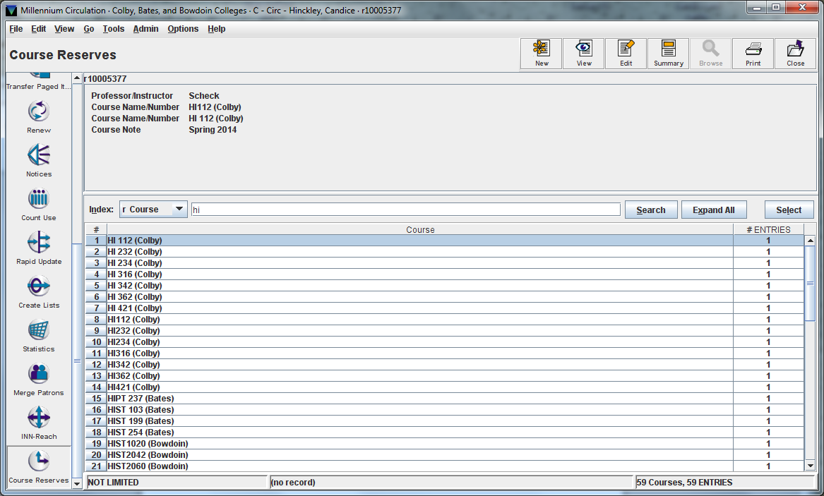
Colby, Bates, and Bowdoin reserves will all show up in Millennium

Slide 7
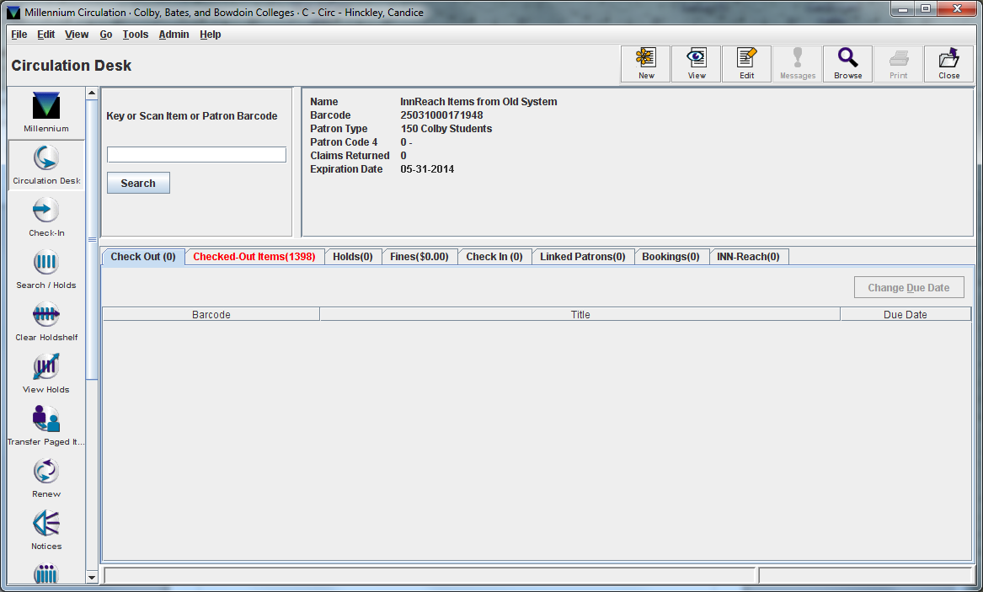
Patron barcodes
If someone is still having trouble logging-in, remind them to only use the number part of their barcode. Ignore the A & B.
THIS is also the number you should be writing down on the Manual Check out forms!

Slide 8
Things that aren’t working quite right yet and what you can say/do about it
No courtesy notices are being sent
Items requested/checked out in the old system
Cannot be seen in new system
Waiving fines
Be respectful of the patrons concerns. Let them know we are aware of these issues and they are being worked on.
If the person takes issue with this, send them to a Staff Member. Not only can we say “No” in a polite way, we can help by waiving a fine, or may know another way to help them.

Slide 9
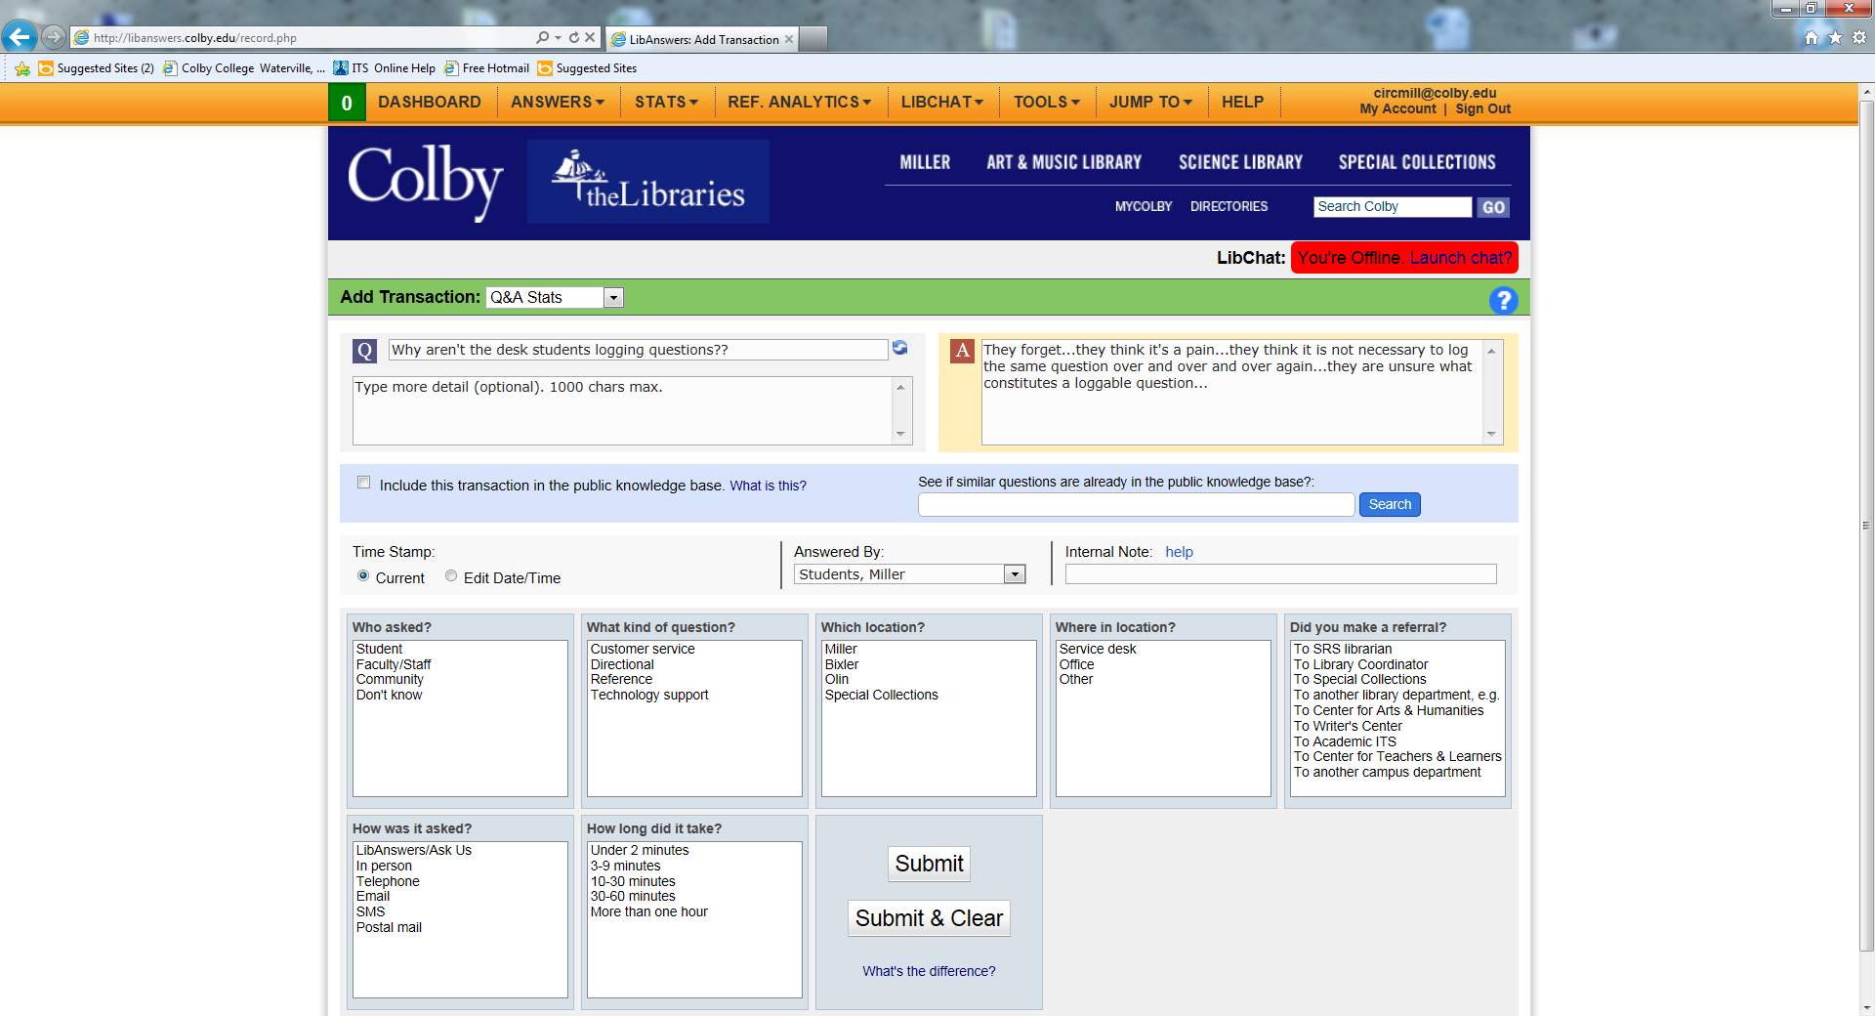
We are still logging questions…or we should be!

Slide 10
A few thousand additional well-chosen words about Lib Answers…
Remember…
We are also still shelving!

