Slide 1
Using Create Lists Import Records
to Facilitate a Weeding Project
Pam Childers – Indiana Wesleyan University

Slide 2
Inventory and Weeding
Each Summer the Jackson Library inventories the circulating collection
We have developed a 5-year plan to weed specific areas of the collection during inventory – appears to be more like 7
In the past the weeding process has been slow and limited us to how much we can process
The ability to upload records into a create list as allowed us to streamline this process

Slide 3
Prior to the Upload Create List Feature
After the section selected for weeding has been inventoried, we begin pulling books and placing them in carts
In the past a technical service staff member, checked the number of checkouts, internal use and the last checkout date for each book, write it on a paper so that the librarians could evaluate the book.
After the cart was ready it was taken to the reference desk area. All of the librarians would go through the books checking the paper and moving which books were to be kept to one side of the cart.

Slide 4
Deleting the Books
The cart with the books to be weeded was returned to the Tech Services Area
One by One each book had to be removed
Sierra
In Sierra each book had to marked for Deletion
A create list was created
EDS
The create list was used to remove the books from Sierra and EDS
OCLC
Each book had to be removed individually using a printout from the create list

Slide 5
HELP!!!!
This Photo by Unknown Author is licensed under CC BY-NC

Slide 6
Add a Field to Create Lists Export
One of the first things I had to do was submit a ticket have Innovative add this fixed length field:
LCHKIN #68
We needed the LCHKIN #68 or Last Check In Date to help us evaluate whether a resource was being used recently
Number of checkouts and internal use numbers don’t tell us whether something has been checked out in the past 5 years

Slide 7
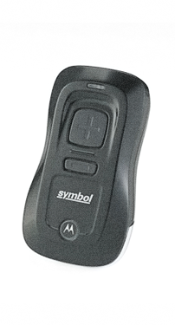
Items Used For Weeding/Withdraws
A small mini wireless handheld scanner
NotePad++ -- free advanced text editor
Sierra Create Lists
OCLC Connexion

Slide 8
The Weeding Report

Slide 9
Scanning
Arrange books on cart for scanning
Unplug scanner from the charging cable
Scan each book on the cart

Slide 10
Saving the Data
Plug scanner back into the computer.
Open folder on desktop “Scanned Weeding Barcodes - Shortcut”
Right click BARCODES.txt and select “Edit with NotePad++”
Go to File
Click “Desktop” on the left side and save file in the “Weeding 2023 - Shortcut” folder and name the file. (Example: “main13” or “JE5”. . .no spaces)
Close text file
Delete the “Barcodes.txt” file from the “Scanned Weeding Barcodes - Shortcut” folder.
Close all windows and leave scanner plugged into computer until next use.

Slide 11
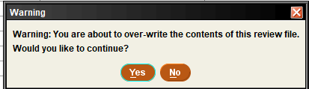
Importing Data Using Create Lists
Open Sierra Desktop
Under Function go to Create Lists
Under Review Files select Main
Click on Import Records button at the top
You will get a warning about overwriting records, click Yes

Slide 12
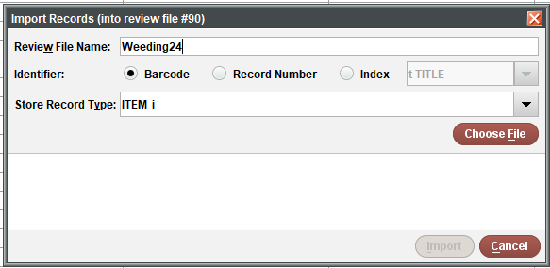
Importing Data Using Create Lists
Enter the review file name Weeding # -- We try and match the number to the export
Make sure that the Barcode radio button is selected, and the Store Record Type is set to Item

Slide 13
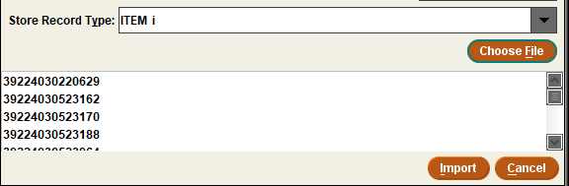
Importing Data Using Create Lists
Click on the Choose File button to select the file
The file will then load
Once the file is loaded, click the import file button

Slide 14
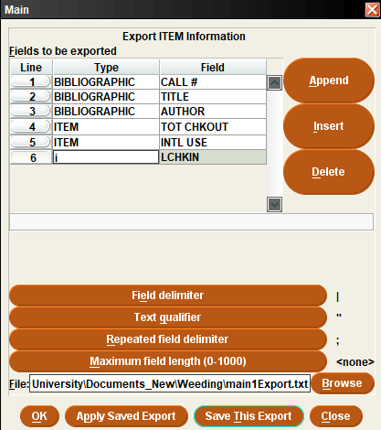
Export the File
Go to Saved Exports – apply Weeding
Browse to the folder
Click OK

Slide 15
Our Shared Weeding Folder

Slide 16
Open and Print the Export File
Open Excel
Click on Open
Click on Browse
Change the file drop down to All Files
Go to the folder that contains the export file.
Click on the file name, then click the Open button
Make sure that the Delimited radio button is selected

Slide 17
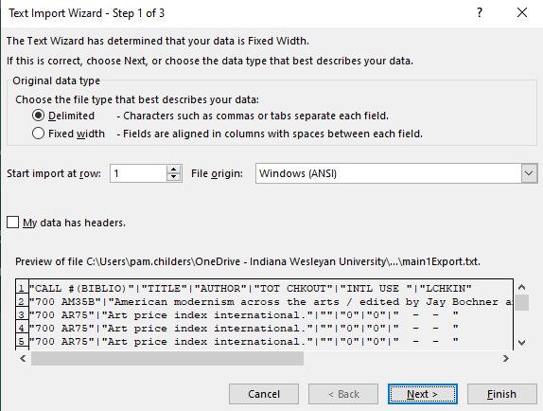
Open and Print the Export File
Click the Next button

Slide 18
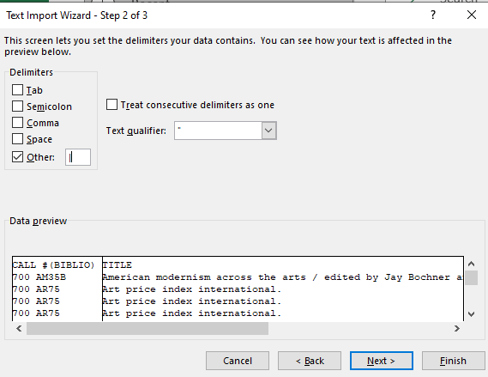
Open and Print the Export File
On the next screen uncheck Tab under Delimiters and check Other, then put the | character in the box.

Slide 19
A Couple of Tips
Make sure and change:
The Call Number field Column Data Format to text
The Barcode field Column Data Format to number
Click Finish
Make sure that you count the books when you scan – add a line at the top that has the report name and the number of books on this report

Slide 20
Add the page number to the report

Slide 21
Repeat column headings and Gridlines

Slide 22
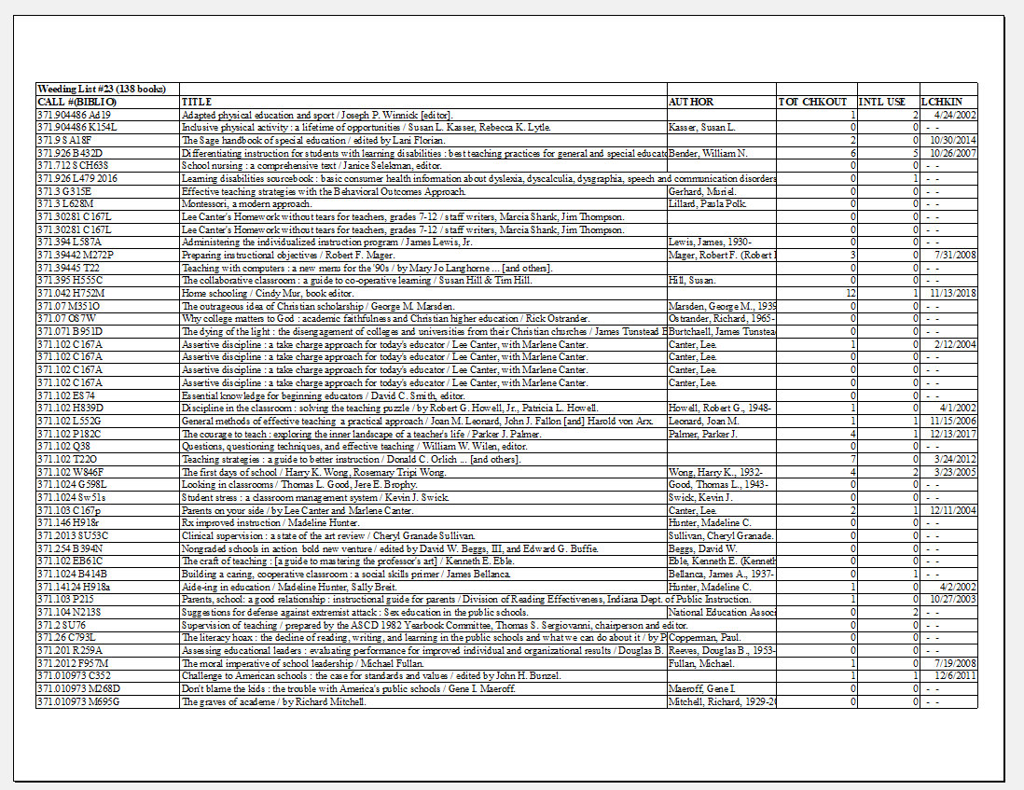

Slide 23
Report Is Place in Cart
The Excel report with all the important information on it is placed on the cart
The librarians go through the report, remove any books that will be retained in the collection and highlight and initial the removed books on the report.
Once the cart is complete, then it goes on to the next stage of withdrawing the unwanted items.

Slide 24
The Withdraw Process

Slide 25
Cart of Books
Cart Checklist
Remove any books that are additional copies as these must be done individually
Count the remaining books on the cart to be able to check the number of books scanned to the number of books on the cart.
Scan the Cart
Scan the items for deletion using the scanner in technical services
Plug the scanner into computer via the USB port
Use a desktop shortcut or File Explorer to navigate to the scanner
Open the file Barcodes.txt in NotePad++
Use the line numbers in NotePad++ to check to make sure that all items have been scanned

Slide 26
Save the Withdraws File
Save the file Barcodes.txt to the computer as Withdraws (1, 2, etc.) using the desktop shortcut to Withdraws \\iwufiles\common\LIBRARY\librarycirc\Inventory\Withdraws
Delete the Barcodes.txt file from the scanner
Unplug the scanner from computer USB port

Slide 27
Import Withdraws File Into Sierra Create Lists
Open Sierra
Select Create Lists from the Function dropdown
Click on a Withdraws Review File – or an empty file
Click on the Import Records button
You will get a message that says you are about to over-write a file, click Yes to continue

Slide 28
Import Withdraws File into Sierra Create Lists
In the Review file name enter name
The radio box for Barcode should be selected
Store Record Type should be ITEM
Click on the Choose File button and select Withdraw1, etc… file to upload it

Slide 29
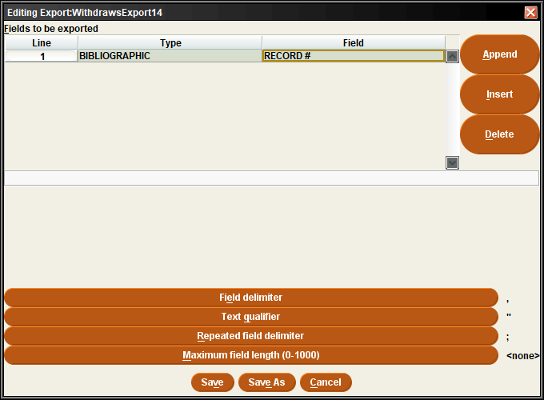
Create WithdrawsExport Report – Get the Bib Record Numbers
In Create Lists click on Withdraws
Click on the Export Records button
When the dialog box comes up, click on the Apply Saved Export button
Go to Saved Exports – Select Weeding under Export Name
Click the Browse button and go to the Withdraws folder
Type in WithdrawsExport 1, 2, etc. txt – always match the number
Click OK

Slide 30
Create An OCLCDeletes File – Get the OCLC Numbers
In Create Lists click on Withdraws
Click on the Export Records button
When the dialog box comes up, click on the Apply Saved Export button Go to Saved Exports—Select OCLC Deletes under Export Name
Click on the Browse button and go to the Withdraws folder
Overwrite the file OCLCDeletes.txt

Slide 31
Network Directory with the Exported Files

Slide 32
Create EDSDeletes File
File with Bib Record Numbers for Removing Records From EDS
In Create Lists click on Withdraws
Click on the Export Records button
When the dialog box comes up, click on the Apply Saved Export button Go to Saved Exports—Select EDSDeletes under Export Name
Click on the Browse button and go to the Withdraws folder
Overwrite the file EDSDeletes.txt

Slide 33
EDSDeletes
The export file has all the bib record numbers of the items on the cart.
Now the file can be imported back into Sierra

Slide 34
Import EDSDeletes File in Sierra Create Lists
Open Sierra
Select Create Lists from the Function dropdown
Click on the Review file EDSDeletes -- # 1
Click on the Import Records button
You will get a message that says you are about to over-write a file, click Yes to continue
In the Review file name enter EDSDeletes
The radio box for Record Number should be selected
Store Record Type should be BIBLIOGRAPHIC b
Click on the Choose File button and EDSDeletes.txt to Upload it
Click Import

Slide 35
Importing the File
Note: the record count in this review should match the record count in the Withdraws review file

Slide 36
Update the EDSDeletes Records
From the Function menu go to Global Update
Make sure the record type selected is BIBLIOGRAPHIC and the dropdown is set to Review
Under Review file select EDSDeletes
Select the Search button

Slide 37
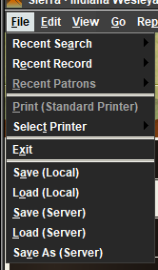
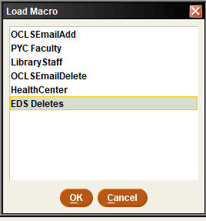
Click on 2. Command Input, when the dialog box comes up, click CANCEL
Under File, select Load (Server)
When the Load Macro box comes up, select EDS Deletes, then OK

Slide 38
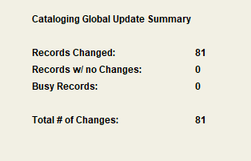
The Command should look like the image below
Click the 3. Preview button, you should see that the REC.STAT is changing from “c” to “d” on all lines
Click the Process button
Click Yes when the Process Changes dialog box comes up
The summary that appears should have the same number of records as your previous files

Slide 39
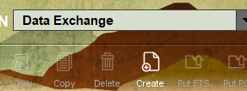
Create the EDSWeeding MARC File
Go to Data Exchange in Sierra
Under Select Process choose Output MARC records (out)
Click on the Create button which is in the upper right of the screen
Enter a name for your output file, use EDSWeeding with the number that matches your Withdraws export file
Select Review from the dropdown and the Review file should be EDSDeletes

Slide 40
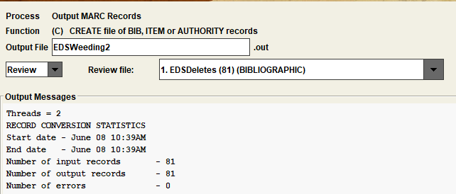
Create the EDSWeeding MARC File
Click the Start button
When the process is completed, it should look like so
We store the output file on our network

Slide 41
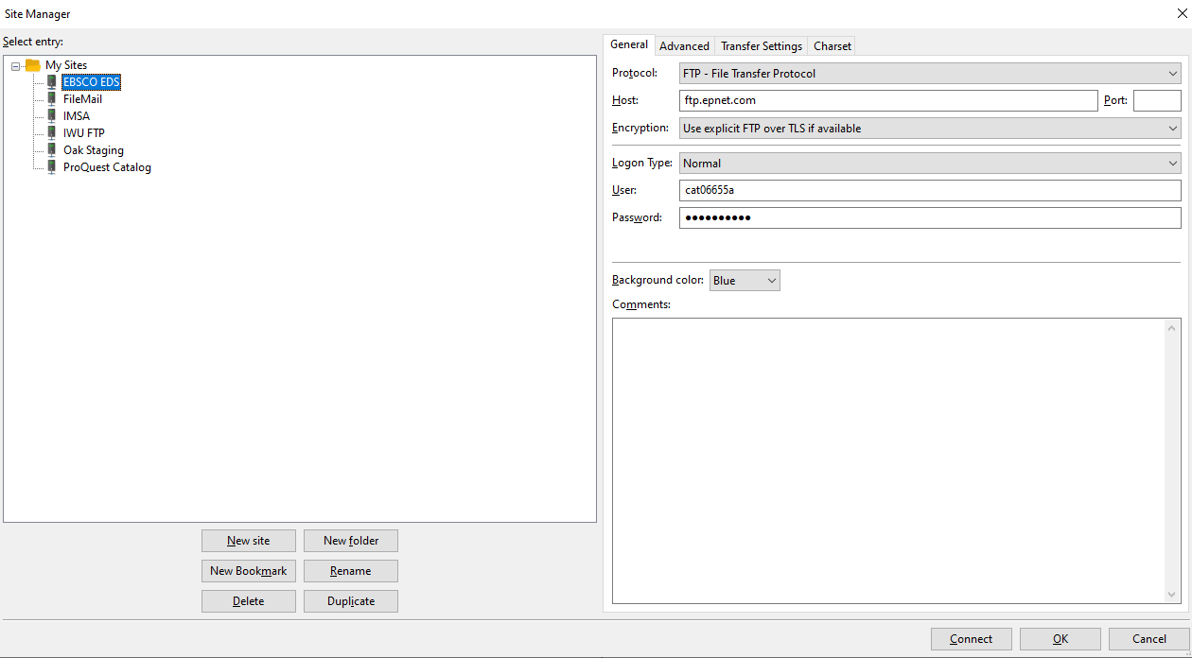
FTP the EDSWeeding MARC File to EBSCO
We use FileZilla to get this file to EBSCO. It usually takes 24 hours, but it will delete the holdings from EDS – our discover service

Slide 42
Create the OrderRecordDeletes File
Note: this file will only contain bibs that have order records. It is possible that you may not have any order records in your scanned cart
In Create Lists click on Withdraws
Click on the Export Records button
When the dialog box comes up, click on the Apply Saved Export button
Go to Saved Exports—Select OrderRecordDeletes #33 under Export Name
Click on the Browse button and go to the Withdraws folder
Overwrite the file OrderRecordsDeletes.txt
Right click on the OrderRecordsDeletes.txt and select Edit with NotePad++
If the file contains any record numbers, then to the section Delete Order Records
If the file DOES NOT contain any record number, then skip the Delete Order Records section and go to the Delete Bib Records section

Slide 43
Delete Order Records/Delete Bib Records
Delete Order Records
If there are order records in the OrderRecordDeletes.txt, then import them into a create list
Delete Bib Records
Select the Delete Records from the drop-down menu in Sierra
Make sure the Review is selected
Use the EDSDeletes review file
Click Start
Select Delete the bibliographic record and all attached records
Click the Delete Records button
Check the errors file
Fix any errors

Slide 44
Remove Records From OCLC
Open Connexion Client and log in
Click on the Batch tab on your Connexion toolbar
Click Batch > Holdings by OCLC number
Browse to the file of OCNs that you created, using Notepad++
Import a file of OCNs by clicking Import; this will run very quickly; the OCNs will be listed in the large white box.
When import completes, answer NO to whether you want to delete your file.
Click Delete Holdings to chose that option.
Click OK, the batch processes very quickly and
if the report option or print report option was selected (or both), the report will immediately appear, and the report will immediately print, depending on options chosen
Save the report as a pdf file to
\\iwufiles\common\LIBRARY\librarycirc\inventory\withdraws\

Slide 45
THANK YOU
Questions?

