Slide 1
Quarantined!
How One Academic Library Responded to the COVID-19 Pandemic
Joel Tonyan, Systems and User Experience Librarian University of Colorado Colorado Springs

Slide 2
Objectives
Who We Are: The Kraemer Family Library
Services Interrupted
Disabling Lending and Holds
Dealing with Already Checked Out Items
Going Remote
Remote access to Sierra
Restoring Limited Services
Limited lending for students, faculty, and staff only
Requiring holds
Quarantining returned items
Enabling semester-long checkouts
Restoring Full Services
Lessons Learned

Slide 3
The Kraemer Family Library
Serves a campus of more than 12,000 students, plus faculty, staff, and the general public
An Innovative customer since the 1990s
Has used Sierra since 2012, after migrating from Millennium
Our collection consists of more than 400,000 print books, plus over half a million eBooks
The UCCS Kraemer Family Library

Slide 4
Services Interrupted
Due to the pandemic, the Kraemer Family Library was forced to abruptly close our building on March 22nd
We did not re-open the building until July 28th
Closing our doors for four months meant that we could not:
Loan physical materials to our patrons
Participate in our local INN-REACH network, Prospector
Accept returned materials

Slide 5
Services Interrupted
We had to quickly figure out how to disable the system functions that make a library a library: requesting, lending, overdue notices, and even the ability to return items already checked out.
We had never been in a crisis before that required a complete interruption of services, and quickly realized there was no manual for turning off these functions in the event of emergency.
However, the Sierra manual covers how these functions work, and carefully studying it helped us determine how to proceed.
Moreover, we paid attention to the chatter on the Sierra listserv to see how other libraries were responding to the pandemic.

Slide 6
Disabling Requesting/Holds
Three Possible Approaches that We Identified:
Simply hide the Request button in the WebPAC
Edit the Patron Blocks Table and set the Max Holds for each patron type to “0”
Disable the ability for all patron types to place holds in the WebPAC

Slide 7
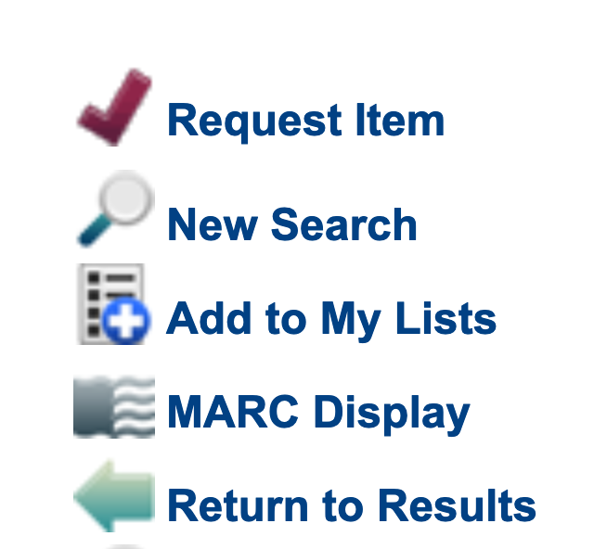
Hiding the Request Button in the WebPAC
With the building closed, the simplest way to disable patrons’ ability to place holds was by hiding the “Request” button in the WebPAC
We decided against this, though, because we wanted to provide error messaging to inform our patrons as to why requesting was disabled.
An attempt to request became an opportunity to inform patrons about interruptions to all our services.

Slide 8
Editing the Patron Blocks Table to Disable Holds
Then, we considered simply setting the “Max Holds” field in the Patron Blocks table to “0” for each patron type.
However, we decided against this option because we wanted error messaging if patrons found a working Request link and attempted to place a hold.

Slide 9
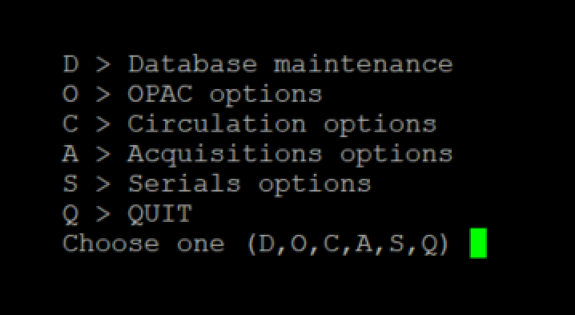
Disabling the Ability to Place Holds in the WebPAC
If you have OPAC option #19, “Requests: Patron eligibility determined by” set to “P TYPE”, then you can disable holds for specific or all patron types using option #20, “Eligible patrons."

Slide 10
Disabling the Ability to Place Holds in the WebPAC, contd.
A closer look at OPAC Option #20, “Requests: Eligible Patrons”
Lets you specify patron types individually or in a range. We removed all patron types and set the value to ”0.”
Then, we set OPAC Option #21, “Message for Patrons denied access” to read “Requesting is disabled. Please see www.uccs.edu/library/covid-19

Slide 11
Disabling Lending and Holding: Other System Changes
We changed the label for our ”Available” item status to read “Unavailable – COVID19”
Since we disabled holds, we just left the status of all our items the same and relabeled the status to be another indicator that we weren’t operating normally.
We also placed a large banner at the top of every WebPAC page explaining the interruptions to our services, with a link to a COVID-19 page on our library website for more information.

Slide 12
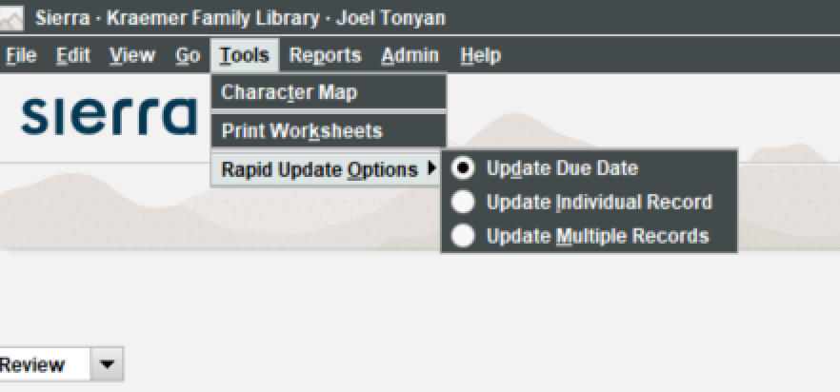
Dealing with Already Checked-Out Items
We noticed on the listserv that III was offering an addition to the Rapid Update tool that lets you batch update due dates for borrowed materials
We disabled all of our overdue notices in Sierra by simply setting the value in the Auto field to “No” for the relevant scheduled notice jobs

Slide 13
Going Remote
Getting workstations home with our staff
Getting Sierra installed on personal computers
Whitelisting additional IP ranges for our expanded campus VPN

Slide 14
Going Remote
A Word document from
March 13, 2020, recording my attempt to figure out our staff’s technology needs, the day before campus shut down.
(Luckily, we had everyone who needed to take a workstation home take one home that day ☺)

Slide 15
Restoring Limited Services
We re-opened the building until July 28th, but to students, faculty, and staff only. The library remains closed to public users, alumni, etc. due to the campus being closed to the same populations.
We needed to restore lending and borrowing, with the following changes:
Loaning physical materials to our patrons, albeit with mediated checkouts in place
We needed to turn on holds for students, faculty, and staff only
We needed to quarantine books for six days before they could be recirculated
Because of rising case counts on campus, we decided to provide semester-long checkouts to students, faculty, and staff

Slide 16
Restoring Requests/Holds
Simply a matter of undoing what we did when disabled holds, albeit in limited fashion for fewer patron types, in OPAC Option #20,
We left the following error message in place for those patron types we didn’t add back: OPAC Option #21, “Message for Patrons denied access” to read “Requesting is disabled. Please see www.uccs.edu/library/covid-19

Slide 17
Creating a Workflow for Mediated Checkouts
Relabeled our “Available” status message to read “On Shelf – Request Item”
Placed a banner across the top of every record page explaining how and why we are handling mediated checkouts.

Slide 18
Creating a Workflow for Quarantining Returned Items
Updated our Time to Shelf status from “Recently Returned” and a 24-hour period
First, we changed it to “Quarantined” with a 72-hour period and then later updated it to a 144-hour period after guidance from health advisors on campus
During this quarantine period, the books were quarantined away from staff and patrons for 3 days and then later 6 days
We used this status change as a means of alerting patrons to our quarantining of returned items

Slide 19
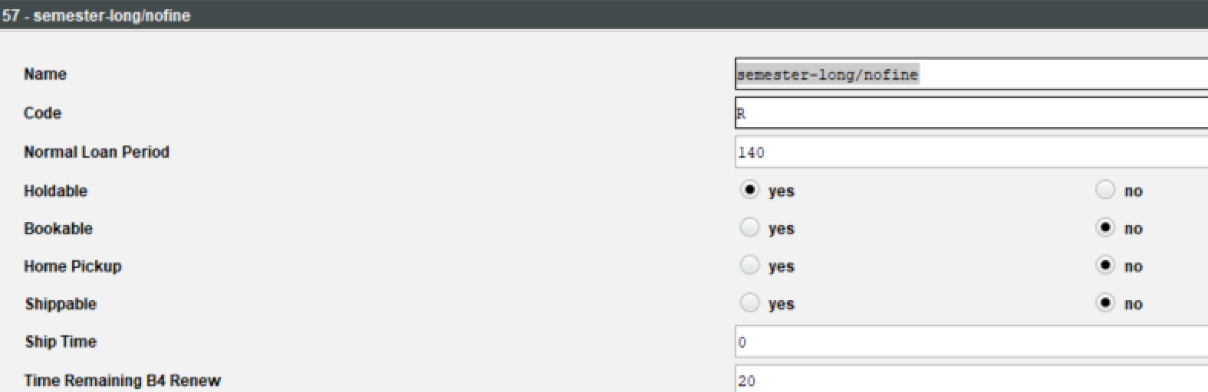
Enabling Semester-Long Checkouts
As cases rose on campus, we decided to extend the loan periods for student, faculty, and staff checkouts to reduce the frequency of people visiting the library just to return materials
We gave everyone semester-long checkouts instead of the three weeks we normally give undergraduates and the six weeks we give graduate students, faculty, and staff
We built a new loan rule with

Slide 20
Enabling Semester-Long Checkouts
As cases rose on campus, we decided to extend the loan periods for student, faculty, and staff checkouts to reduce the frequency of people visiting the library just to return materials
We gave everyone semester-long checkouts instead of the three weeks we normally give undergraduates and the six weeks we give graduate students, faculty, and staff
First, we built a new loan rule with 140 loan period, long enough to cover the entire semester

Slide 21
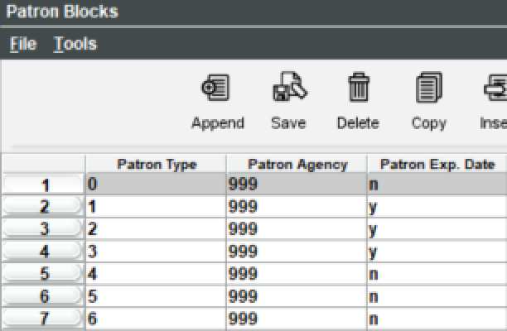
Enabling Semester-Long Checkouts, contd.
Next, we set the Patron Exp. Date patron block to yes for the student, faculty, and staff patron types.
With this setting enabled, the patron’s expiration date overwrites the due date if the due date assigned by the loan rule is past the end of the semester
Then, we updated everyone’s expiration date to 5/21/2021, when the semester ends
This way, a patron checking out an item in January and a patron checking out an item in March, get the same semester-long checkout with a due date of 5/21/2021

Slide 22
Restoring Full Services
Re-enable holds for public patrons, alumni, and other patron types that haven’t been allowed to use the library during the pandemic
Restore our normal checkout processes, including unmediated borrowing and normal return to shelf periods, and end semester-long checkouts
Participate again in our regional INN-REACH network, Prospector, for borrowing/lending

Slide 23
Restoring Full Services
With the pandemic underway, we have yet to restore normal services
We will revisit our decision to be closed to the general public in May
We are working on getting back into Prospector, our INN-REACH network, within the next month now that it looks unlikely there will be any more closures
Instead of restoring our previous loan rules, that charged fines to undergrads and graduate students with overdue materials, we are working on going fines free for Fall 2021
The timing for restoring full services depends partly on when our frontline workers can get vaccinated
We have a new dean starting in April who will help us make these decisions

Slide 24
Lessons Learned
Have a disaster preparedness plan that considers the worst possible scenario and truly prepares for it
We had a disaster plan in place prior to the pandemic that considered how we would work remotely in the event of a building closure, but we never got into the details of how we would disable basic services or operate them in limited form
We have documented everything we did during the pandemic so that we’re ready next time if we have another situation that requires us to shut down services

Slide 25
THANK YOU
Questions?
Joel Tonyan, Systems and User Experience Librarian
Kraemer Family Library
jtonyan@uccs.edu

