Slide 1
RETHINKING SELECTION AND ACQUISITION WORKFLOWS
Lynn Gates
Rhonda Glazier

Slide 2
INFORMATION ABOUT KRAEMER FAMILY LIBRARY
Kraemer Family Library is part of the University of Colorado Colorado Springs (UCCS)
UCCS FACTS:
11,300+ students
800+ faculty
800+ staff
Six Colleges offering 70+ undergraduate and graduate degree programs
KRAEMER LIBRARY
Recently designated an R2 institution
$1.5 million materials budget
$100,000 spent on single title purchases
from UCCS Photography Database

Slide 3
BACKGROUND
Hadn’t changed selection or acquisition workflow for over 20 years
Reorganization of the library was being discussed
Limited staff to do all the work – had to find efficiencies
Wanted to preserve the relationship of faculty liaisons with the departments on campus

Slide 4
WHAT WE DID
Set up a Task Force
Both Acquisition’s staff members
Librarian from Instruction
Director of Cataloging and Metadata Services
Interlibrary Loan Staff Member
Director of Collections Management – led the group
Four 3-hour meetings were held over the summer
July 19
July 26
August 1
August 25th
Task Force goals
Identify problems, inefficiencies, & roadblocks
Brainstorm potential workflow solutions
Develop potential ideas for new tools

Slide 5
WHAT WE FOUND

Slide 6
PROBLEM: Communication
Multiple ways orders are sent to acquisitions
A lot of back and forth when acquisitions needs to check with selector
Handwriting information cataloging needs
Selectors don’t know what acquisitions is holding on to
Faculty requests to liaisons
Notes:
Multiple ways orders are sent to acquisitions
Selection journals, catalogs, emails, print outs, GOBI, etc.
A lot of back and forth when acquisitions needs to check with selector
Waiting for answers delays ordering
Handwriting information cataloging needs
Selectors don’t know what acquisitions is holding on to
Pre-pub, problem orders, foreign language
End up with duplicate orders
Faculty requests to liaisons
Arrive when can’t order
Hard to get

Slide 7
PROBLEM: Time
Duplicates checking
Prioritizing rush and hold titles
Orders not submitted regularly, leads to backlogs or nothing
Selection journals are routed slowly
Liaisons requesting non-typical items
Almost everything is a procurement card order
Vendor shipping times vary greatly
Notes:
Selection journals are routed slowly
Impacts both liaisons & acquisitions
Vendor shipping times vary greatly
Orders not received in acquisitions regularly, leads to backlogs or nothing
Impacts acquisitions, receiving, cataloging, processing
Procurement card orders
Frequently spread out across multiple shipments
Can’t receive until charge shows up in expense system
Cataloging needs to prioritize rush and hold titles
Liaisons requesting non-typical items
Impacts acquisitions, cataloging, processing
Checking for duplicates

Slide 8
PROBLEM: Limited Staffing
Small staff, yet multiple people involved in the process with competing interests
Problem orders take extra staff time to solve
When there’s no student help it means staff need to do processing
Liaisons have a lot of other work making it hard to find time for selection
Liaisons may be ordering in unfamiliar subject areas
Selection journals are not available in all subject areas
Notes:
Small staff
Only one person in acquisitions has procurement card
Only one person can pay in university procurement system
Lots of people involved in process, with competing interests
Staff duplicating work
Liaisons ordering in areas they aren’t familiar with, selection journals not available in all areas to help
Liaisons busy, hard to find time for selection
Problem orders take extra staff time to solve
When there’s no student help it means staff need to do processing

Slide 9
PROBLEM: Miscellaneous
Ebooks
Not thinking about the collection as a whole
Liaisons not spending their budgeted amounts
Limited number of vendors we use
Physical care of the collection
Should we plan for the entire lifecycle of items purchased?
Notes:
Ebooks
Discovery vs. purchased
Should they be considered duplicates?
Is the budget allocated correctly? Need to spend budget
Is there a way to take into account entire lifecycle of items purchased? From selection to deselection
Need to think about collection as a whole,
Print collection vs. electronic collection
Specialized collections
Physical care of the collection
Replacing damaged materials
Shifting
Need to broaden the number and type of vendors we use

Slide 10
IDEAS

Slide 11
SOLUTIONS: Communication
Regular communication with selectors
Set-up a group email for orders & communication
Create centralized place where held orders can be tracked by everyone
Regular budget updates
Set preference for receiving orders
GOBI, then email or selection journal, then printed
Standardized regular notes
Investigate different methods for transferring information to cataloging
Use status 1 order records so everything is in Sierra once submitted by selectors

Slide 12
SOLUTIONS: Time
Reduce duplicate checking pre-ordering
Unspent money from previous month swept
Request selection journals be given to acquisitions immediately if a selector marks titles
Investigate new vendors to reduce procurement card orders
Use Sierra load profiles to create order record when importing a bibliographic record

Slide 13
SOLUTIONS: Limited Staffing & Miscellaneous
Develop new workflow for ordering by integrating ILL
Ask Team Green to investigate ideas & costs for recycling weeded books
Examine materials budget allocation
Investigate how eBooks & streaming video are purchased, ordered, & cataloged
Review all workflows to identify how work can be distributed appropriately

Slide 14
IMPLEMENTATION

Slide 15
NEW TOOLS
Create an online file of orders that cannot be ordered
Use status 1 order records for titles available, but order not confirmed
Use receipt printer in acquisitions to print order record notes
Create a SQL dashboard for selectors to know how much money they have left to spend

Slide 16
NEW WORKFLOW
Selectors will send in orders to acquisitions
Problem orders will be placed in a central place that everyone can access
ILL will do all pre-searching
Titles not appropriate to order will be moved to ILL to request
ILL will download a bibliographic record from OCLC and attach an order record
Order records will be brought in with a status 1
Acquisition staff will place order with vendors
Acquisition staff will receive titles
Standardized notes will be printed using a receipt printer in acquisitions at time of receipt
One staff member in the administrative office will pay invoices in the campus procurement system
Every three months, money not spent based on a base amount being spent each month will be swept for end of the year spending

Slide 17
WHY ORDER RECORD CODES MATTER
Fixed length order record fields gather information for fund codes
Order code1 is a subfund in the fund code display
Can define it for whatever you want to track by subfund
Fixed length order record fields allow you to run statistics against each code
Allows you to break down expenditures
Can determine number of copies purchased
Allows you to compare years

Slide 18
STATISTICS: Creating a New Query

Slide 19
UPDATING ORDER RECORD CODES
Acquisition Type: used for method of paying
Alphabetic or numeric: Up to 32 codes (1 character)
25 character limit for definition
Acquistion Type (ACQ TYPE)
code | name
d | PREPAID
e | EXCHANGE
g | GIFT
n | NO CHARGE
p | PURCHASE
r | RECHARGE
t | procurement card
c | CU Marketplace
l | Bookstore
s | Split Funded
e | EBA
a | DDA

Slide 20
STATISTICS: Acq Type
Used to indicate how it was purchased – allows us to track how much we are spending on our procurement card versus regular purchasing

Slide 21
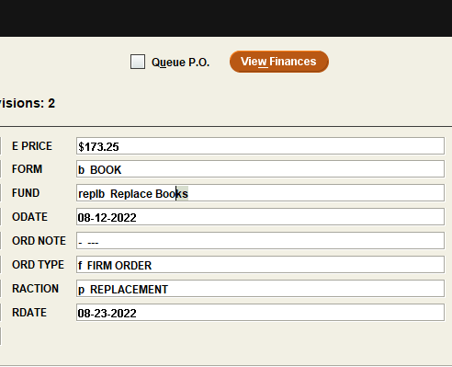
UPDATING ORDER RECORD CODES
Form: Physical form of the material
Alphabetic or Numeric: up to 32 codes (1 character)
25-character limit for definition
Form
code | definition
f | STREAMING FILM
d | CD/MUSIC
e | ELECTRONIC Miscellaneous
b | BOOK
c | CASSETTE
r | CD-ROM
z | DATABASE-FullText
o | OTHER
l | LASER DISCS
m | MICROFORM
j | EJOURNAL (S)
k | MEDIA KITS
i | SLIDES
Form
code | definition
w | DVD WITH RIGHTS
v | VIDEO/DVD
u | MAP
s | SERIAL
q | EBOOK
p | PERIODICAL
y | ERESOURCE Package
x | DATABASE-Index/Abst
a | EjOURNAL PACKAGE
g | EBOOK PACKAGE
h | SET

Slide 22
STATISTICS: Form
Create statistics/cost by type of material

Slide 23
UPDATING ORDER RECORD CODES
Ord Type: Way the material is acquired
Alphabetic or numeric: Up to 32 codes (1 character)
25-character limit for definition
Order Type (ORD TYPE)
code | definition
a | APPROVAL PLAN
b | BLANKET ORDER
c | COMES WITH
d | DEPOSIT ACCT
e | E-resource
f | FIRM ORDER
g | GIFT
i | ITEM S.O.
m | MEMBERSHIP
o | STANDING ORDER
p | PACKAGE PLAN
s | SUBSCRIPTION

Slide 24
STATISTICS: Ord Type
We broke ORD TYPE down by into three areas: the subscription category is misleading because we had a lot of serial records for eResources that we are still using.

Slide 25
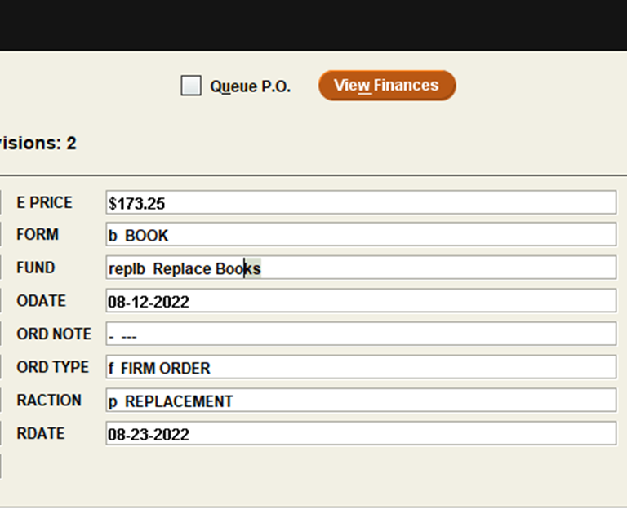
UPDATING ORDER RECORD CODES
Raction: Receiving action usually indicating special handling
Alphabetic or numeric: Up to 32 codes (1 character)
25-character limit for definition
Raction
code | definition
- | ---
a | ATTENTION
f | FAST ADD
g | GIVE TO ACQ TE
h | HAVE EDIT/VOL
k | KRAEMER
m | MOORE
n | NOTIFY
p | REPLACEMENT
r | REFERENCE
u | RUSH
b | BOOKPLATE
c | CATALOG NOTE

Slide 26
STATISTICS: Raction
RACTION code may have to have a “no action” code added to get rid of bad codes

Slide 27
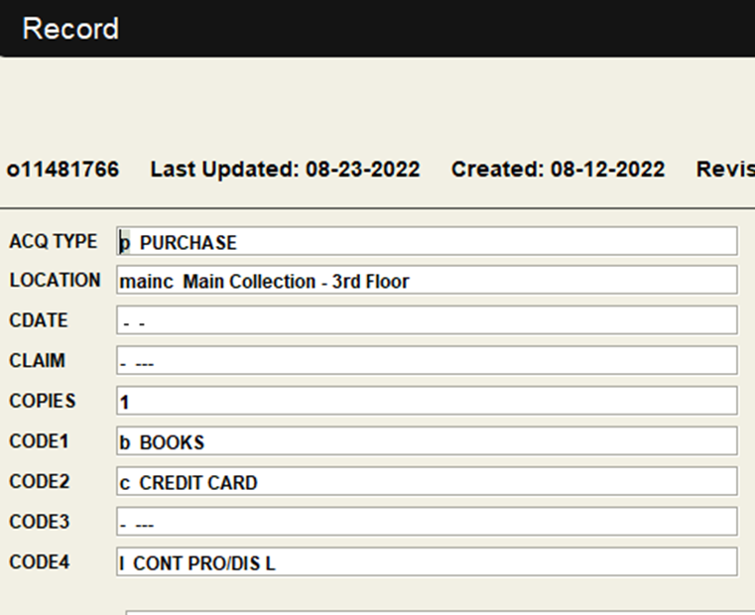
UPDATING ORDER RECORD CODES
Ocode1: shows as a subfund in fund code record
Lumps the 1st subfund and subfunds above 7 together
Alphabetic or numeric: Up to 32 codes (1 character)
25-character limit for definition
ocode1
code | definition
b | BOOKS
e | ELECTRONIC
m | MEMBERSHIPS
n | NON-BOOK
o | OTHER
p | PERIODICALS
s | Standing Orders

Slide 28
STATISTICS: Code1
CODE1 is also used in the Fund Code report

Slide 29
FUND CODES: Code1

Slide 30
UPDATING ORDER RECORD CODES
OCODE2: library defined
Alphabetic or numeric: Up to 32 codes (1 character)
25-character limit for definition
ocode2
code | definition
- | ---
a | TO BE ARCHIVED
c | CREDIT CARD
d | TO BE DELETED
n | NO LONGER REC'D
w | Watch list
l | cancellation list
p | perpetual access
t | Time limited access

Slide 31
STATISTICS: Code2
CODE2 is mainly used for eResources in our system

Slide 32
UPDATING ORDER RECORD CODES
OCODE3: library defined: shows way material is acquired
Alphabetic or numeric: Up to 32 codes (1 character)
25-character limit for definition
ocode3
code | definition
- | ---
a | Colorado Alliance
c | CU System
g | GWLA
l | CLiC
m | Multi-see notes
o | Other-see notes
u | UCCS Only

Slide 33
STATISTICS: Code3
CODE3 is used for how we pay for eResources

Slide 34
THINGS TO REMEMBER
Document all changes to codes before changing them
Change codes at a logical time – beginning fiscal year
If you redefine a code, any older records with that reused code will get the new definition. Deleting codes will result in bad code column in statistics

Slide 35
QUESTIONS?
CONTACT INFORMATION
Lynn Gates
lgates@uccs.edu
Rhonda Glazier
rglazier@uccs.edu

Slide 36
THANK YOU

