Slide 2
Search Engines, Meet BIBFRAME!
Unlocking Library Data for the Web
01110101 01101110 01101100 01101111 01100011 01101011 00100000 01101100 01101001 01100010 01110010 01100001 01110010 01111001 00100000 01100100 01100001 01110100 01100001 00100001 00100001 00100001 00100001 00100001
&

Slide 3
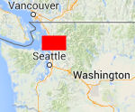
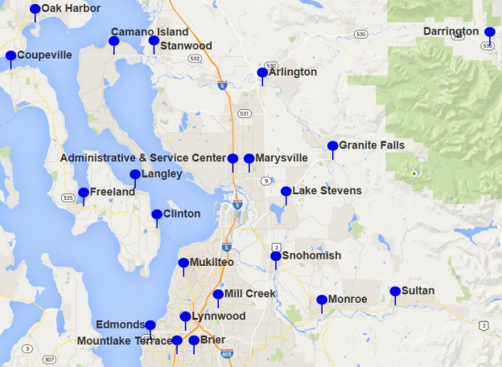
439,000+ Borrowers
61% of population with active library cards
1.2 Million+ Items
6.7 Million Physical and Electronic Items Circulated in 2015
Notes:
Sno-Isle Libraries is a Polaris Public Library system with 21 libraries. We are located in Washington State north of Seattle and south of Canada covering more than 2,000 square miles that includes rural and urban communities from the islands to the Cascade Mountains. We have a service population of more than 700,000 residents and 61% of them have active library cards. We have over 1 million items in our collections. We circulated 6.7 million electronic and physical items to them in 2015.
Presenting today is Casey Gabehart, ILS Manager for Sno-Isle Libraries, Eric Miller, President of Zepheira, and myself, Colleen Brazil, Content Access Manager for Sno-Isle Libraries.

Slide 4
What We Will Cover
DEFINITIONS
HOW IT WORKS
EARLY ADOPTERS
MEASUREMENTS
FUTURE
Notes:
We’ll explain
Some definitions and how we got started in this project.
How BIBFRAME works and interacts with MARC and RDA data
How our Early Adopter Project has evolved
How we measure results using Analytics and other measurements
You’ll hear:
More about the future and what lies ahead for libraries, Libhub and BIBRAME

Slide 5
Notes:
When the search engine spiders crawl the web, they march right up to the library catalog data and bam, they hit the brick wall.

Slide 6
Definitions
BIBFRAME
LIBHUB INITIATIVE
ZEPHEIRA
Notes:
There are three terms that might be unfamiliar to you and are the building blocks of our program.
BIBFRAME is a vehicle for our catalog data to be consumable by Web search engines. MARC records have served a similar purpose, but on the much narrower landscape of a library systems catalog.
LIBHUB INITIATIVE is the active movement that is raising the visibility of BIBFRAME among libraries and library vendors and encourages collaboration among them. For this big library data experiment, the more libraries and vendors that participate, the more likeliness of success.
ZEPHEIRA is an organization who first worked with the Library of Congress in the early development of BIBFRAME back in 2011. They were also a founding sponsor of the LIBHUB Initiative.

Slide 7
Early Adopters
Notes:
We joined the LIBHUB Initiative Early Adopter program early in 2015 along with 11 other Public Libraries in the United States and Canada. We were all a little unclear of where we were headed, but we all knew absolutely, that the theory was correct. It is essential that our library data is found in Google or other search engine results.

Slide 8
MARC AND RDA DATA
AUTHORITY
SUBJECTS, NAMES, UNIFORM TITLES
WORK
EXPRESSION
BIBLIOGRAPHIC
SUBJECTS, NAMES, UNIFORM TITLES
EXPRESSION
MANIFESTATION
HOLDINGS
HOLDINGS
ITEM
MARC
RDA
Notes:
This graphic shows the main concepts of both MARC and RDA data and how they are related.
MARC is the vehicle that contains our Bibliographic metadata. It was designed in the early days of computing so a computer with the right software – Typically ILS software - could read it, display it and allow a person to interact with it. It has served the library well and continues to do so for now.
One of the most important things MARC has done is to force libraries to maintain data standards. When you have standards applied to data, you have consistency and more powerful access.
The data input into MARC is guided by rules. First AACR2 which was created in 1967 and not updated since 2005. Then, along came new rules, Resource, Description and Access or better known as RDA.

Slide 9
BIBFRAME
WORK
A CONCEPTUAL VIEW OF A RESOURCE
INSTANCE
A PHYSICAL EMBODIMENT OF A WORK
AUTHORITY
KEY CONCEPTS WITH DEFINED RELATIONSHIPS TO WORKS AND INSTANCES
ANNOTATION
A FLEXIBLE ADD-ON TO WORKS AND INSTANCES
Notes:
BIBFRAME accommodates our beautiful, structured, curated data and transforms it.
BIBFRAME pays attention to:
“The Work” – A Resource’s concept
“The Instance” – The physical object that contains the work
“The Authority” – The agreed upon concept that defines relationships between works and instances
“The Annotation” – The descriptive data for the Work and The Instance

Slide 10
Colleen Brazil
Content Access Manager
Mike Longley
Web Developer
Diana Clementson
Cataloging
Casey Gabehart
ILS Manager
Jacob Thornton
Web Developer
Notes:
Sno-Isle is one of 12 early adopter public libraries partnering with Zepheira and we’re active participants in their community which they’ve named “The Foundry” ---- Alumni
We will continue to share our experiences with each other and with Zepheira to continue to develop the product and the process.
In fact, teams of different libraries are forming together to focus on different areas of interest and development.
In our partnership with Zepheira, we have formulated a early adopter project team locally, here at Sno-Isle
This is a core team that went through the training, who monitors our progress, and who looks for innovative ways to improve the use of our data.
Colleen is our project manager, and together with Diana, ensure that our records are of the highest quality.
Mike and Jacob lend their expertise in how the web works, and will be experimenting with our data to see what we can do with it beyond just making it accessible by search engines.
Lastly there’s little ol’ me. I have, or like to think I have, a solid understanding of Polaris and how we can use it to make our project a success.

Slide 11
Awareness and Education
Readiness Assessment
Implementation and Exploration
[ April/June 2015]
Notes:
In April and June, this team went through an intensive training hosted by our vendor, Zepheira.
Training lasted about six weeks and when we started, we had no idea what to expect.
The training helped us understand what to expect and gave us a better understanding of what we needed to do to be more discoverable.
We learned about their conversion tools. The things that actually transform MARC data into BIBFRAME.
We also learned a lot about Search Engine Optimization and how search engines might use our data.

Slide 12
Awareness and Education
Readiness Assessment
Implementation and Exploration
[ June/July 2015 ]
Notes:
Once we completed the course, we moved on to our readiness assessment.
This step has us take a serious look at our catalog data with a critical eye.
We were trying to find problems that may crop up during implementation.
In order to do this, we sent Zepheira 100,000 of our records for a test conversion.
After Zepheira converted our records from MARC to BIBFRAME and analyzed the results, we were pleased to learn that we were above average in the quality of our records.
Our data was highly connected and there were very few errors discovered.
This told us that our data is in good shape, and ready for the next step in the process.... Implementation

Slide 13
Awareness and Education
Readiness Assessment
Implementation and Exploration
Notes:
The Implementation and Exploration phase in an ongoing process.
Ultimately, we’ve done it – we’ve released our records to the web.
Sno-Isle has published 380,000 of our records which translated into over 1.5 million links or individual URIs

Slide 14
Manual Maintenance Process
Extract
Convert
Load
Publish
WWW
Notes:
The challenge has been figuring out a process for maintaining our data.
The information is static, so the task has become, “How do remove records for things no longer have, and how do we publish records that we no longer have?”
Extract: A complete extract of the entire ILS database needs to occur. This extraction does not take very long to run.
At Sno-isle, we have been able to build a custom SQL Query and schedule the extract, so the time it takes to process the extract is minimal.
Convert: Once the extraction occurs, it needs to be converted into XML. If your system doesn’t do this automatically, it is a manual process.
At Sno-Isle, the scheduled extract job is emailed directly to Colleen. Colleen then converts it into XML data as this is the format Zepheira needs in order perform the next step. She uses MarcEdit to do this conversion and it only takes about 10 minutes.
Load: The information is loaded into Zepheira’s link loader. This process only takes a few seconds.
Once Zepheira has it, the last step is to publish it to the web.
At this point in time, the maintenance process occurs on a monthly basis, but we are always looking for ways to improve it.
III Innovative issued a press release stating that they are interesting in partnering with Zepheria and Libhub libraries in order to automate this process.
I have outlined our current process, but it would be ideal for this maintenance process to be handled exclusively by the ILS.

Slide 15
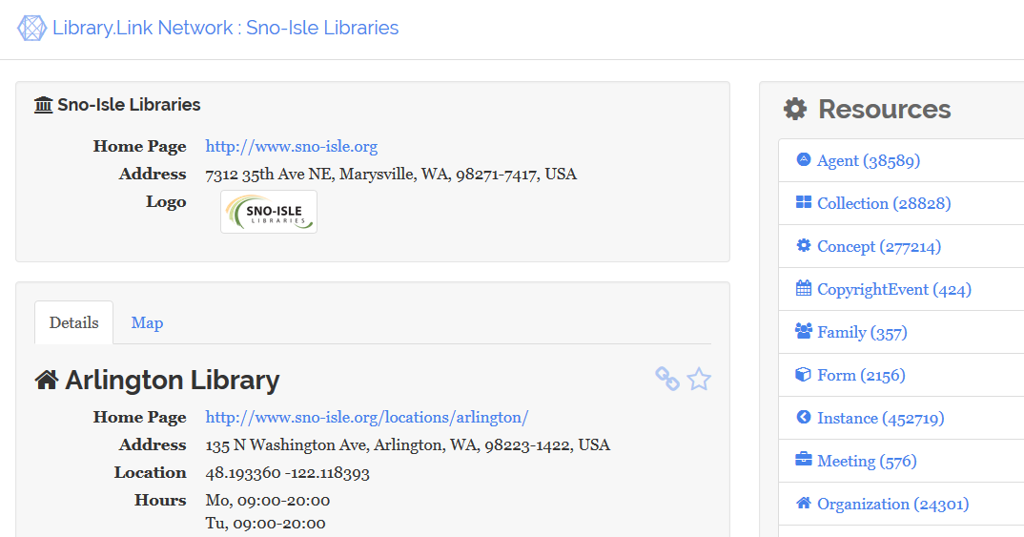
http://link.sno-isle.org/
Notes:
Now that our data has been published, this is what the main page looks like.
If you want to know what a title looks like, you can go to the link at the top of this slide and see it for yourself.
The next step would is to have Search Engines crawl our records, and this has already begun.
Keep in mind that we have published over 1.5 million links, and these are meant to be machine readable and are not designed for our users.
If a user lands on one of these pages from the search engine, it will count down from 10 before re-directed them to our catalog.

Slide 16
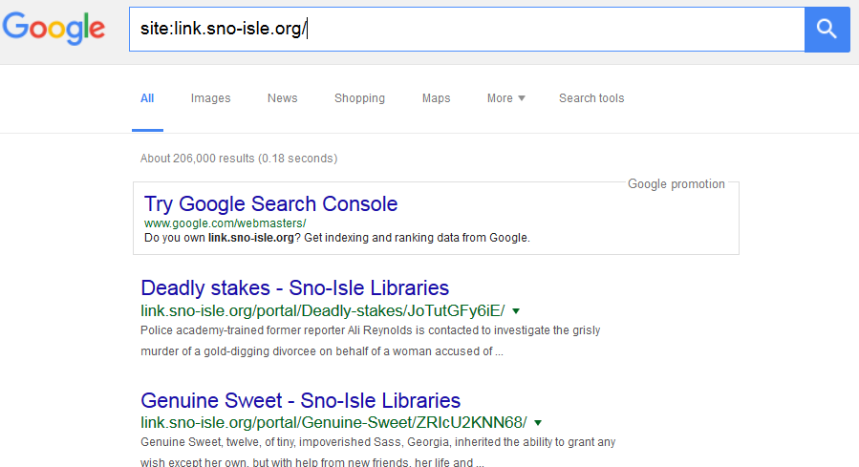
Notes:
We track what a search engines has indexed.
About 90% of our traffic from this hosted site is coming from Google.
Google has located and indexed 206,000 of the 380,000 records so far.
That means more than half have been indexed by Google.
Now that our data is published, we have some ongoing monitoring to do
First, we want to monitor the records that we’ve published.
What are people finding?
We also want to record any additional traffic we receive on our website.
Are these pages pointing more customers to us directly?

Slide 17
Notes:
So what are customer’s finding?
The control number for the bibliographic record is caught by google analytics during the referral process.
We imported these control numbers into our system and analyzed them
This chart represents the number of bibliographic records found in each collection, but does not take into account the popularity.
It appears Adult Nonfiction, DVD, and electronic resources are the top three categories.
We also see International was relatively high here.
At this point in time, we have noticed that unique collections, in our case digitized historical photos, tend to be the material people find through the search engines.
Our data is geocoded, which means that the search engines should be able to take our location into account.
The ultimate goal, down the road, is to have our library appear on the results page whenever a search for material is done through the search engine for customers in our service area.

Slide 18
Measuring the amount of referrals from
link.sno-isle.org > www.sno-Isle.org
Notes:
Mike, one of our brilliant web developers, has set up some dashboard to help us track the amount of hits we get from these pages and from Google.
We’re hoping to see a rise in the number of people in our area that are finding us through the web, rather than coming to us first.
This dashboard demonstrates the amount of traffic that we received from the site every day, the amount of pageviews, sessions, and average session duration as well as shows the percentage of new visitors, 98%, to returning visitors.
On average, we receive around 22 referrals to our site every day from these “Link” pages.
A referral is the number of times a person clicks through to our catalog from another page. In this case, we are limiting the referrals to just our hosted data site.
This quickly adds up.

Slide 19
Measuring the amount of referrals from
link.sno-isle.org > www.sno-Isle.org
Notes:
Since the start of the project, we have had over 4,200 people link through to our catalog from one of the pages hosted by Zepheira.
We can also tell from Google Analytics that a large portion of these referrals are coming from the United States, specifically the Northwest region.
Once we drilled down even further, we found that the distribution of referrals is equivalent to that of the population.
By that I mean, the city of Seattle has quite a few hits, where as a small community may not have many.
We had a minor glitch in February where data was not being counted, which is why it appears there has been such a big drop off.
Before you draw your own conclusions, a drop off is a good thing!

Slide 20
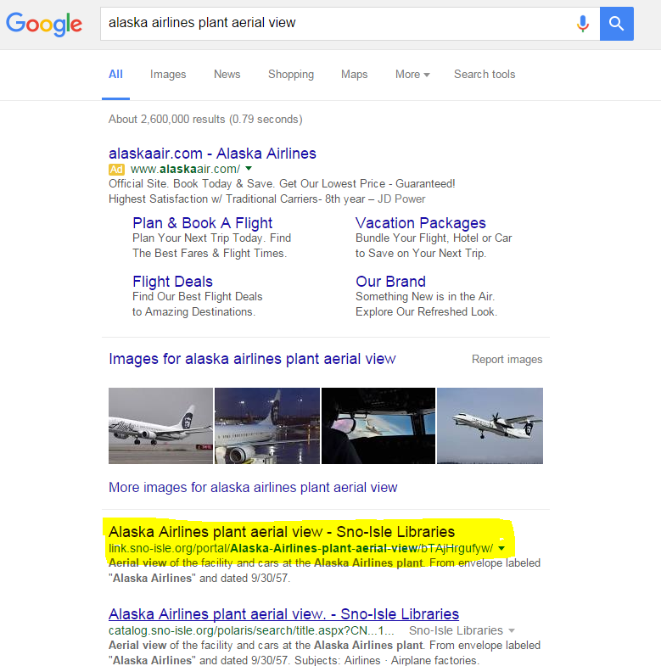
link.sno-isle.org
catalog.sno-isle.org
Notes:
Ultimately, these pages exist to give our library pages a higher ranking to Google.
Eventually, we hope people will hit our webpage first, and not these hosted pages.
In theory, once google realizes that this data is being pulled from the library’s catalog, it will start valuing our pages more and move them closer to the top.
These hosted pages, would then begin to fall off the front page as they do not have the original content.
So we should be seeing a decline in the number of times these pages link to our catalog.

Slide 21
Measuring the amount of referrals from
www.google.com > www.sno-Isle.org
Notes:
That means that, in theory, we should see an increase in the number of referrals directly from Google.
Before, I was showing you referrals directly from our hosted data.
As this graph demonstrates, we have seen a bit of a bump in the number of referrals directly from Google.
Now, please keep in mind that these are just numbers for one search engine, Google.
They just happen to have indexed more of our pages than any other Search Engine at this point in time.
We find and discover new and interesting data measures every day.
To talk more about new and innovative developments, let me hand it over to Eric Miller from Zepheria

Slide 22
Summary
DEFINITIONS
HOW IT WORKS
EARLY ADOPTERS
MEASUREMENTS
FUTURE
Notes:
We shared some of the commonly used terms that you will hear tossed around when discussing BIBFRAME
We showed the relationships between MARC records, old and new cataloging rules and how all of this converts nicely into BIBFRAME thanks to our wonderful structured metadata. And we need that attention to metadata and authority records now more than ever.
We described our experience as an Early Adopter Library and how success is one part technical skill and knowledge and another part optimistic belief in the theory and forging ahead.
We are seeing results and discovering ways to measure, we are moving beyond theory and starting to show value.
We heard about exciting plans for the future and how BIBFRAME and Libhub are evolving.

Slide 23
YOUR TURN

Slide 24
Why Convert to BIBFRAME?
It’s trendy
To eliminate our Public Access Catalogs
Make library content visible on the web
RDA won’t work otherwise

Slide 25
What does Google like?
Authorized, established sources
Unique terms
Hierarchical data
All of the above

Slide 26
True or False?
BIBFRAME is a replacement for MARC

Slide 27
True or False?
Catalogers will soon be cataloging in BIBFRAME

Slide 28
Presenters
Colleen Brazil
cbrazil@sno-isle.org
Sno-Isle Libraries
Casey Gabehart
cgabehart@sno-isle.org
Sno-Isle Libraries
Eric Miller
em@zepheira.com
Zepheira

