Slide 2
Presenting the Numbers:
Strategies for Creating Meaningful Budget Reports
April 4, 2017
Rhonda Glazier
Director of Collections Management
University of Colorado Colorado Springs

Slide 3
Types of Information Commonly Needed
Overview of budget for administrators
Breakdown of budget by format
Breakdown of budget by account
Projection of money to be spent for selectors

Slide 4
Step One: Creating Funds in III
Create fund code structure that is intuitive
Busb – Business books
Buss – Business serials
Busm – Business microforms
Create fund codes for format types that are paid from different accounts (or sub accounts) at the institutional level
Example of funds used for material budget allocation
Library materials (print)
Serials
Binding
Electronic Resources – Cap
Electronic Resources – Noncap
Replicate a similar structure for gift, grant and other external accounts.

Slide 5
Step Two: Fund Setup in III
Assign an External Fund Code to each Fund Code
Can have up to 500 different external funds
***Defaults to 0
Use default external fund for account that most of your payments will be paid against.
Establish External Funds for the Fund Codes that are paid through your institution’s accounting system
Name external funds clearly
Maximum of 23 characters
Examples of External Fund Code names
12345678-999999 Books (print books from materials budget)
12345678-999998 Serials (serials from materials budget)
12345678-555555 Eresnca (electronic resources – noncap from materials budget)
87654321-11111 Replacement Account
67891234-333333 KR Main (books purchased on gift account)

Slide 6
External Fund Codes
Steps to find external codes in Sierra
Funds
Admin
Parameters
Acquisitions
External Fund Codes
These steps will take you to the list of your external fund codes. You can either edit an existing external fund code or create a new external fund.

Slide 7
External Fund Codes
Different Accounts with the same sub-accounts for format

Slide 8
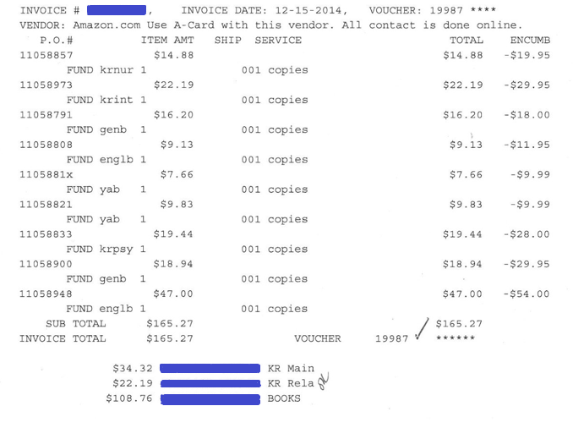
Invoice Register
Bottom Section:
Totals of any funds used in the invoice
External fund code information

Slide 9
Web Management Reports
Circulation
Circ Activity
Cross-Tab
Collection
Age of Collection
Collection Development
Acquisitions
Fund Reports
Vendor Information

Slide 10
Downside to Web Management Reports
Limited functionality
SCAT table impacts how items are categorized
If you scat table isn’t set up correctly, data will not be reliable if SCAT table is not accurate
Can’t combine circulation and collection reports in Web Management Reports

Slide 11
Using Sierra Functions
Fund Hierarchies
Statistics
Create Lists

Slide 12
Fund Hierarchies
Table and graph displays
Can only show dollar amounts using bar charts
Bar & Pie charts based on hierarchy
Use quick list to create hierarchies on the fly
Can’t collapse table to show totals only
Best use: tracking individual funds

Slide 13
Table Graph

Slide 14
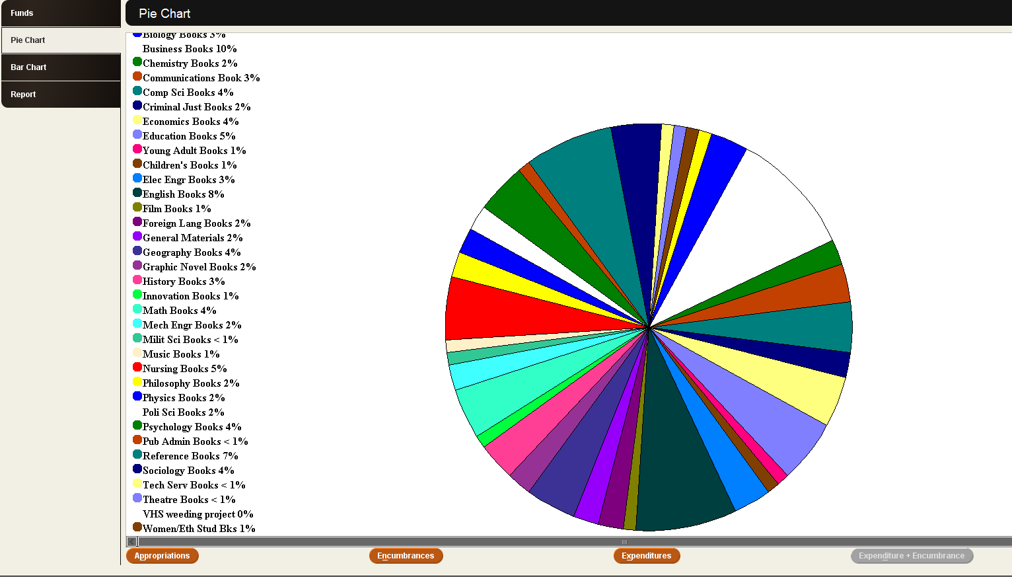
Pie Chart
Can’t email or save chart – only option is to print
Can’t toggle to $ or show both

Slide 15
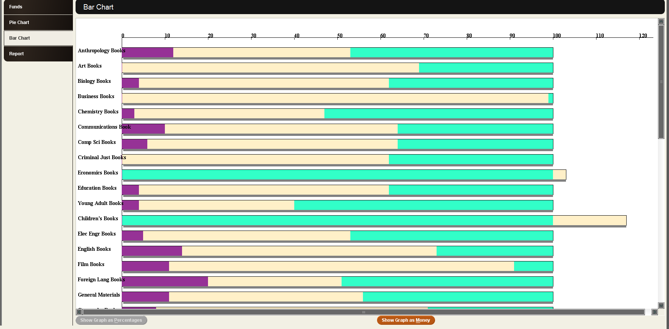
Bar Chart in Fund Reports
Can’t email or save chart – only option is to print
Can only show either percentage or
$, not both

Slide 16
Quick List Table
Quick List allows customization
But only totals list – does not allow for subtotals

Slide 17
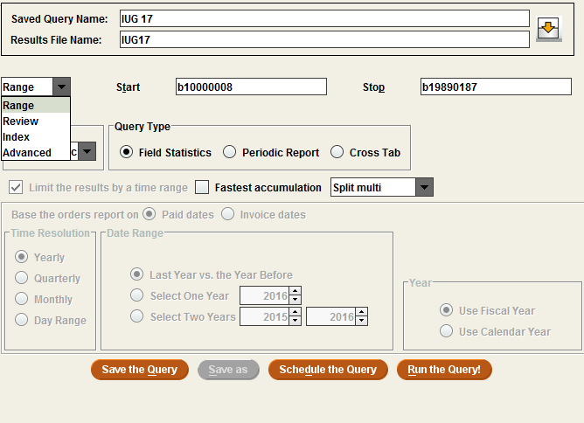
Options
You can choose several
Different Options
You can also do a cross tab report – choosing two different elements

Slide 18
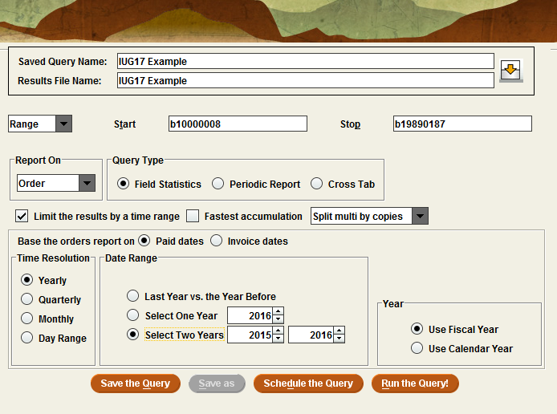
Creating a Statistical Report

Slide 19
Type of Reports Available
Useful if you separate a lot of your collections
Useful for format
Use for budget projections and budget analysis
Quick snapshot of vendors used
Call number breakdown useful if your scat table is correct

Slide 20
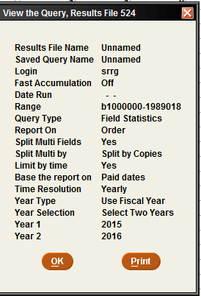
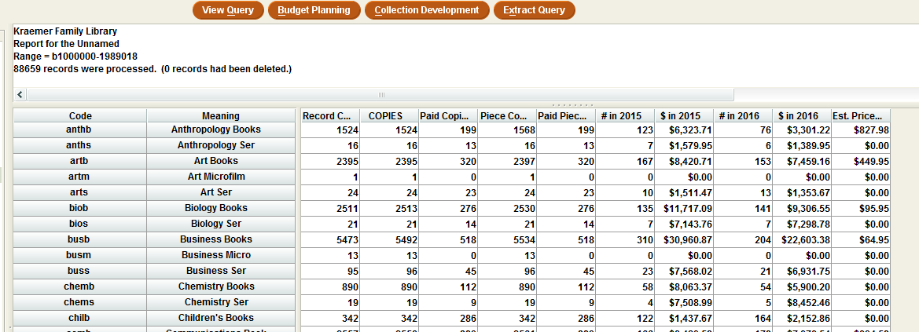
Sample Report

Slide 21
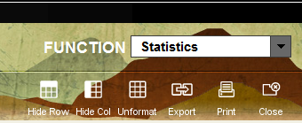
Some Functionality

Slide 22
What it Looks Like in Excel

Slide 23
Report Options
Choose the Budget Planning option to get a cost forecast

Slide 24
Budget Forecast
Change Column name & Input field
Eprice only works if you consistently put in estimated cost
Projected percentage defaults to 3% - but you can change it to whatever percentage you want.

Slide 25
Statistics
As you can see, we do not use e price – so this report doesn’t work for us.

Slide 26
Cross Tab Example Using Call Number
Remember: Call number reports are dependent on having your scat table set up correctly

Slide 27
Create Lists
Search strategy for year
Add date range to create list if wanting a monthly list

Slide 28
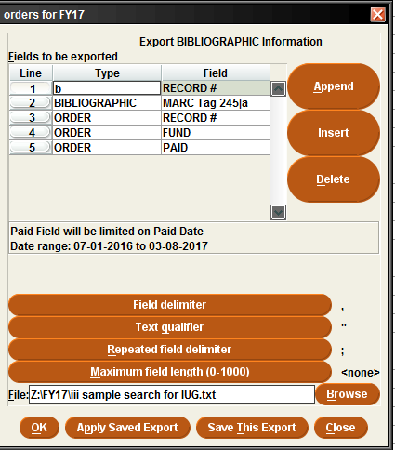
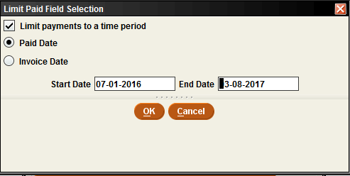
Exporting Lists to Excel

Slide 29
Pros/Cons to Create Lists For Budget Numbers
Create lists function is limited
For example it is difficult to limit by date range
Order records with multiple payments export all payments – not those in the date range
Exporting to Excel can be tricky

Slide 30
Cleaning up the Excel Worksheet
Custom sort by fund code
Remove all funds not associated with a specific account
Remove orders with multiple payments
Or delete unneeded payment by moving voucher # and payment into correct column
Copy fund payments to a new sheet
One sheet for each format
Sort list by voucher number
Total payments
If totals of all sheets do not equal amount in Sierra – add each voucher # and verify amount against Sierra
Balance amounts by voucher number

Slide 31
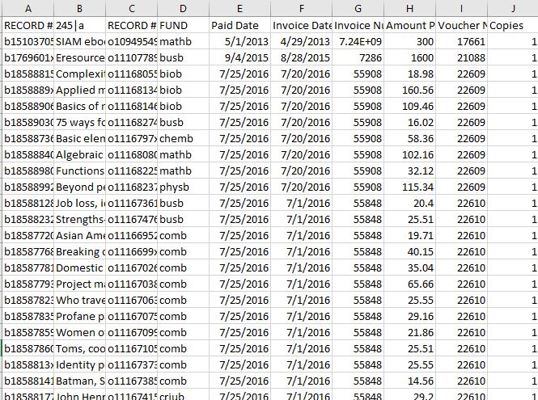
What it Looks Like After it is Cleaned Up

Slide 32
Materials Budget
In FY 17 we will spend $993k on electronic resources. Plus, we will spend another $354k from other funds.

Slide 33
Digging Deeper
Last year, we used $393K from accounts outside of the base budget. We saved $19.9K through aggressive renewal negotiations and $28.2K through cancellations.

Slide 34
Information for Selectors
Unspent funds do not carry over
All funds must be swept and reallocated before the end of the fiscal year
Looking for a way to encourage orders
Need to get firm order money spent in time to reallocate – but first priority is to spend the money on area originally allocated

Slide 35
Information Needed
Weekly email sent to each selector beginning 8 - 10 weeks before end of the fiscal year
Fund
Appropriation
Expenditure
Encumbrance
Orders not in III
Amount left to spend
Total or orders needed each week to meet fiscal deadline

Slide 36
Information Sent to Selectors
Only show funds an individual selector is responsible for spending
SUBJECT AREA | FUND | FY14 | EXPEND | ENCUMB | ORDERS NOT IN III | TOTAL | LEFT TO SPEND | AMOUNT NEEDED TO SPEND EACH WEEK
Art | artb | $ 9,307.14 | $ 6,006.34 | $ 1,433.33 | $ 769.00 | $ 8,208.67 | 1,098.47 | $ 274.62
Communications | comb | $ 9,057.14 | $ 5,360.96 | $ 945.09 | $ 643.00 | $ 6,949.05 | 2,108.09 | $ 527.02
Education | educb | $ 29,284.68 | $ 20,595.41 | $ 3,336.14 | $ 3,265.00 | $ 27,196.55 | 2,088.13 | $ 522.03
English | englb | $ 20,009.92 | $ 13,969.60 | $ 3,197.10 | $ 1,457.00 | $ 18,623.70 | 1,386.22 | $ 346.55
Foreign Language | forlb | $ 5,666.32 | $ 2,391.12 | $ 424.15 | $ 677.00 | $ 3,492.27 | 2,174.05 | $ 543.51
Music | musb | $ 2,791.29 | $ 2,167.06 | $ 391.40 | $ 2,288.00 | $ 4,846.46 | (2,055.77)
Reference | refb | $ 23,500.00 | $ 11,848.78 | $ 1,176.47 | $ 7,676.00 | $ 20,701.25 | 2,798.75 | $ 699.69
State Grant |  | $ 3,168.00 | $ 1,274.68 | $ 730.49 | $ 1,875.00 | $ 3,880.17 | (712.17)
Film | filmb | $ 1,911.43 | $ 1,316.03 | $ 384.90 | $ 691.00 | $ 2,391.93 | (480.50)
Innovation | innb | $ 4,850.00 | $ 1,659.34 | $ 114.88 | $ 148.00 | $ 1,922.22 | 2,927.78 | $ 731.95
WEST | westb | $ 6,855.64 | $ 4,757.48 | $ 515.45 | $ 1,607.00 | $ 6,879.93 | (24.29)
Theater | theab | $ 1,577.69 | $ 1,521.28 | $ 36.95 | $ 123.00 | $ 1,681.23 | (103.54)
TOTAL: |  | $ 117,979.25 | $ 72,868.08 | $ 12,686.35 |  | $ 106,773.43 | 11,205.22 | $ 2,801.31

Slide 37
Questions?
Email: rglazier@uccs.edu
Phone: 719-255-3291

